Slide 1
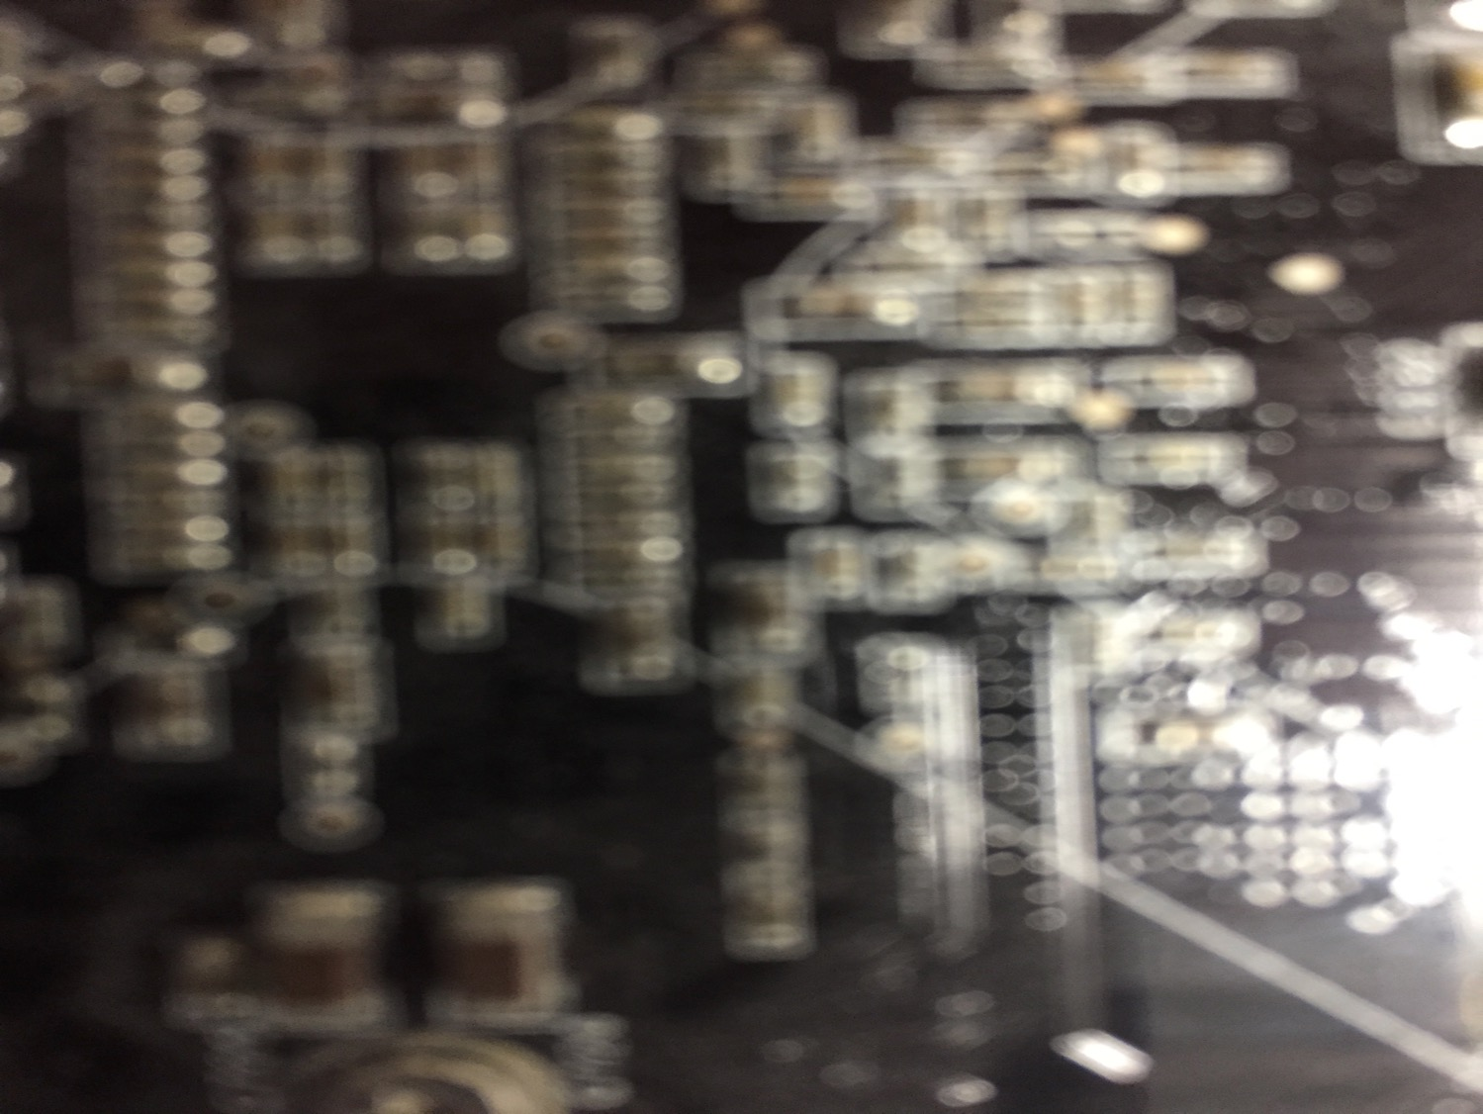

Communications Law: Introducing the Course
Talk 1
LAW 424 001
Communications Law
Allard School of Law, UBC
Spring, 2019
Jon Festinger Q.C.
Centre for Digital Media
QMUL School of Law (CCLS)
Festinger Law & Strategy
http://commlaw.allard.ubc
@jonfestinger
jon_festinger@thecdm.ca

Slide 2

Terrific Tuesdays

Slide 3
Logistics

Slide 4
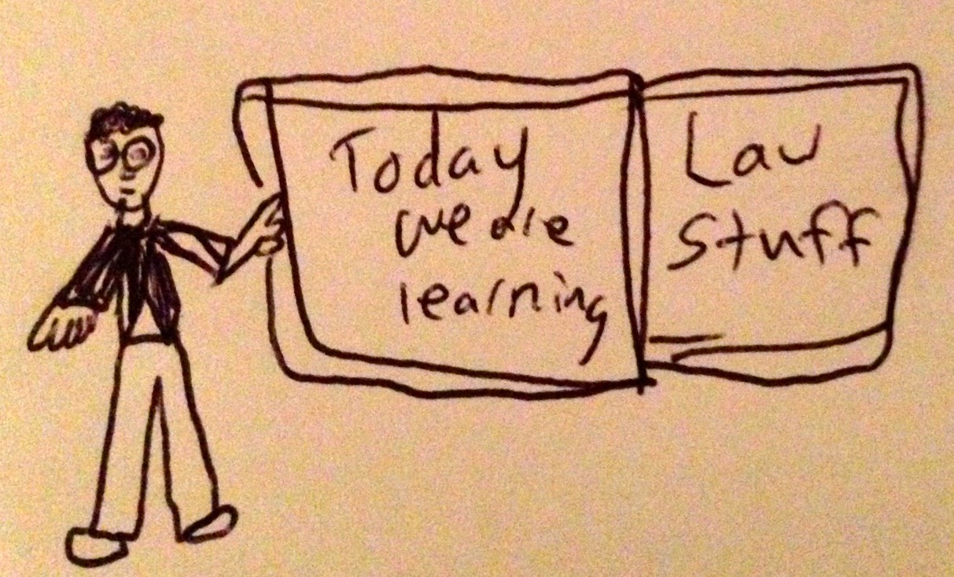

Slide 5
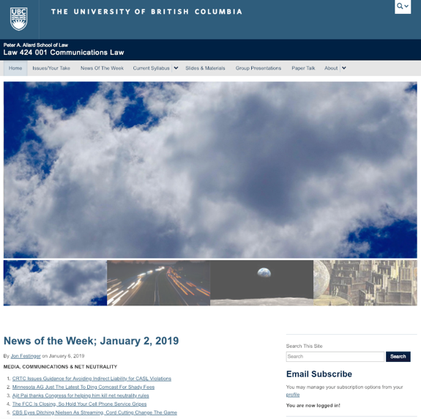
Initial Course Website
http://commlaw.allard.ubc.ca

Slide 6
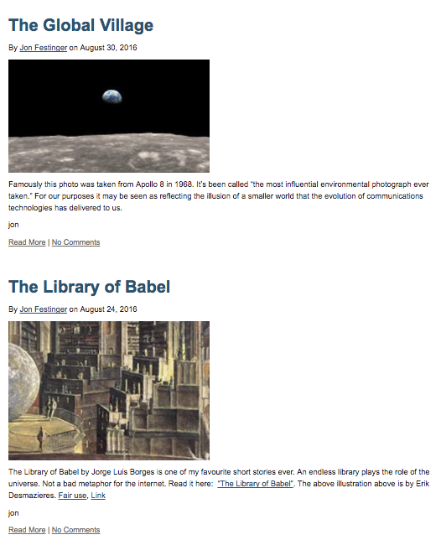
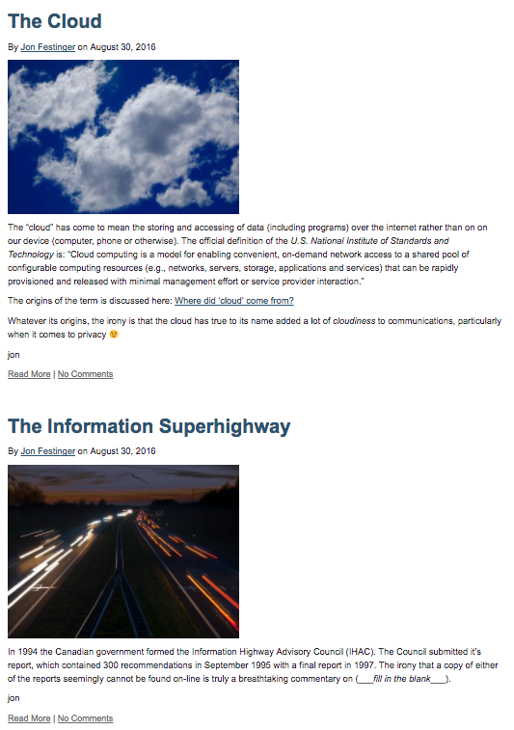
What’s the deal with the pictures?

Slide 7
COMING
SOON

Slide 8
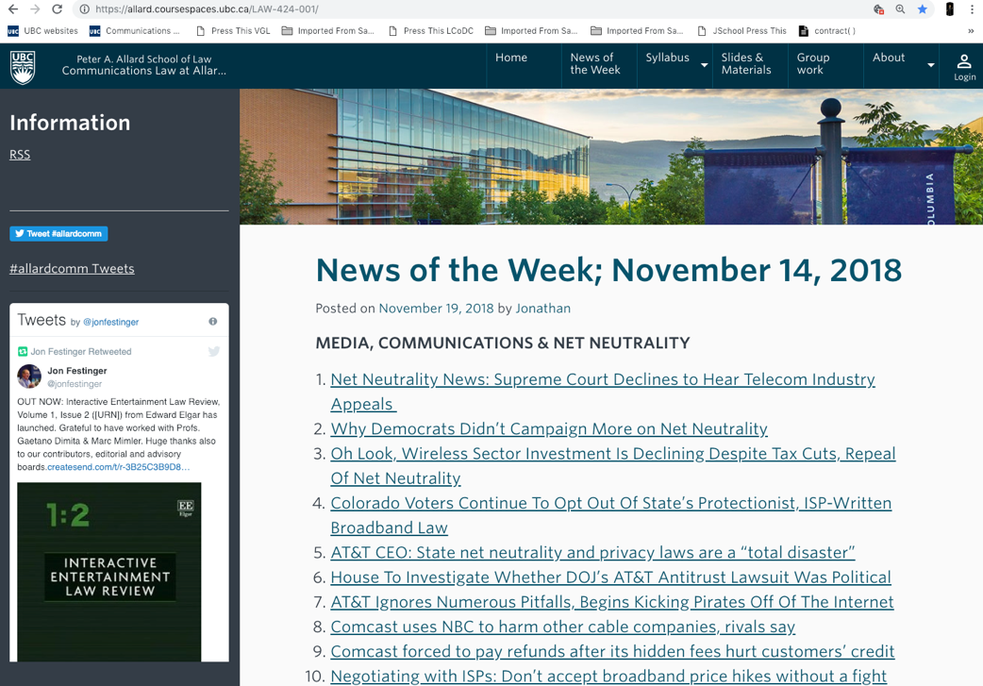
V2 Course Website (Spaces)

Slide 9
For full privileges on the website
1. Please create an account at http://cms.ubc.ca/ using your CWL.
2. Once you create an account and sign in at http://cms.ubc.ca/ you can click your name in the top right. Half way down the following page will be your WordPress email address.
3. Send me your WordPress email address at jfestinger@telus.net or at jon@fblawstrategy.com
4. Then, I will invite you to participate with authoring privileges via your WordPress email address.

Slide 10

Why post?
Engaging and engaging others is the key.
Because you don’t love speaking up in class.
Because you just saw something and you’ll never remember it unless you post it now.
If you : #allardcomm

Slide 11
Tips:
Don’t feel your posts have to be perfect. Engaging and engaging others is the key.
Please tweet #allardcomm

Slide 12

Anything & everything can be done via email if you prefer

Slide 14
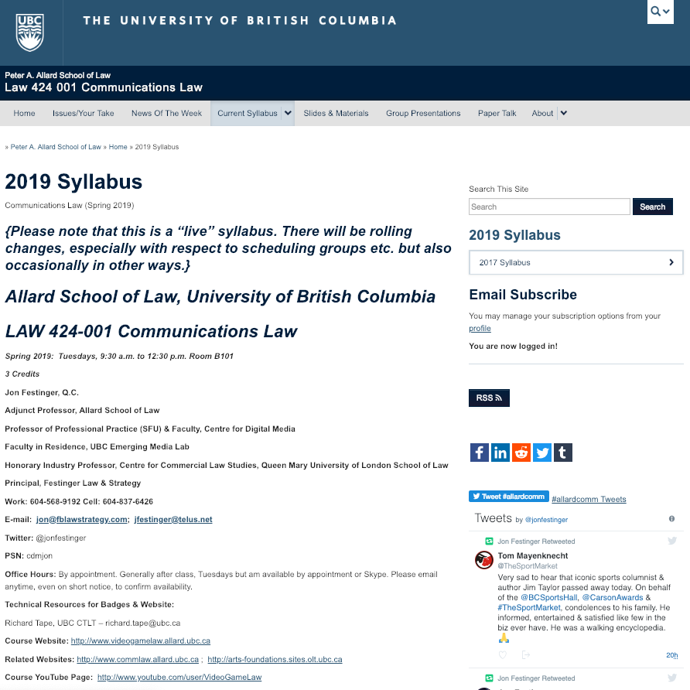
“Living” Syllabus

Slide 15

& Badges…

Slide 16
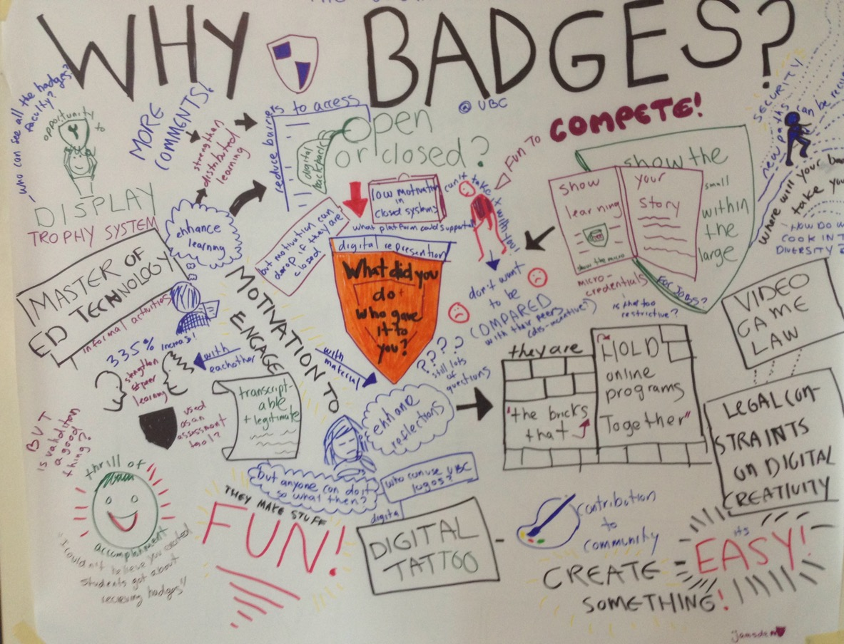

Slide 17
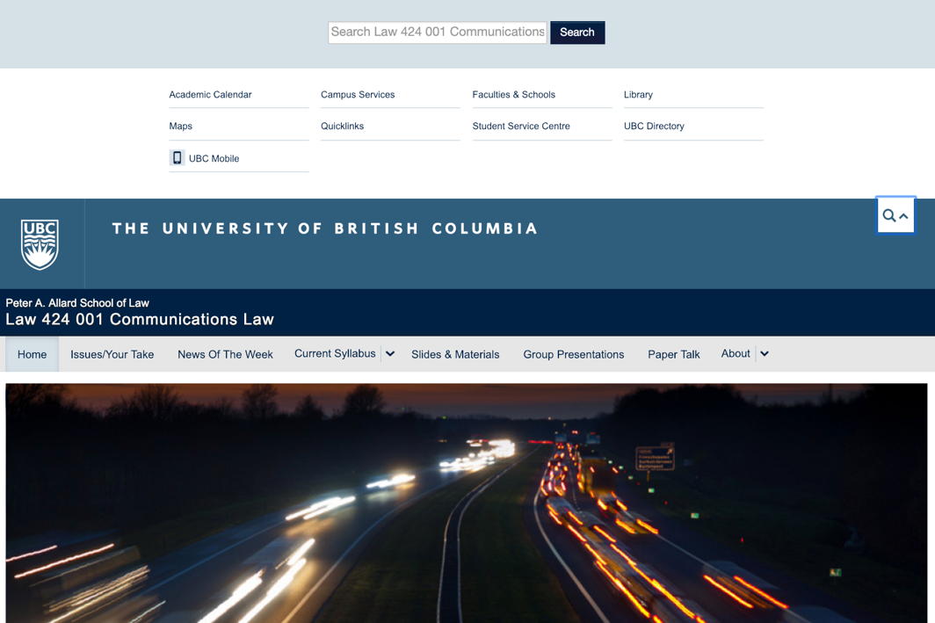
Real Search…

Slide 18
QUESTION
OF THE
WEEK

Slide 19
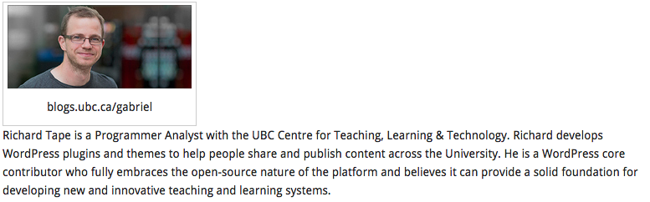
Website issues…

Slide 20
No “hidden” data collected.

Slide 21

Office “Hours”: Ideally Tuesdays after class but am flexible…
Email me & am happy to come to Allard: jfestinger@telus.net
Skype: jon.festinger
Phone:
o. 604-568-9192
c. 604-837-6426

Slide 22
COMING
SOON

Slide 23
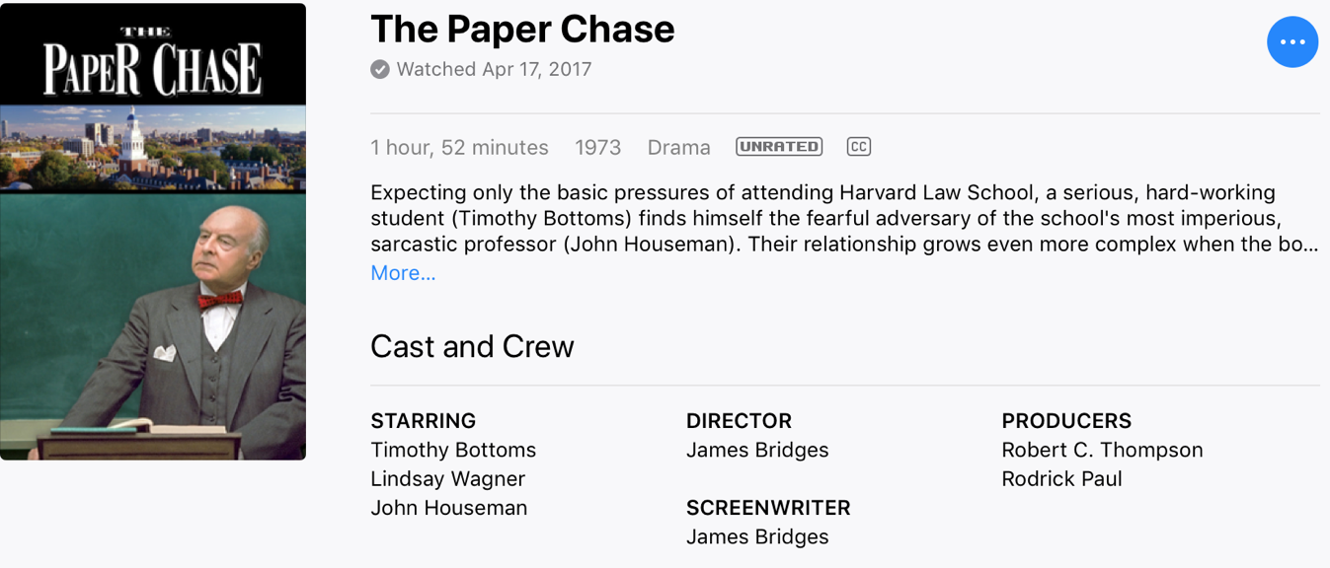
Embedded Self Socratic A.I.(ish)

Slide 24
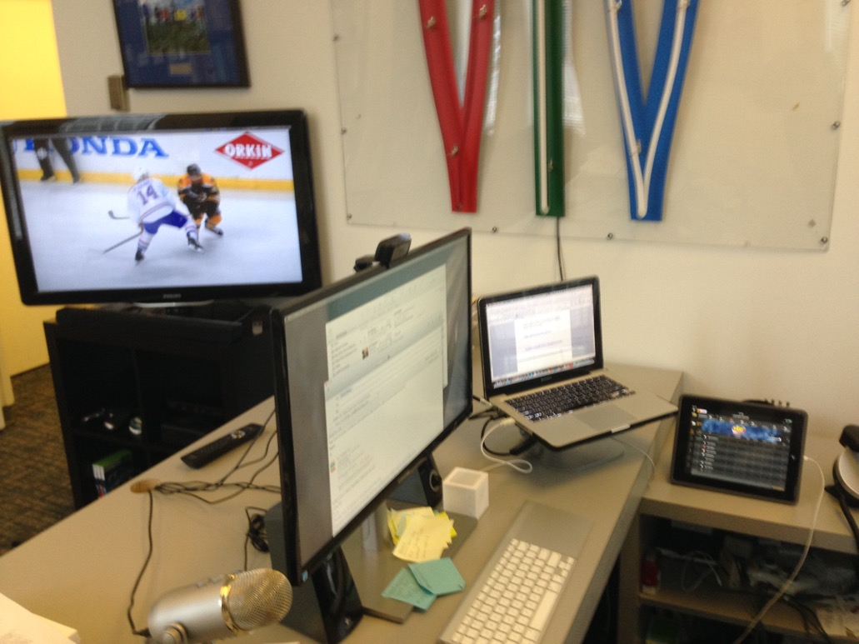
Computers Strongly Encouraged…

Slide 25
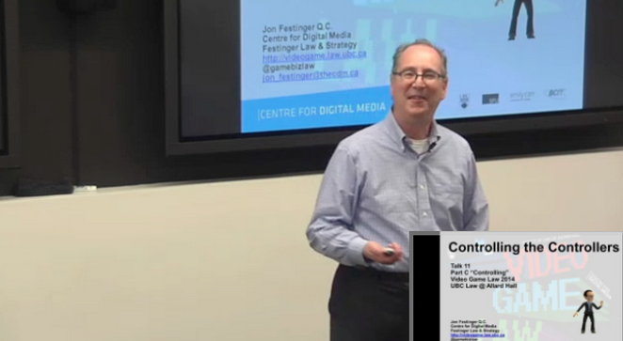
Lecture Capture

Slide 26
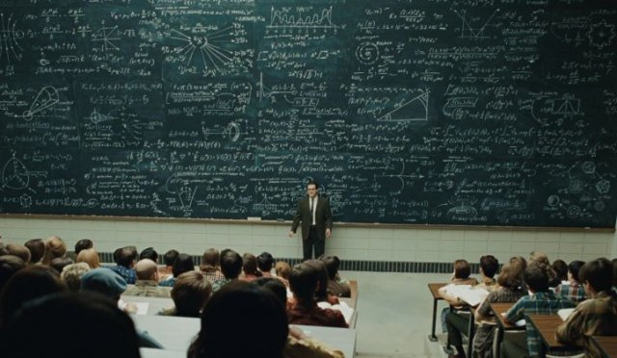
Pedagogic theory please?…

Slide 27
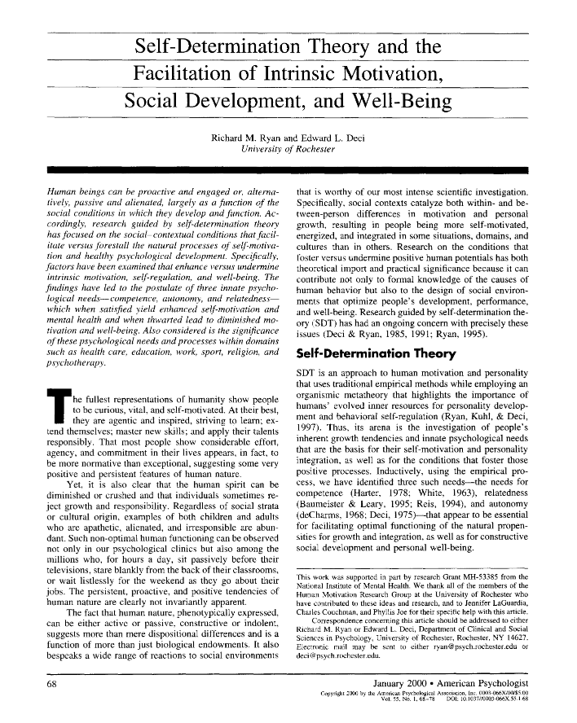

Slide 28
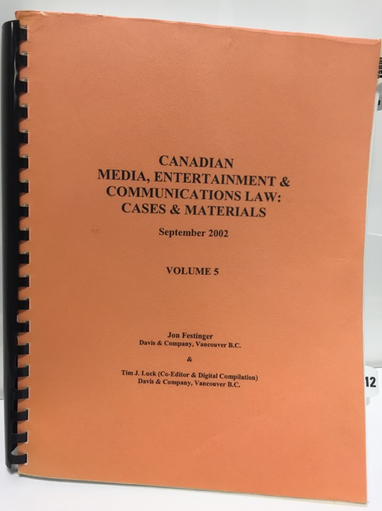
Why this course?

Slide 29
2.0?

Slide 30

The Digital Differences

Slide 31
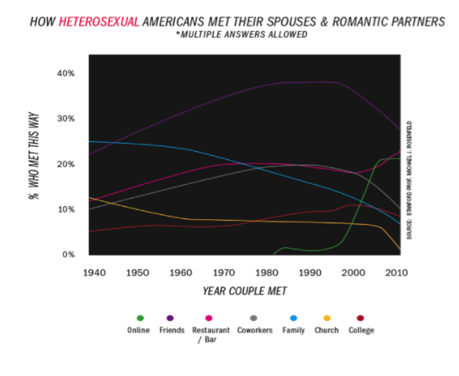

Slide 32
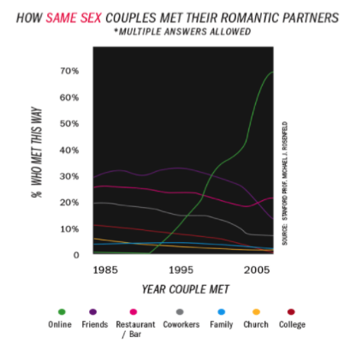

Slide 33
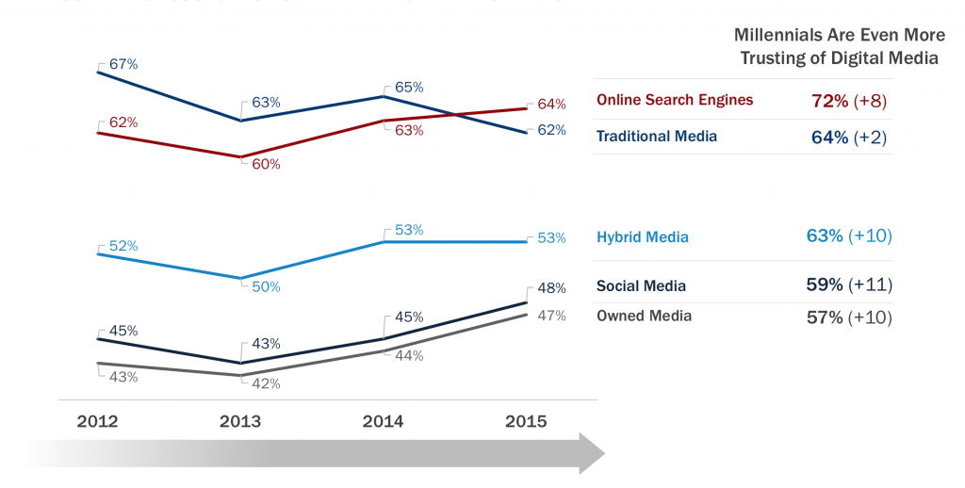

Slide 34
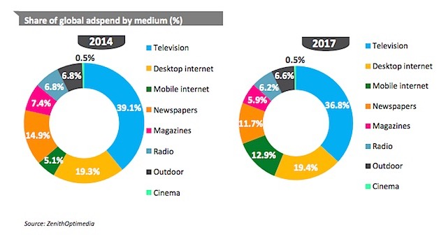

Slide 35
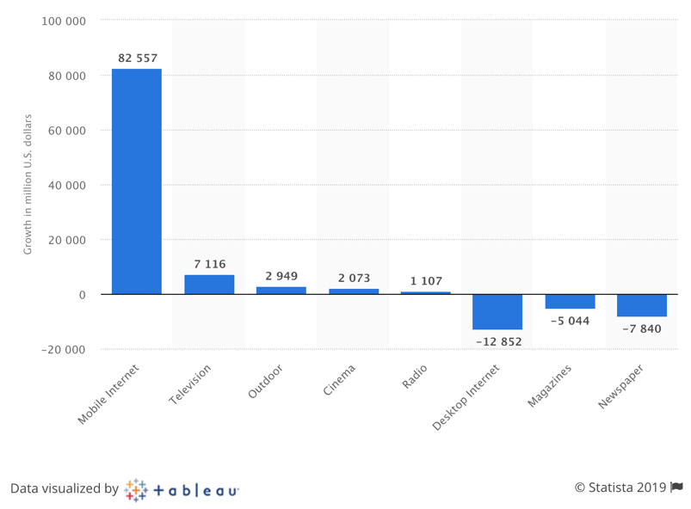
Change in global advertising spending between 2017 and 2020, by medium (in million U.S. dollars)

Slide 36
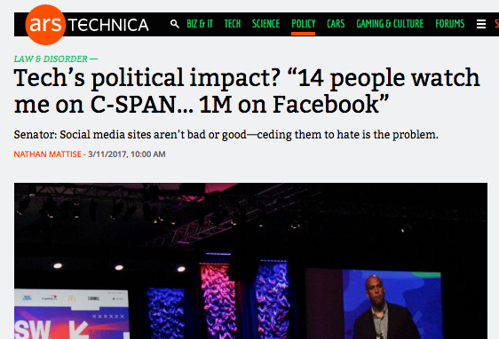

Slide 37
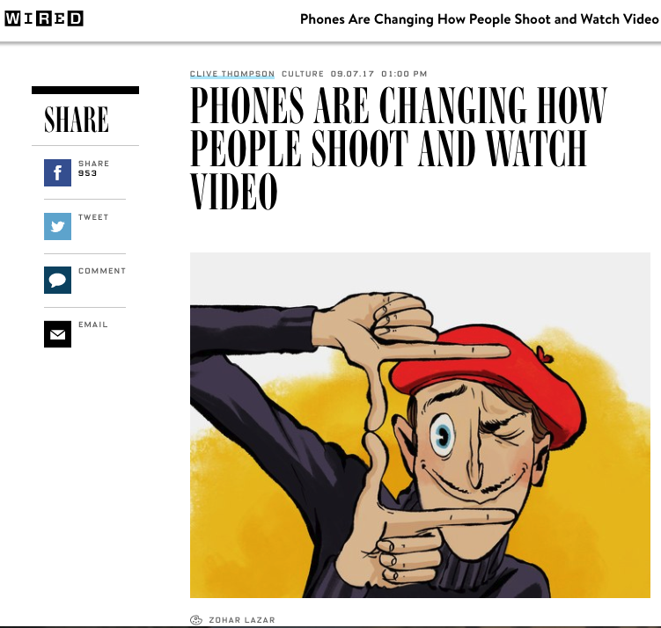

Slide 38
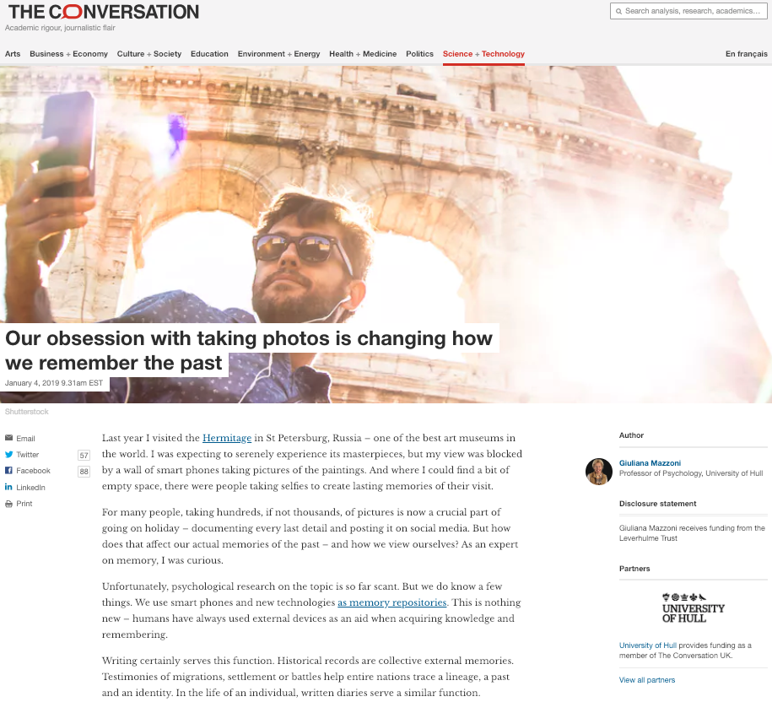

Slide 39
EVALUATION
Term paper = 60% of the final grade.
5000 word paper
The paper is due on the last day of the exam period at 4:00 p.m.
Class Participation = 40% of the final grade
25% of the mark will be based on group preparation of a Class Discussion, with a Discussion Outline provided to the class—preferably by posting on the course website—a week before.
15% for student participation in other course activities including seminar discussions etc.

Slide 40
Paper Confessional
(or what I learned one winter holiday)
Legal/normative reasoning/argument including footnote/bibliography support & Contribution/Move forward → 60%
Presentation including layout, headings, grammar, language/writing skills, “tightness” → 25%
Topic/Originality/Degree of Difficultly → 15%
THIS IS NOT A RUBRIC. IT IS A SELF ASSESSMENT.

Slide 41
Group Presentations
3 (ideally) per group
Sign-up at the break or email me
Any topic – not constrained by what I’m talking about that week
Consult with me re the topic you want to take on
Post one thing you want us to read or watch

Slide 42
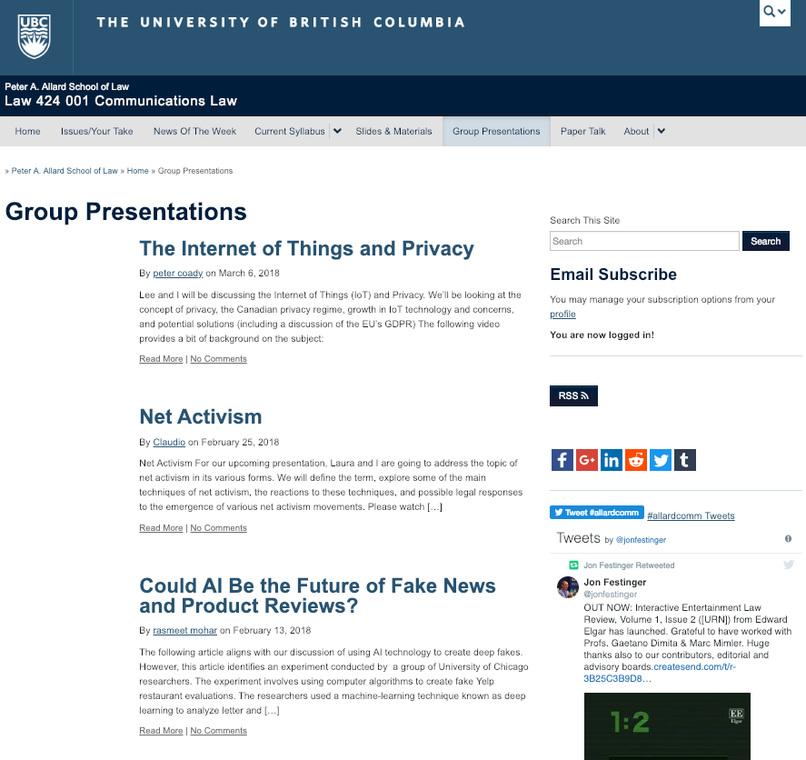

Slide 43
Evaluation Tips
Term paper topics need not be discussed with me, but often helpful to you if you do.
Term paper can be on your presentation topic.
Participation: In-class or other contributions, including attendance.
Group presentation need not be on that week’s topic (20 minute per student multiplier suggested 2-4 per group to 60 minute max).

Slide 44
Grades (primarily)
Paper → Quality
Participation → Effort

Slide 45
Will read: drafts…outlines…synopsis……abstracts…etc.
As late as I can…
Due last day of exams by 4:00 PM.
Hand in papers to front desk & send by email.
If email only, make sure you get acknowledgment of receipt.

Slide 46
Don’t you think
you better
TELL THEM!!!!
So I forgot about
class size…

Slide 47
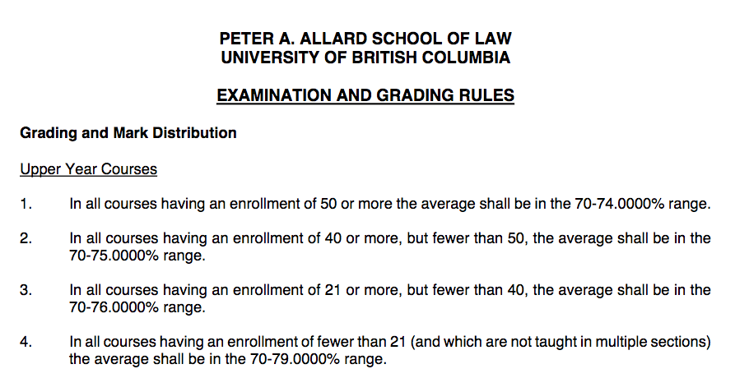

Slide 48
Currently (6:34 PM 1.7.19)
22 + LLM
(2 “over”????)

Slide 49
QUESTIONS?
THOUGHTS?
DISCUSSION?

Slide 50
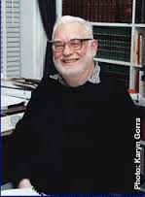
Only rule of of Admin Law
(H. Janisch)?

Slide 51
READ THE STATUTE !!!

Slide 52


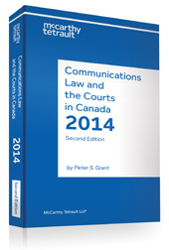
Main Texts on Reserve
10 copies
13 copies
13 copies

Slide 53
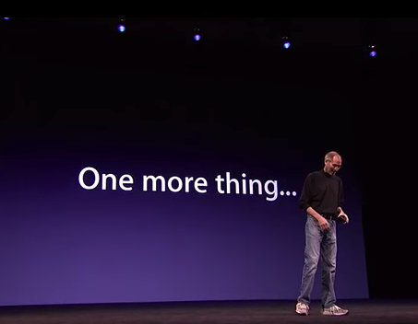

Slide 54
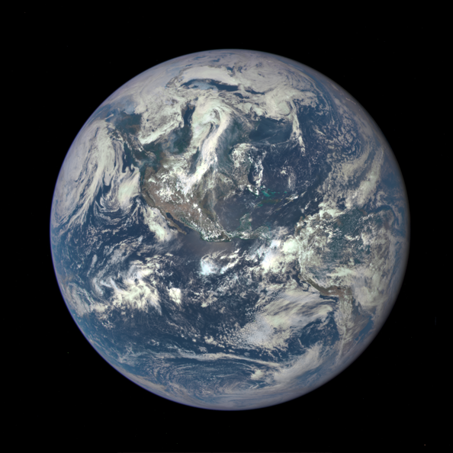
Communications Law is International

Slide 55
News of the Week

Slide 56
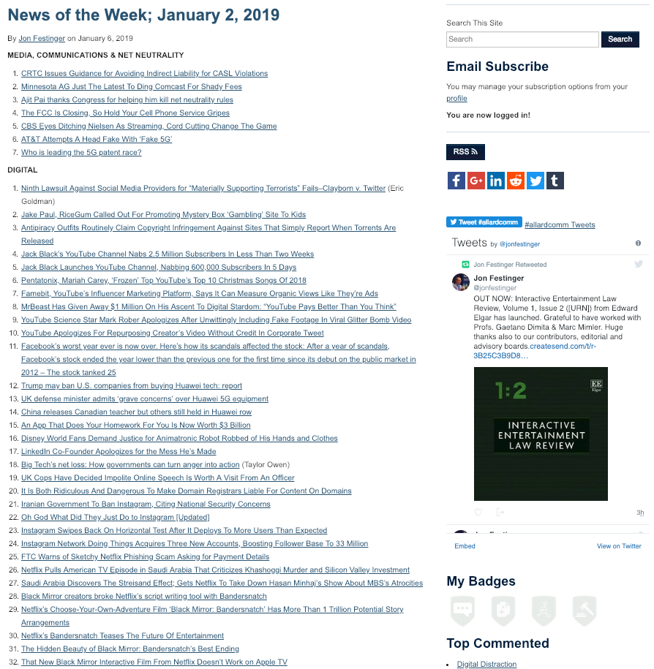

Slide 57
Yours?

Slide 58
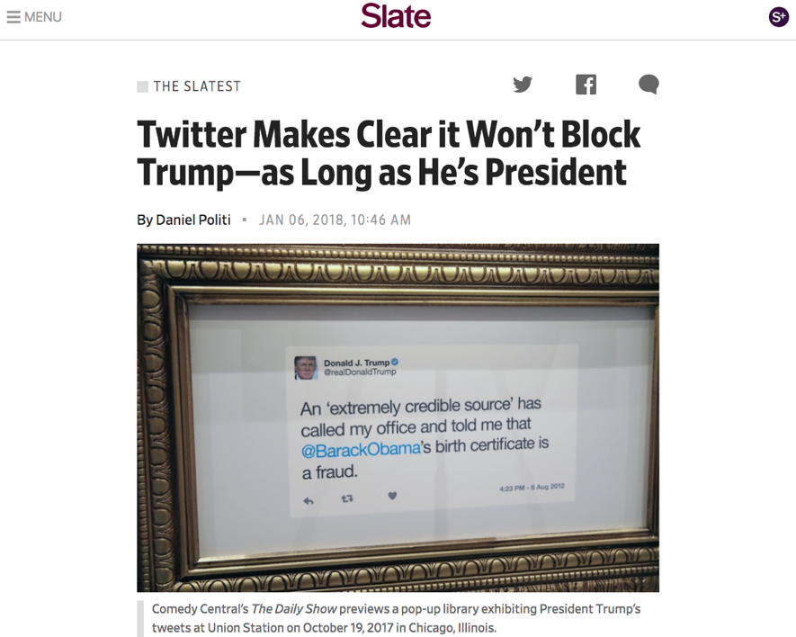
Last year this time…

Slide 59
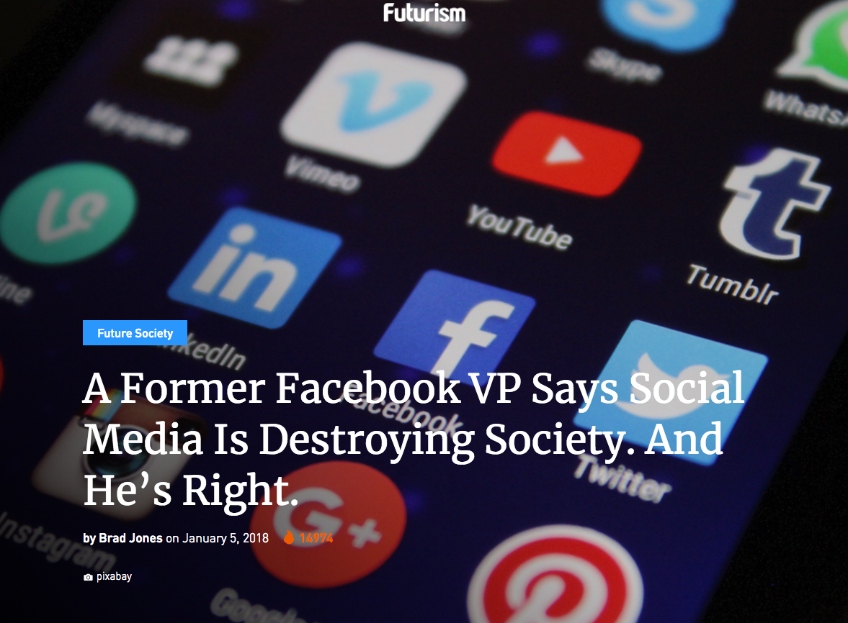

Slide 60
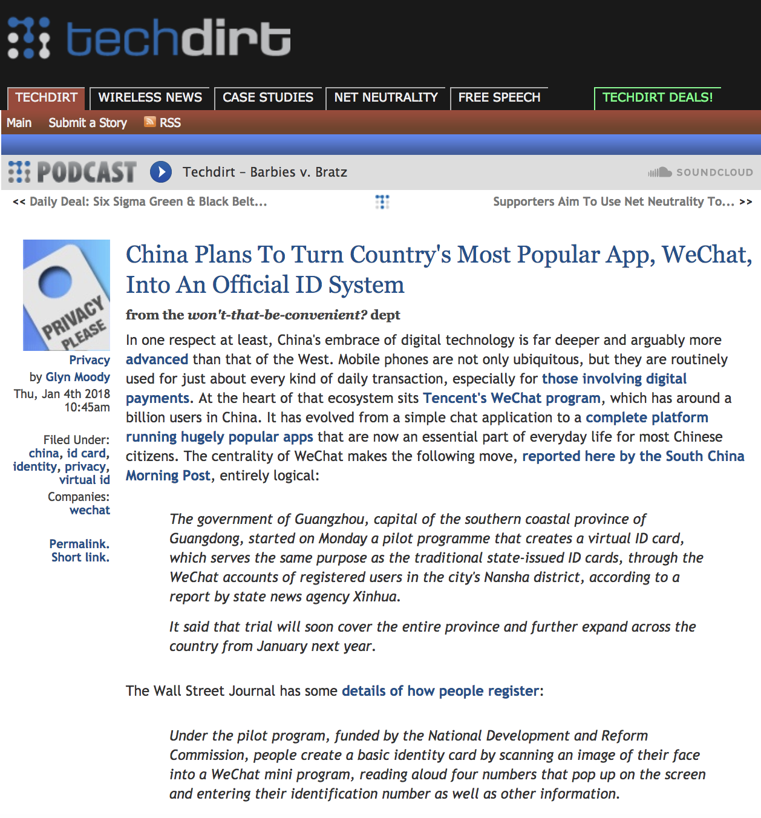

Slide 61
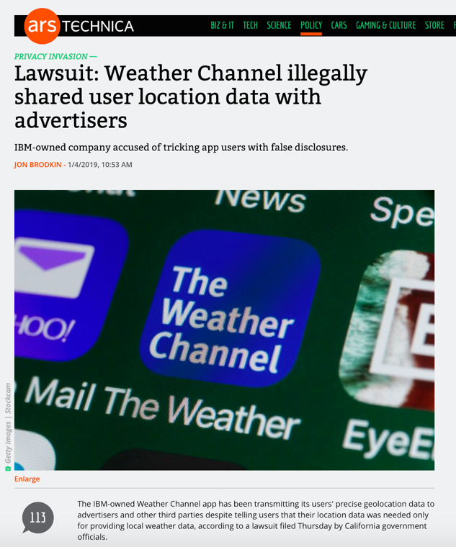
This year this time…

Slide 62
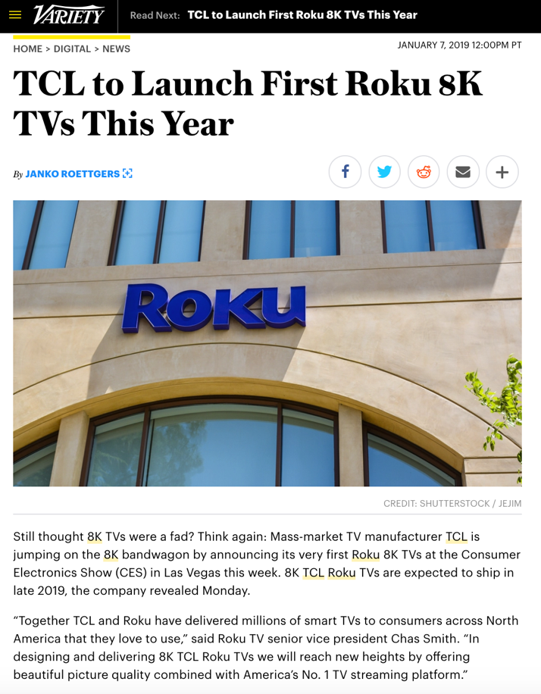

Slide 63
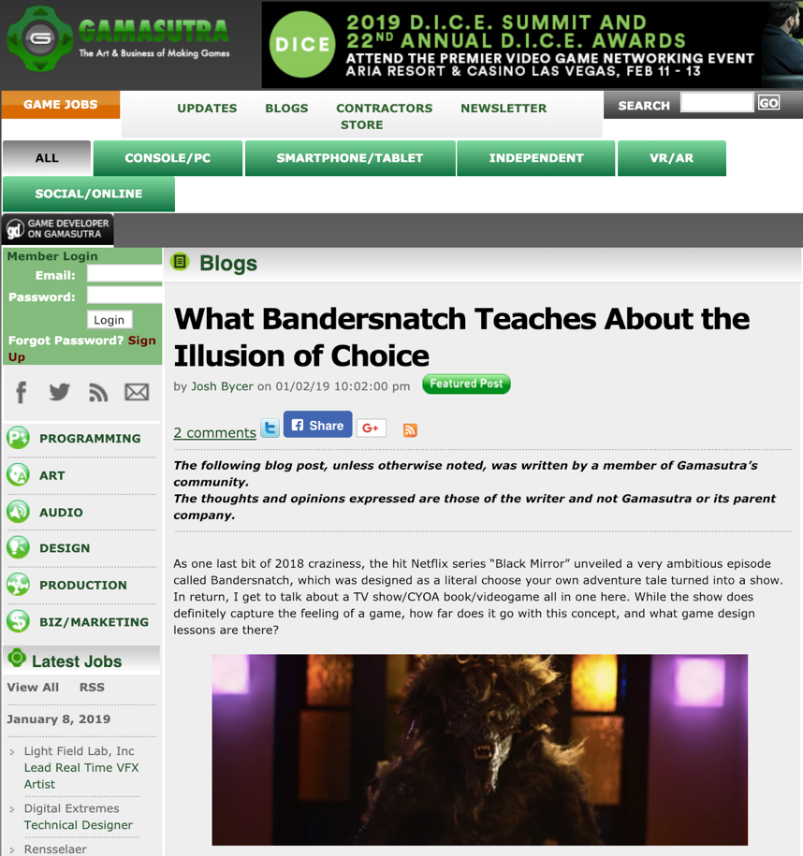

Slide 64
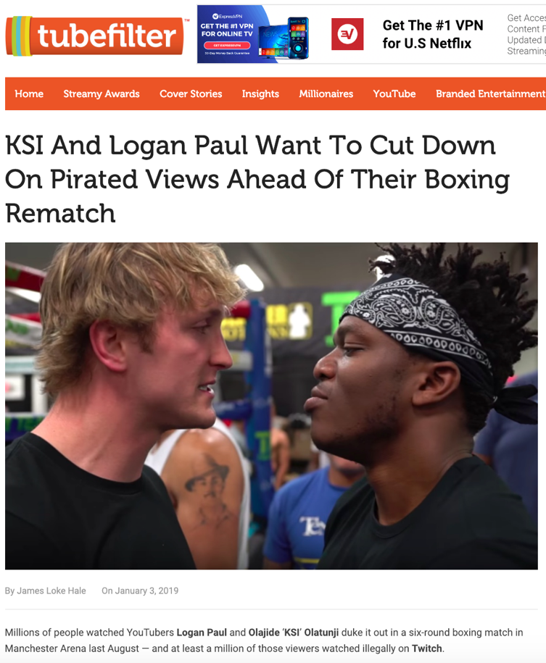

Slide 65
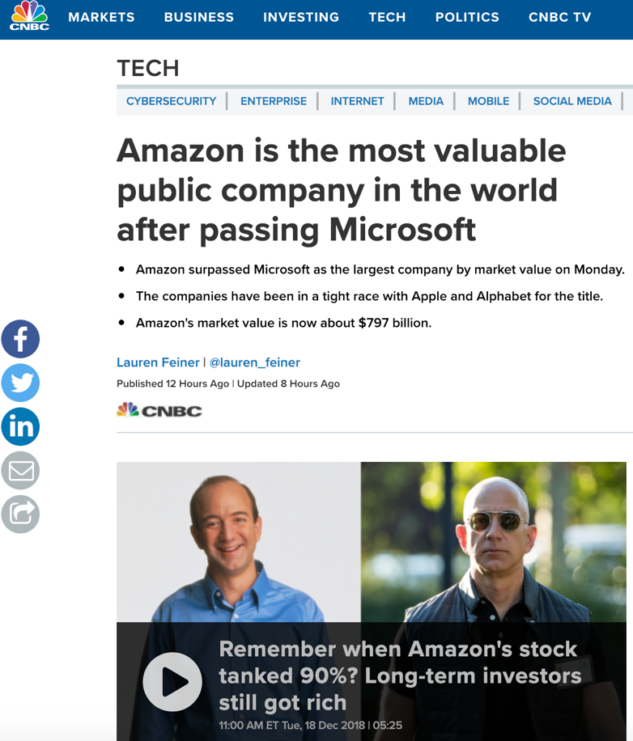

Slide 66
QUESTIONS?
THOUGHTS?
DISCUSSION?

Slide 67

Pause

Slide 68
What is at the heart of Communications Law?

Slide 69
“To regulate, or not to regulate, that is the question.”

Slide 70
To regulate, or not to regulate, that is the question:
Whether 'tis nobler in the mind to suffer
The slings and arrows of outrageous fortune (like Netflix),
Or to take Arms against a Sea of troubles (like Bell),
And by opposing end them: to die, to sleep
No more; and by a sleep, to say we end
the heart-ache, and the thousand natural shocks
that the Broadcasting Act is heir to? 'Tis a consummation
devoutly to be wished. To die, to sleep,
To sleep, perchance to Dream of Canadian Content; aye, there's the rub,
for in that sleep of death, what dreams may come,
when we have shuffled off these mortal ratings,
must give us pause. There's the respect
that makes Calamity of so long a statutory life:
For who would bear the Whips and Scorns of time,
the Oppressor's wrong, the proud man's Contumely,
the pangs of despised Love of The Littlest Hobo, the Law’s delay,
the insolence of Crull, and the spurns
that patient merit of the unworthy takes of the intervenors,
when he himself might his Quietus make
with a bare Exemption Order? Who would the Chair bear,
to grunt and sweat under a weary life,
but that the dread of something after death,
the undiscovered country, from whose bourn
no applicant returns, puzzles the will,
and makes us rather bear those ills we have,
than fly to other proceedings that we know not of.
Thus conscience does make cowards of us all,
and thus the native hue of a Call for Applications
Is sicklied o'er, with the pale cast of Thought,
And enterprises of great pitch and moment,
with this regard their Tangible Benefits turn awry,
And lose the name of Action. Soft you now,
The fair level playing field? Nymph, in thy Orisons
Be all my sins remember'd (but not in the Decision).
Hamlet: Act 3, Scene 1 (revised)

Slide 71
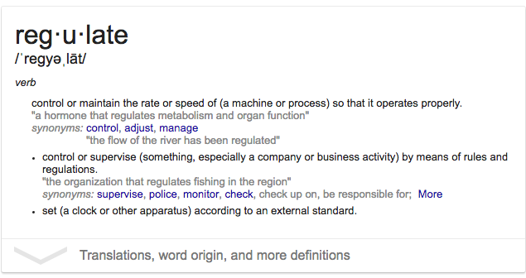
“Regulate” = make regular

Slide 72
QUESTIONS?
THOUGHTS?
DISCUSSION?

Slide 73
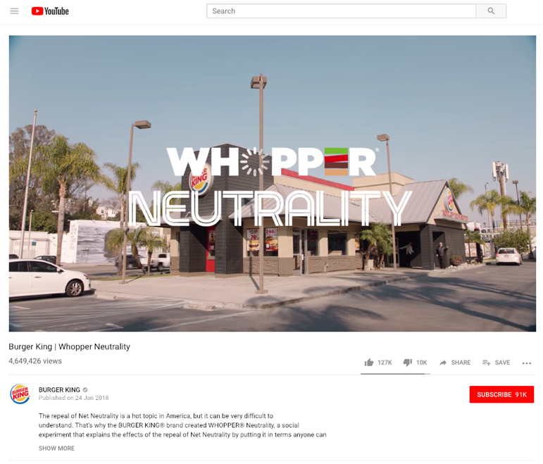
Introduction to Net Neutrality

Slide 74
Pause

Slide 75
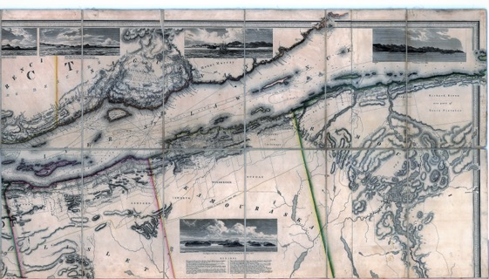
Coming Soon
“Mapping Communications Law 1.0
& 2.0: A Topology”

Slide 76
+You!

Slide 77

About you & what might interest you..

Slide 78
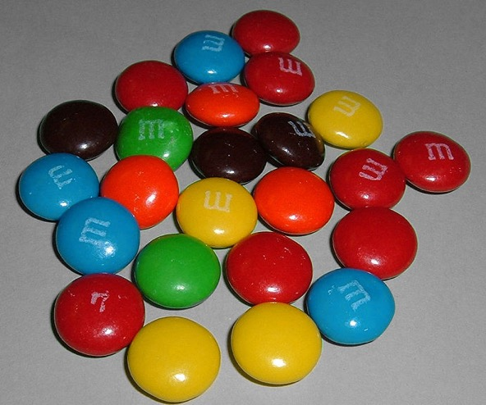
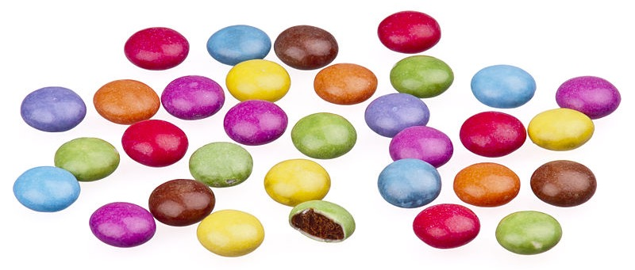
A MATTER OF PERSPECTIVE

Slide 79

Conclusion

Slide 80
SEE YOU NEXT WEEK!

Slide 81

Always include a cat picture

Slide 82
In learning you will teach
And in teaching you will learn
Phil Collins' Son of Man (1999)

Slide 83
Our Academic Partners

