Slide 1
DEFENDING THE STUPID NETWORK
IAN ANDREW BELL twitter: @ianb
hello@ianbell.com

Slide 2
What is the internet?
@ianb

Slide 3
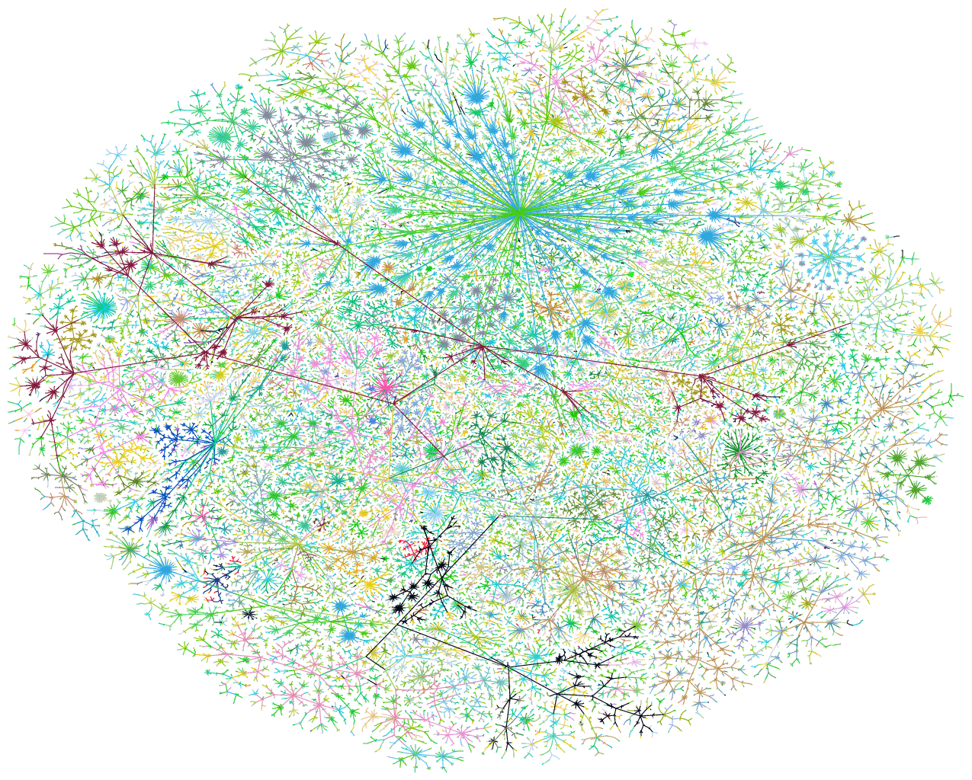
@ianb

Slide 4
@ianb

Slide 5
Founding principles
OF THE OPEN INTERNET
DAVID ISENBERG “RISE OF THE STUPID NETWORK” BELL LABS, 1996
TIM WU “NETWORK NEUTRALITY, BROADBAND DISCRIMINATION” UNIVERSITY OF VIRGINIA, 2003
“FRAMEWORK FOR GLOBAL ELECTRONIC COMMERCE” WHITE HOUSE, 1997
FCC DECLARATORY RULING RE: FWD (AKA “PULVER ORDER”) 2004
@ianb

Slide 6
HOW THEY GET YOU
DISCRIMINATION BY PROTOCOL THROTTLING OR BLOCKING BY PORT/PROTOCOL
DISCRIMINATION BY SOURCE IP ADDRESS THROTTLING OR BLOCKING BASED ON SERVER/SITE ADDRESS
EXEMPTION VIA PRIVATE NETWORKS USING PRIVATE NETWORKS TO FAVOUR CERTAIN SERVICES FOR BILLING, CAP LIMIT EXEMPTIONS
FAVOURED PEERING CONNECTING LOWER-LATENCY LINKS TO HIGHEST BIDDERS
@ianb

Slide 7
WHAT, ME WORRY?
TRAFFIC SHAPING WORKING AT INTERNET SCALE SINCE 2005
DEEP PACKET INSPECTION NOW POSSIBLE AT INTERNET SCALE THANKS TO DSP ADVANCES
BLOCKING HAS HAPPENED IN CANADA / US WITH DISCRIMINATORY RESULTS
DETECTION IS VERY DIFFICULT, REQUIRES EXPENSIVE TECHNOLOGY AND VOLUNTARY DISCLOSURE
COMBINATION PLAY COULD BE USED TO DEVASTATING EFFECT IN COMBINATION WITH LEGISLATION LIKE DMCA
@ianb

Slide 8
CANADA
USA
TELECOMMUNICATIONS ACT (1991, APPLIED COMMON CARRIER STATUS TO ISPs)
ADMINISTERED BY CRTC (MULTIPLE ENFORCEMENT ACTIONS)
2009 NET NEUTRALITY DEC’N (APPLIED 4 KEY CONSIDERATIONS TO ITMP)
FOCUS ON POLICY NOT LAW (PRIVATE MEMBER’S BILL DIED 2017)
CLINTON “HANDS OFF” POLICY (UPHELD BY BUSH/POWELL)
PULVER ORDER 2004 (UPHELD BY BUSH/POWELL + OBAMA)
OPEN INTERNET ORDER 2010 (SIX PRINCIPLES OF NET NEUTRALITY)
MUZZLING OF FCC 2014-2018 (CONGRESS, TRUMP ATTACK AUTHORITY OF FCC)
@ianb

Slide 9
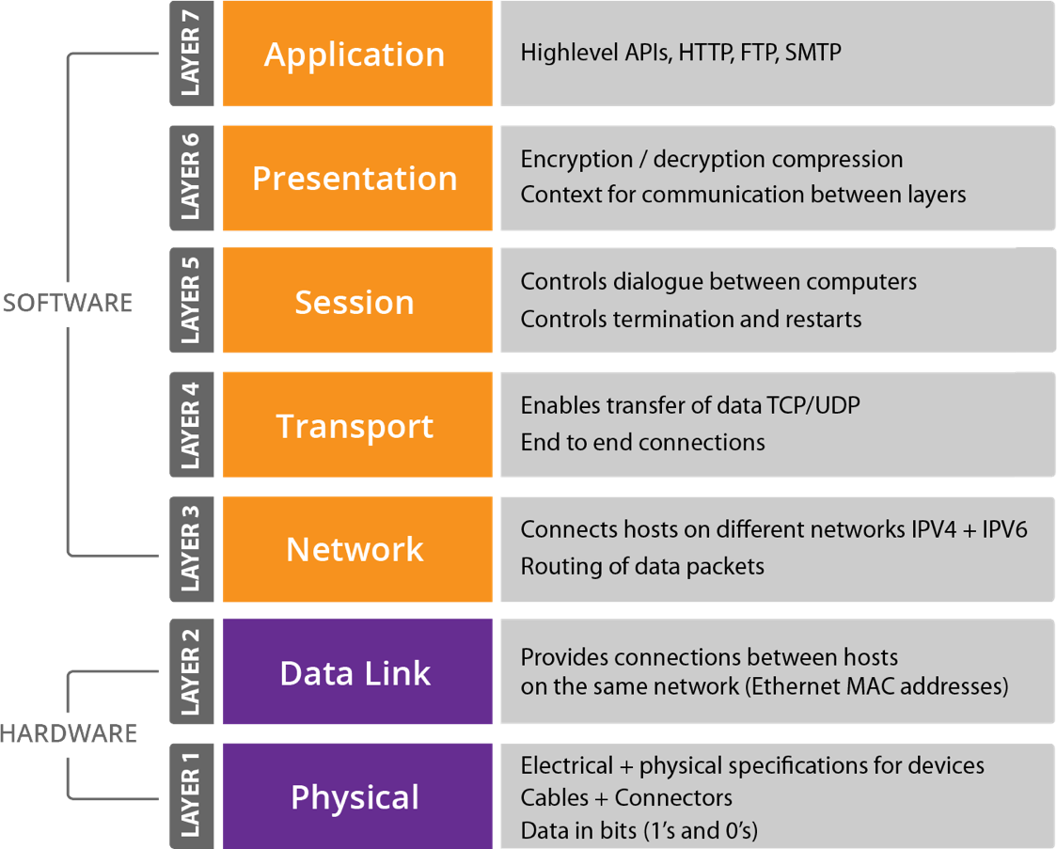
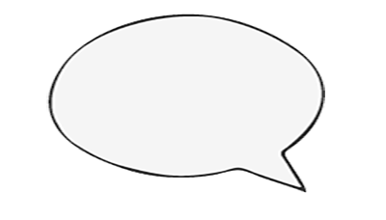
A MODEST PROPOSAL
CANADA: TIME FOR A NEW TELECOMMUNICATIONS ACT THAT SPECIFICALLY ADDRESSES INTERNET
PRINCIPLES OF NET NEUTRALITY MUST UNDERPIN ITS DESIGN
CHALLENGES WILL EXIST VIS-A-VIS CULTURAL PROTECTIONISM
TELCOS: PLAY HERE
@ianb

Slide 10
TWO STORIES
HOW BECAME A $5 BILLION COMPANY
IAN’S FIRST WEEK AT
@ianb

Slide 11
http://ianbell.com
http://twitter.com/ianb
hello@ianbell.com

