Slide 1
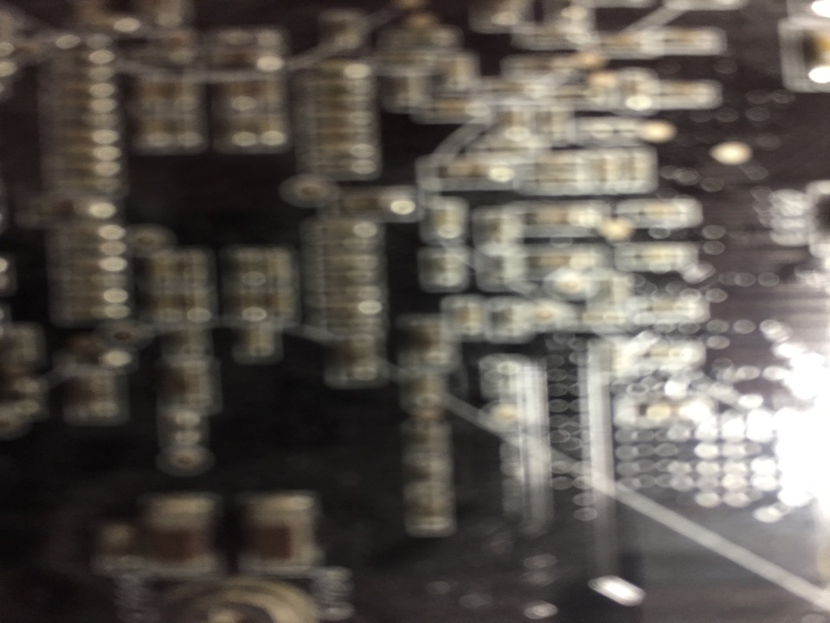

News of the Week
& Other Stuff
Talk 11
LAW 424 001
Communications Law
Allard School of Law, UBC
Spring, 2018
Jon Festinger Q.C.
Centre for Digital Media
QMUL School of Law (CCLS)
Festinger Law & Strategy
http://commlaw.allard.ubc
@jonfestinger
jon_festinger@thecdm.ca

Slide 2

Another Wonderful Wednesday

Slide 3
Logistics

Slide 4
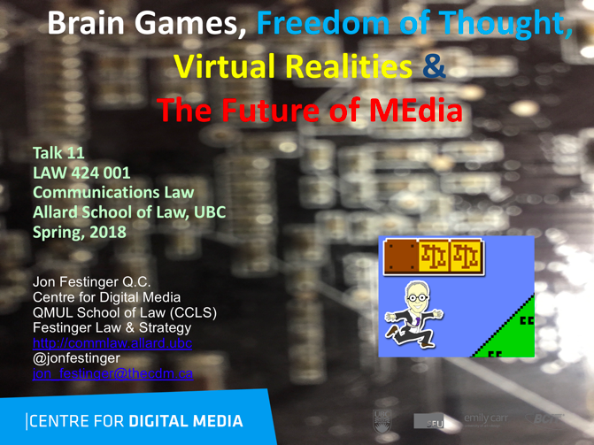
On the Website…

Slide 5
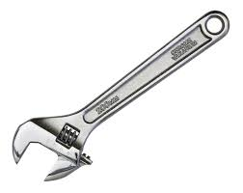
Group Presentations:
Any Adjustments?

Slide 6
Questions on..
Papers ?
Participation ?
Class Presentations ?

Slide 7
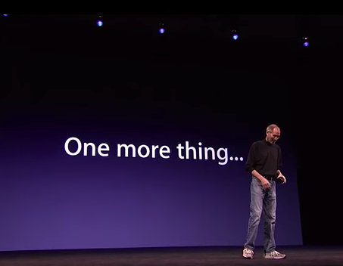

Slide 8
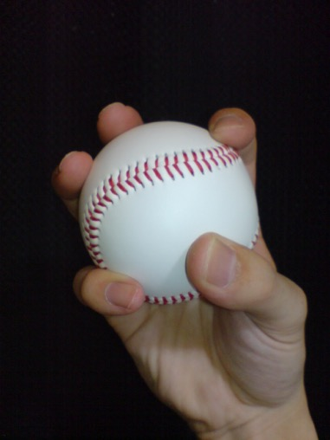
Changing it up…

Slide 9
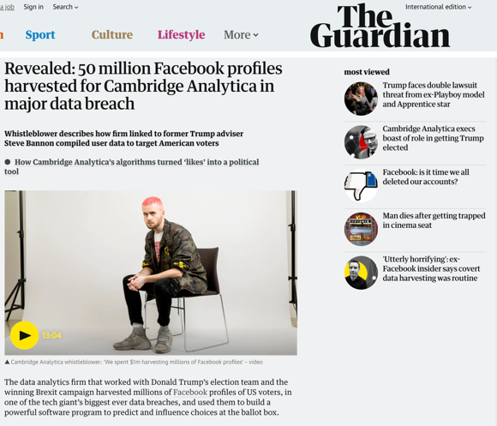
Because…

Slide 10

+ Next week’s presentation...

Slide 11
QUESTIONS?
THOUGHTS?
DISCUSSION?

Slide 12

Pause

Slide 13
News of
the Week

Slide 14
Yours?

Slide 15
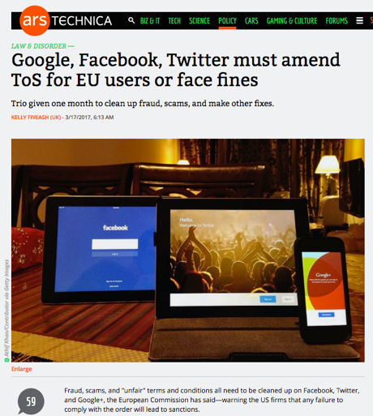
Last year this time…

Slide 16
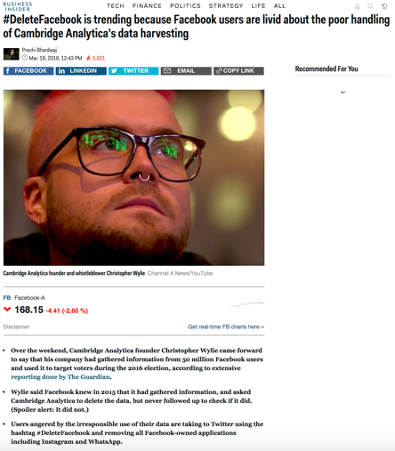
This year this time…

Slide 17
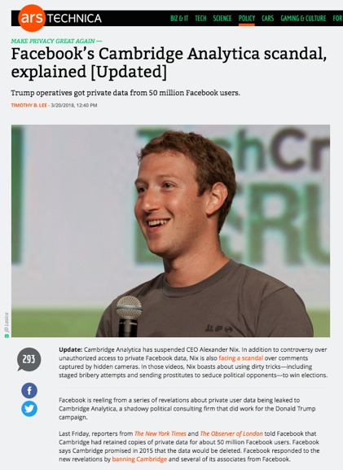

Slide 18
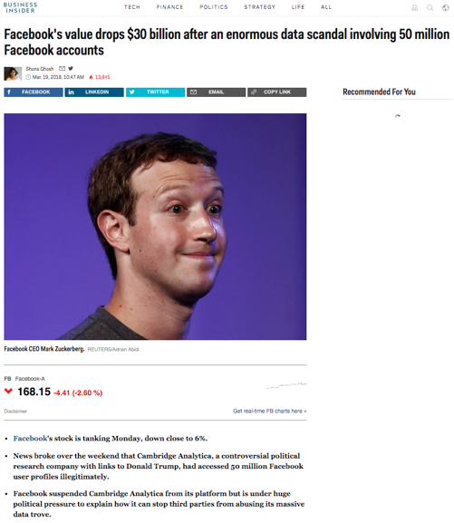

Slide 19
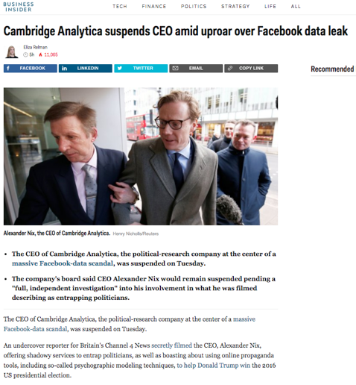

Slide 20
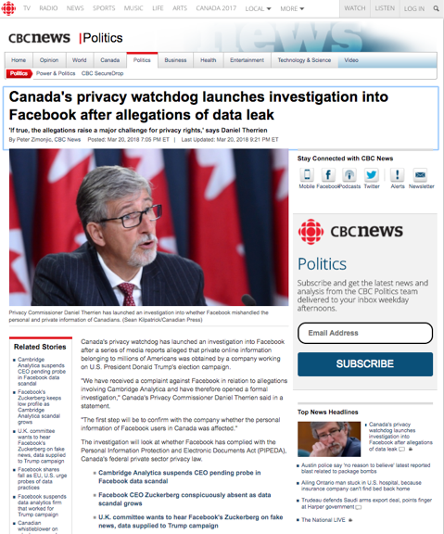

Slide 21
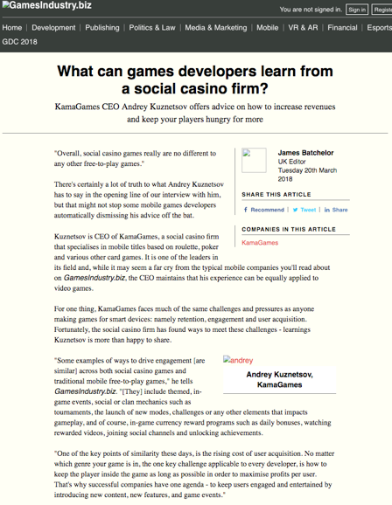

Slide 22
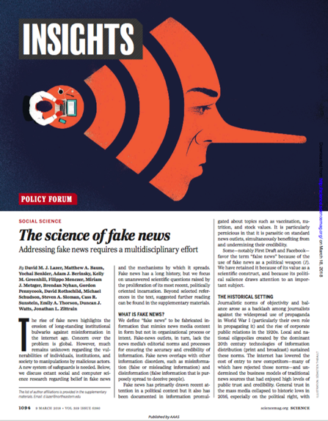

Slide 23
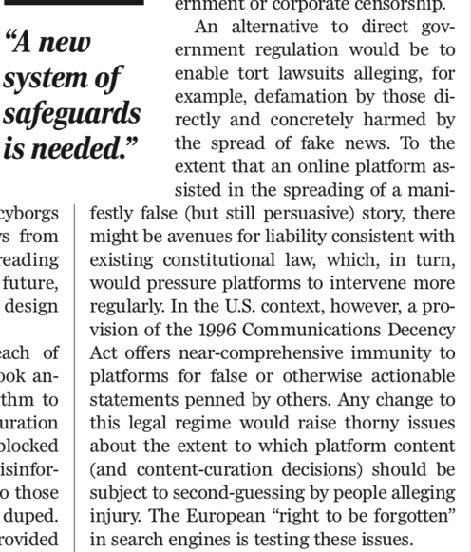
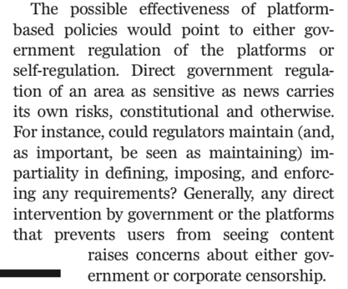

Slide 24
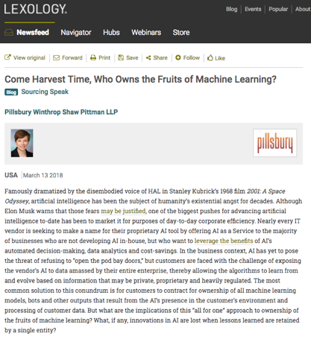

Slide 25
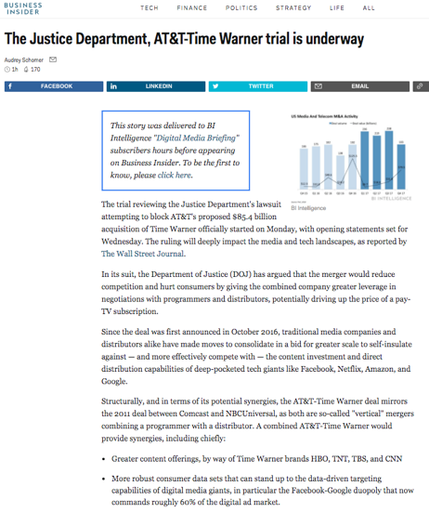

Slide 26


Slide 27
QUESTIONS?
THOUGHTS?
DISCUSSION?

Slide 28
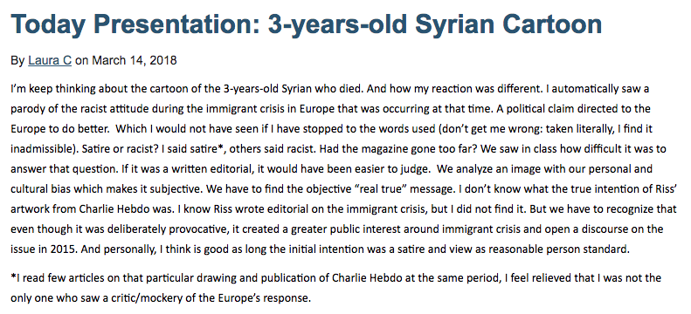
From the website Etc…

Slide 29
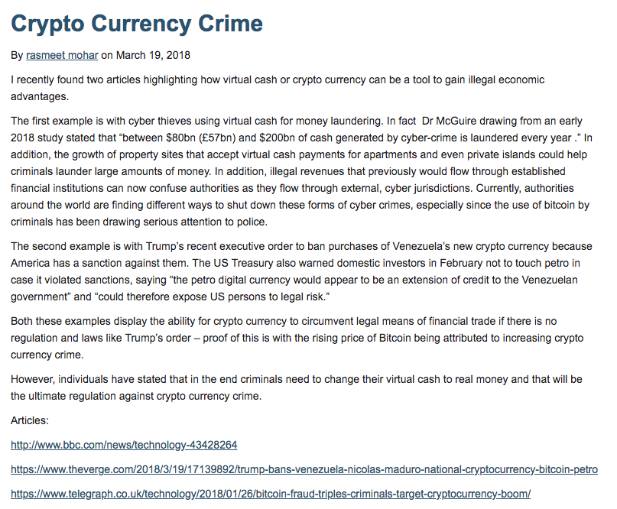

Slide 30
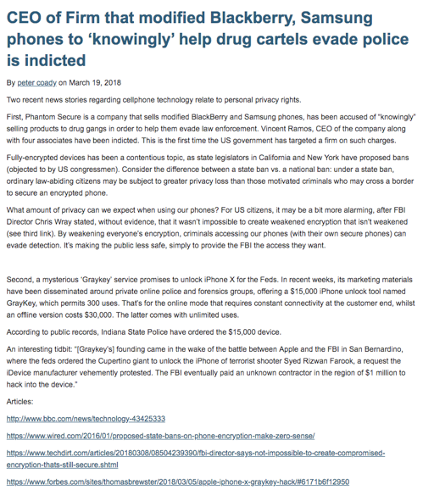

Slide 31
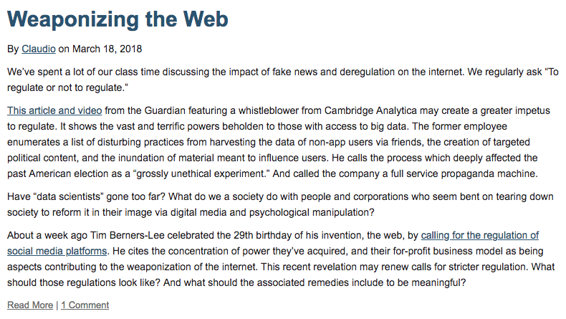

Slide 32
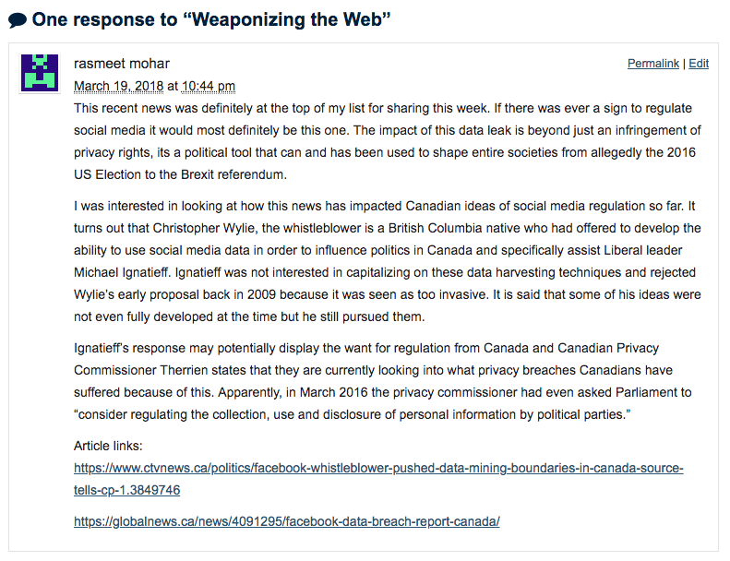

Slide 33
QUESTIONS?
THOUGHTS?
DISCUSSION?

Slide 34
Pause

Slide 35
QUESTION
OF THE
WEEK

Slide 36
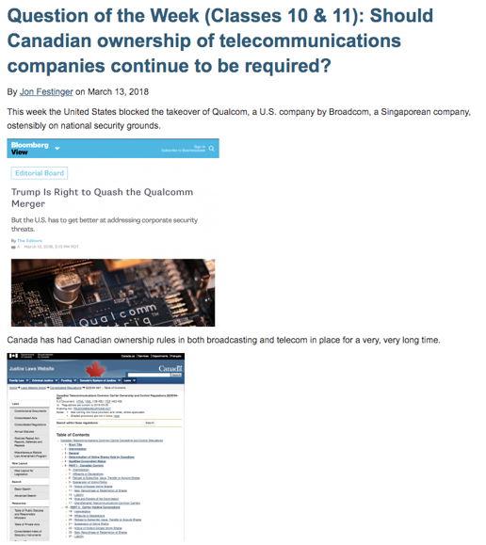

Slide 37
QUESTIONS?
THOUGHTS?
DISCUSSION?

Slide 38

Today’s Presentation

Slide 39
Pause

Slide 40

Now Back to Our NOT SO Regularly
Scheduled Programming…

Slide 41
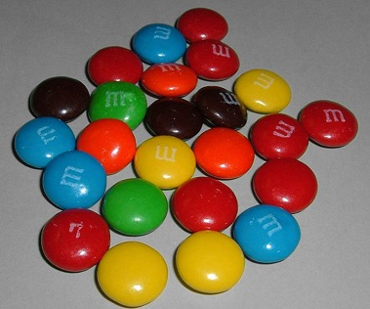

A MATTER OF PERSPECTIVE

Slide 42

Always include a cat picture

Slide 43
Our Academic Partners

