Slide 1
Privacy & The Internet of Things
According to Lee Dorner & Peter Coady, at least.

Slide 2
Privacy: Our Computerized world
Collections of information about people are able to be searched/distributed/combined to generate comprehensive records of individual attributes and activities
Problem: keeping proper vigilance on where such information can and should go

Slide 3
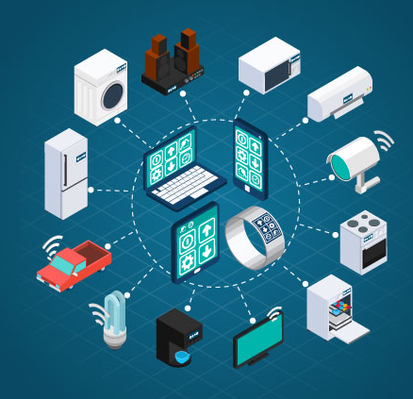
Internet of Things
the networking of physical objects connecting through the internet (OPC Internet of Things)
IoT application domains span almost all major economic sectors: health, education, agriculture, transportation, manufacturing, electric grids, and many more
The combination of network connectivity, widespread sensor placement, and sophisticated data analysis techniques now enables applications to aggregate and act on large amounts of data generated by IoT devices in homes, public spaces, industry and the natural world

Slide 4
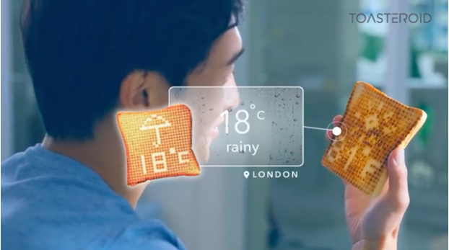

Slide 5
Literature on our control over personal information data
Firms that traffic in personally-identified data argue that the information collected, processed, and exchanged is both their property (because it is valuable) and their constitutionally-protected speech (because it is information) – Cohen
In contrast, some privacy scholars argue that individuals should have control over their personal information data
determine when, how, and to what extent information about themselves is communicated to others
a difficult task for a highly computerized culture

Slide 6
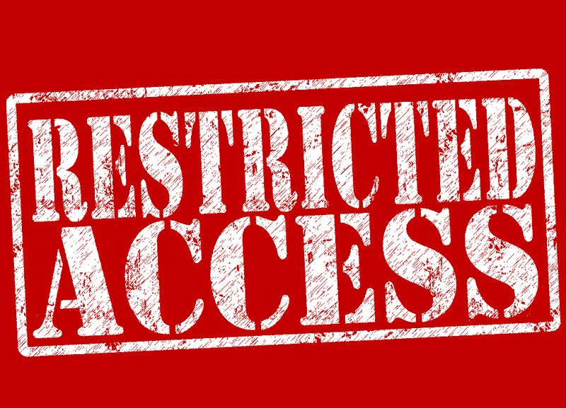
A restricted Access Approach to Information Privacy – James Moor
To ensure that only the right people have access to relevant information at the right time
To give individuals as much control (informed consent) over personal data as realistically possible
Privacy as a complex of situations in which information is authorized to flow to some people some of the time

Slide 7
Importance of Restricting Access
Cohen: informational autonomy comports with important values concerning the fair and just treatment of individuals within society.
placing some cost burden on processors and users of personally-identified data promotes greater respect for individual dignity than requiring individuals to purchase their privacy against a default rule of no-privacy
Katyal: autonomy has already been impacted by the very fact that the modern architecture of the internet facilitates rather than prevents, informational invasions.

Slide 8
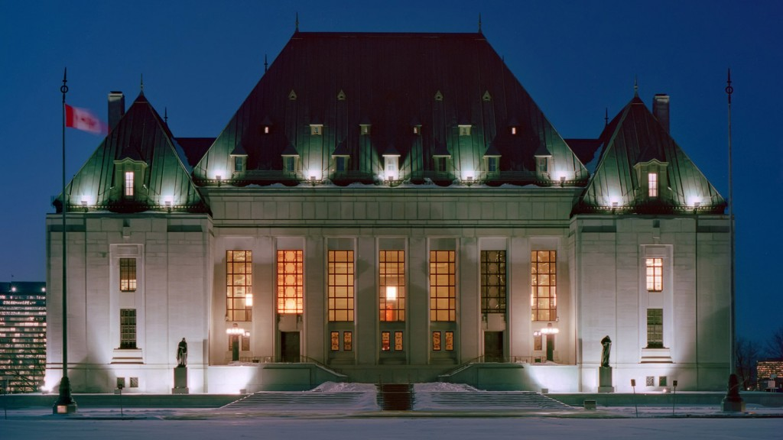
Canadian Jurisprudence on Informational Privacy
R v Silveira: there is no place on Earth where persons can have a greater expectation of privacy than within their ‘dwelling-house’ (1995 SCC)
R v Spencer: there is a reasonable expectation of privacy in subscriber information linked to internet activity, as this information can be the key to unlocking sensitive details about a user’s online activities and is worthy of constitutional protection (2014 SCC)

Slide 9
Canadian jurisprudence on informational privacy
Gordon v Canada: information will be about an identifiable individual where there is a serious possibility than an individual could be identified through the use of that information, alone or in combination with other available information (2008 FC)
Citi Cards Canada: “personal information” has an elastic definition and should be interpreted accordingly (2011 ONCA)
While the temperature in your house may not easily fit into the concept of “personal” information, under the internet of things, it would

Slide 10
Privacy Protection laws in Canada
Four private sector privacy statutes that govern the collection, use, disclosure and management of personal information in Canada (Canada, Alberta, BC, and Quebec – Manitoba’s is not yet in force)
Federal Act (PIPEDA) does not apply where a province has enacted legislation that has been deemed to be “substantially similar”
statutes in Alberta, BC, and Quebec have each been deemed substantially similar to PIPEDA
PIPEDA will apply to commercial trans-border personal information flows

Slide 11
Common key principles
an organization may collect, use or disclose personal information only for a purpose that a reasonable person would consider appropriate in the circumstances
Organizations are accountable for the protection of personal information under their control.

Slide 12
Common Key Principles (Cont’d)
The purposes for which the personal information is being collected must be identified during or prior to the collection.
Personal information may only be collected, used or disclosed by an organization with the knowledge and consent of the individual, with limited exceptions as specified in the legislation.
The collection of personal information is limited to what is necessary for the identified purposes and will be collected by fair and lawful means.

Slide 13
Common Key Principles (cont’d)
Personal information must only be used and disclosed for the purposes for which it was collected, except with consent or as required by law. It can be retained only as long as it is necessary to fulfill those purposes.
Personal information must be as accurate, complete and up-to-date as is necessary.
Personal information must be protected by adequate safeguards.

Slide 14
Common Key Principles (Cont’d)
Information about an organization's privacy policies and practices must be readily available to individuals upon request.
An individual has the right of access to personal information about himself or herself and has the right to seek correction. Both these rights are subject to some exceptions as specified in each statute.
Organizations must provide the means for an individual to challenge an organization's compliance of the above principles.

Slide 15
relevant statutory obligations from a cybersecurity perspective
Security safeguards
must be appropriate to the sensitivity of the information (more sensitive = higher safeguard)
must protect against loss or theft, as well as unauthorized access, disclosure, copying, use, or modification, regardless of the format in which it is held
nature of safeguards will depend on sensitivity of information, the amount, distribution, format, and the method of storage

Slide 16
Relevant statutory obligations from a cybersecurity perspective
the methods of protection include (a) physical measures; (b) organizational measures; (c) technological measures
An organization continues to be responsible for personal information it handles, even where that information has been transferred to a third party for storage or processing, and contractual or other means must be used to ensure that comparable levels of protection exist while the information is being processed by the third party

Slide 17
Canada’s Anti-Spam Legislation
In December 2010, Parliament passed anti-spam legislation (in force as of July 2014)
amended PIPEDA by expanding the Privacy Commissioner’s investigative powers and permitting the Commissioner to take measures against the unauthorized collection of personal information through hacking or the illicit trading of electronic addresses
It complements PIPEDA in regulating certain online commercial practices, such as the sending of commercial electronic messages (by requiring senders to obtain prior consent), as well as the harvesting of electronic addresses and the installation of malicious software on computers.
Under the legislation, the Office of the Privacy Commissioner will share enforcement responsibilities with the CRTC and with the Competition Bureau.

Slide 18
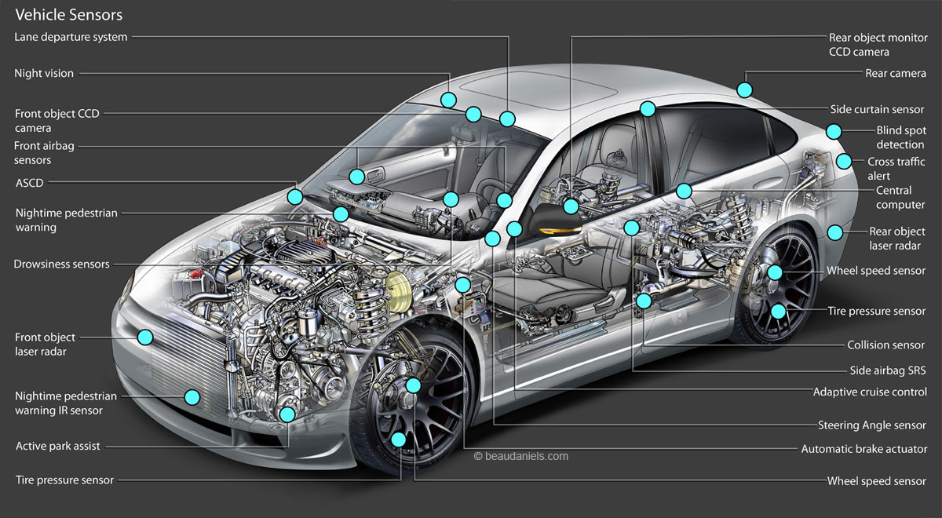
Internet of Things examples
Smart home
Amazon Echo, Google Home, Nest
Wearables
Fit Bit, Apple Watch
Cars
Tesla, integrated apps and GPS
Industrial Applications
logistics and order fulfillment in warehouses
Infrastructure and Energy Conservation
‘Smart cities’ like Barcelona
Appliances
Smart fridge
Notes:
https://www.youtube.com/watch?v=oOVVzdLy69w (Silicon Valley video)

Slide 19
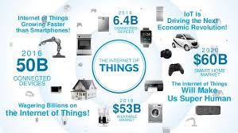
Growth of the IoT
Sensor sales are growing 70% annually since 2010
Machine-to-Machine communications estimated to generate $900 billion in revenues by 2020
IoT market in Canada estimated to be worth $18 billion in 2018
Huge startup presence in the IoT industry

Slide 20
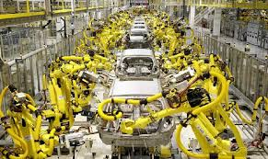
Benefits of the IoT
“IoT could facilitate the next production revolution” – 2016 OECD report
Data collection allows for more flexible and responsive business models
companies have a better idea of what customers want and how to help them
more efficient production lines and roboticization = goods are cheaper for consumers

Slide 21
Iot problems
“The rise of a global internet of things network is ultimately creating a giant, internet-connected global robot which is so disparate and insecure that cyberattacks against it are going to cause major societal problems if it isn’t regulated.” Danny Palmer, “The Internet of Things? It’s really a giant robot and we don’t know how to fix it” ZD Net (June 8, 2017)

Slide 22
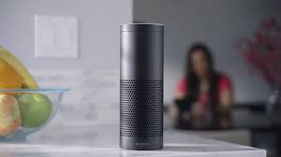
security and Privacy Risks with Iot
Heavy startup presence in the field creates security risks
devices are often crowdfunded or created by new companies who dedicate their limited resources to functionality over security
recent Hewlett Packard study found that 100% of the home security IoT devices they studied had significant security vulnerabilities
No governing body or industry standards for IoT security
devices are vulnerable to external threats (hackers, ransomware, etc.) and internal mishandling/errors by legitimate custodians of the data
even people who have no purchased an IoT device may be contributing data to it unknowingly
August Smart Locks
Amazon Echo

Slide 23
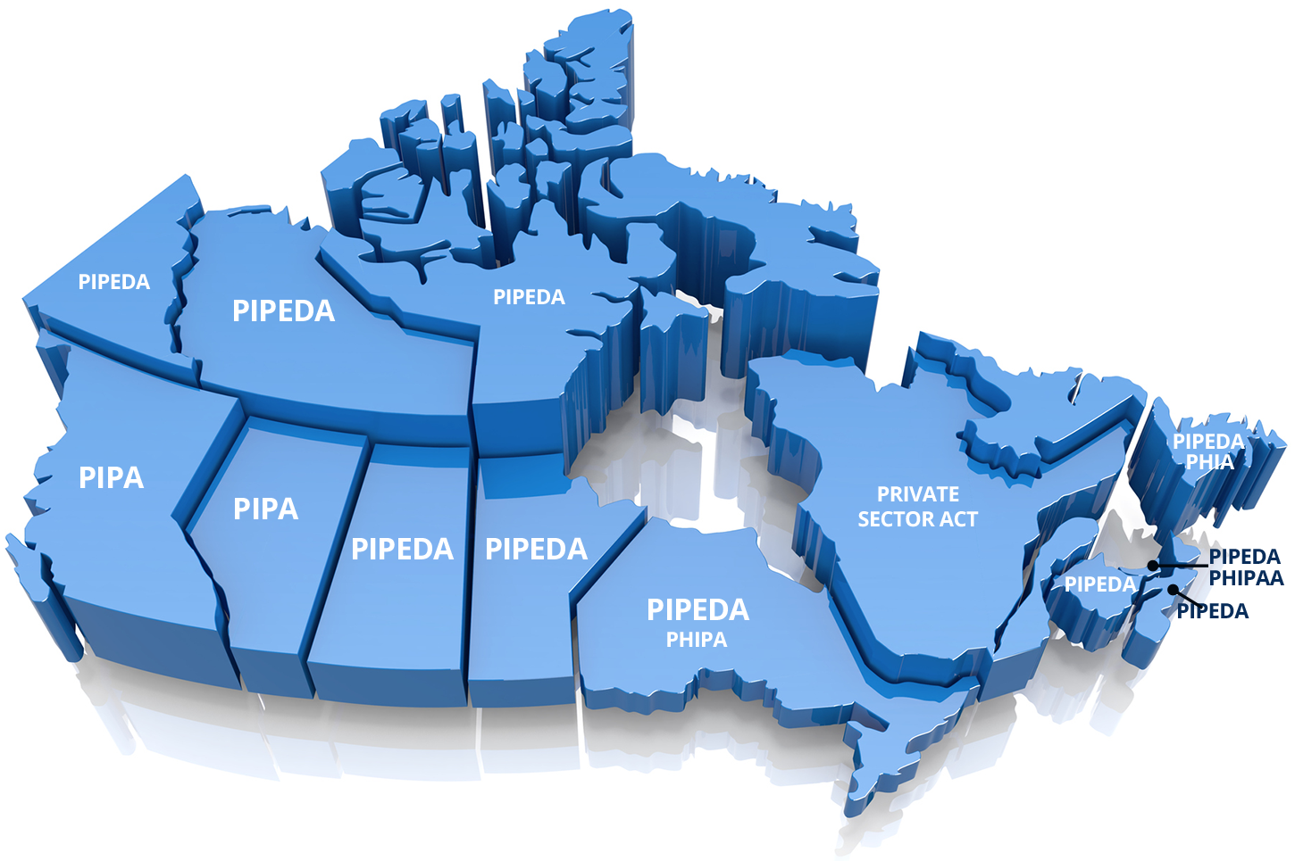
IoT and Canada’s Privacy Regime
Consent is considered to be the cornerstone of PIPEDA, but true consent is problematic in the IoT context
many devices have no user interface
problem for obtaining user consent
anti-spam legislation prevents software updates that users have not consented to, which leads to security vulnerabilities
One-time binary consent may not be sufficient in the ever-changing IoT environment

Slide 24
Iot and Canada’s Privacy Regime
PIPEDA predates smartphones and cloud technology
not well-suited for the IoT environment
“purpose” principle may be obsolete when the high value of data makes the collection of data a purpose unto itself
companies not required to specify which data will be used for which purpose
distinction between personal/non-personal and sensitive/non-sensitive data has lost its relevance
even seemingly innocuous data can be combined to make someone identifiable
’always on’ IoT products make it difficult to treat different data with different standards

Slide 25
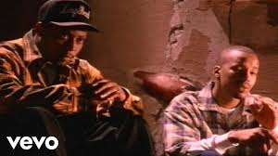
Regulation?
“There is no consensus as to whether privacy concerns will be adequately addressed through a market-based self-regulatory approach, or whether governmental regulation is needed" Samuel Trosow, “The Internet of Things: Implications for Consumer Privacy under Canadian Law”

Slide 26
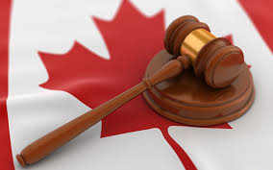
Changes needed to Canada’s Data Protection Laws?
Do we need to change PIPEDA? Start from scratch with new legislation?
February 28 report by Standing Committee on Access to Information, Privacy and Ethics: PIPEDA needs to be updated
Give the OPC the right to impose fines, and more flexibility with investigations
consumer data gathered by the IoT be presumed to be “personally identifiable” and “sensitive”

Slide 27
Changes needed to Canada’s Data Protection Laws?
Privacy policies should follow a standardized format so they are easy to read and understand for consumers
more specific, clear delineations of the permissible scope and purposes for data collection and use
consumers should be able to decline sharing of data without losing device functionality
more clarity regarding the obligations and standards of care for controllers or processors of data
consumers should not be asked to waive the protections of Canadian privacy laws, or submit to foreign jurisdictions

Slide 28
EU General Data Protection Regulation
Comes into force May 25, 2018 in the EU, replacing the 1995 Data Protection Directive
Unlike a Directive, it is directly binding and applicable for member countries regardless without national-level enabling legislation

Slide 29
Highlights of EU’s GDPR
Applies to data where a controller of processor of that data is based in the EU, or where an organization outside the EU is controlling or processing the data of EU residents
Data controller is responsible and liable for implementing effective measures and demonstrating compliance of processing activities even if the processing is carried out by a data processor on behalf of the controller.
Data Protection Impact Assessments (Article 35) have to be conducted when specific risks occur to the rights and freedoms of data subjects. Risk assessment and mitigation is required and prior approval of the national data protection authorities (DPAs) is required for high risks.
Data protection officers (Articles 37–39) are required to ensure compliance within organisations.

Slide 30
Highlights of EU’s GDPR
Data may not be processed unless there is at least one lawful basis to do so
If consent is the lawful basis stated, the consent must be explicit for the specific data used and the specific purpose it was used for
Unlike the PIPEDA consent model!
Right to be forgotten replaced with a more limited “right to erasure”

Slide 31
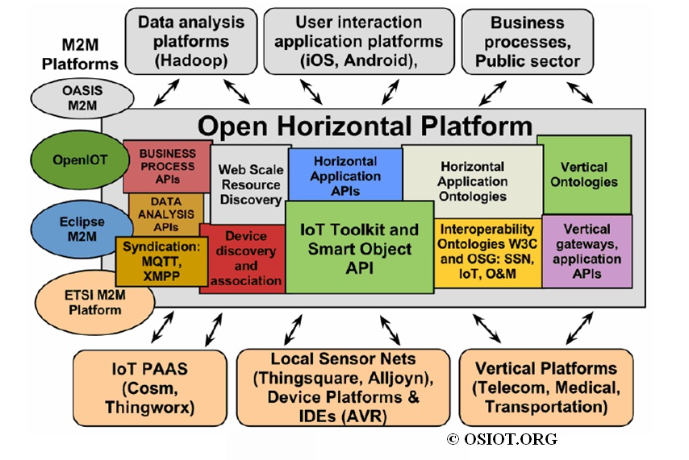
The Open Source Model
OSIOT “building a Rosetta Stone for the IoT”
Creating a horizontal interoperability platform called the Open Horizontal Platform to allow objects and systems within the IoT to communicate and share with each other across sectors
Example: sensors on jet engines on aircraft could be used to create a vast real-time weather data network

Slide 32
The Open Source Model
OSIOT model based on policy and ownership for different levels of control over the data
For example, if water quality sensors were part of the open source IoT, it could be set up so that control over the sensors was restricted to a certain authenticated group, but the public at large could still have access to the data the sensor is producing
Monica Lam on maintaining privacy in the IoT
Notes:
https://www.youtube.com/watch?v=EgLh25ZyMR

