Slide 1
Net Neutrality: a guide
By Ray Nayil

Slide 2
I’ve heard the term, but what does it mean?
Net neutrality is the idea that internet service providers (ISPs) treat all content equally, without prioritising certain websites and placing them in a fast lane, whilst other websites lag behind in terms of user connectivity and access: essentially discriminating or blocking websites not in the ISPs’ interest.
For example, if an ISP has an agreement with a streaming site such as ‘Hulu’, they may deliberately slow the access of users to ‘Netflix’ to affect consumer opinions on the rival streaming service to encourage greater custom for ‘Hulu’.

Slide 4
Territories with strong net neutrality

Slide 5
Territories with weak Net Neutrality

Slide 6
Arguments used for net neutrality
Allows for greater competition due to an “equal playing field”
Crucial for online social movements
Greater opportunities for innovation
Prevents a greater consolidation of corporate power
Corporate censoring of the internet
Zero rating systems imbalance the free market

Slide 7
Arguments used against net neutrality
Less regulation will lead to more investment
Different pricing models will encourage competition
It is not definite that the ISP will block, throttle or offer ‘pay for play’ arrangements with companies- merely that they have the legal standing to do so
The rules work without Title II

Slide 8
Thoughts?

Slide 9
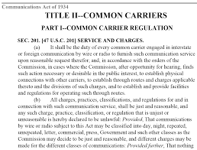
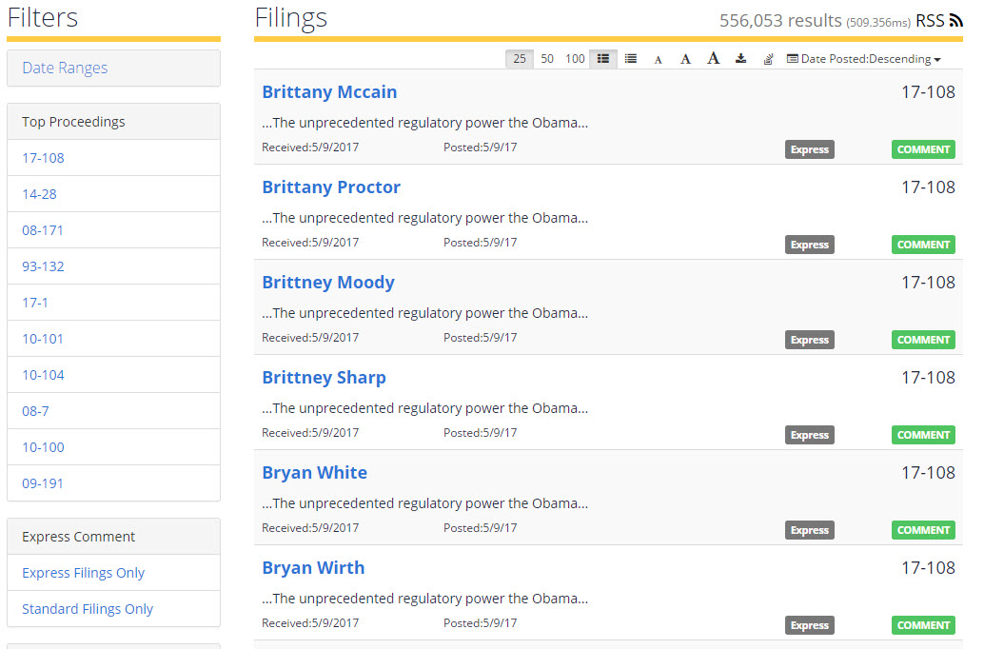
Recent changes in the USA
The FCC comment scandal
Ajit Pai
Title II

Slide 10
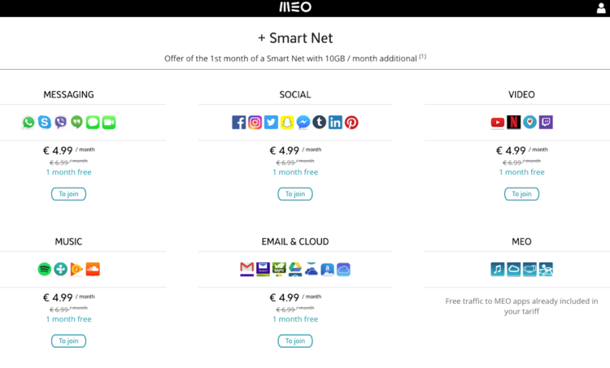
The current state of mobile internet access in Portugal; soon, the US?

Slide 11
Previous abuses
Madison River 2005: Blocking a VOIP service Vonage.
Telus 2005: Began blocked access to a server that hosted a website which was organising a labour strike against the company. It was found this action also blocked an addition 766 unrelated sites.
AT&T, SPRINT and VERIZON 2011-2013: Blocked Google Wallet to promote their own similar software called ‘ISIS’. Really.
AT&T 2012: Announced they would block the FaceTime iPhone App unless customers purchased a more expensive package.
Verizon 2012: Blocking customers from using free tethering applications in order to have them pay the companies $20 for their own service.
Verizon and Comcast: Netflix begins paying these ISPs to “improve streaming services for consumers” after having their service artificially slowed by the ISP.

Slide 12
Net Neutrality in Canada
Not directly legislated for, but strong bipartisan support for the notion.
The CRTC has been a positive force in maintaining net neutrality practices. Notably, monitoring ISPs internet traffic management practices, decision against zero rating and preferential pricing strategies (2015) and the introduction of a new framework to examine whether differential pricing strategies employed by ISPs are in line with Subsection 27(2) of the Communications Act.
“No Canadian carrier shall, in relation to the provision of a telecommunications service or the charging of a rate for it, unjustly discriminate or give an undue or unreasonable preference toward any person, including itself, or subject any person to an undue or unreasonable disadvantage.”
“A free and open Internet gives everyone a fair chance to innovate and for a vast array of content to be discovered by consumers. A free and open Internet also allows citizens to be informed and engage on issues of public concern without undue or inappropriate interference by those who operate those networks. Rather than offering its subscribers selected content at different data usage prices, Internet service providers should be offering more data at lower prices. That way, subscribers can choose for themselves what content they want to consume.”
- Jean-Pierre Blais, Chairman and CEO, CRTC

