Slide 1
The Rise, Fall and Future of Newspapers and Print Media
By: Julian Caldwell

Slide 2
Does Anyone here Subscribe to a Traditional Newspaper?

Slide 3
Does Anyone Subscribe to a Magazine?

Slide 4
Does anyone pay for an online subscription to a traditional News Outlet?
Ex: Globe and Mail unlimited, National Post, New York Times

Slide 5
Why do you not pay for News?

Slide 6
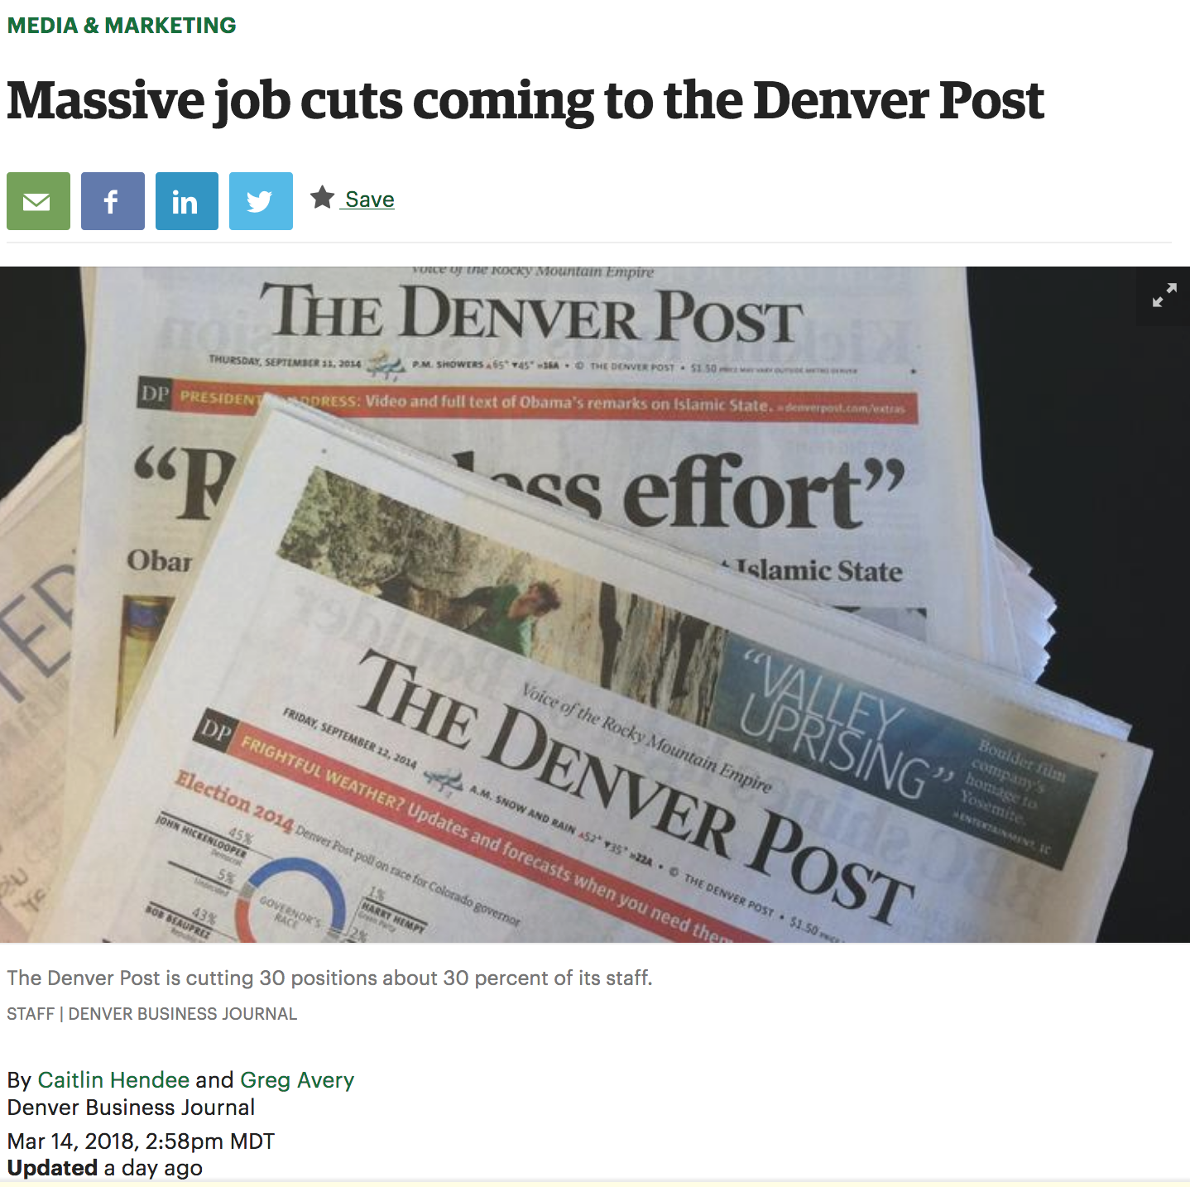

Slide 8
The Cratering Newspaper Industry

Slide 9
Agenda
History of the Newspaper
The Modern Newspaper
Challenges
Possible Solutions to the “Crisis”

Slide 10
The History of The Newspaper
Earliest news was spread by word of mouth at crossroads, markets, and campfires
Town Criers
16th Century – Venetian News Sheets
Oldest surviving printed newspapers published in German in 1609 – Strasbourg, Relations
First newspaper in England – September 24, 1621 – “Corante, or weekly newes from Italy, Germany, Hungary, Poland, Bohemia, France and the Low Country’s”
2 Styles
Dutch Corante
German Weeklies

Slide 11
Newspapers in north America
First colonial newspaper printed in 1690.
Boston News Letter, printed in 1704 was the first weekly newspaper
Newspapers played a large role in the American Revolution
The Penny Paper Revolution of 1833
The Birth of the Associate Press - 1848

Slide 12
Canada
Halifax Gazette – 1750
Before confederations, most newspapers were allied with political movements, cultural groups, and mercantile and agricultural interests.
The Globe (Precursor to the Globe and Mail) – founded in 1844 as an outlet for the Reform (Liberal) Party
The Toronto Mail (1872) was a mouth piece for the conservative party and Sir John A. Macdonald.

Slide 13
The 20th Century Newspaper
The Newspaper industry in the 20th century was big business. In 1911, there were 143 daily newspapers in Canada and in 1986 there were still 110.
Newspaper Revenue Breakdown
80% ad revenue from selling 50-60% of their space
20% from subscriptions/sales.
Some newspapers saw as much as 40% of ad revenue come from classified ads (late 1990s)
Radio and Television changed the way people received the news
Change from niche segment/market strategy to a mass-market segment strategy

Slide 14
“Freedom of the Press is for those who own one” – A.J. Liebling

Slide 15
Consolidation
In 1961, A.J. Liebling, a New Yorker magazine writer and former journalist said, “The United States was advancing towards a “mono-vocal, monopolistic, monocular press. With the decline in the number and variety of voices, there is a decline in the number and variety of reporting eyes.”
In 1994, 3 of the largest newspaper chains in Canada owned 58% of the papers.
Today, the 4 largest chains owned 68% with Postmedia Newtwork Inc owning 45%.
To achieve economies of scale, newspapers are consolidating.
More newspaper companies are being acquired by private equity firms, pension funds, and investment partnerships. Their goal is to maximize revenue and cut costs.
Do you see this as a problem? How many national news organizations is enough?

Slide 16
The Challenges Newspapers Face in the 21st Century

Slide 17
Declining Circulation
In 2016, total weekday circulation for U.S. Daily newspapers fell 8% in both print and digital. Marked the 28th year of declines.
Circulation revenue on the other hand has risen slightly, from $10.4 to $10.9 from 2015-2016.
With so many free options available, why would you pay for a daily newspaper?

Slide 18
Declining Ad Revenue
10% decline in advertising ad revenue in 2016.
Total ad revenue for the industry was $18 billion, a third of what it was 10 years ago.
This is the steepest decline since the 2008 recession, when it dropped 13.7%.
Despite digital push, newspapers find it difficult to make money on mobile products
TV, Radio, and outdoors have all managed to generally maintain their advertising shares.

Slide 19
Fake News
Newspapers have always been thought of as being the beacon of truth and professional journalism.
Trump’s effect on the confidence of the public in media and journalists
Donald Trump’s Definition of fake news vs. Academic Definition
With shift in how consumer’s consume the news, not enough time to fact check/refine stories.
In September 2017, 41% of people turned to their social media feeds for news

Slide 20
Layoffs
Modern newspaper owners are focused on profits, are not committed to local journalism.
Hedge funds and Private Equity firms have snapped up cheap newspapers in the past decade, and demand performance and returns more then previous, family owners did.
In November of 2017, Torstar Corp and Postmedia Network Inc swapped newspaper resources and closed 36 papers, eliminating 291 jobs.
In the last 5 years, over 6,000 jobs lost in Canada.
Many newspapers cutting daily print editions across the country.

Slide 21
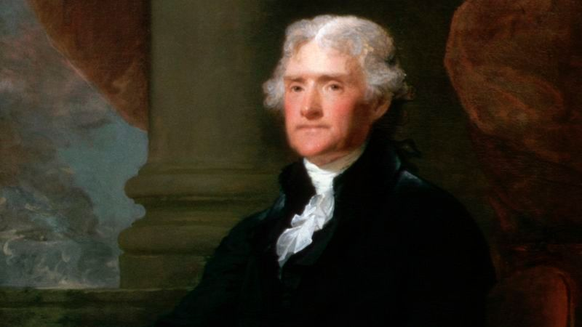
Layoffs & the Decline of Democracy
The people are the only censors of their governors: and even their errors will tend to keep these to the true principles of their institution. To punish these errors too severely would be to suppress the only safeguard of the public liberty. The way to prevent these irregular interpositions of the people is to give them full information of their affairs through the channel of the public papers, and to contrive that those papers should penetrate the whole mass of the people. The basis of our governments being the opinion of the people, the very first object should be to keep that right; and were it left to me to decide whether we should have a government without newspapers or newspapers without a government, I should not hesitate a moment to prefer the latter.” – Thomas Jefferson

Slide 22
Is an Unhealthy Press contrary to the Freedom of Expression?
The First Amendment guarantees freedoms concerning religion, expression, assembly, and the right to petition. It gives freedom of expression by prohibiting Congress from restricting the press or the rights of individuals to speak freely.
Section 2(b) of the Charter states: “everyone has the following fundamental freedoms: freedom of thought, belief, opinion, expression, including freedom of the press and other media of communication.”
A healthy press is able to allow for a free expression of opinion and news.

Slide 23
Is the decline of newspapers a Threat?
As journalism dies, the type of credible information that people need to be well-informed citizens dies as well.
In Jan, 2017, the Public Policy Forum released a report commissioned by the Liberal Government on the Newspaper industry.
Proposed changes to the CBC, tax law and the Canadian Press in order to increase services and the press in city halls, legislatures, and courts across the country.
Newspapers Canada said that recommendations won’t do much to help build out sustainable new business models.

Slide 24
24 Hour News Cycle
Newspapers are only printed in the morning, but now, news is accessed and broken at all hours.
Journalists bemuse about the “good old days, when news wasn’t just thrown at you in a barely-edited mess, but journalists spent time and effort and had 24 hours to reach conclusions on a story and its significance.”
Digital/social media have largely changed this disadvantage for newspapers, but does this mean that a daily newspaper is useless?

Slide 25
Solutions

Slide 26
All-Digital Strategy
Large change in consumer habits in terms of consumption and how they read the news.
Some publications, like La Presse in Montreal, have gone to an all - digital platform and do offer a print edition anymore (except for Saturdays).
Website, E-News formatted for tablets and smart phones.
Toronto Star Touch - failure

Slide 27
Changes to the Content
Bite-Sized News
Infographics
Video
Change in philosophy from a “news first organization to a digital-first in philosophy and practice” – The Guardian
Change in what is covered, what will effect the greatest audience more then everything that is going on
From Niche-market segment strategy to mass-market, mass appeal segment strategy
Increase in commentary, opinion pieces

Slide 28
Social Media
Social Media has been an important part of every journalist’s jobs, and goes beyond posting links to articles they have written.
Newspapers can use social media to reach a broader audience
Allows engagement with readers (in good and bad ways)
Clickbait – Newspapers have to try and gain traction to their website away from the social media platform.

Slide 29
Paywalls
The New York Times, Washington Post, Financial Times, Wall Street Journal, Globe and Mail, New Yorker, National Post and many more publications currently have a paywall.
Supporting rigorous journalism requires a direct relationship between the publications and the readers.
It is becoming increasingly difficult to capture the whole value of an internet audience using advertising alone
Toronto Star and the Sun have both dropped paywalls in recent years.
Difficulties include putting a barrier between the newspaper and the casual reader and pretty much going against the whole history and idea of internet access.

Slide 30
Government Intervention
In January 2018, the Heritage Minister Mélanie Joly promised increased funding and changes to the Canadian Periodical fund
Over 55% of Canadians support or somewhat support additional government funding to keep local news sources open
Criticism that this could effect journalistic independence

Slide 31
Private Sector Intervention

Slide 32
What Do you Think? Will the Newspaper Industry Survive?

Slide 33
Thank you
p.s. pay for good journalism!

