Slide 1


“Broadcasting Policy: Origins, Regulation, & Cases” Part B
Talk 7
LAW 424 001
Communications Law
Allard School of Law, UBC
Spring, 2018
Jon Festinger Q.C.
Centre for Digital Media
QMUL School of Law (CCLS)
Festinger Law & Strategy
http://commlaw.allard.ubc
@jonfestinger
jon_festinger@thecdm.ca

Slide 2
Logistics

Slide 3
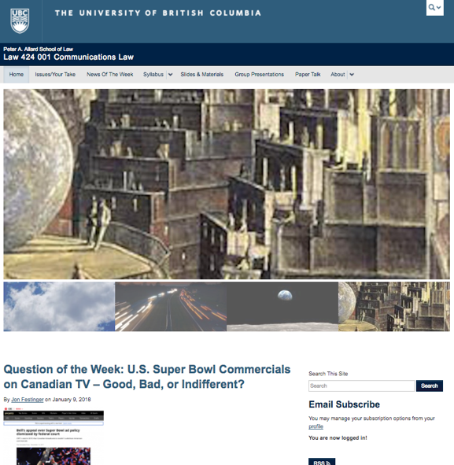
Course Website
http://commlaw.allard.ubc.ca

Slide 4
For full privileges on the website
1. Please create an account at http://cms.ubc.ca/ using your CWL.
2. Once you create an account and sign in at http://cms.ubc.ca/ you can click your name in the top right. Half way down the following page will be your WordPress email address.
3. Send me your WordPress email address at jfestinger@telus.net or at jon@fblawstrategy.com
4. Then, I will invite you to participate with authoring privileges via your WordPress email address.

Slide 5
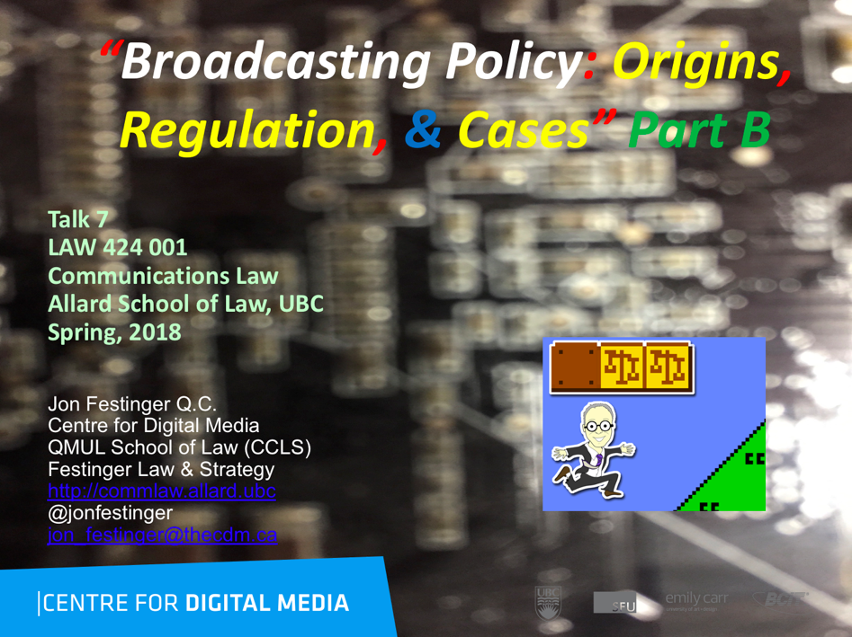
On the Website…

Slide 6

Group Presentations:
Any Adjustments?

Slide 7
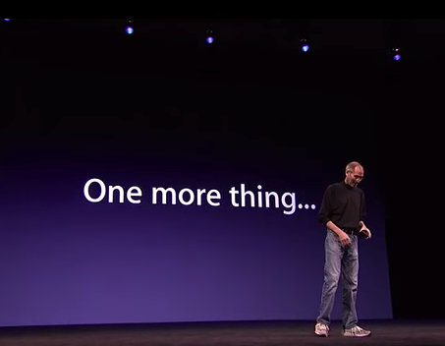

Slide 8
Questions on..
Papers ?
Participation ?
Class Presentations ?

Slide 9
Evaluation
60% Term Paper.
40% participation including 25% attributed to group presentation.
Term paper topics need not be discussed with me but often helpful to you if you do.
Term paper can be on your presentation topic.
Participation includes 1. Attendance; 2. In-class, web or other contributions; and 3. participation/contribution to group presentation.
Group presentation can be on any topic and need not be on that week’s topic (15 minute per student multiplier suggested).
You can bring in guests.

Slide 10
Marking generally
Class averages is the UBC Law way – know the ramifications
Useful to ask re paper topics (but not mandatory)
Will help you sort through topics
Will read and review all or part of a paper, including indexes, outlines, abstracts etc.
Inclusive definition of “participation”

Slide 11
Papers: My marking criteria
Topic originality/angle
Set out your purpose, vision and goal for the paper
Organize into named sections & sub-sections
Am a sucker for clever creative arguments, but only if they are fully supported
Citations/research is looked at seriously (for substance more than form)
Don’t simply describe a problem and apply the “fairness doctrine”
This is graduate school – move things forward towards resolution, if only a bit

Slide 12
I don’t care about fonts (but no Comic Sans please).
Avoid single spacing. My eyes appreciate 1&1/2 or double spacing.

Slide 13
Grades!
Paper → Quality
Participation → Effort

Slide 14
Paper Confessional
(or what I learned on my winter holidays)
Legal/normative reasoning/argument including footnote/bibliography support & Contribution/Move forward → 60%
Presentation including layout, headings, grammar, language/writing skills, “tightness” → 25%
Topic/Originality/Degree of Difficultly → 15%
THIS IS NOT A RUBRIC. IT IS A SELF ASSESSMENT.

Slide 15
QUESTIONS?
THOUGHTS?
DISCUSSION?

Slide 16

Pause

Slide 17
News of
the Week

Slide 18
Yours?

Slide 19

Last year this time…

Slide 20
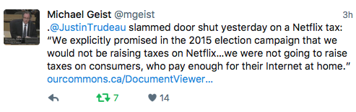
Back to the present (future)

Slide 21


Slide 22
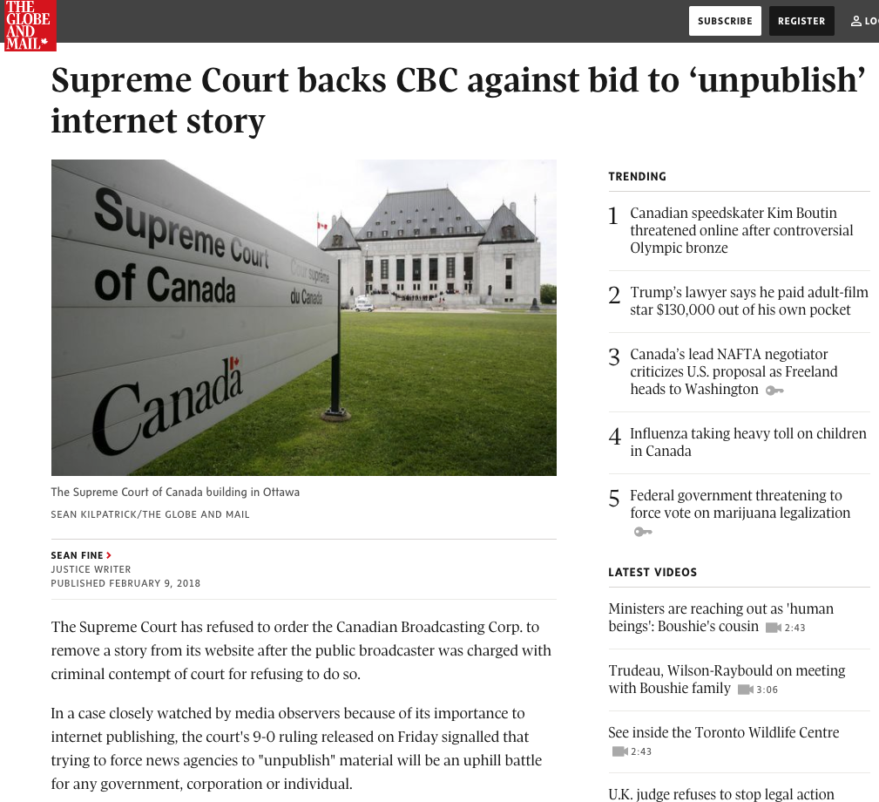

Slide 23


Slide 24
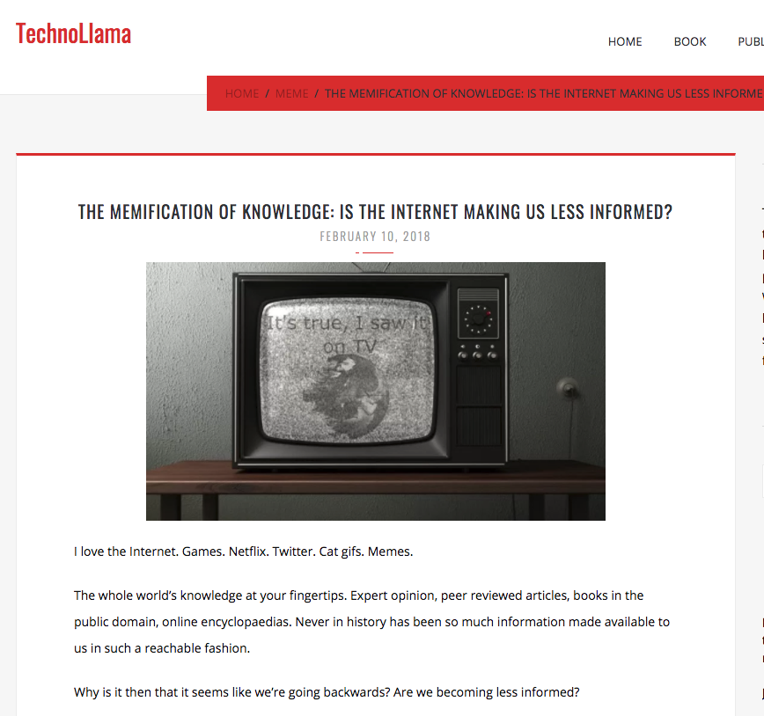

Slide 25
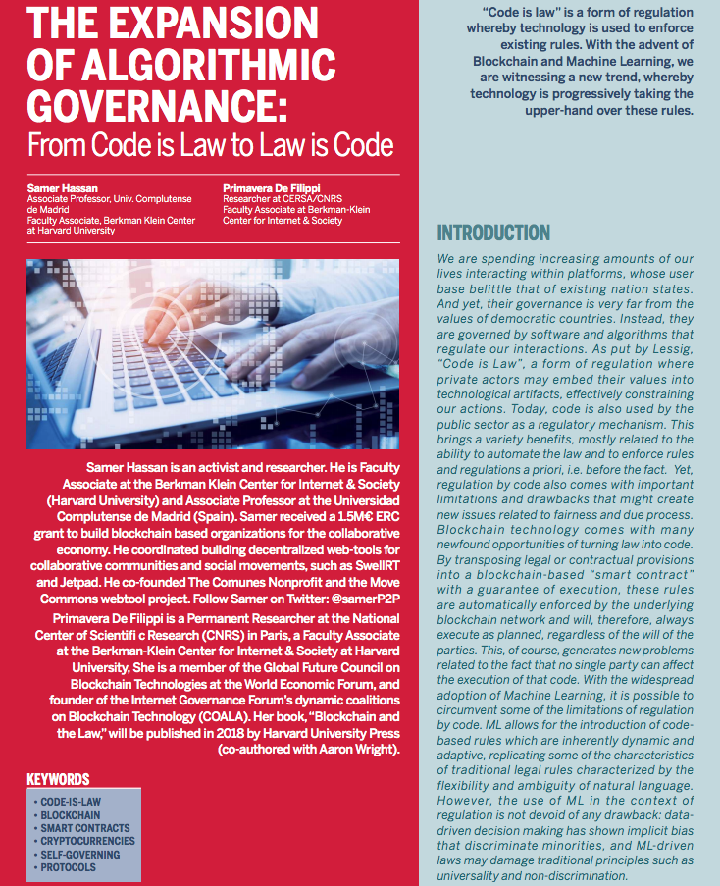

Slide 26
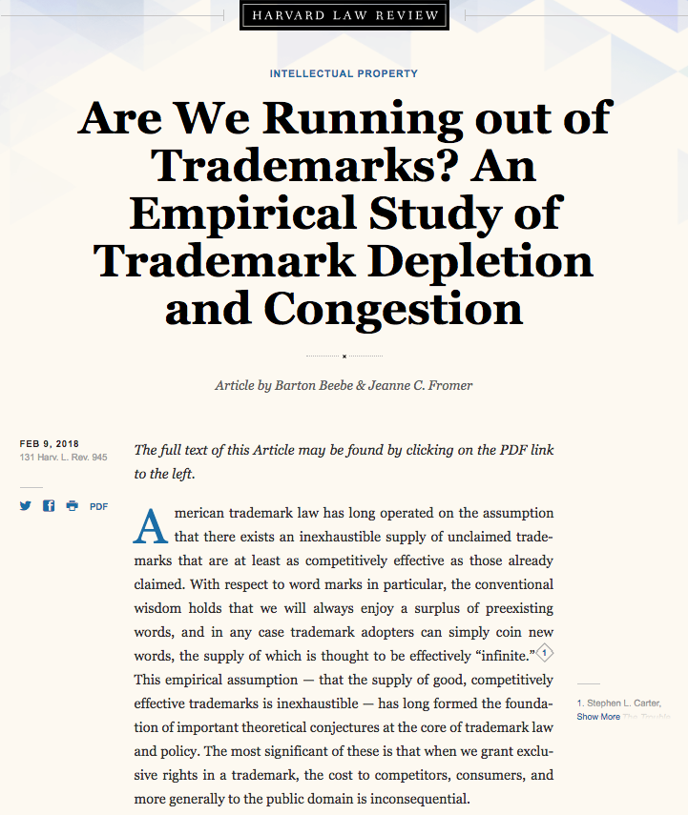

Slide 27


Slide 28
QUESTIONS?
THOUGHTS?
DISCUSSION?

Slide 29
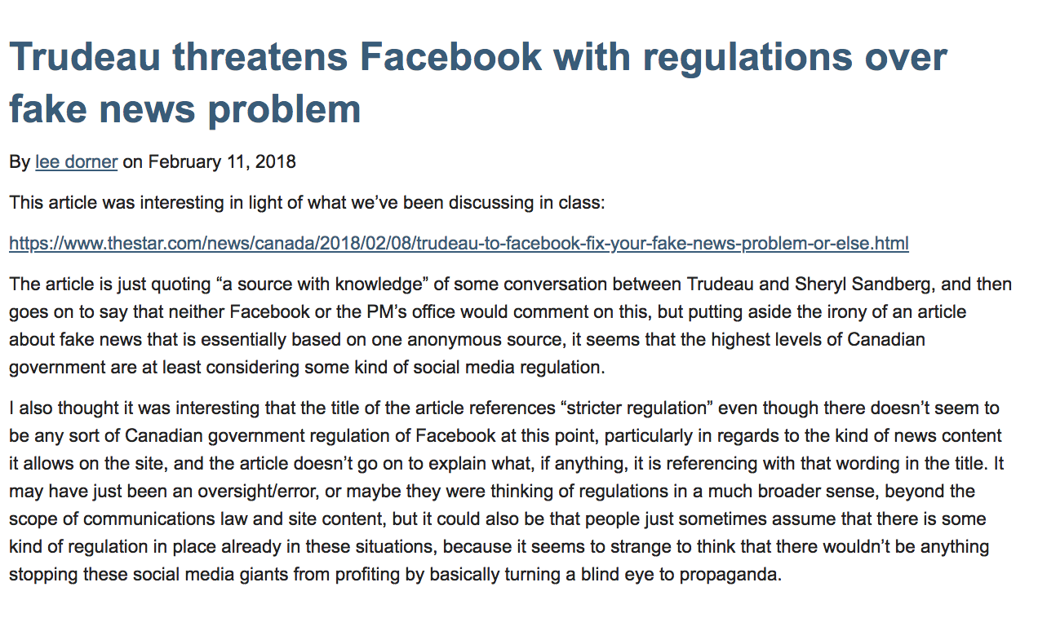
From the website…

Slide 30


Slide 31
QUESTIONS?
THOUGHTS?
DISCUSSION?

Slide 32
Pause

Slide 33
QUESTION
OF THE
WEEK

Slide 34


Slide 35
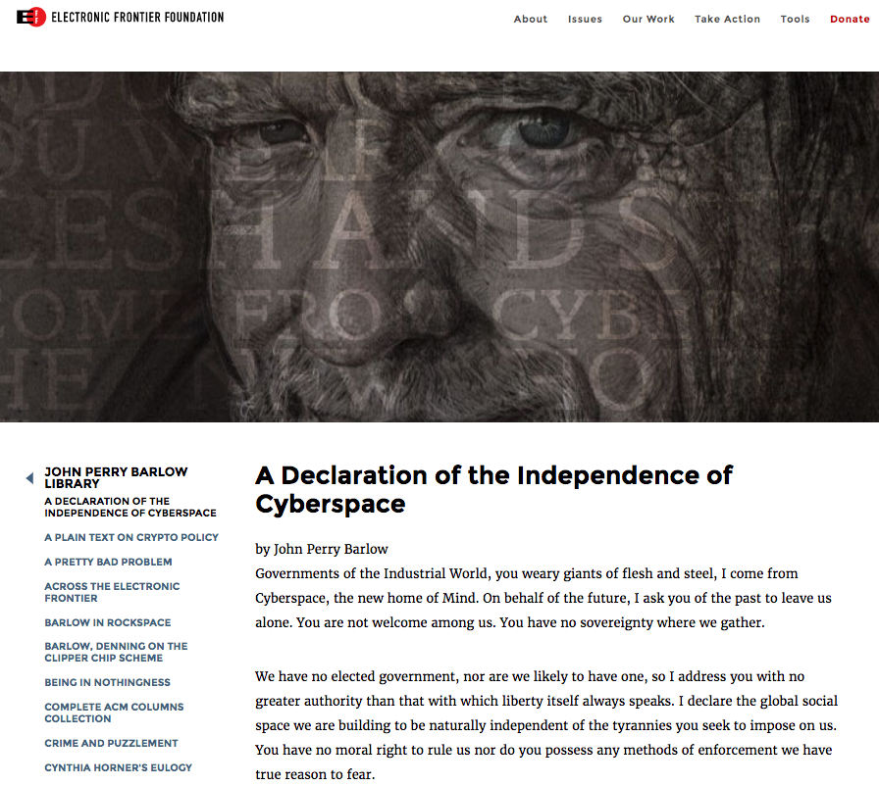

Slide 36
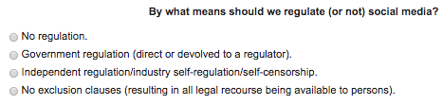

Slide 37
QUESTIONS?
THOUGHTS?
DISCUSSION?

Slide 38

Today’s Presentation

Slide 39
Pause

Slide 40

Now Back to Our Regularly
Scheduled Programming…

Slide 41
“Broadcasting Policy:
Origins, Regulation & Cases”

Slide 42

RECAPPING

Slide 43
Core Binaries
Cultural
Content
Regulation
Privacy
Industrial
Carriage
Free Market
Surveillance

Slide 44

In Broadcasting the issue seems to be
CULTURE (OWNERSHIP)

Slide 45

Starting Point: A Theory

Slide 46
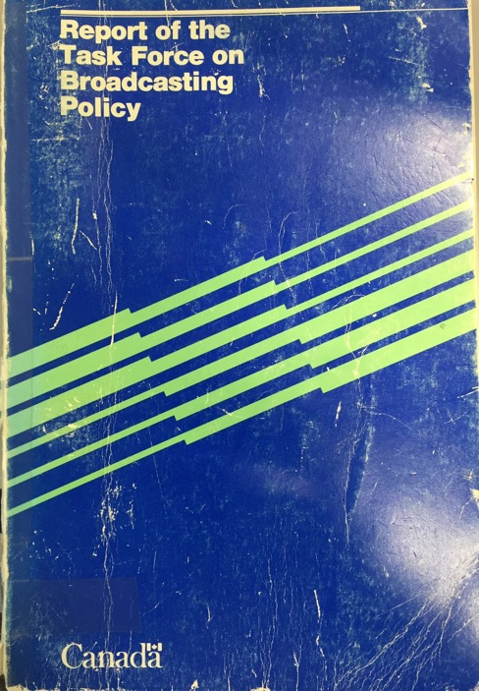
Q: Where did we lose our way?
Caplan/Sauvageau Report, 1986

Slide 47
A: Precisely here?...
“But whatever kind of Buck Rogers Future is in store for us, surely the Canadian tradition demands that we must continue to entrench the Canadian presence in our broadcasting system, and we must adopt policies to do so in a new world in which substantially greater choice may be available to Canadian viewers. More than ever, broadcasting must be seen as a fundamental part of cultural policy. It must be program-driven, not hardware-driven as in its first decades.”

Slide 48
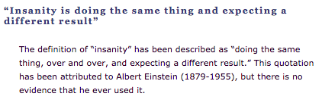
Entrench because tradition demands it
Broadcasting must be seen as cultural policy

Slide 49
So add to the equation
Uncertainty
+
Bureaucracy

Slide 50
=

Slide 51
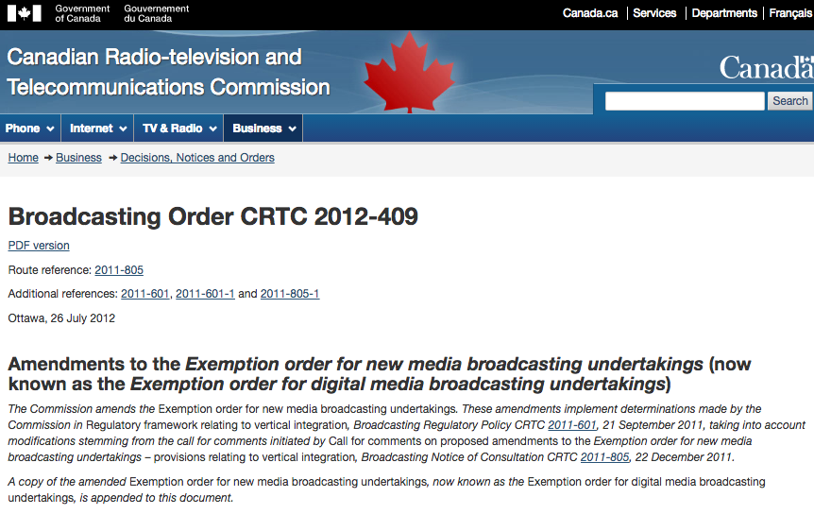

Slide 52
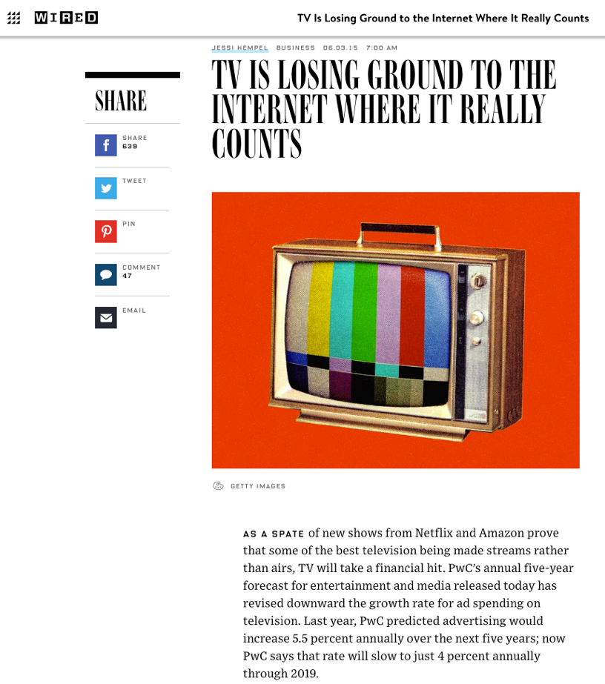

Slide 53
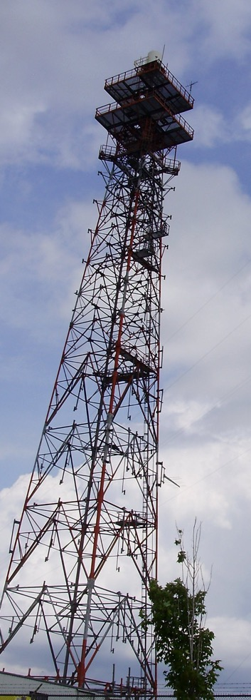
Today…
“Broadcasting Policy: Origins, Regulation & Cases” Part B

Slide 54
Starting Point #2: History
Most slides in this section are only slightly adapted from those prepared by
Hank Intven of McCarthy’s for his Communications Law materials.

Slide 55
Early Radio
1913 Radiotelegraph Act
Federal government Minister authorized licensed radio broadcasters. There was small license fee for each radio receiver [remnant in Radiocommunication Act - p. 65 “Black Book” - 4 (1) No person shall, except under and in accordance with a radio authorization, install, operate or possess radio apparatus, other than: (a) radio apparatus exempted by or under regulations made under paragraph 6(1)(m); or (b) radio apparatus that is capable only of the reception of broadcasting and that is not a distribution undertaking.]
1928 - 68 radio stations; 400,000 battery-operated radios
Mostly private stations
CNR radio department formed 1st national broadcasting network

Slide 56
1928-9: Aird Royal Commission
First major policy review of Canadian broadcasting. Key issues:
1. Lack of Canadian programming: “the majority of programs heard are from sources outside of Canada…[this] has a tendency to mold the minds of young people in the home to ideas and opinions that are not Canadian”
2. Universal service issues: Uneven availability of Canadian services and programming in different parts of the country.

Slide 57
Aird: Key Recommendations
The federal government should create a national broadcaster to promote Canadian unity and development – and to inform the public on questions of Canadian national interest
“…broadcasting will undoubtedly become a great force in fostering a national spirit and interpreting national citizenship…”

Slide 58
1932 Radio Reference intervenes
During the Aird Commission’s work, Québec passed legislation authorizing provincial licensing and regulation of radio broadcasting.
In Re Regulation and Control of Radio Communication, [1932] A.C. 304 Privy Council ruled jurisdiction over broadcasting was federal only.
Case did not address the “content question” directly. Question referred to the court was: “Has the Parliament of Canada jurisdiction to regulate and control radio communication, including the transmission and reception of signs, signals, pictures and sounds of all kinds by means of Hertzian waves, and including the right to determine the character, use, and location of the apparatus employed?”

Slide 59
Found the basis of federal jurisdiction in S. 92(10)(a) BNA Act: “Lines of Steam or other Ships, Railways, Roads, Telegraphs, and other Works and Undertakings connecting the Province with any other or others of the Provinces, or extending beyond the Limits of the Province.”
Viscount Dunedin: “Broadcasting as a system cannot exist without both a transmitter and a receiver. The receiver is indeed useless without a transmitter and can be reduced to a nonentity if the transmitter closes. The system cannot be divided into two parts, each independent of the other. "Undertaking" is not a physical thing but is an arrangement under which of course physical things are used.”

Slide 60
Canadian Radio Broadcasting Commission
After the Radio Reference, the Conservative R.B. Bennett government established the CRBC to:
Regulate, control and carry on broadcasting activities in Canada, in the national interest.
Take over operations of the CNR national radio network.
Regulate private broadcasters, and over time, assume control over all aspects of Canadian broadcasting.
The latter objective was frustrated by the great depression of the 1930s, which prevented the government from buying out private radio operators and entrenching Canada’s mixed public private system (unlike UK and European systems of the time).
CRBC’s joint operator/regulator role transferred to CBC in 1936 – funded by increased licence fees

Slide 61
Fowler Commission & Committee
(1957 & 1965)
Canadian television started in Montréal & Toronto in 1952
  Initially 1 private station licensed per market to carry the CBC’s national programming
  Public demand for more choice and content
Fowler recommended separation of public broadcaster/regulator roles
  inherent conflict of interest for CBC
  1958 Broadcasting Act created the Board of Broadcast Governors (BBG) as regulator

Slide 62
1968 Broadcasting Act
1. New Act followed
1964 Fowler Committee Report
1966 White Paper on Broadcasting
2. Distanced government and the regulator from administration, finance and broadcast programming decisions of CBC
3. Established & mandated CRTC to implement a new “broadcasting policy” for Canada:
to safeguard, enrich and strengthen Canadian sovereignty
to ensure Canadian ownership and control of system
to promote high quality programming with substantial Canadian content
to limit concentration of private station ownership
to bring cable TV under CRTC jurisdiction

Slide 63
CRTC Initiatives to Implement 1968 Act
1. Pierre Juneau appointed first chair
2. Order in Council 1968-1809 required all broadcasting undertakings (including cable TV) to be 80% Canadian-owned
3. Established and enforced Canadian programming content quotas for CBC and private broadcasters
Radio (leading to naming of “Juno” awards)
TV (leading to everlasting frustration of Canadian viewers)

Slide 64
1991 Broadcasting Act
Current legislation – still in force
Four parts
I –Definitions & New Broadcasting Policy
II –Objects & Powers of CRTC re Broadcasting
III –Powers & Functions of CBC
IV –Related & Consequential Amendments

Slide 65
QUESTIONS?
THOUGHTS?
DISCUSSION?

Slide 66
Pause

Slide 67
Starting Point #3: Carriage Cases

Slide 68

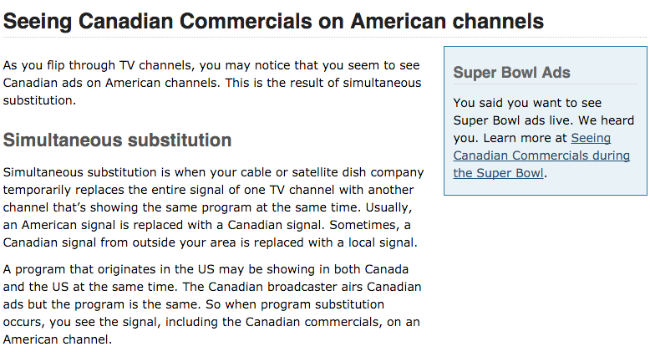
Simultaneous Substitution

Slide 69

Which brings us to…
Capital Cities Communications Inc. v. CRTC. [1978] 2 S.C.R. 141

Slide 70
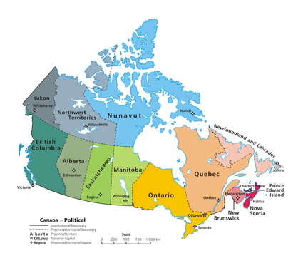
Held…
Cable television is part of a “single system” coming under Federal jurisdiction

Slide 71
Laskin, C.J.
“Rogers' licence, which is formally a licence to carry on a "broadcasting receiving undertaking", as defined in the Broadcasting Act, 1967-68 (Can.),…authorized it to serve certain areas of Metropolitan Toronto with an off-air broadcasting receiving antenna at a specified location. The licence specified eleven television broadcasting stations whose signals or programmes could be received by Rogers and distributed or retransmitted by it on the same or different channels,… Among the eleven television broadcasting stations included in the licence were three Buffalo stations, operated respectively by the three appellant com­panies and whose signals or programmes were carried over channels 2, 4 and 7.”

Slide 72
“The appellants were not and were not required to be licensed by the respondent CRTC. Their programmes reached Canadian viewers in areas adjacent to Buffalo, including Toronto, and were freely available to those whose television sets could directly receive those programmes. They could however receive them, and other programmes too which their sets could not attract, by becoming subscribers of Rogers through the latter's cable operation. I will consider the nature of that operation later on in these reasons. What precipitated the matters now before this Court was Rogers' decision, made and carried out some time prior to October, 1973, to delete commercial messages from the programmes received from the appellants' stations and to transmit those programmes to its subscribers without those messages but with substituted announcements of its own.”

Slide 73

“In dealing with the constitutional authority of Parliament to regulate cable distribution systems which receive and distribute television signals, I leave to one side, so far as the present case is concerned, the determination of regulatory authority over programmes carried by such systems which are of their own origination and which are transmitted to their subscribers in the Province of such origination, and hence not received by other owners of television sets in the Province.”

Slide 74
“The fallacy in the contention on behalf of the Attorney-General of' Ontario and of the Attorneys-General of Quebec and of British Columbia, and, indeed, of the appellants, is in their reliance on the technology of transmission as a ground for shifting constitutional competence when the entire undertaking relates to and is dependent on extra-provincial signals which the cable system receives and sends on to subscribers. It does not advance their contentions to urge that a cable distribution system is not engaged in broadcasting. The system depends upon a telecast for its operation, and is no more than a conduit for signals from the telecast, interposing itself through a different technology to bring the telecast to paying subscribers.”

Slide 75
“I am therefore in no doubt that federal legislative authority extends to the regulation of the reception of television signals emanating from a source outside of Canada and to the regulation of the transmission of such signals within Canada. Those signals carry the programmes which are ultimately viewed on home television sets; and it would be incongruous, indeed, to admit federal legislative jurisdiction to the extent conceded but to deny the continuation of regulatory authority because the signals are intercepted and sent on to ultimate viewers through a different technology. Programme content regulation is inseparable from regulating the undertaking through which programmes are received and sent on as part of the total enterprise.”

Slide 76
Where was “copyright”?
“Some of the legal consequences of the transmission of TV programs by coaxial cable were considered, in respect of copyright legislation, in two cases that came at the same time, one before this Court, the other before the Supreme Court of the United States. The case in this Court was Composers, Authors and Publishers Association of Canada Ltd. v. CTV Television Network Ltd. The question was whether CTV was infringing composers' copyright by transmitting programs to stations holding licences to broadcast the copyrighted works. After finding that such transmission to the stations was not "a communication of the works" within the literal meaning of the statute, this Court held that, on the basis of the intention disclosed by the language of the treaty annexed to the statute, it did not constitute an infringement, the treaty provision being aimed only at radio communications to the public i.e., broadcasts.”

Slide 77
DISCUSSION:
Decided correctly?
Why or why not ?

Slide 78
QUESTIONS?
THOUGHTS?

Slide 79
Pause

Slide 80


Slide 81


A MATTER OF PERSPECTIVE

Slide 82
Coming Soon
“A History of Cultural Policy: Regulated, Unregulated & Self Regulated Industries”

Slide 83

Always include a cat picture

Slide 84
Our Academic Partners

