Slide 1
Net-Activism
By Claudio Storelli and Laura Courdi
February 28, 2018

Slide 2
Net-activisM
What is net-activism? How could digital communication tools be leveraged by net-activists?
What are some of the responses generated by the appearance of net-activism?
encouraging vs inhibiting interventions
Should laws that govern the Internet be shaped to secure fundamental righs? Should new rights be created to promote a liberal Internet experience?
Notes:
DiMaggio et al. (2001) argue that the
Video

Slide 3
What is Net-activism?
Lets start with a Video
Notes:
3 min
Start at .15

Slide 4
Net-activism Definition
The use of electronic communication technologies (such as social media, e-mail, and podcasts) for various forms of activities to achieve political or social change (“progress”) to enable faster and more effective communication, the delivery of particular information to large and specific audiences as well as coordination.
Rely on the Internet: Purely online forms or partially online e.g. offline but organized online or combination of off and on line.
Top-down or down-top
Political groups, corporations, independent activists bodies, individuals
Notes:
Definition
Over the last 15years, online activism has become increasingly prevalent for sharing information and organizing people to express resistance to dominant organizational elites.
3 main categories: Awareness/advocacy, organization/mobilization, and action/reaction
e.g.:
e-petitions
Hastag activism: « #IamJada » → anti-rape message (2014); #metoo → anti-rape culture (2017); « #Iamcharlie » → freedom of speech, freedom of press (2015)
Use in Political campaigns, catalyst for protestation, corporate activism, health and diet activism, religious, environmental, fundraising
Purely online forms or partially online
Some argue that the cyber effort need to be extended into real space to make a change.

Slide 5
Advantages
Diminish geographic boundaries
Feeling of groupness
Protect anonymity
Facilitate information dissemination, communication and, untimely, participation
Critics
Amalgamation of facts and beliefs… serve the cause and not the society.
Reduce likelihood of a real debate.
Fragmentation of discourse and community
Segmentation of representative voices
Observation / Question
Does the net-activism rethink the concepts of participation and democracy?
Hacktivism, Cyberterrorism, Cybersectarianism: forms of net-activism?
Notes:
Specifically, activism through the Internet can help organize people, initiate and mobilize crowds, and provide the possibility of organizing events with high levels of engagement, focus and network strength.
Diminish geographic boundaries, greater global audience, creation of networked → international support e.g. Iran 2009, as a result of shared videos, several protests emerged among Iranians in the US, Canada, Australia and Asia (interventions) showing solidarity with the protestors
Establish collective identity, solidarity and feelings of groupness; reduce attention to differences that exist within the group
Anonymity provides the possibility of expressing views that might otherwise be punished or sanctioned
Reduce likelihood of a real debate.
seek websites, forums or blogs with like-minded people who reinforce their views of the world.
Online media is therefore distinct from traditional media: if one ﬂips on the television news, one is forced to view whatever news stories the mass media chooses to run, thus exposing oneself to opposing points of view and thereby gaining a fuller perspective.
Multiple sources → unable to choose
Fragmentation of discourse and community
the Internet "allows people who agree with each other to talk to each other and gives them the impression of being part of a much larger network than is necessarily the case.“
discussions that lead to fragmentation and polarization rather than consensus
Segmentation of representative voices
“became the voice of a selected group of people who had access to better Internet connection and had a better usage of anti-filtering systems.”
Does the net-activism rethink the concepts of participation and democracy?
Lost of the sense of “activity/action”. With all this information so readily available, there is a rising trend of "slacktivism" or "clicktivism".
2017 research’s findings suggested that contrary to public opinions and early theorizing, the Internet enhance political interest and fosters civic and democratic values. Online activism fuels offline activism and vise versa. Making young people engages in one type of activity makes it more probable that they would engage in others; making engage in soft activities makes it more probable that they would engage in “hard activities”.
people begin to think that clicking "like" on something is enough of a contribution, or that posting information about a current hot topic on their Facebook page or Twitter feed means that they have made a difference.
Give more voices to people who have access and ability… sociodemocratic categorization.
A form of net-activism? Civil disobedience
Hactivism: acts of electronic disruption
cyberterrorism: acts of physical harm caused by the disruption of power grids, traffic control, and other systems of resource delivery and public safety)
Cybersectarianism is the phenomenon of new religious movements and other groups using the Internet for text distribution, recruitment, and information sharing. Cybersectarianism as an organizational form involves: "highly dispersed small groups of practitioners that may remain largely anonymous within the larger social context and operate in relative secrecy, while still linked remotely to a larger network of believers who share a set of practices and texts, and often a common devotion to a particular leader. Overseas supporters provide funding and support; domestic practitioners distribute tracts, participate in acts of resistance, and share information on the internal situation with outsiders. Collectively, members and practitioners of such sects construct viable virtual communities of faith, exchanging personal testimonies and engaging in collective study via email, on-line chat rooms and web-based message boards.

Slide 6
Internet Freedom
“Internet's impact on socio-political movements varies depending upon how economic factors, government regulation and users collectively shape the Internet as a socio-political technology.”
Notes:
Net activism embody the idea to achieve political or social change.
It is taking place or is help by Internet.
Internet is the environment where net activism lives.
The way Internet is shaped / regulated will invariably influence its power to impact socio-political movements

Slide 7
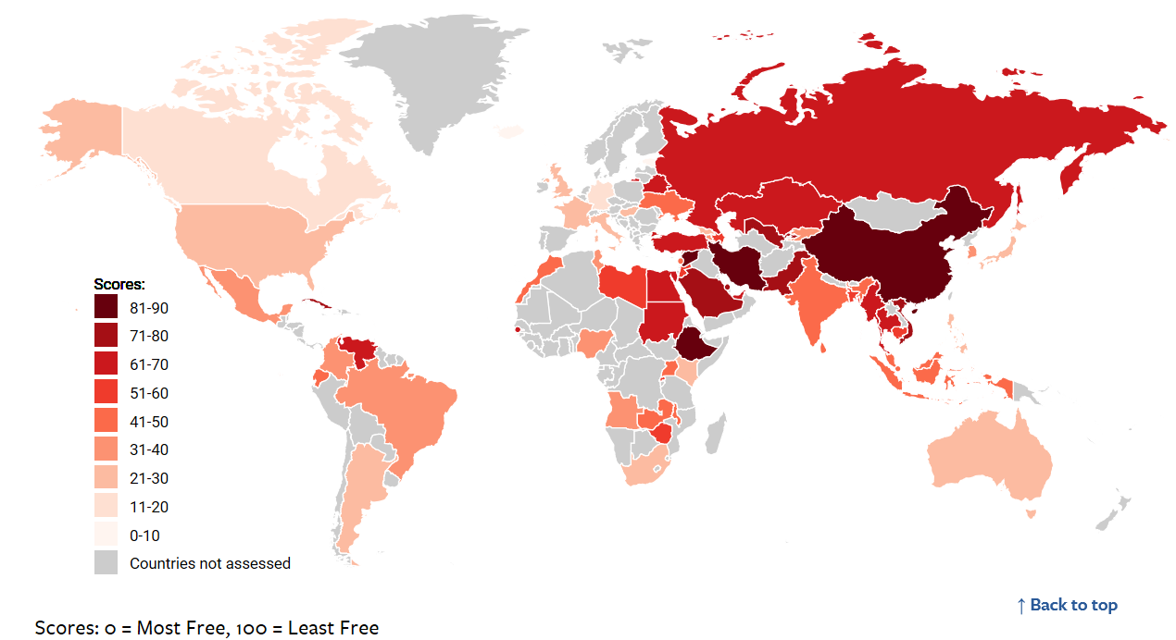
Internet Freedom
https://freedomhouse.org/report/freedom-net/freedom-net-2017
Free-Net 2017 Report from Freedom House
23% of internet users reside in “Free zone”, 36% in “Not Free’, 28 % “Partly Free”. 13% not assessed.
65 countries covered = 87% of users, 40% of users live in
China = Not free
India = Partly Free
United States = Free
3 pillars of freedom: access, content, users rights
Notes:
https://freedomhouse.org/report/freedom-net/freedom-net-2017
Free zone: meaning there are no major obstacles to access, onerous restrictions on content, or serious violations of user rights in the form of unchecked surveillance or unjust repercussions for legitimate speech.
Freedom House is an independent watchdog organization dedicated to the expansion of freedom and democracy around the world.
We analyze the challenges to freedom, advocate for greater political rights and civil liberties, and support frontline activists to defend human rights and promote democratic change. Founded in 1941, Freedom House was the first American organization to champion the advancement of freedom globally.
We recognize that freedom is possible only in democratic political environments where governments are accountable to their own people; the rule of law prevails; and freedoms of expression, association, and belief, as well as respect for the rights of minorities and women, are guaranteed. More than 2.5 billion people live in countries that Freedom House designates “Not Free,” more than a third of the globe’s population.

Slide 8
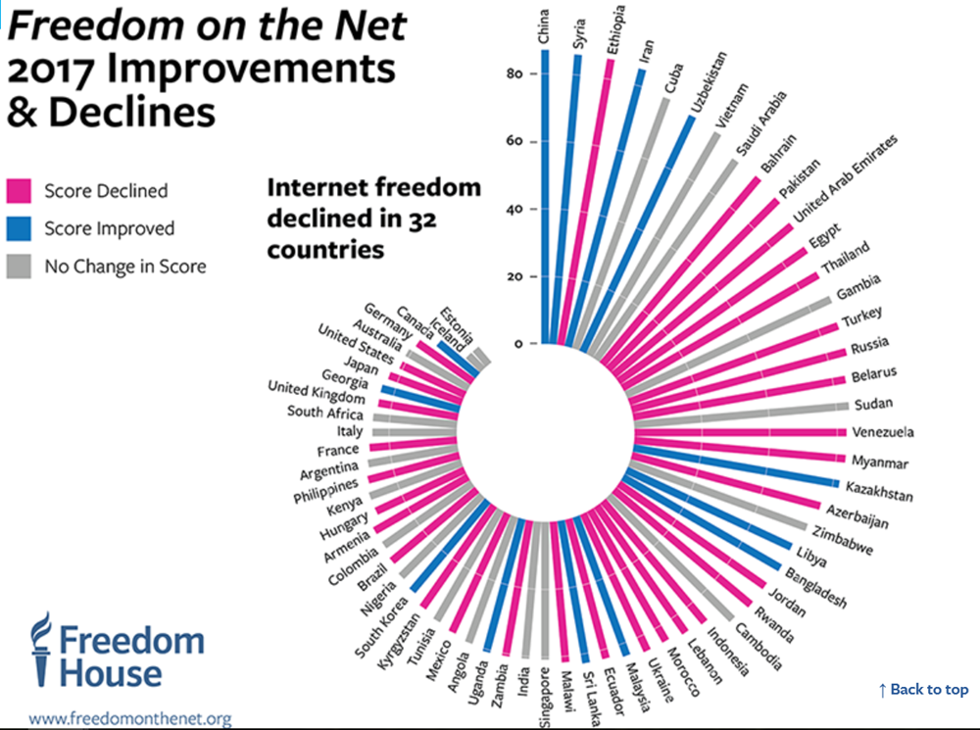
versus 13 countries have made gains
 | 2011 | 2017
Estonia | 10 | 6
Canada | N/A | 15
US | 13 | 21
Brazil | 29 | 33
India | 36 | 41
Russia | 52 | 66
Egypt | 54 | 68
Vietnam | 73 | 76
Syria | N/A | 86
China | 83 | 87
Notes:
https://freedomhouse.org/report/freedom-net/freedom-net-2017
32 countries have been on decline of freedom vs 13 have made gains
32 countries have been on decline of freedom vs 13 have made gains
Biggest declines: Ukraine, Egypt, Turkey

Slide 9
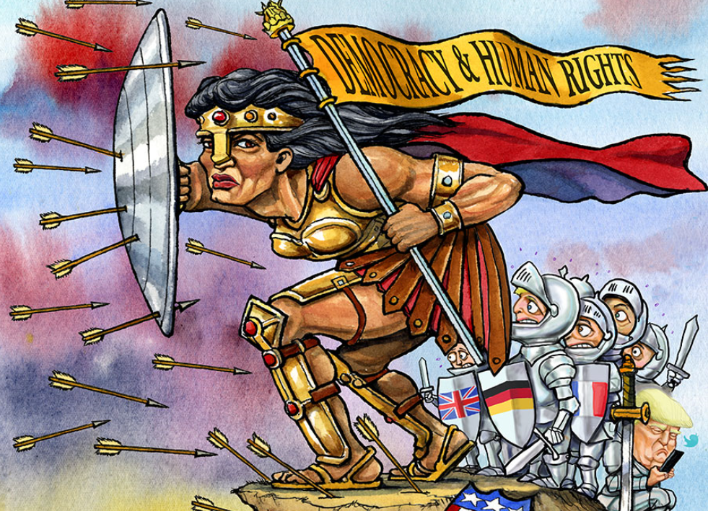
Main aspects and trends
Against Internet Freedom. 2017
Access: obstacle to no major obstacle
State censors target mobile connectivity
More governments restrict live video
Content: onerous restrictions or no restriction
“Fake News”/manipulation of information on social media
On VPNs
User rights: serious violations or not in the form of
Surveillance
Repercussions for legitimate speech
Technical attacks against dissenting voices
Image by KAL.

Slide 10
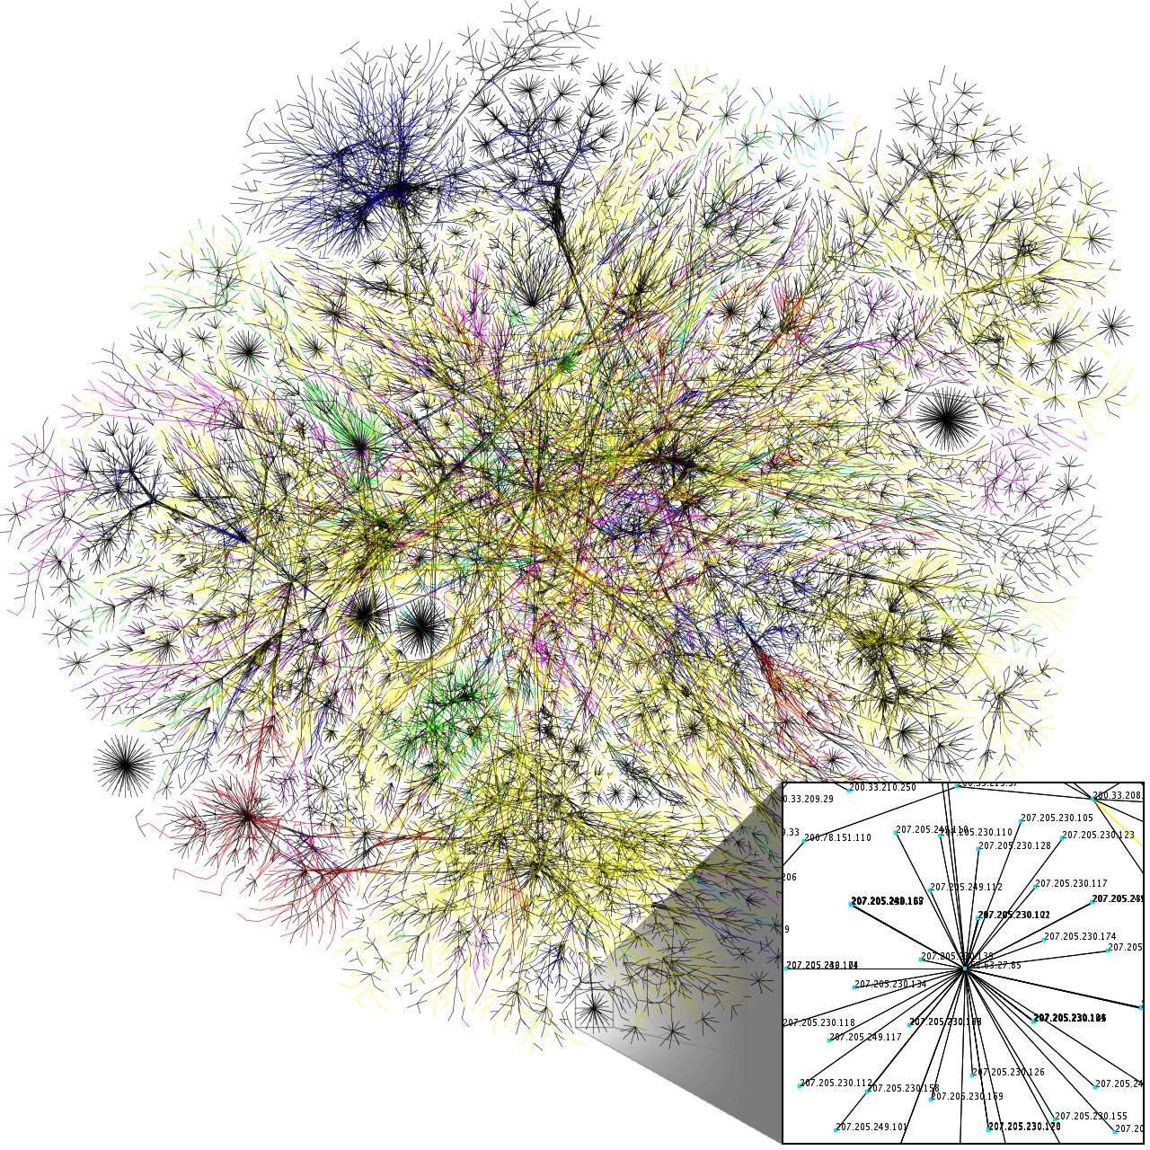
Digital rights
Right to Privacy
Right to Freedom of Expression
Right to be Forgotten
Right to Internet Access
Right to Own Data
Copyrights
Moral Rights
Contract Law
And…?
Notes:
Digital Rights

Slide 11
digital communication tools
Promoting Net-Activism

Slide 12
E-petition

Slide 13
E-Petitions = Slacktivism?
PETITION PLATFORMS
- - - - - - - - 200 million people in 196 countries
- - - - - - - - 186 million people in 156 countries
- - - - - - - - 46 million people in 194 countries
- - - - - - - - 39 million people around the world
- - - - - - - - 1567 petitions and 647,382 profiles
- - - - - - - - “one of the largest communities of online activists”
- - - - - - - - “the impetus to change the world can come from us”
- - - - - - - - “Over 2.1 million calls to US Congress”
Notes:
Online Petitions 1

Slide 14
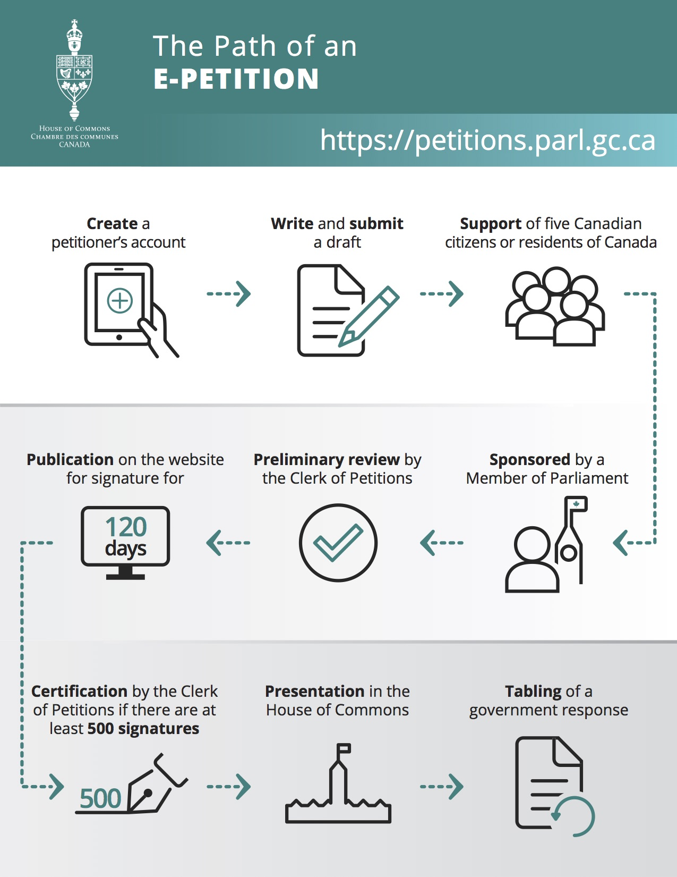
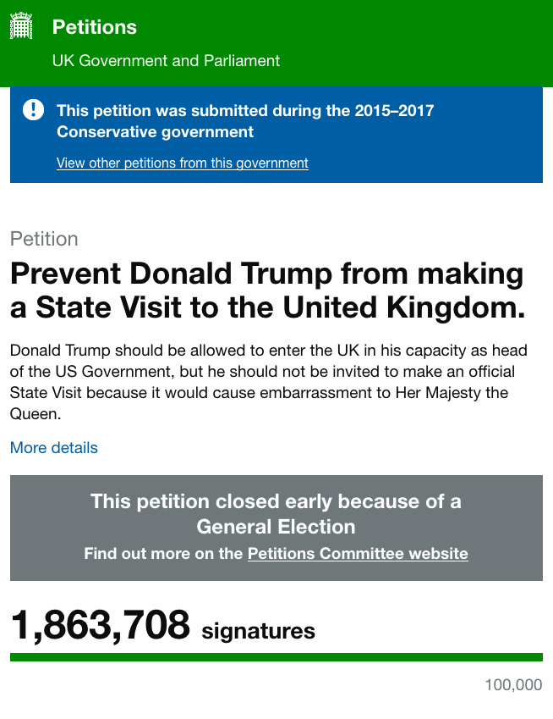
E-PETITIONS
GOVERNMENT CONDUCT
Notes:
Online Petitions 2

Slide 15
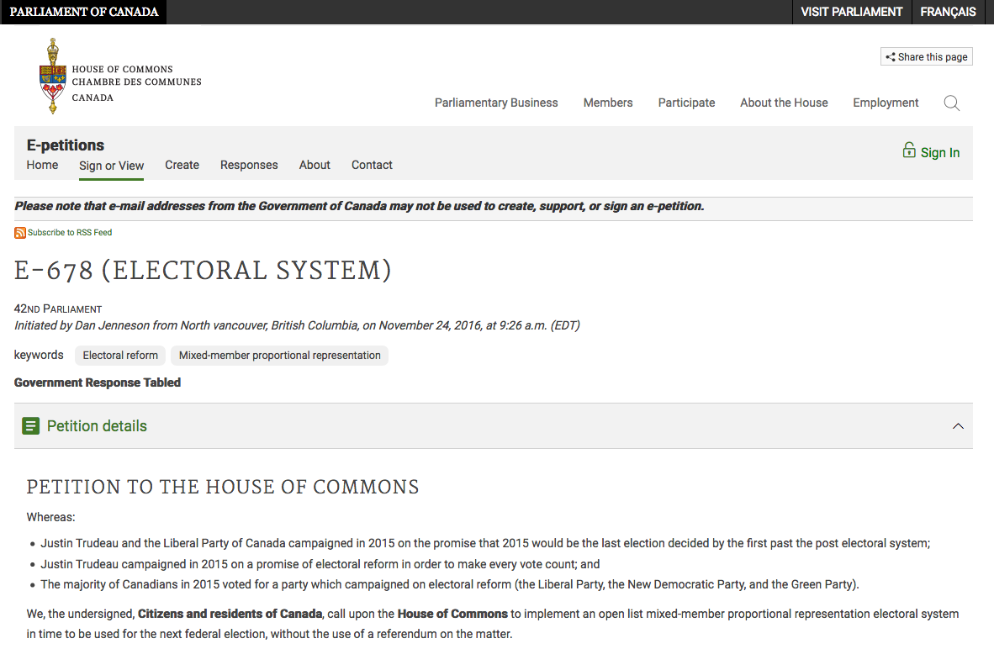
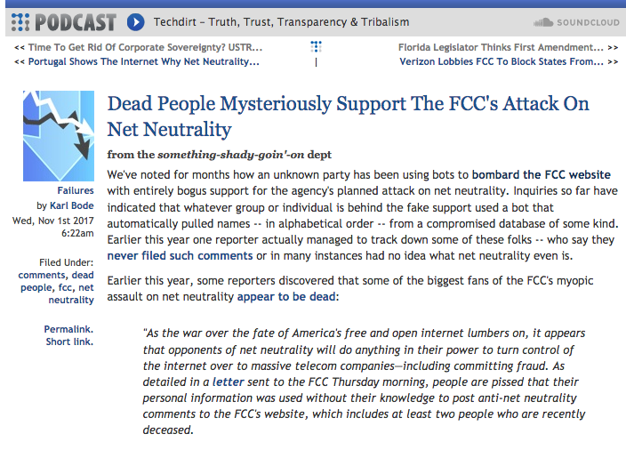
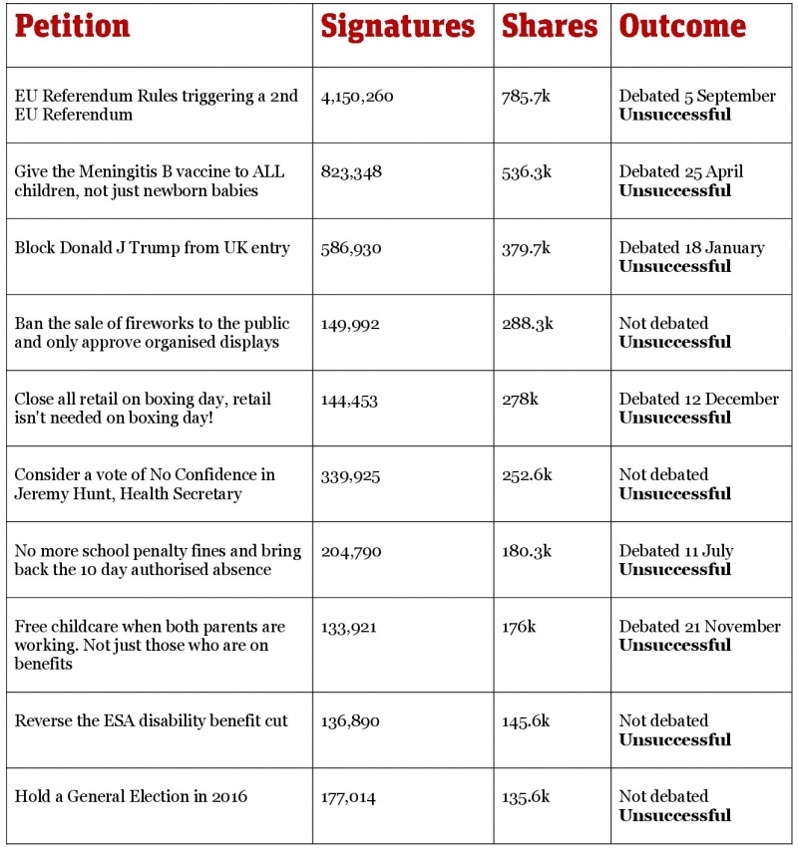
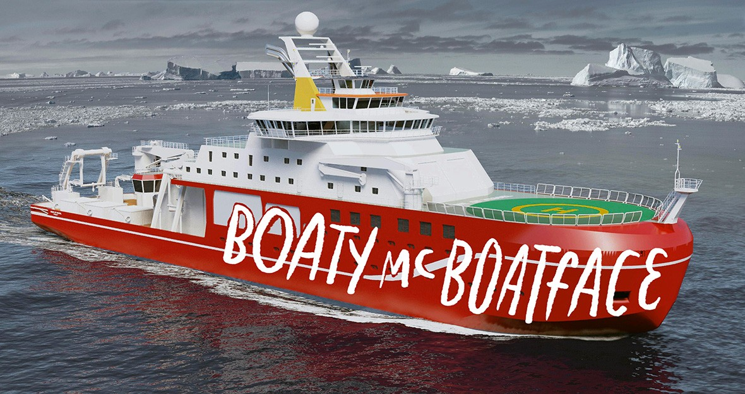
Online Petitions = Slacktivism?
E-PETITIONS
SOME CRITICISMS
Notes:
Online Petitions 3

Slide 16
fundraising

Slide 17
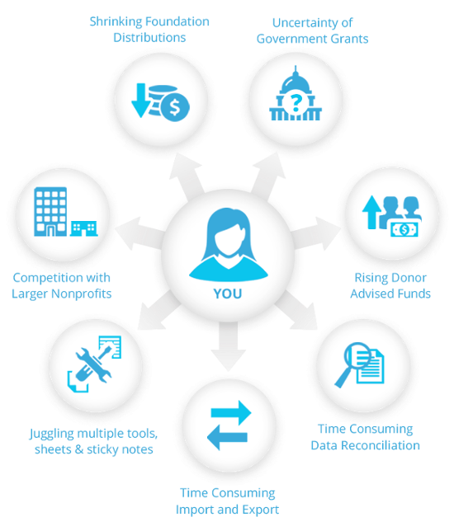
Fundraising Challenges
Proposed Solutions
FUNDRAISING
ONLINE
Notes:
Fundraising

Slide 18
Visual activism

Slide 19
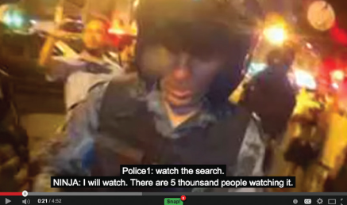
Sharing high visibility videos
Videos:
livestreaming: Black lives matter
online mash-up
remixing
Showing a political opportunities, mobilizing people and provoking action (e.g. protests)
A form of citizen journalism (?):
platform for expression
footage of own version of reality
awarded by a journalist award in USA: Neda death - Iranian election protests (2009)
Question
Be a witness of human rights violation… Is it a form of journalism? Is it a part of a political and social debate?
Should it be protected under freedom of press? Or it is not a form of journalism and it should be protected under freedom of expression
Should freedom to access be protected?
Alternative representation to the mainstream (mis)representation
Notes:
Democratisation of the tool: Often use mobile phones to film, upload the video on blogs or application, and then share on social media or traditional media.
in conjunction with low cost, or even free editing tools have made video- production, remixing and commentary literally for everyone. The threshold of storage, processing capacity, and bandwidth, opened up new possibilities for dedicated video makers and catapulted political video into mainstream consciousness and everyday media practices (Russo and Coppa 2012).
Categorization: we decided to limit to 3: livestreaming, mash-up and remixing, but we could have use other categorization or term as: mobilisation video, witness video, documentation video, archived radical video remediating historical work and finally, the political mash-up video.
More people are using video to document protests, civil right violation, police violence (especially in places like Brazil, Mexico, all across Latin America). To document Refugees voyage through Europe.
Livestreaming:
Streaming video in real time has become increasingly popular since the launch of a now-defunct mobile app, Meerkat, in early 2015. Many apps have since added live-streaming features, and deliver content to large global networks. The ability to stream live content directly from a mobile device without the need for elaborate equipment or a distribution strategy has made the technology more accessible. Dedicated news outlets and other content producers also continue to stream live content from their own websites, and some are now doing so in conjunction with apps and social media platforms. Often this allows them to bypass regulations specific to traditional broadcasters, and to reach new audiences.
People stream all sorts of things, from cultural events to everyday interactions. But live video is an important tool for documenting state abuse. In Armenia, digital journalist Davit Harutyunyan reported that police officers assaulted him and broke his equipment to stop him from sharing live footage of police attacking other journalists as they covered antigovernment demonstrations. Even in democracies such as the United States, live-streaming tools have become critical to social justice causes. In one case, live video broadcast on social media by the girlfriend of black motorist Philando Castile after he was fatally shot by police in Minnesota in July 2016 helped bring the incident to nationwide prominence.
Journalists have embraced live streaming, and it has developed into an accessible alternative to broadcast television channels, especially in countries whose traditional media outlets do not tell the full story.
Black lives matters video: (6min) On July 6th, 2016; Diamond Reynolds began a Facebook Live stream just seconds after her partner, Philando Castile, was shot. That place in US – considered as free internet country.
US Free 2011(13), 2017 (21)
Other example: 2013 protests in Brazil when, during an encounter between police and activists, a police officer approaches members of an activist collective to try and stop them filming and potentially arrest them the Police Man wanted to search his bag: “Watch the search.” Midia Ninja: “I will watch. There are 5 thousand people watching it.” He was arrested, but quickly released.
Brazil partly free2013 (32) 2017 (33)
To stream in real time produce an automatic backup of the footage in the event that their camera is confiscated or destroyed. Broadcast to a specific audience before be more broadly share.
A lot of videos that are highly shared/used as a rallying cry for protesters show the death of someone.
E.g: Egyptien revolution (2011): video of the death of a young Egyptian businessman beaten to death was posted on social media and all « fans » were invited to joined a nationwide protest against corruption and abuse.
Egypt: partly free in 2011 (51) → to not free in 2017 (68)
E.g. Neda death (Iran election 2009): The videos spread across the internet virally, quickly gaining the attention of international media and viewers (US, Canada, Australia and Asia). Discussions about the incident on Twitter, using a hashtag of #neda, became one of the "'trending topics'" by the end of the day on 20 June 2009. The incident was not originally reported by the state-controlled Iranian media, but was instead first reported on by international media. The video was shown on CNN and other news networks. The video was used to make people join together to support the cause /whose death was seen as a rallying cry for the protesters.
Iran: not free 2009 (76) to 2017 (85)
Online mash-up: Egypt video (2 min): Tamer had an audience and community of circulation in mind as he created the video: people in Europe and the USA who would not know, in these first days of the revolution in Egypt, what was going on and who could be mobilized into the incipient ‘solidarity of revolution’ (Chouliaraki 2014, 63) within which the narrative is framed. In considering these audiences he explicitly sought out found images and interviews that, to his mind, challenged audience perceptions about the Arab world – including a central clip of a bearded young man declaring that everyone – Christian, Muslim, atheist – should stand up, demand their rights and not be silenced.
The video was a moment of acting in solidarity; an act in itself, not just a decision to create a communications conduit to a defined outside audience.
he did not include graphic images, in order to give no reason for YouTube to block it
Remixing: deliberate recycling and reincarnation of previous imagery in new contexts. There are questions about it is still accurate or not; goal to inform or distortion of the reality and it not acceptable.
Citizen journalism:
Net-activism gave rise to citizen journalism.
Definition: citizen journalism as an alternative and activist form of newsgathering and reporting that leverages networked social media and functions outside but in relation to mainstream media institutions. Indeed citizen journalism is a practice that refers to non-professionals who engage in acts of journalism,, typically using ICTs such as mobile phones, the Internet, and social media or blogging platforms to self-publish the resulting user-generated content.
amateur versus professional (such as reporting, fact-checking, documenting, verifying, and quoting)
activism versus journalism,
Citizen journalism becomes a distinctive form of journalism
It is also a form of political activism, particularly in repressive countries where the circulation of information is inherently subversive. Citizen journalism has become the distinguishing form of political activism in authoritarian and undemocratic societies in the 2000s. In these regimes, citizen journalism, in the form of blogging and social networking, has become central to contemporary contentious politics and represents a most potent form of political contestation. Citizen journalism alters
how news is created
Influence public perception of the very political logic of authoritarian systems predicated on control of information and a monopoly on the means of symbolic power.
it is a way to present an alternative version of “the truth” propagated by the mainstream media
bring attention to issues ignored by the mainstream media and helped shift the informational status by chipping away at the state’s monopoly on information.
It creates spheres of dissidence where critiques of the dominant, mainstream media version of reality is articulated and alternative political and social orders are proposed..
Nadia death: (video 2 min/not to show): by an anonymous mobile phone owner, which was posted on YouTube. The shared videos had a widespread reception and were shown by internationals televisions. As a result, several protests emerged among Iranians in the US, Canada, Australia and Asia (interventions) showing solidarity with the protestors. → https://www.huffingtonpost.com/2010/02/16/neda-video-wins-polk-award_n_463378.html → The videos were awarded the George Polk Award in Journalism (American, annually presented,) for Videography in 2009. “This award celebrates the fact that, in today’s world, a brave bystander with a cell phone camera can use video-sharing and social networking sites to deliver news,”
Question:
Be a witness of human rights violation… Is it a form of journalism?
Should it be protect under freedom of press?
Or it is not a form of journalism and should be protected under freedom of expression?
And, is it a part of a political and social debate and should freedom to access should be protected?
What were the social and political consequences of online activism:
increasing perceived political opportunities
powerful role in shaping collective actions: even if the shared videos had limited popularity (compared to the overall population), what is important is that enough people become organized to contribute to some collective good; and not reaching a threshold point for unanimous participation’.

Slide 20
responses generated e.g. Egyptian Revolution 2011 Legal context:
Shut down of Internet network
Block mobile phone service
Censorship – “keep public order”
Blocking websites, online news network or human rights organizations
Restrict media coverage
Slow down networks, service time-outs, denial-of-service attacks
Surveillance or monitoring
Access ISPs’ customer database
FB accounts hacked, online comm, content removed or disseminated
Detention
journalists prosecution: fd of press – “in the service of society”
bloggers prosecution: fd of expression – “safety of the national structure”
Prison sentences
Constitution & Media Laws: Right of free expression, free press
National security
Cultural value
Press freedom exercises in the service of society
Emergency law
Broadcasting outlets state-owned
No specific laws governing the Internet
Dev. of IT a national priority
Economic liberalization
Notes:
Egyptian Revolution Jan 25th 2011– Take What’s Yours
Responses generated:
How authorities intervened and responded to online activism by encouraging or inhibiting those interventions generates societal outcomes. It will challenge the role of online activism in facilitating social improvements: the progression of activism) and its dynamic.
Unlike some countries will protect visual activism; other will intervene against visual activism directly or indirectly.
More specifically: In countries where inhibiting interventions such as Internet filtering and surveillance were dominant →
contributed to the ultimate decline of activism and
expansion of lasting outcomes such as digital divide. (A digital divide: Def: is an economic and social inequality with regard to access to, use of, or impact of information and communication technologies. → create inegality, Fragmentation of discourse and community, Segmentation of representative voices)
We concur with the view that the impact of technology (net-activism) is not given only in its inherent potential (e.g., increasing perceived political opportunities) but in strategic choices that are shaped by social, economic and cultural factors (e.g., governing access to the Internet)
E.g. Egyptian revolution 2011
At that time Egypt was in a politic context toward an economic liberalization. IT has the development of the information technology as priority. Internet was accessible by a portion of the population. Politics effect media and vice versa. Telecom policies (the press, telecommunications, and audiovisual laws) thus become sites of conflict between different social and political interests. The intersection of legal and regulatory choices, media reform, economic liberalization and privatization, and ICT development exemplify the tension inherent in seeking growth and progress while attempting to maintain control in a new media ecosystem. Social-networking websites helped spread ideas of discontent among Egyptians by calling them to join in protest and put pressure on the Egyptian government. Activists used Twitter to highlight local events, drawing global attention to what was happening on the ground and directly informing Western media coverage.
Egypt’s constitution reflected a cultural interpretation of rights built around nationalist and essentialist principles of what it meant to be Egyptian. → thus if information undermines solidarity, it must be anti-social and harmful to the nation, thus justifying limitations on its communication. E.g.: there were legal limits on foreign ownership, requirements for the nationality of content producers, specifications about the duties and roles of journalists, and specific reference to the importance of upholding cultural values and unity.
Often conflict with: -liberalization of the Communication; - citizen journalism
Mass media, like tv, television was one of the most important mechanisms used by authoritarian states like Egypt to manipulate domestic public opinion. Broadcasting outlets were state-owned. Although the ISPs were privately-owned, the Egyptian government maintains tight control through strict rules and regulations as well as by monitoring their performance.
Initially there were no specific laws governing the Internet, meaning that a series of content, publication, and criminal laws were invoked to regulate Internet content and publishers, as well as the MSM they were originally designed to cover. The regulatory and legal environment in Egypt was structured so as to maintain the political status quo while permitting greater investment and service provision through liberalization.
***Those are some example of interventions taken by the elite governing entities***
Shut down of Internet Network
Shut down the Internet: the Egyptian government decided to shut down the internet altogether on January 27, 2011. Only the Noor service provider (which served the country’s cabinet, public banks, and Egypt’s airways) was left operating but was denied service couple of days later after several activists began accessing the network from a local office in Alexandria. Egypt’s netizens, however, found ways to circumvent the government ban. For example, activists began using mobile and satellite mobiles to send short messages for broadcast by Egyptians abroad. Since fixed-phone lines were still working, foreign ISPs in France and Sweden offered modem connections to produce content. Meanwhile, Google and Twitter set up a system of voice tweets whereby people could call a foreign number and leave messages that were instantly posted on Twitter under the hashtag, “#egypt.” The authorities decided to unblock internet access on February 2, 2011.
Block mobile phone service:
Mobile operators were ordered to cut all mobile phone service, including mobile internet and SMS text-messaging, under the pretext that “foreign intelligence [was] using communication technologies to plan terrorist actions,” according to State Intelligence. It’s privately own but under the company’s terms of agreement, the government had the right to cancel any or all mobile services when necessary. Granting broad powers to the president during emergencies to confiscate, suspend or shutdown all means of communication, the Emergency Law also provided legal justification for the Mubarak regime’s unprecedented decision to shut down all internet and mobile connections.
Censor
The government censored five of the Muslim Brotherhood websites and disseminated denial-of-service (DoS) messages to media portals including Al Jazeera, BBC Arabic, and Al Arabiya.
The government blocked Twitter, Bambuser, and Facebook websites
Surveillance:
News reports speculated that the authorities unblocked the internet to make it easier to monitor dissidents’ discussions and plans of actions online, since it was more difficult to monitor events as they unfolded on the ground.
In 2011, the government enforced an article from the 2003 Telecommunication Act (Law #65) that obliges ISPs and mobile operators to allow government access to customer databases.
Internet cafe customers need to provide their names, email addresses, and mobile numbers to receive a personal identification number (PIN) to access the internet. The country’s three mobile operators are also required to register their subscribers as well as keep records of their online activities, and an out-going phone call can be traced by a half-dozen government entities.
Monitoring
State police admitted monitor online dissident discussion
Both mobile service providers and ISPs are regulated by the National Telecommunication Regulatory Authority (NTRA),. there have been some reports revealing the NTRA’s ties to online access control and surveillance activities, such as controlling the database of mobile subscribers and mobile short messages (especially those of news website services), as well as monitoring social media applications such as WhatsApp.
ASD began experiencing systematic attempts, allegedly orchestrated by the military and government, to hack its website. The hacking resulted in the deletion of news items about protests against the government and the subsequent dissemination of pro-government/SCAF messages, which forced the group to change its Facebook account.
News websites reported slow networks and usual cut-offs.
Detention: Physical attack/ arrestation
These legal norms obligated the press “to exercise its vocation freely and independently in the service of society.” Arrested several bloggers, dissidents, activists, and human rights figures in an attempt to control online discussions.
Journalist prosecution bcse the freedom of press shall be in the service of society
Bloggers prosecution; not journalist bcs not professional; Constitution guaranteed the freedom of express and publicize opinion that “[s]elf criticism and constructive criticism shall guarantee the safety of the national structure.”
The Mubarak regime and SCAF military administration used the Emergency Law to stifle freedom of expression, restrict citizens’ rights to access and publish information, and detain thousands of civilians between 2010 and early 2012, including several online activists.
Violations against users, especially bloggers, continued to grow between 2010 and 2012, with several bloggers and activists threatened, beaten, or harassed. Prior to the January 2011 revolution, a number of bloggers—including Wael Abbas, Israa Abdel Fattah and Asmaa Mahfouz—were detained to keep them from communicating online under claims that their posts endangered social welfare and/or threatened national security. During the first few days of the 2011 revolution, Egyptian security forces detained a number of activists, bloggers, and Facebook group administrators, including Wael Ghoneim, the founder of the “We are All Khaled Said” group that was created to protest Khaled Said’s brutal death by the hands of police forces in July 2010.
Prison sentences:
Egypt: Social media users received lengthy prison sentences for a range of alleged offenses, including insulting the country’s president
In March 2011, Sanad was arrested again in his home by military police and sentenced to three years’ imprisonment on charges of “insulting the military” in his blog post titled, “The Army and the People Were Never One Hand.” On December 14, 2011, the Egyptian supreme military court of appeals reduced his sentence to two years, and after mounting local and global pressure, Sanad was pardoned by the military on January 23, 2012.
***Other examples***
Governments restrict live video, especially during protests
Net Freedom 2017 another key trend: More governments restrict live video. As live video streaming gained popularity over the last two years with the emergence of platforms like Facebook Live and Snapchat’s Live Stories, some governments have attempted to restrict it, particularly during political protests, by blocking live-streaming applications and arresting people who are trying to broadcast abuse. Internet users faced restrictions or attacks for streaming live video in at least nine countries. Live broadcasting tools and channels were subject to blocking, and several people were detained to halt real-time coverage of antigovernment demonstrations. Government censors have had to adapt to the trend.The public use of smartphones to document events in real time turned ordinary internet users into citizen journalists—and easy targets for law enforcement officials.
Considering that citizen journalists most often stream political protests on their mobile phones, governments in countries like Belarus have at times disrupted mobile connectivity specifically to prevent live-streamed images from reaching mass audiences. Officials often justified their restrictions by noting that live streaming can be misused to broadcast nudity or violence, but blanket bans on these tools prevent citizens from using them for any purpose.
Vietnam: February 6, 2018: 14 years in prison: he was convicted of abusing democratic freedoms to infringe on the interest of the state and opposing officers on duty. The activist was livestreaming on FB fisherman marching to file a lawsuit against a Taiwan-owned steel plant’s spill of toxins into the ocean in April 2016. It killet massive amounts of fish. He commented that the fisherman were stopped and beaten by authorities. The court said his comments were untrue and slandered authorities. http://vancouversun.com/pmn/news-pmn/vietnam-jails-activist-for-livestreaming-pollution-march/wcm/30ff8a6c-db6a-4dc9-80b4-d99a1cf0c829
E.g. Spain’s gag law: (july 2015 – I think that now inconstitutional) Local and international press groups are particularly concerned by the law's ban on the unauthorized use of images of law enforcement authorities or police--a measure seemingly aimed at photographers, camera crews or ordinary citizens with cameras documenting police action during protests. Such "use" would draw a €30,000 fine. According to the IPI mission report published last month, the vague wording of the law (see article 36/23) "potentially offers security forces carte blanche to prevent journalists from carrying out their work.“
E.g.: . In Bahrain, the information ministry banned news websites from streaming live video altogether in July 2016.
E.g: Iran blocked Instagram, used more ad hoc methods, to disrupt live streaming when it was already in progress.
E.g.: Some countries restricted real-time broadcasts to curb obscenity, but the effects extended to journalism and digital activism.
E.g: Singaporean streaming app Bigo Live was shuttered for a month in Indonesia until it brokered a deal with the government to limit streaming activity that violates Indonesia’s broad bans on obscene or otherwise “negative” content.
E.g.: In China, police in southern Guangdong Province shut down hundreds of live-streaming channels during a purge of pornography and other illegal content—a category that includes banned news and commentary.
E.g.:Venezuelan regulators ordered service providers to block three websites that broadcast live as tens of thousands of protesters marched against President Maduro in April 2017.
E.g: In June, live coverage of anticorruption protests in Russia was interrupted when the electricity supply to the office of opposition leader Aleksey Navalny was intentionally cut off, leaving his YouTube channel Navalny Live without light and sound.
e.g.: The internet freedom status of Venezuela and Armenia was downgraded. Venezuela went from Partly Free to Not Free amid a broader crackdown on E.g.: At least two video bloggers were arrested and a third was fined for broadcasting antigovernment Freedom Day protests in Belarus; local colleagues observed that they lack the institutional support and legal protections of their professional counterparts.
E.g.: a Belarusian animal rights worker was fined in a separate case because a court found that her live video from a rescue shelter violated a law governing mass media broadcasts.
political rights and civil liberties following President Nicolás Maduro’s May 2016 declaration of a “state of exception and economic emergency,” which was renewed in May 2017. The government blocked a handful of sites that provided live coverage of antigovernment protests, claiming the sites were “instigating war.” Armed gangs physically attacked citizen and online journalists who tried to document antigovernment protests, while the political opposition and independent outlets experienced an unprecedented wave of cyberattacks, effectively taking their sites offline for periods of time and disabling their accounts. In Armenia, which dropped from Free to Partly Free, the police attacked and obstructed journalists and netizens who were trying to live stream antigovernment protests. Thousands of people demonstrated in response to the police’s mishandling of a hostage situation, during which officials temporarily restricted access to Facebook.

Slide 21
Encryption and P2P

Slide 22
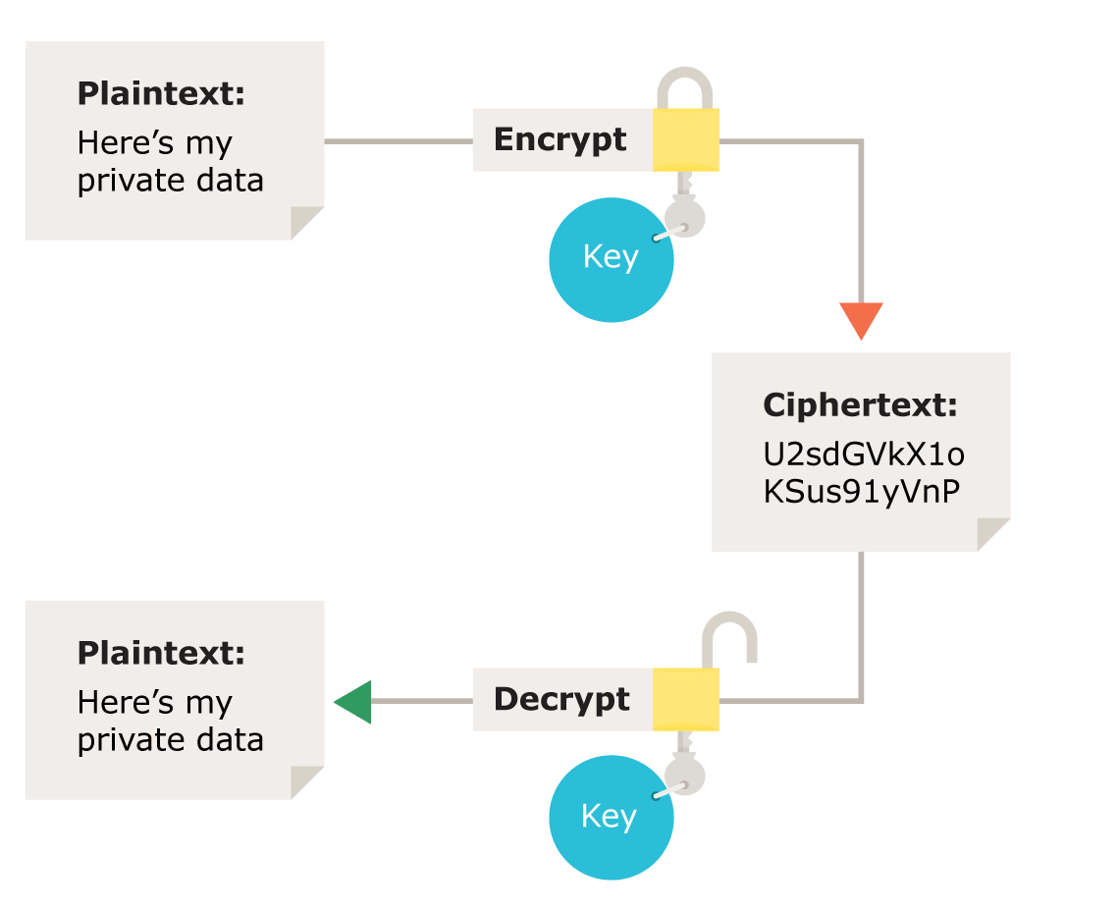
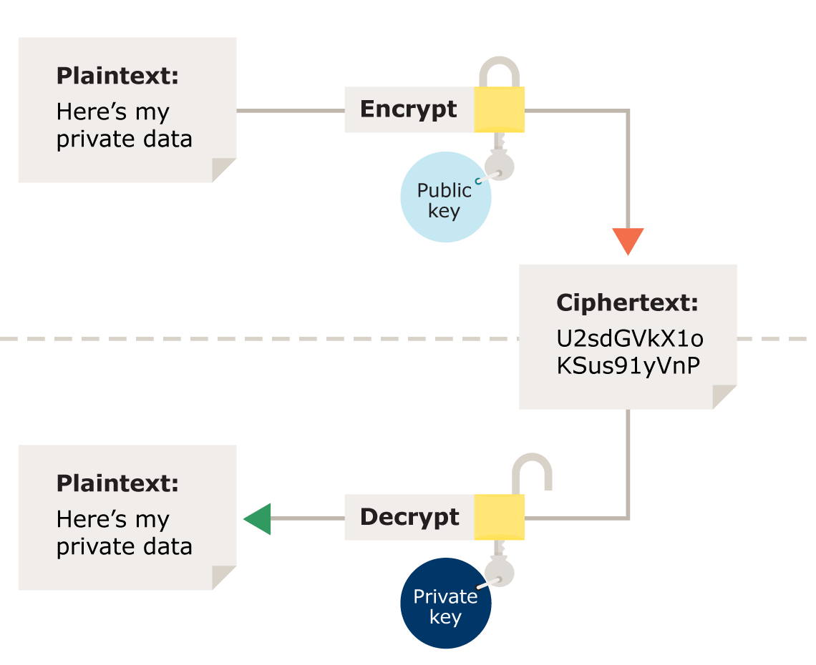
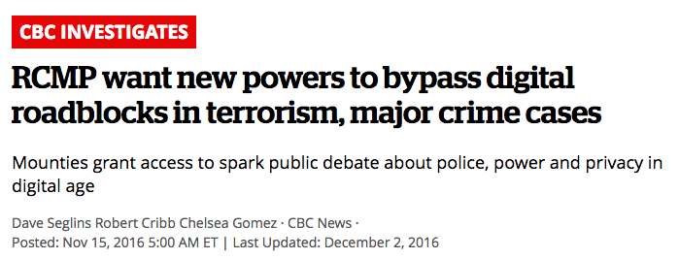
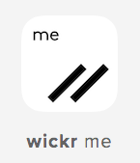
Symmetric Encryption
Asymmetric Encryption
ENCRYPTION
Liberals bill support anti-terrorism bill
Notes:
Encryption (2min) *ads
http://www.cbc.ca/player/play/2652001088/

Slide 23
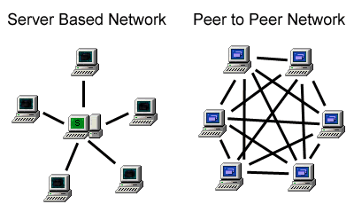
PEER-TO-PEER NETWORKS
Notes:
Peer-to-peer

Slide 24
hacktivism

Slide 25
HACKTIVISM
Common Hacking Techniques:
Keyloggers = Data breaches
Distributed Denial of Service Attacks
Waterhole attacks/Fake Wifi
Phishing
Virus/Trojan, Worms, Malware
ClickJacking Attacks
Cookie Theft
Eavesdropping
Notes:
Hacktivism 1

Slide 26
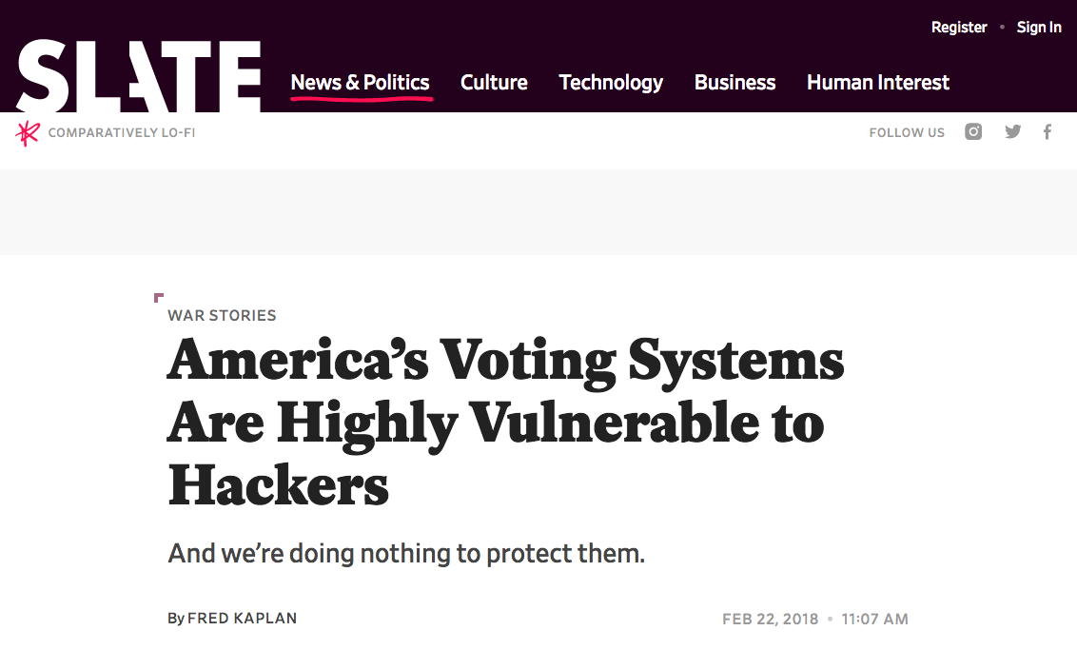
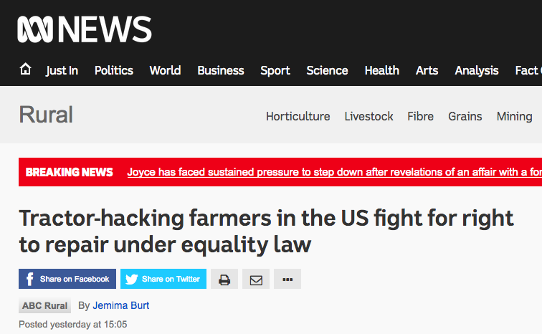
Hacking Governments &
The Private Sector
HACKTIVISM
Notes:
Hacktivism 2

Slide 27
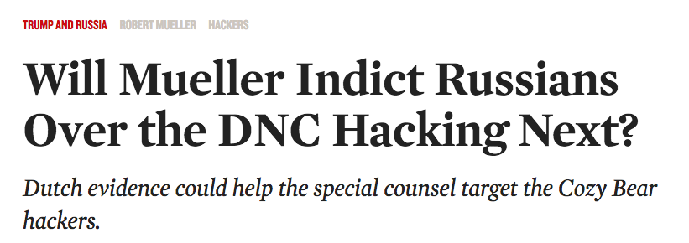
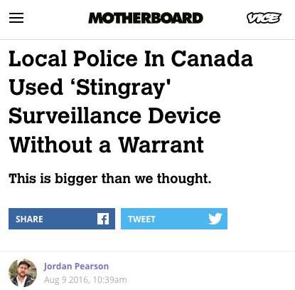
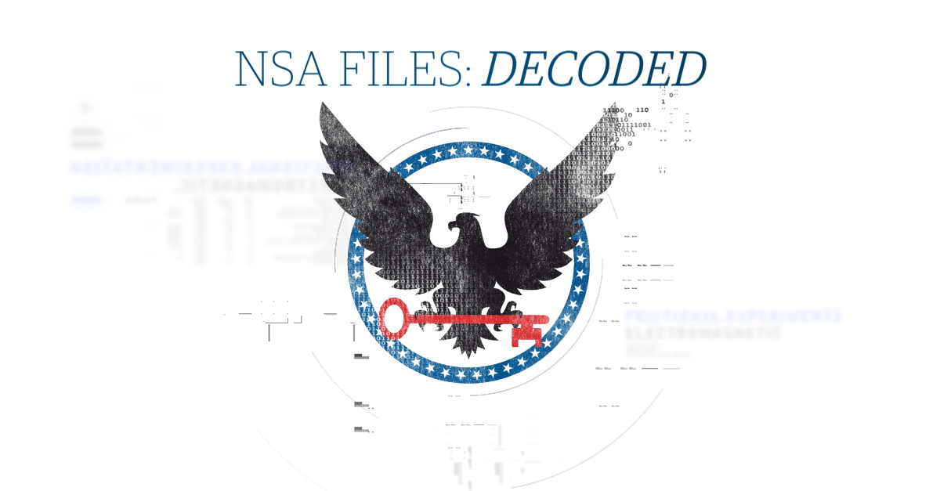
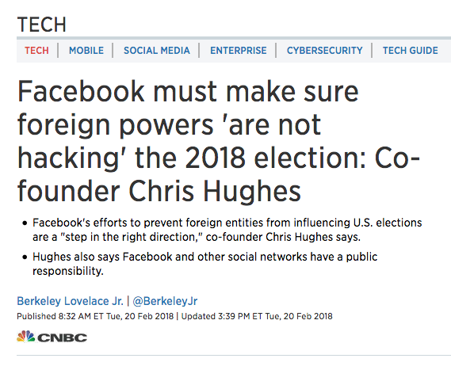
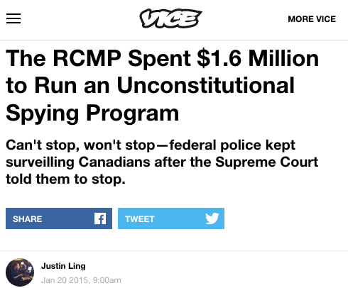
Governments Hacking &
Industrial Surveillance
HACKTIVISM
Hacking Social Media
Notes:
Hacktivism 3

Slide 28
Shaping the internet
“While technology shapes the future, it is people who shape technology, and decide to what uses it can and should be put”.
Notes:
Citation from: AsKoﬁ Annan stated in 2003.
Tension: Internet tool of democracy and tool of control.

Slide 29
What should we do? Some impacts:
Discussion:
Promote self-censorship
Discouraging dissenting view
Generate digital divide
Decline of net-activism
Decline of offline activim
Enable to see criticalness of a situation
Create information asymmetries to preserve their power
Open Internet
Access-Controlled
2000
2005
2010
Access-Denied
Access-Contested
Notes:
Solution:
Strengthen regulations on entity who control the technology of Internet: private co governance as social responsability vs government regulation
creating an independent body in the form of the Digital Rights Commission
More active role of tech Co? reexamining algorithms, disabling fake antidemocratic account
Social Media Enforcement Law
https://www-cambridge-org.ezproxy.library.ubc.ca/core/services/aop-cambridge-core/content/view/AEFBA8BCA0CD6CDB3E4AD61B706D1BCF/9781107278721c1_p1-35_CBO.pdf/internet_as_a_democratising_force.pdf
The ﬁrst phase, paralleling the preceding discussion, was the phase of the open internet, in which the internet was seen as a separate space outside of governmental and other legal control. The second phase, from 2000 to 2005, he describes as the access-denied phase, in which the internet was seen by states as something to be managed; this period was therefore characterized by the use of ﬁltering technologies. The third phase – access-controlled, from 2005 to 2010 – was characterized by more nuanced and sophisticated forms of control often layered on other forms of regulation. Filters were still used, but they could be targeted to particularly sensitive political events, such as the ﬁltering of a controversial photo from the Tiananmen Square massacre leading up to the twenty year anniversary. Additionally, it was characterized by the increasing use of private companies to regulate online content through data collection and sharing or blocking, licensing schemes to publish online, or a combination of ﬁlters combined with laws, as seen in cases like Twentieth Century Fox Film Corp & Ors v. British Telecommunications Plc,28 where a UK court ordered ISPs to block access to ﬁle-sharing sites.
We have moved into a new phase, aptly described by one scholar as the time of the ‘cyberrealists’,29 where discussions of the internet as a democratising force are re-emerging but with more sophistication and less naivety than in the past. Users are simultaneously creators and consumers of content. The access-contested phase, in which ‘the regulation that states have imposed in the earlier phase is giving rise to strong responses from the private sector and from other states unhappy with this regulation ... Regulation online is increasingly a blend of the public and private’.
https://www-cambridge-org.ezproxy.library.ubc.ca/core/books/regulating-speech-in-cyberspace/concluding-remarks/E22F7F59D5860FD324FE1C1B6C1FD17E/core-reader#FN-fn-1224
. This book showed that CSR is the link that has been missing from discussions of internet regulation to address human rights issues, bridging the extralegal dimension of human rights with the rule-making arm of the law.

Slide 30
What should we do? Some impacts:
Discussion:
International Level
Internet user rights treaty
Independent body for protection of users rights
Limitation on government intervention
Journalism international treaty
Protection of Net-Activist
Nationally Level
Social media enforcement law
Corporation governance regulation
Unregulated Level
More active role of technology corporations
Promote self-censorship
Discouraging dissenting view
Generate digital divide
Decline of net-activism
Decline of offline activim
Enable to see criticalness of a situation
Create information asymmetries to preserve their power
Open Internet
Access-Controlled
2000
2005
2010
Access-Denied
Access-Contested
Notes:
Solution:
Strengthen regulations on entity who control the technology of Internet: private co governance as social responsability vs government regulation
creating an independent body in the form of the Digital Rights Commission
More active role of tech Co? reexamining algorithms, disabling fake antidemocratic account
Social Media Enforcement Law
https://www-cambridge-org.ezproxy.library.ubc.ca/core/services/aop-cambridge-core/content/view/AEFBA8BCA0CD6CDB3E4AD61B706D1BCF/9781107278721c1_p1-35_CBO.pdf/internet_as_a_democratising_force.pdf
The ﬁrst phase, paralleling the preceding discussion, was the phase of the open internet, in which the internet was seen as a separate space outside of governmental and other legal control. The second phase, from 2000 to 2005, he describes as the access-denied phase, in which the internet was seen by states as something to be managed; this period was therefore characterized by the use of ﬁltering technologies. The third phase – access-controlled, from 2005 to 2010 – was characterized by more nuanced and sophisticated forms of control often layered on other forms of regulation. Filters were still used, but they could be targeted to particularly sensitive political events, such as the ﬁltering of a controversial photo from the Tiananmen Square massacre leading up to the twenty year anniversary. Additionally, it was characterized by the increasing use of private companies to regulate online content through data collection and sharing or blocking, licensing schemes to publish online, or a combination of ﬁlters combined with laws, as seen in cases like Twentieth Century Fox Film Corp & Ors v. British Telecommunications Plc,28 where a UK court ordered ISPs to block access to ﬁle-sharing sites.
We have moved into a new phase, aptly described by one scholar as the time of the ‘cyberrealists’,29 where discussions of the internet as a democratising force are re-emerging but with more sophistication and less naivety than in the past. Users are simultaneously creators and consumers of content. The access-contested phase, in which ‘the regulation that states have imposed in the earlier phase is giving rise to strong responses from the private sector and from other states unhappy with this regulation ... Regulation online is increasingly a blend of the public and private’.
https://www-cambridge-org.ezproxy.library.ubc.ca/core/books/regulating-speech-in-cyberspace/concluding-remarks/E22F7F59D5860FD324FE1C1B6C1FD17E/core-reader#FN-fn-1224
. This book showed that CSR is the link that has been missing from discussions of internet regulation to address human rights issues, bridging the extralegal dimension of human rights with the rule-making arm of the law.

Slide 31
Questions
Net-Activism
by Claudio Storelli and Laura Courdi

