Slide 1
FAKE NEWS
A guide by Rasmeet Mohar and Geeth Makepeace

Slide 2
Definition
‘‘Fake news’’ is information that has been deliberately fabricated and disseminated with the intention to deceive and mislead others into believing falsehoods or doubting verifiable facts.
It is disinformation that is presented as, or is likely to be perceived as, news.

Slide 3
THE HISTORY

Slide 4
Pre-Printing Press Era

Slide 5
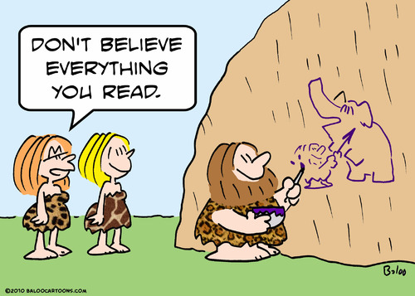
The Stone Age

Slide 6
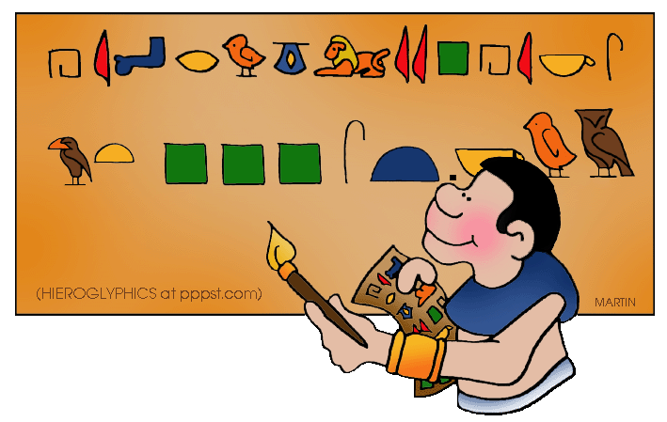
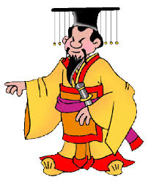
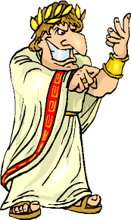
Writing Materials used to Gain Power
Forms of writing inscribed on materials like stone, clay, and papyrus was usually limited to the leaders of the group. Controlling information gave some people power over others.
Who knows whether this information was fake or not?

Slide 7
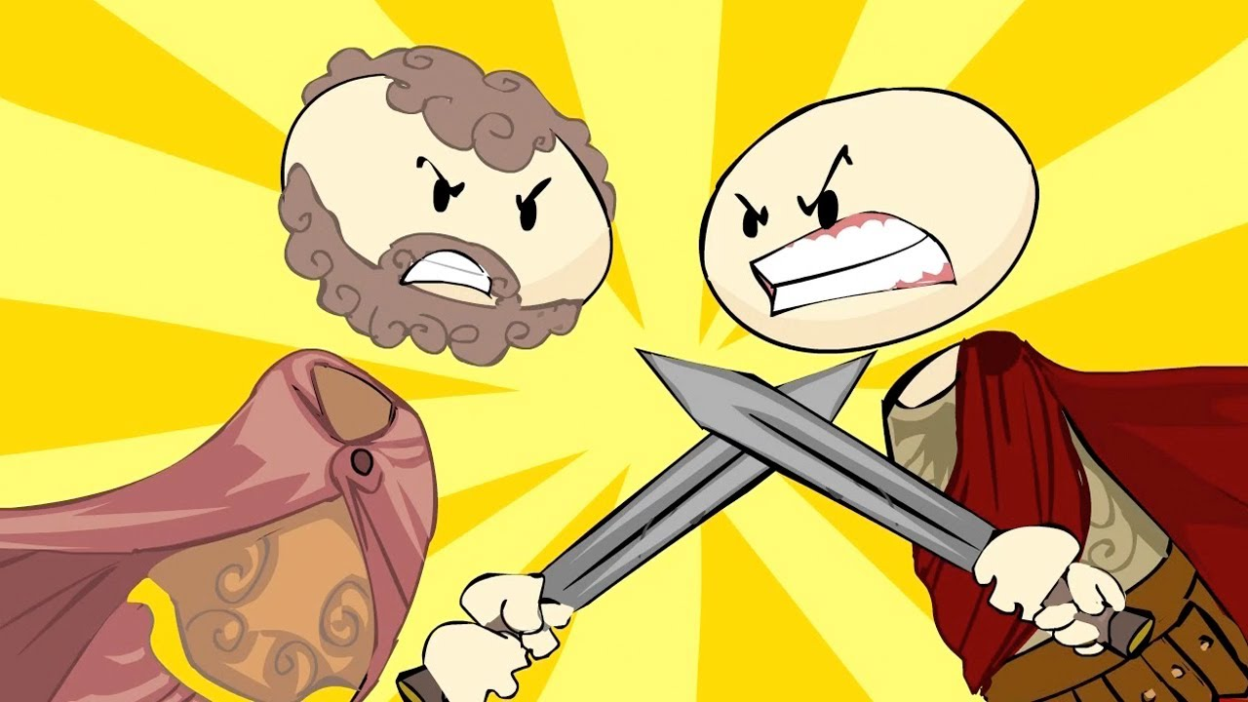
Information Wars of Ancient Rome
In the sixth century AD, Procopius of Caesarea (500–ca. 554 AD), the principal historian of Byzantium, used “fake news” to smear the Emperor Justinian. After the emperor’s death Procopius published a Secret History that discredited the emperor.

Slide 8
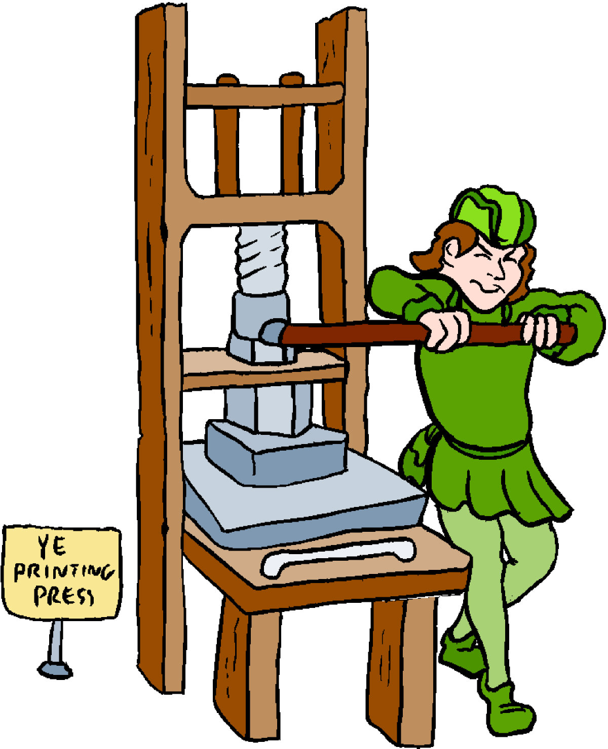
The Printing Press
15th century introduction
Printed information became available in different formats by writers who had a monetary incentive. Some were paid by a publisher to provide real news. Others, for the benefit of their employer.

Slide 9
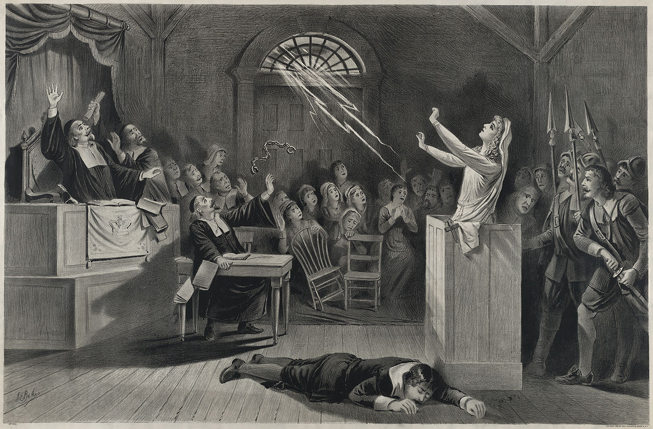
EXAMPLES OF FAKE NEWS FROM THE PRINTING PRESS ERA
1522 PIETRO ARETINO : Roman satire called Pasquino
FRENCH FAKE NEWS: Canard - unfounded rumor/story
1710 JOHN SMITH: Wrote “The Art of Political Lying”
1844 EDGAR ALLEN POE: Fake news writer
16TH- 17TH CENTURY: Waves of fake news/conspiracies
Religious and political authorities panicked and set up draconian regimes of censorship
SALEM WITCH TRIALS

Slide 10
Regulation of the Printing Press
Widespread licensing of all printers by the state and/or the requirement for advance approval by church authorities for texts to be published.
The export and import of books was also controlled or forbidden. In more autocratic states, printing was banned for two hundred or more years.
Between the 16th and 19th centuries struggle against restrictions on publication waged in the name of political freedom and human rights.
The freedom to publish was achieved by gradual change in Britain and by revolution in France at the end of the eighteenth century and gradually in territories of the Austrian and Prussian Empires during the nineteenth century.

Slide 11
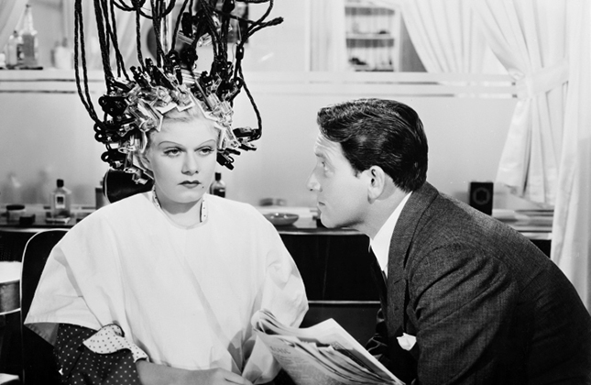
The Appearance of Fake News Continued Overtime:
“Hollywood tackled Fake News Nearly a Century Before Trump”
Many films and plays displayed how journalism was viewed in a negative light
Example : In 1928, former reporters Ben Hecht and Charles MacArthur wrote The Front Page, a hugely popular Broadway comedy that satirized the unscrupulousness of the newspaper business.
To be a reporter, or “newspaperman,” on screen in the early 1930s was to be calculating, underhanded and altogether amoral

Slide 12
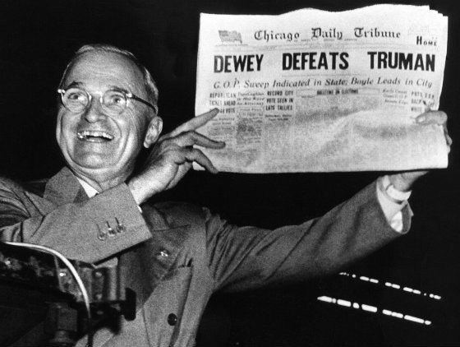
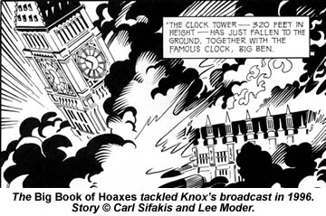
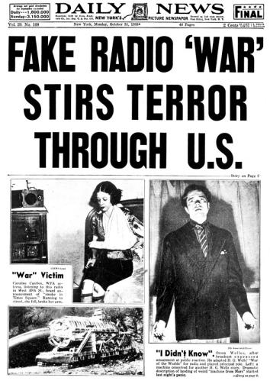
The Appearance of Fake News Continued Overtime:
1948 Dewey Defeats Truman
1926 Broadcasting the Barricades on BBC Radio
 |  |  |  | Mass Media Era
1938 War of the Worlds Broadcast

Slide 13
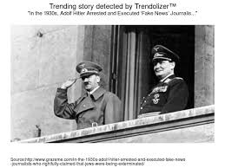
The Appearance of Fake News Continued Overtime:
Mass Media Era
Use of mass media to discriminate minority groups with fake news or destroying news that supported minorities by labelling them as fake:

Slide 14
Mass Media Era
Regulation of Mass Media
Introduction of other media beyond print - the electric telegraph, the telephone, wireless, which led to public radio broadcasting from 1920 onwards.
REGULATION: Regulated by national laws that were more or less required by international agreements relating to technical requirements (e.g. radio frequency allocation).
Often regulation was: control by state bodies or public monopolies or a powerful governmental body. During the early 20th century, the cinema film was established, typically regulated locally.
Broadcast media were the most closely regulated of all media nearly everywhere during the twentieth century and they have never achieved the degree of freedom enjoyed by print media.
DEREGULATION: Since about 1980, new forms of distribution by cable and satellite have led to a great expansion of media output and the been deregulation of media
RE-REGULATION OF MEDIA?

Slide 15
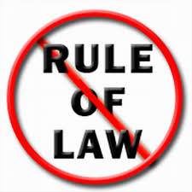
The Internet Age
Computer and Cellphone Innovations made it cheaper and as a result easier to spread information on a GLOBAL SCALE
Some fake websites were created in the early years of the Internet
People today create fake news for same reasons as the past : entertainment, satire, parody, political/ economic gain
21st century economic incentives further motivate fake news with Internet being funded by advertisers
Increase in gossip, sensationalized story filled websites equivalent to pop culture magazines preying on people’s attraction to gossip, rumor and scandal
Social media catapulted things further

Slide 16
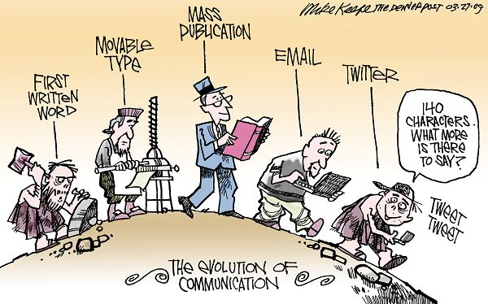
SUMMARY OF THE EVOLUTION

Slide 17
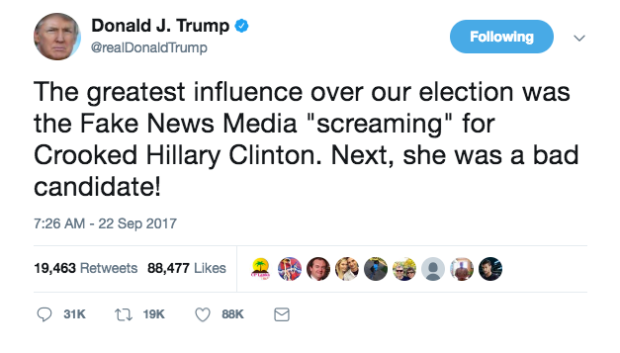
FAKE NEWS IMPACT ON US ELECTION

Slide 18
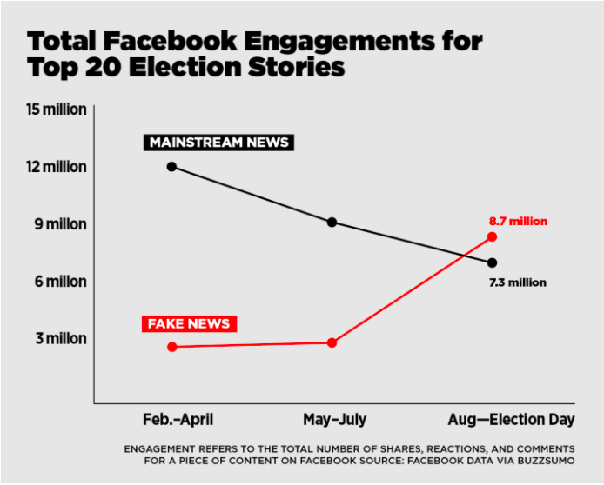
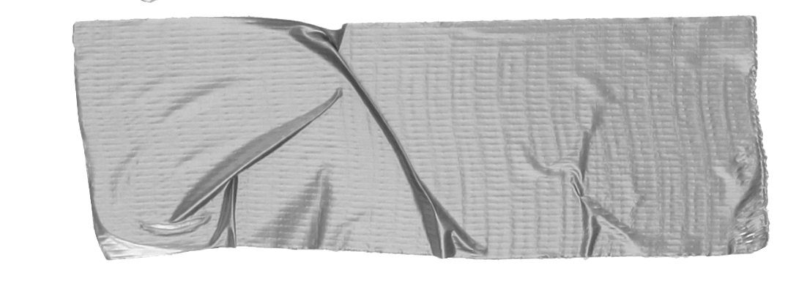
➸ 20 top-performing false election stories from hoax sites and hyperpartisan blogs generated 8,711,000 shares, reactions, and comments on Facebook.
➸Within the same time period, the 20 best-performing election stories from 19 major news websites generated a total of 7,367,000 shares, reactions, and comments on Facebook.

Slide 20
Fake News Economics
Using well-known economic analysis, fraudsters will engage in the creation and management of fake news if:
Mb 1 Pb . Ic 1 O1c 1 Pc 1 (O2c πarr πcon), (1)
Where:
Mb 5 the monetary benefits of engaging in frauds involving fake news;
Pb 5 the psychological (noneco- nomic) benefits of engaging in frauds involving fake news;
Ic 5 direct investment costs;
O1c 5 the opportunity costs of engaging in the creation and management of fake news;
Pc 5 the psychological costs of engaging in frauds involving fake news;
O2c 5 the monetary opportunity costs of conviction;
HOW TO BREAK THIS?
Creators, consumers, and arbiters of disinformation have a reinforcing effect on each other. This leads to a fake news ecosystem.

Slide 21
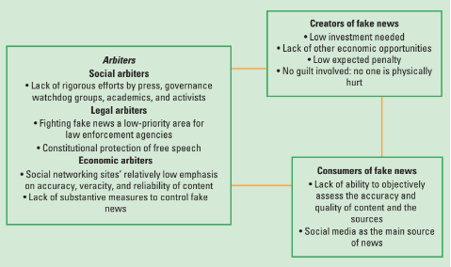
Fake News Economics

Slide 22
Role of Fake News: Global Examples
Turkey
American Professor Henri Barkey blamed for coup attempt in Turkey
Professor Barkey was conducting a workshop about Iran near Istanbul. Government sponsored pro-Erdogan media claimed that Barkey was not discussing Iran’s foreign relations but rather was present to direct the coup on behalf of the CIA.
The media claimed that Barkey employed Scott Peterson, a convicted killer, as muscle. Peterson is imprisoned in California. However, an American journalist named Scott Peterson happened to be at the workshop.

Slide 23
Role of Fake News: Global Examples
2. Philippines
US Ambassador to the UN, Nikki Haley, Praises President Rodrigo Duterte
The only problem is that this never happened. The article quotes the ambassador as saying that “we must give President Duterte the space to run his nation” and that “destructive forces have calibrated their forces to oust the president”. Articles like this have been propagated to gain support for otherwise unpopular governments.
Some articles went as far as to say that NASA has named president Duterte as the “best president in the solar system.”

Slide 24
Role of Fake News: Global Examples
3. Singapore
New laws on fake news to be introduced in Singapore
The legislation is aimed at working with technological platforms to delegitimize fake news and to help people identify what is fake news. Where fake news is spread for malice or profit, the legislation has to determine how to deal with perpetrators.
The problem with this is that Singapore is already known for restricting free speech, so there is a possibility that this legislation may be used to squash dissent.

Slide 25
Who is susceptible to fake news?
Study: Asked subjects to rate a fictitious person on character traits.
Result: subjects with low scores on cognitive ability continued to be influenced by damaging information even after told the information was false.
Implication: Fake news poses a threat to democratic society when it is used as propaganda to make people think and behave in ways they otherwise wouldn’t.
Finding:
Subjects high in cognitive ability adjusted their ratings more than did those lower in cognitive ability. The subjects with lower cognitive ability had more trouble shaking their negative first impression even after controlling for openmindedness and intolerance.
Source: https://www.scientificamerican.com/article/cognitive-ability-and-vulnerability-to-fake-news/
Notes:
· Over 400 subjects take a personality test then randomly assigned to one of two conditions:
o 1. Experimental condition: subjects read a description of a young woman named Nathalie. The bio explained that Nathalie, a nurse at a local hospital, “was arrested for stealing drugs from the hospital; she has been stealing drugs for 2 years and selling them on the street in order to buy designer clothes.”
§ The subjects then rated Nathalie on traits such as trustworthiness and sincerity, after which they took a test of cognitive ability.
§ Finally, the subjects saw a message on their computer screen explicitly stating that the information about Nathalie stealing drugs and getting arrested was not true, and then rated her again on the same traits.
o 2. Control condition was identical, except that subjects were not given the paragraph with the false information and rated Nathalie only once.
· The subjects in the experimental condition initially rated Nathalie much more negatively than did the subjects in the control condition.
· The interesting question was whether cognitive ability would predict attitude adjustment—that is, the degree to which the subjects in the experimental condition would rate Nathalie more favorably after being told that this information was false.
o It did: subjects high in cognitive ability adjusted their ratings more than did those lower in cognitive ability.
o The subjects with lower cognitive ability had more trouble shaking their negative first impression of Nathalie.

Slide 26
Can you spot the fake?

Slide 27
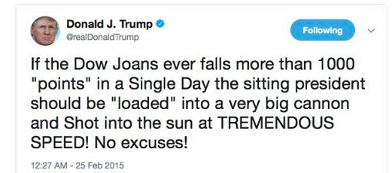

Slide 28
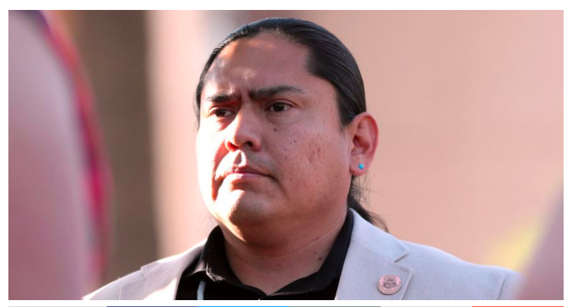
Did armed Trump supporters ask a Navajo Legislator if he’s “Legal”?

Slide 29
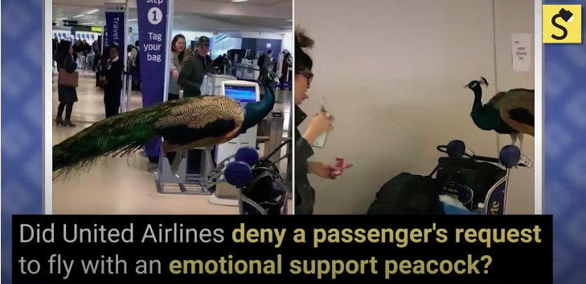
Did United Airlines deny a passenger’s request to fly with an emotional support peacock?

Slide 30
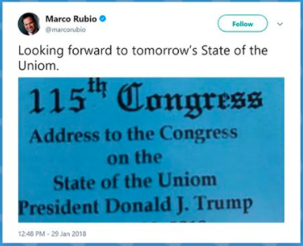
Were misspelled tickets issued for the State of the Union address?

Slide 31
Freedom of Expression or Regulation? What is more important?

Slide 32
Responding to Fake News
Governmental Approaches
➸ Take a negative approach → forms of punishment/sanctions for spreading fake news
➸ Take a positive approach → regulate infrastructure and the flow of information (current approach)
➸ Use funding or economic incentives to indirectly promote legitimate news
➸ Use “whitelists”of news sources based on user/independent institution ratings.
➸ Increase intermediary liability
Non-governmental Approaches
➸ Use “whitelists”of news sources based on user/independent institution ratings. Not a government monitored whitelist.
➸ Educate content consumers on how to distinguish credible sources from their counterparts.
➸ Enforce norms of professional news gathering on content creators and content distributors.
➸ Better enforcement of platform terms of service either by the platform or by permitting a third-party to enforce the terms of service.
➸

Slide 33
The End.

