Slide 1
Regulating Social Media
Charlotte Chamberlain

Slide 2
To regulate or not to regulate?
Government regulation (direct or devolved)
Independent regulation/self-censorship
No regulation
No exclusion clauses
Notes:
1.
2.
3.
4. No legal recourse to the courts can be blocked

Slide 3
What behavior should be regulated?
Censorship?
Freedom of Association?
Free Speech?
Commercial Speech?
Equality?
Fairness?
Paternalism?
Freedom of religion?
Reputation?
Justice?
Democracy?
Notes:
Should!!! – at this stage rightly so.
V. Subejective – hopefully if it became law there would be less shoulds
Free Speech
Freedom of Association
Freedom of Religion
Reputation
Paternalism
Equality
Fairness
Justice
Democracy

Slide 4
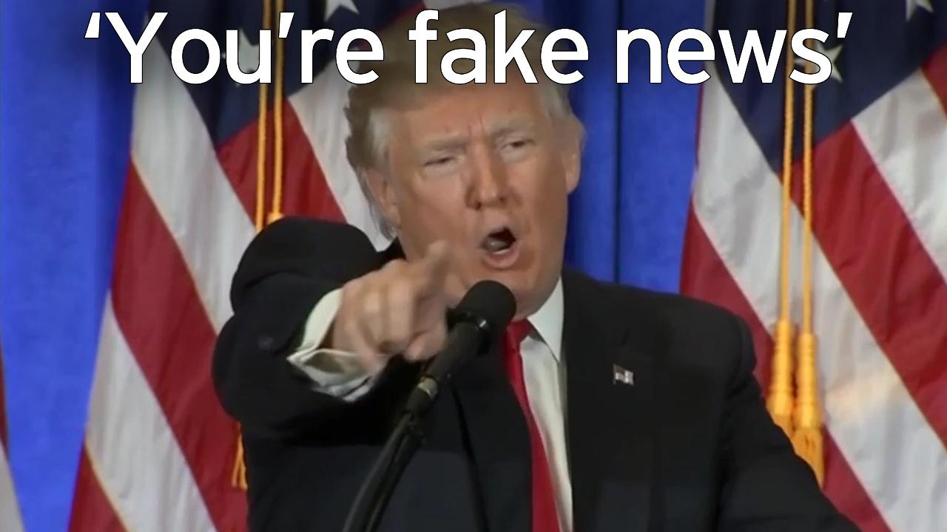
Fake News
Defamation Law
US – actual malice (knowledge or reckless disregard)
- New York Times Co. v Sullivan (1964)
Canada – responsible journalism on matters of public interest
- Grant v Torstar (2009)
UK – Tendency to lower the reputation of the claimant in the eyes of a reasonable man + Defamation Act 2013 (serious harm to reputation).
https://www.youtube.com/watch?v=W6ZHY0E4_Wg

Slide 5
Hate Speech & Radicalism
Canada
S.2 Charter - freedom of conscience and religion, freedom of thought, belief, opinion and expression, including freedom of the press and other media
S.1 Charter – restrictions must be prescribed by law and necessary in a democratic society
Cf. Article 10 European Convention on Human Rights
S.318-320 Criminal Code – “hate propaganda” – advocating genocide or public incitement of hatred against an identifiable group

Slide 6
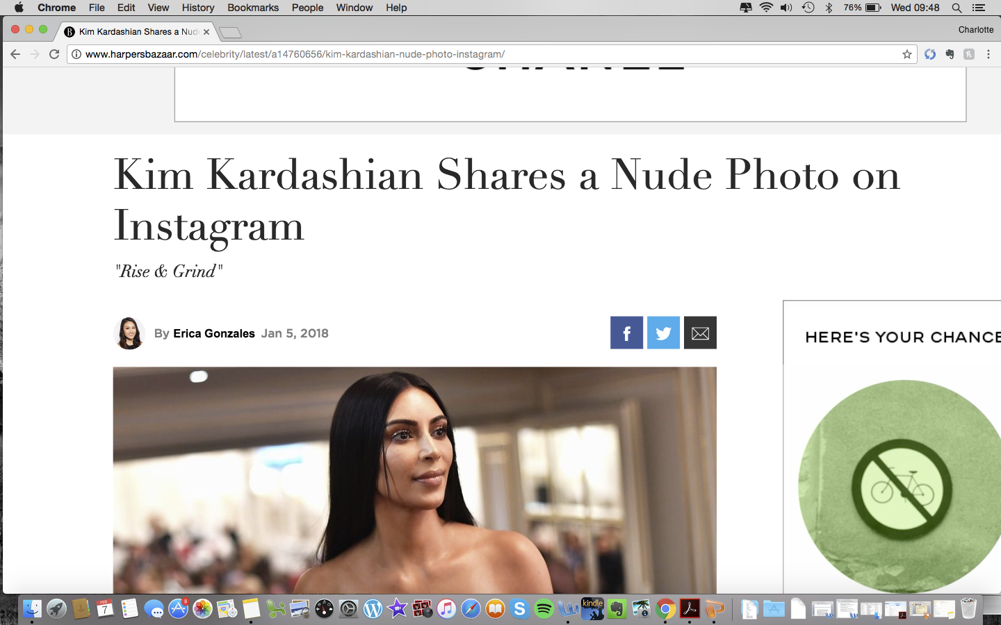
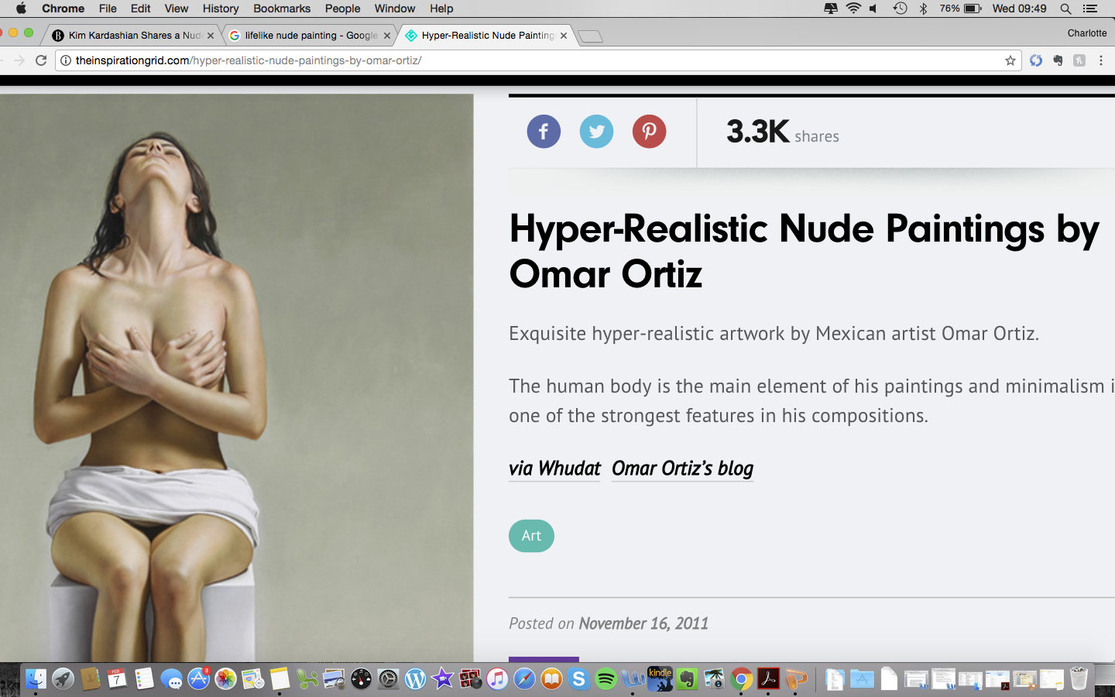
Nudity
No specific offence in Canada
- Obscenity s.163 CC
- Child Pornography? s.163.1 CC
- Indecent Exposure s.173 CC
Instagram’s anti-nudity policy + very specific exceptions
Breastfeeding + post-mastectomy scars
Sculptures, sculpture and art
Freedom of Expression?
Democracy?
Notes:
https://petapixel.com/2015/04/16/instagram-clarifies-its-rules-on-copyright-and-nudity/
https://petapixel.com/2015/10/05/instagrams-strict-anti-nudity-policy-is-due-to-apple/

Slide 7
Revenge Porn
British Columbia - Section 1(1) Privacy Act (T.K.L v T.M.P (2016) - secret explicit videos and online sharing for the purposes of revenge)
Manitoba – The Intimate Image Protection Act (2016)
Ontario – Tort of “public disclosure of private facts” (Doe v N.D 2016)
Nova Scotia – Cyber Security Act 2013 (struck down by Supreme Court of Nova Scotia)
Cf. Israel – Revenge porn explicitly added to the Sexual Harassment Act making it punishable by imprisonment for up to 5 years
Notes:
https://www.canadiancybersecuritylaw.com/2017/02/cyberbullying-revenge-porn-an-update-on-canadian-law/

Slide 8
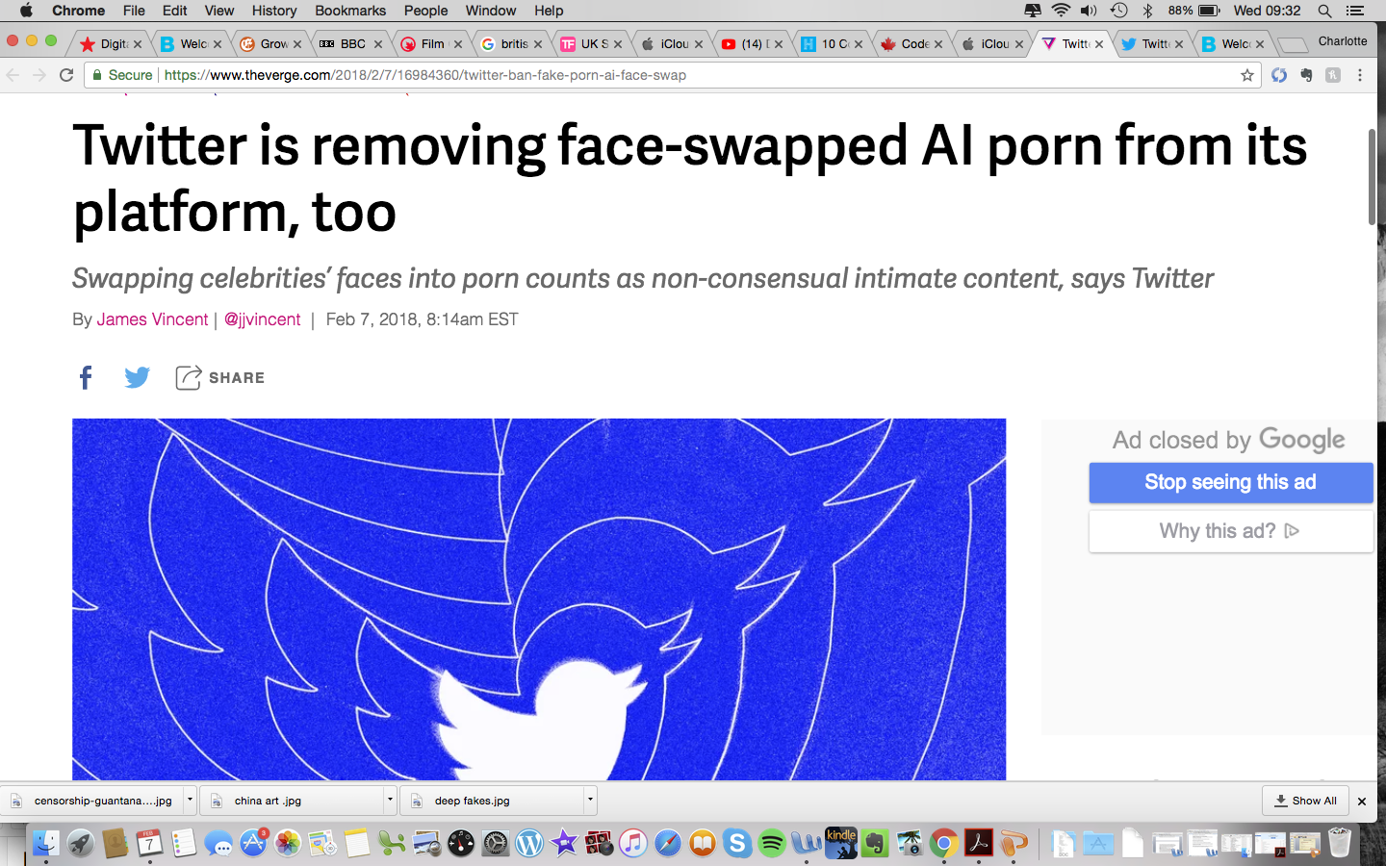
‘Deep Fakes’
No law YET!
Fake news +
TODAY Twitter announced that they are banning deep fake videos!
PornHub also banned AI porn
https://www.youtube.com/watch?v=VUE15N3q8LE
Personality Rights?
Passing Off?
Privacy? (s.3 BC Privacy Act)
Defamation?
Copyright?
Freedom of Expression? Art?

Slide 9
Swearing
175 (1) CC – Causing Disturbance
Every one who
(a) not being in a dwelling-house, causes a disturbance in or near a public place,
(i) by fighting, screaming, shouting, swearing, singing or using insulting or obscene language,
is guilty of an offence punishable on summary conviction.
Social Media as a public place?
Freedom of Expression?
Uniformly enforced?
Social Media could enforce
laws that are not enforced in reality

Slide 10
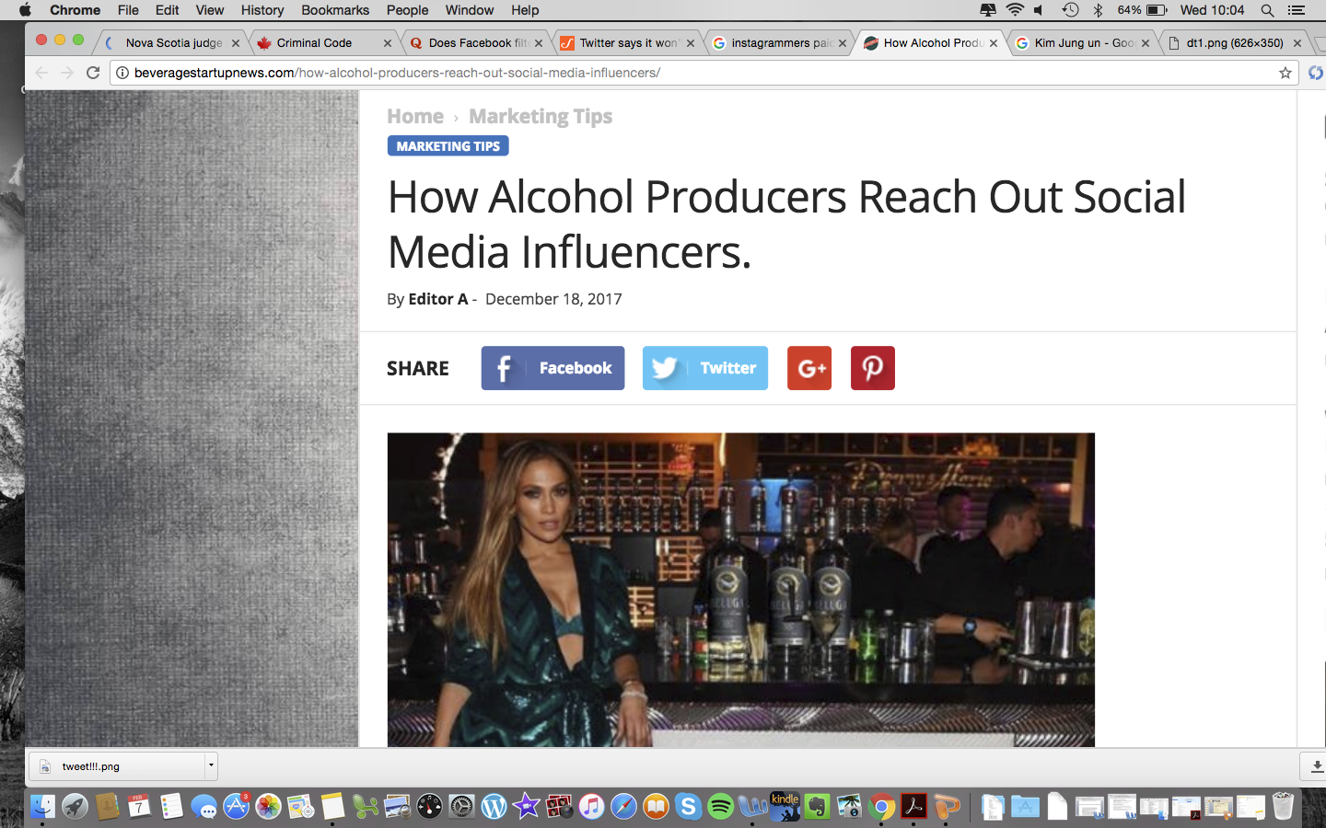
Drugs, Alcohol & Gambling
Legal v Illegal Use
Advertising to minors?
Social Media Influencers?
CRTC Code for Broadcast Advertising of Alcoholic Beverages
Commercial messages for alcohol beverages shall not:
…
(d) contain an endorsement of the product, personally or by implication, either directly or indirectly, by any person, character or group who is or is likely to be a role model for minors because of a past or present position of public trust, special achievement in any field of endeavour, association with charities and/or advocacy activities benefiting children, reputation or exposure in the mass media;
Notes:
https://crtc.gc.ca/eng/television/publicit/codesalco.htm

Slide 11
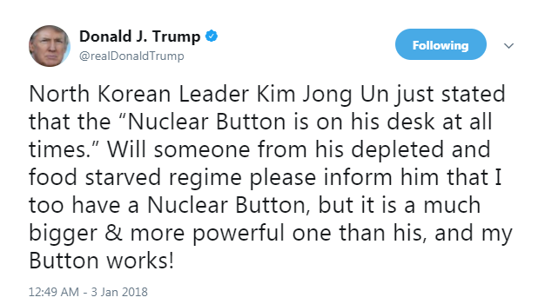
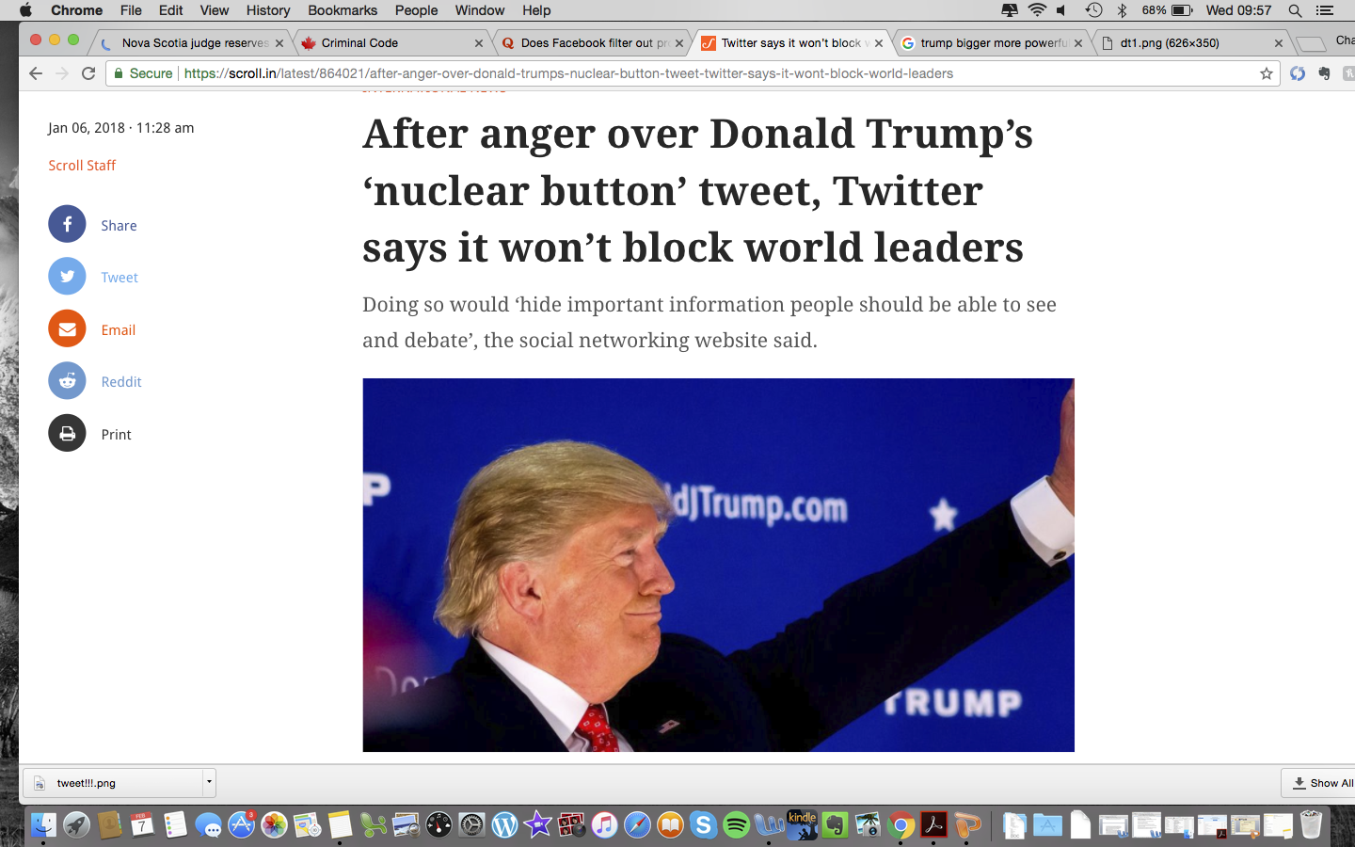
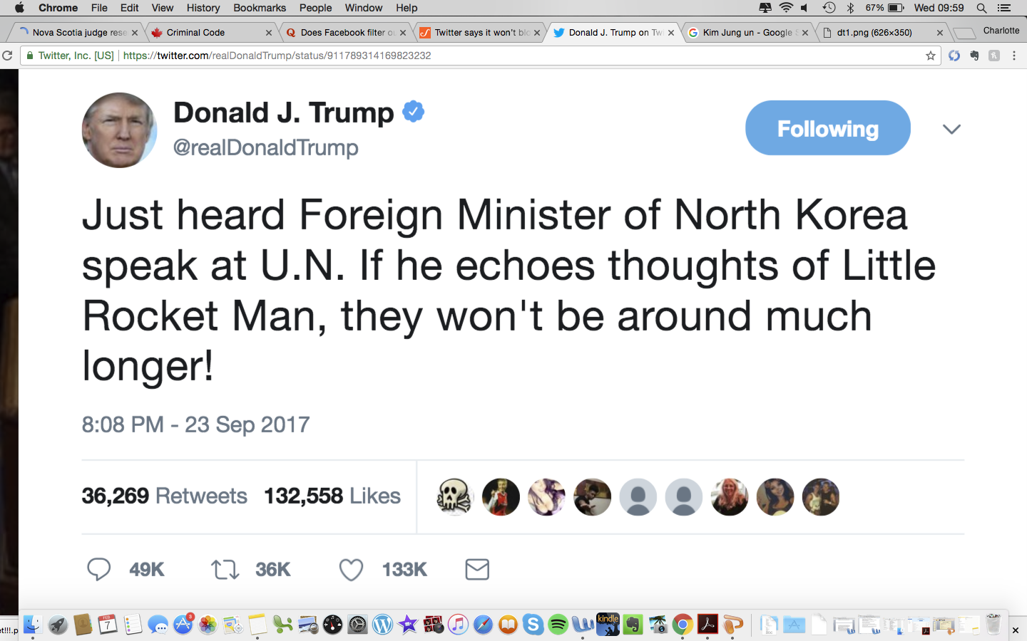
Take Downs & Blocking
Double standards?
Democracy?
Censorship?
Should Twitter block Donald Trump (and Kim Jung On)???
Compare with Ramzan Kadyrov (blocked by Facebook and Instagram – December 2017 – 3m Instagram followers
Notes:
We have talked about what people might want taken off, but what about stuff that is taken off?
Who is deciding?
Is it democratic?
Is it applied equally?

Slide 12
How are other expressive mediums regulated?

Slide 13
Television & Radio
Government Licensing
- CRTC - role or authorising non-Canadian channels for distribution in Canada
Complaints
Canadian Broadcast Standards Council (CBSC) – an industry funded self-regulating organisation (760 private radio and television stations) – enforces Code of Ethics of Canadian Association of Broadcaster
CRTC retains authority – in particular a) serious/controversial cases b) reviewing CBSC decisions b) dealing with complaints about broadcasters who are not CBSC members (most importantly public broadcasters - CBC)
- cf. Independent Press Standards Organisation (UK) – completely independent of government
Notes:
https://crtc.gc.ca/eng/info_sht/g8.htm

Slide 14
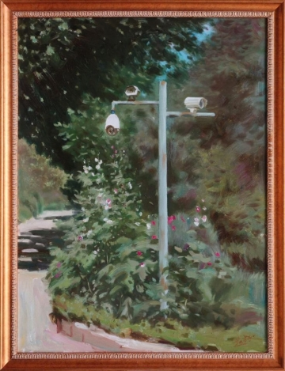
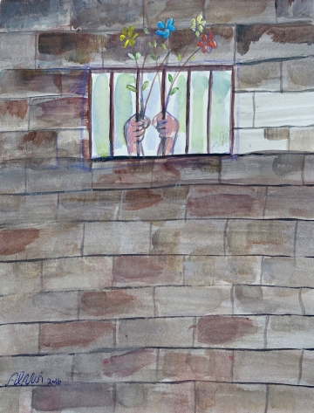
Art
Canada - Section 2(b) charter
Brazil – Queermuseum (263 worrks by 65 artists exploring work of marginalized cultural practitioners active in exploring queer narratives) – shut down on he basis of blasphemy & pedophilia
China – Paintings by Zhai Bando (above) criticizing mass surveillance barred from entering the country
United States – State ownership of Guantanomo Bay Art
Muhammad Ansi, “Untitled (Hands Holding Flowers through Bars)” (2016)
Notes:
https://hyperallergic.com/419184/art-censorship-2017/

Slide 15
Film
Film Classifications & censorship
Canada – only bans films containing prohibited content. Classification is a provincial responsibility.
- British Columbia Film Classification Office - part of the Business Practices and Consumer Protection Authority in the Canadian province of British Columbia under the Motion Picture Act (MP Act) of BC.
United States – only bans films with content prohibited by specific laws (eg child pronography) – no federal agency control
- Independent/Self-censorship - Motion Picture Association of America (MPAA) film rating system
China - China’s State Administration of Press, Publication, Radio, Film and - “No television drama shall show abnormal sexual relationships and behaviours, such as incest, same-sex relationships, sexual perversion, sexual assault, sexual abuse, sexual violence, and so on”… extends to smoking, drinking, adultery, sexually suggestive clothing, even reincarnation.
Notes:
https://www.theguardian.com/tv-and-radio/2016/mar/04/china-bans-gay-people-television-clampdown-xi-jinping-censorship

Slide 16
Internet Content
Identity issues – requiring real names (verification, ID, privacy issues) – to facilitate that
ISP liability
- EU's E-Commerce Directive (ISP protection)
Cf. social media company liability
Notes:
Blogs? Videos…
https://torrentfreak.com/uk-should-hold-google-facebook-liable-for-illegal-content-after-brexit-171217/

Slide 17
Social Media?

Slide 18
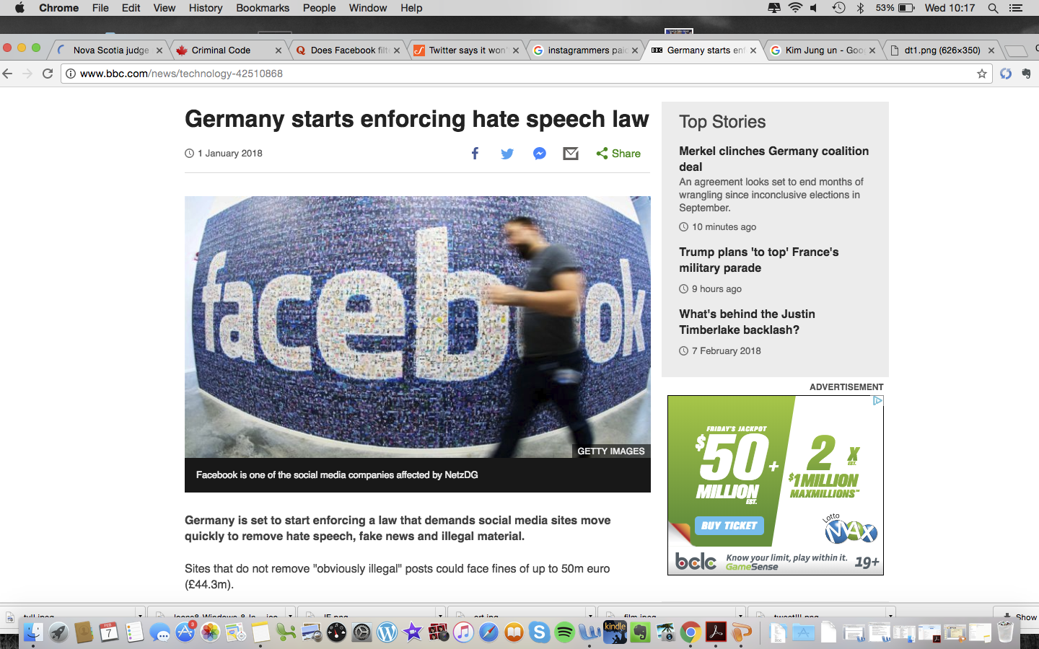
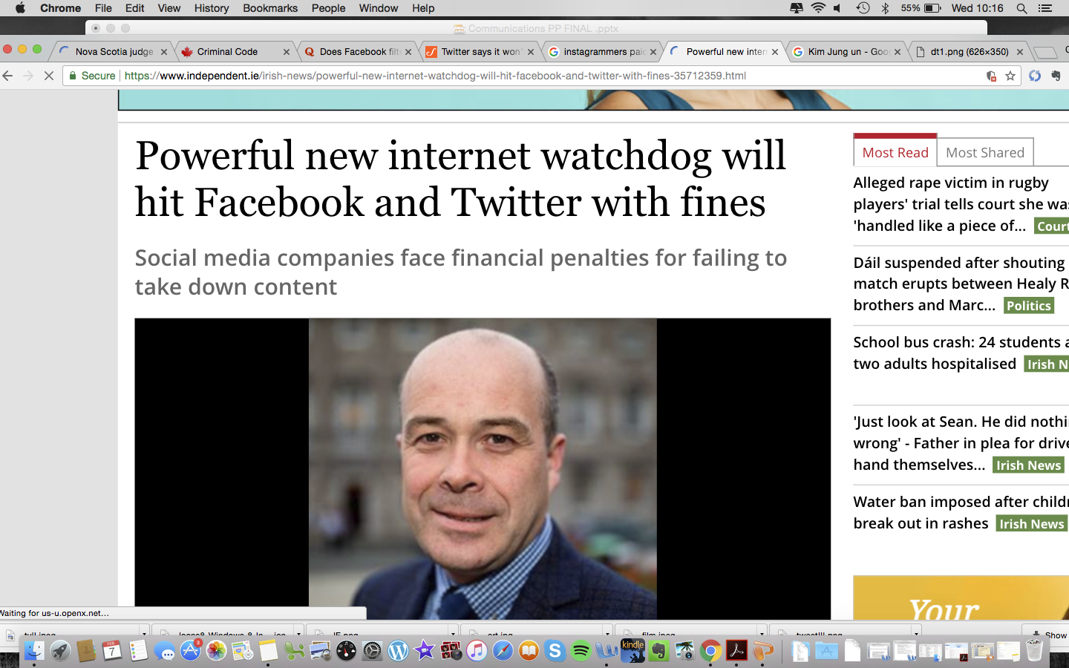
Government Regulation?
UK - government committee on Standards in Public Life recently suggested that UK move away from ISP liability protections under EU law post-Brexit
Ireland – digital Safety Watchdog with a social media code?
Germany – social media companies fined non-removal of prohibited content (including hate speech within 24 hours) – 1 January 2018
“Netzwerkdurchsetzungsgesetz (NetzDG) law”
ISP Liability?
Free speech?
Jurisdictional Issues?
Notes:
http://humansarefree.com/2016/06/facebook-twitter-youtube-microsoft-vow.html
https://torrentfreak.com/uk-should-hold-google-facebook-liable-for-illegal-content-after-brexit-171217/

Slide 19
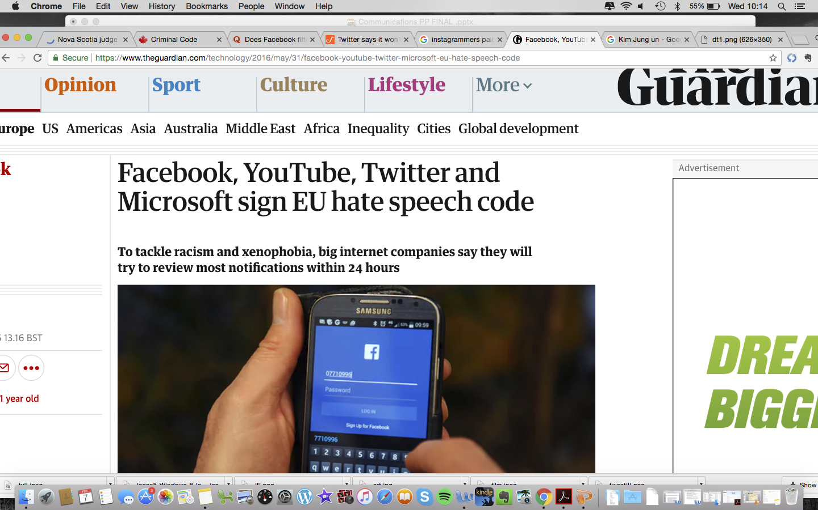
Independent Regulation?
Example of US Film Classification
Uniformity
Industry Support
Streamlined with Legal Standards
What about those who do not join?
Public-Private Partnership
– EU ‘code of conduct’

Slide 20
No Regulation
Leave everything as it is?
Allow private companies to make decisions regarding content
Too large and fast to regulate
A matter for private contract?
Live content e.g periscope
Twitter media policy –
https://help.twitter.com/en/rules-and-policies/media-policy

Slide 21
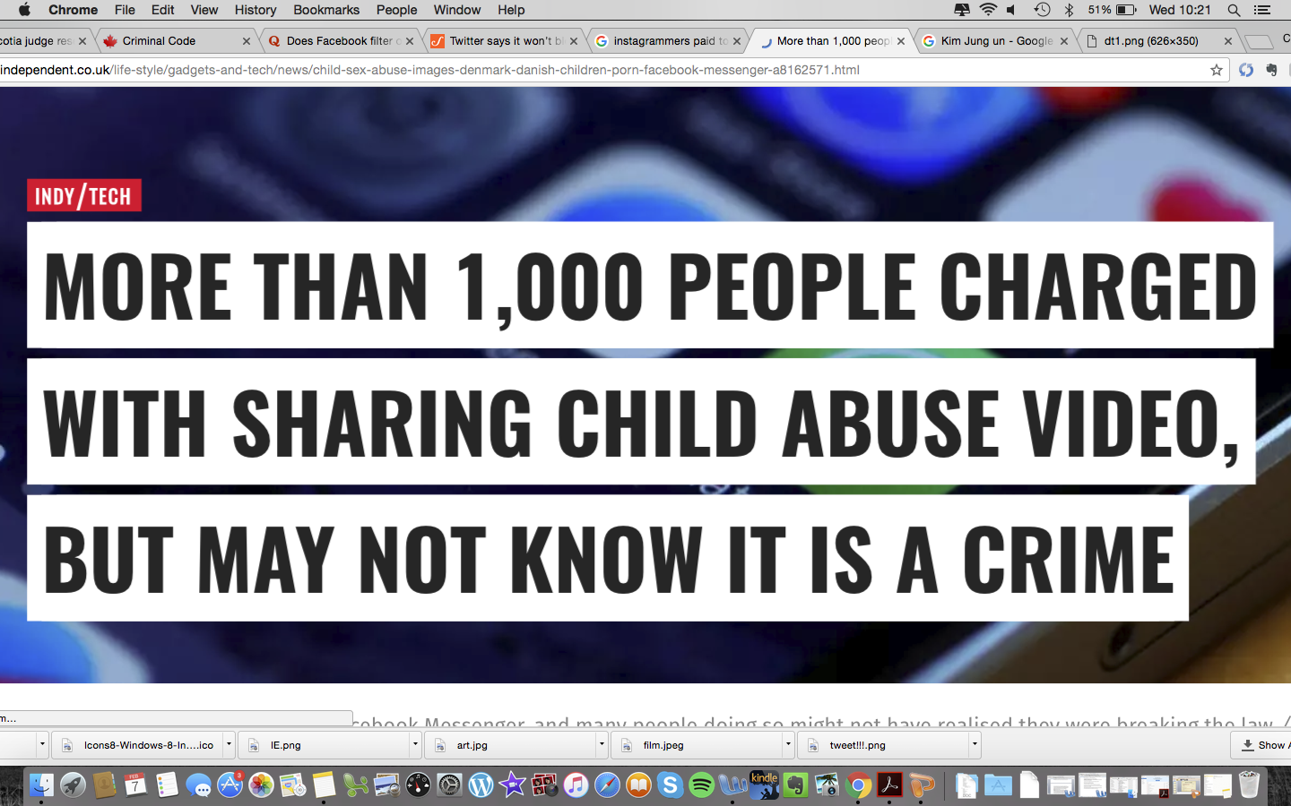
No Exclusion Clauses
Leave it to the law
Invalidate exclusion clauses?
Forum Shopping Concerns? Jurisdiction?
Infinite liability for social media companies? - Douez v Facebook
Enforceability – Court time and resources
- January 2018 –over 1,000 teenagers charged in Denmark with sharing video footage on facebook of two 15-year olds engaged in sexual activity

Slide 22
Questions?

