Slide 1
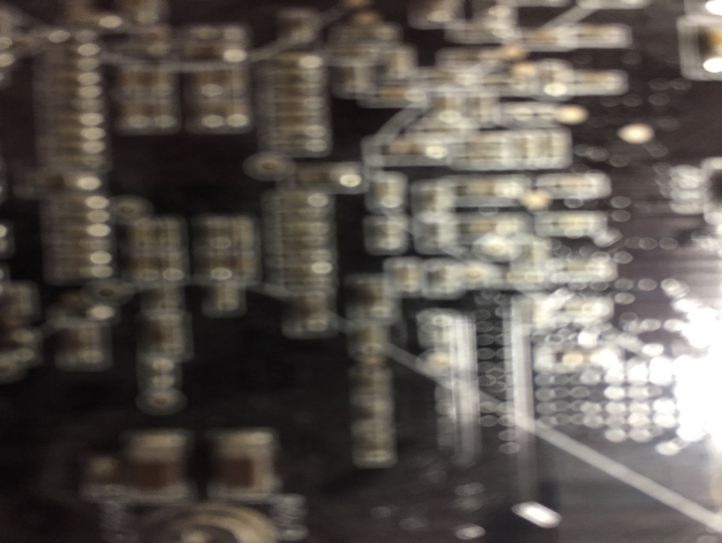

Telecommunications Policy: Origins & Regulation
Talk 5
LAW 424 001
Communications Law 2.0
Allard School of Law, UBC
Spring, 2018
Jon Festinger Q.C.
Centre for Digital Media
QMUL School of Law (CCLS)
Festinger Law & Strategy
http://commlaw.allard.ubc
@jonfestinger
jon_festinger@thecdm.ca

Slide 2
Logistics

Slide 3
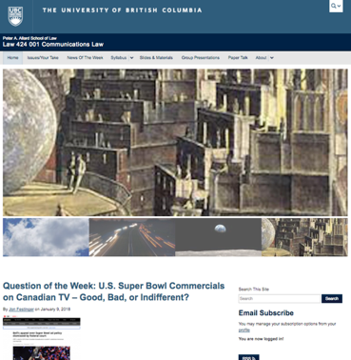
Course Website
http://commlaw.allard.ubc.ca

Slide 4
For full privileges on the website
1. Please create an account at http://cms.ubc.ca/ using your CWL.
2. Once you create an account and sign in at http://cms.ubc.ca/ you can click your name in the top right. Half way down the following page will be your WordPress email address.
3. Send me your WordPress email address at jfestinger@telus.net or at jon@fblawstrategy.com
4. Then, I will invite you to participate with authoring privileges via your WordPress email address.

Slide 5
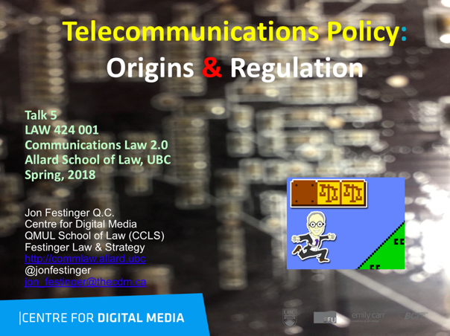
On the Website…

Slide 6
Group Presentations:
All in?

Slide 7
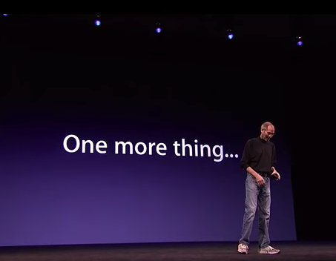

Slide 8
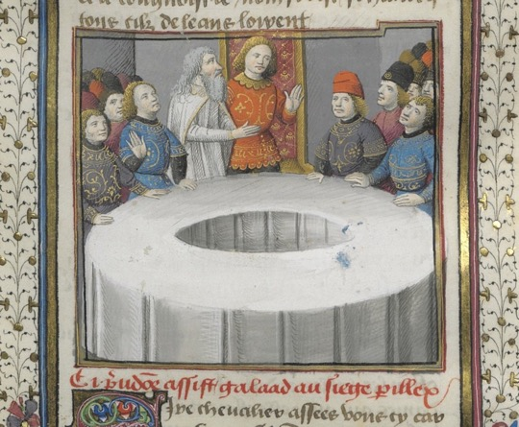
Round-table of presentation topics
(if available, even if tentative)?

Slide 9
QUESTIONS?
THOUGHTS?
DISCUSSION?

Slide 10

In-Class Group Exercise: STEP 1

Slide 11
Invent a media technology that will impact the world …

Slide 12
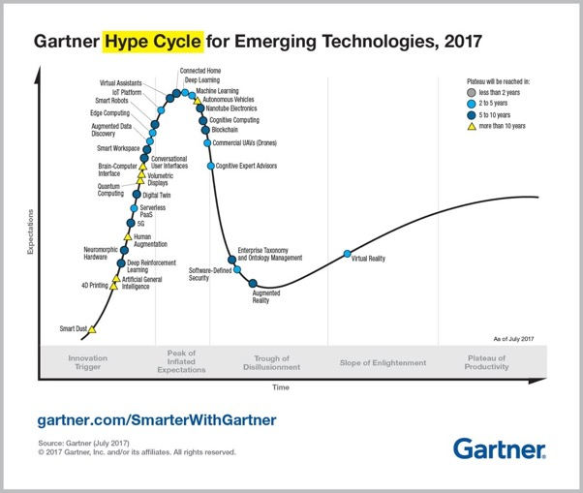
Resource 1

Slide 13
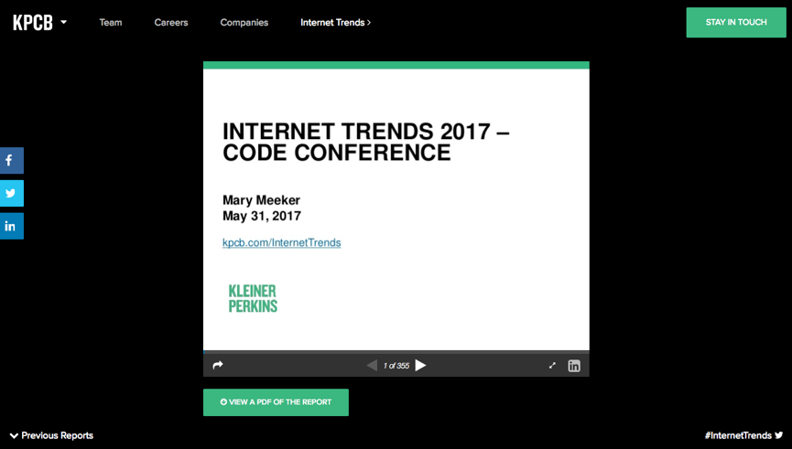
Resource 2
http://www.kpcb.com/internet-trends

Slide 14
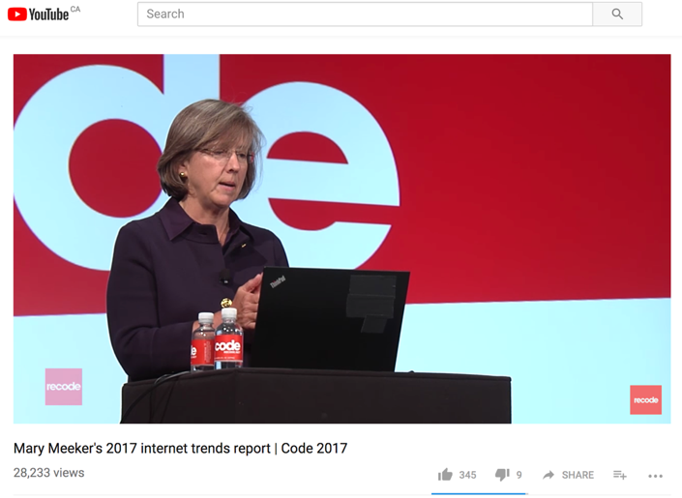
https://youtu.be/UC8GwG6srqs

Slide 15

Resource 3???

Slide 16
QUESTIONS?
THOUGHTS?
DISCUSSION?

Slide 17

Pause

Slide 18
DESCRIBE WHAT YOU INVENTED

Slide 19

of
Communications
Law?

Slide 20
“To regulate, or not to regulate, that is the question.”

Slide 21

Historical Example: Sega video games service Public Notice CRTC 1995-5 - EXEMPTION ORDER RESPECTINGVIDEO GAMES PROGRAMMING SERVICE UNDERTAKINGS

Slide 22
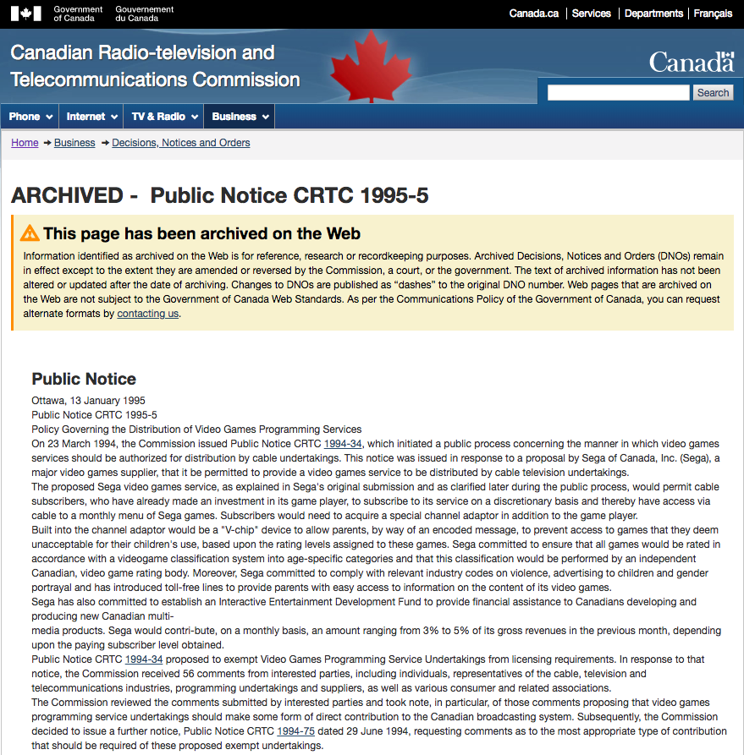

Slide 23
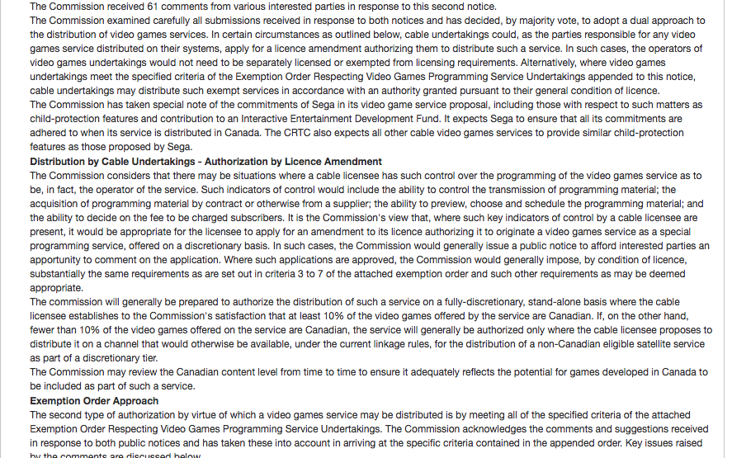

Slide 24
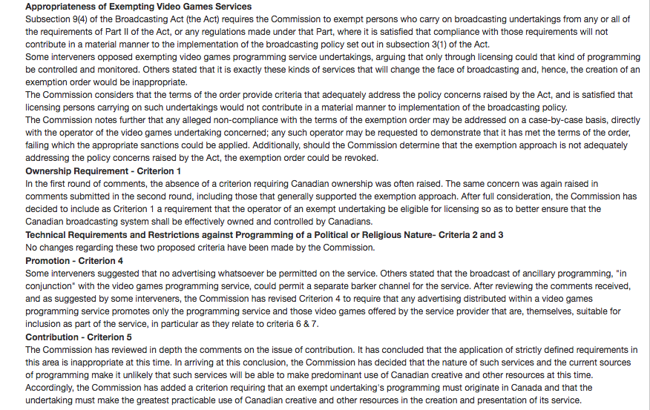

Slide 25
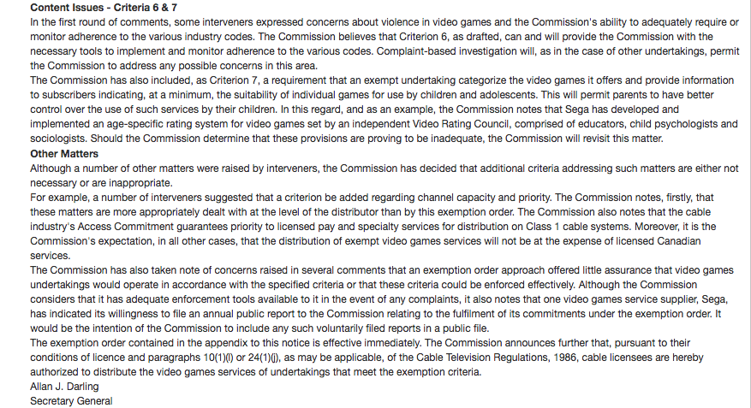

Slide 26
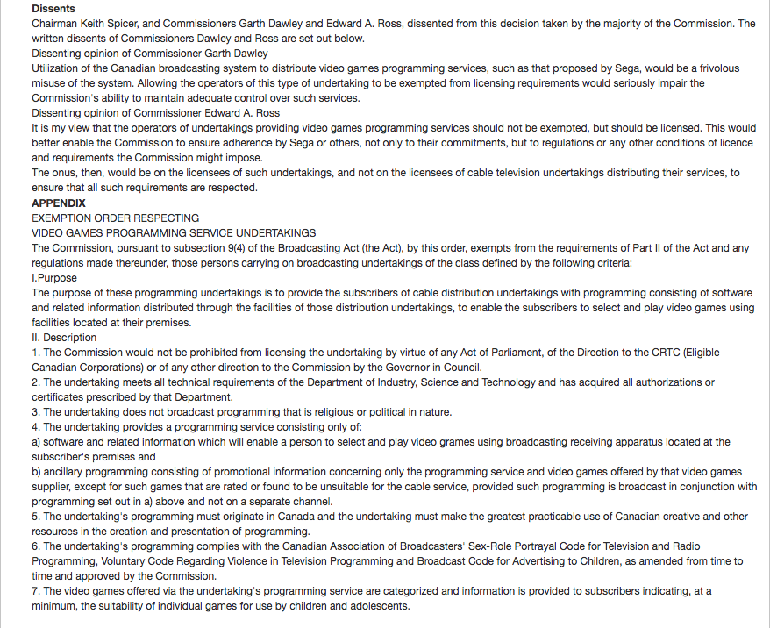

Slide 27
STEP 2

Slide 28
…Now ask is it possibly within the definition of “Broadcasting” in the Broadcasting Act.

Slide 29
broadcasting means any transmission of programs, whether or not encrypted, by radio waves or other means of telecommunication for reception by the public by means of broadcasting receiving apparatus, but does not include any such transmission of programs that is made solely for performance or display in a public place;
broadcasting receiving apparatus means a device, or combination of devices, intended for or capable of being used for the reception of broadcasting;
encrypted means treated electronically or otherwise for the purpose of preventing intelligible reception;
program means sounds or visual images, or a combination of sounds and visual images, that are intended to inform, enlighten or entertain, but does not include visual images, whether or not combined with sounds, that consist predominantly of alphanumeric text;
radio waves means electromagnetic waves of frequencies lower than 3 000 GHz that are propagated in space without artificial guide;
(2) For the purposes of this Act, other means of telecommunication means any wire, cable, radio, optical or other electromagnetic system, or any similar technical system

Slide 30
QUESTIONS?
THOUGHTS?
DISCUSSION?

Slide 31
DESCRIBE IF WHAT YOU’VE INVENTED IS “BROADCASTING”

Slide 32
QUESTIONS?
THOUGHTS?
DISCUSSION?

Slide 33
Pause

Slide 34


A MATTER OF PERSPECTIVE

Slide 35
News of the Week

Slide 36
Yours?

Slide 37
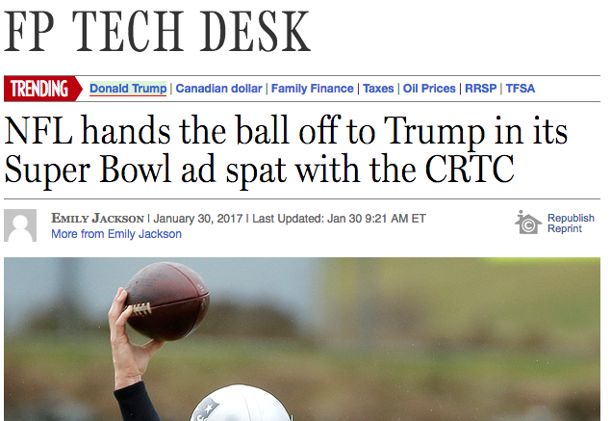
Last year this time…

Slide 38
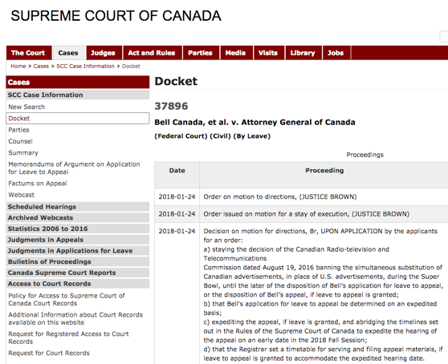
Activity on the Super Bowl issue…

Slide 39

Other than that…

Slide 40
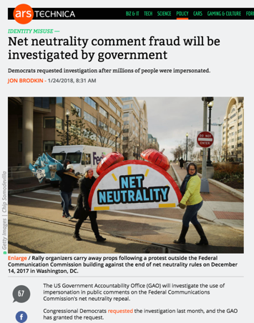
Back to the present (future)

Slide 41
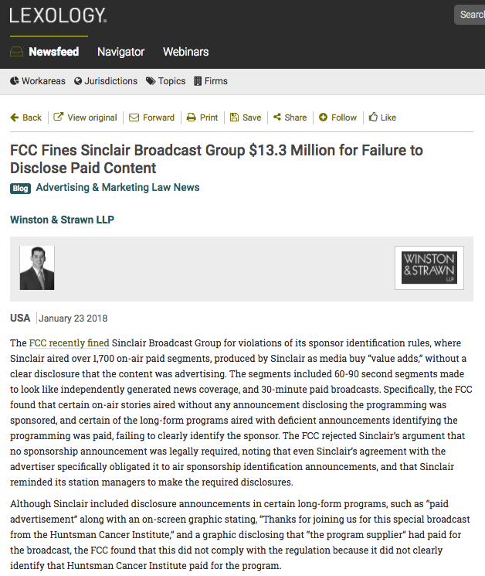

Slide 42
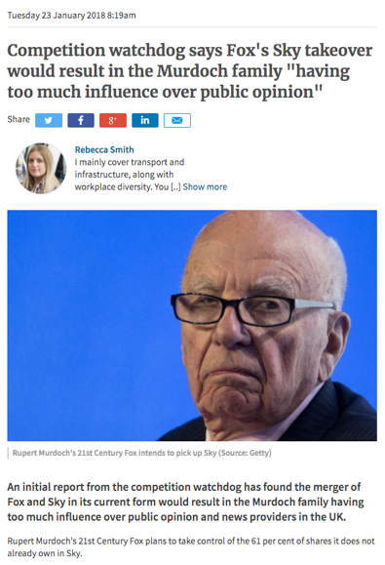

Slide 43
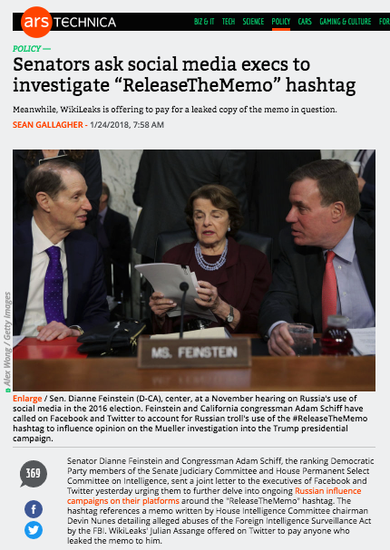

Slide 44
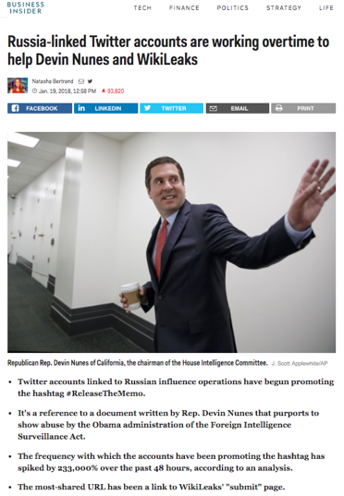

Slide 45


Slide 46
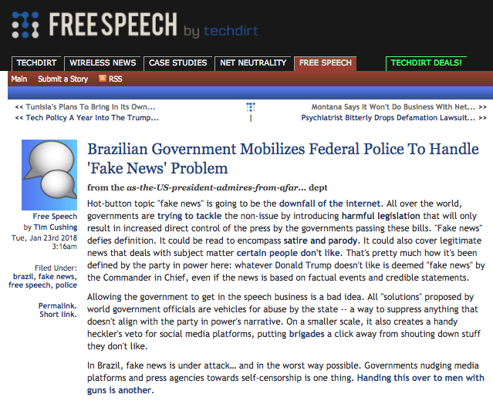

Slide 47
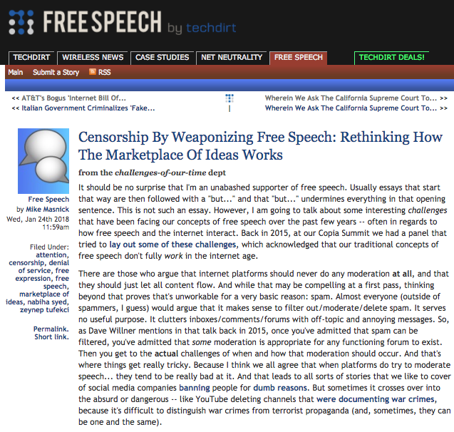

Slide 48
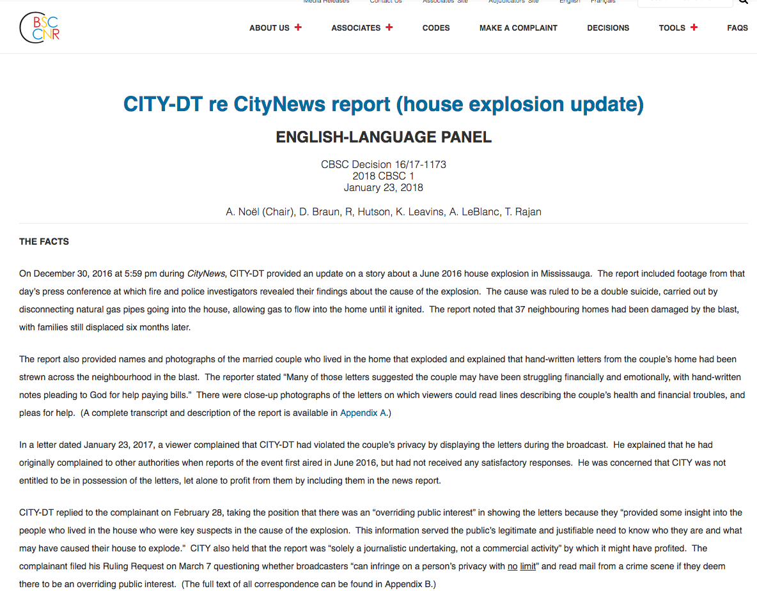

Slide 49
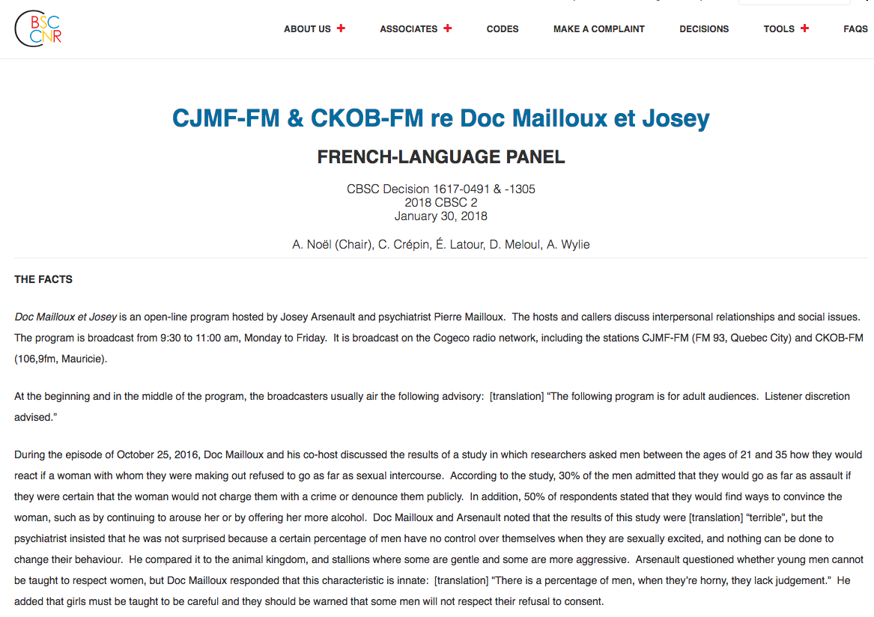

Slide 50
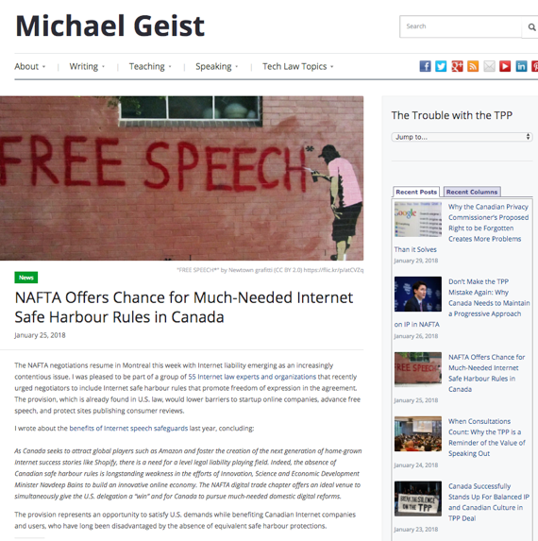

Slide 51
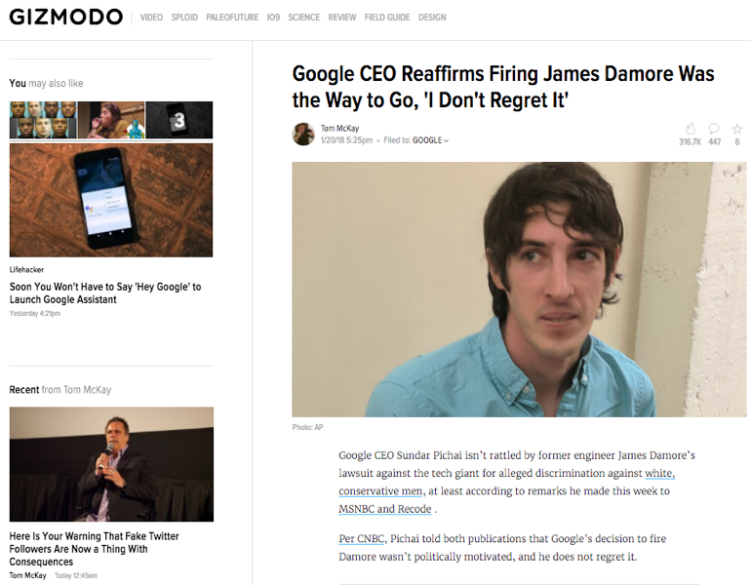

Slide 52
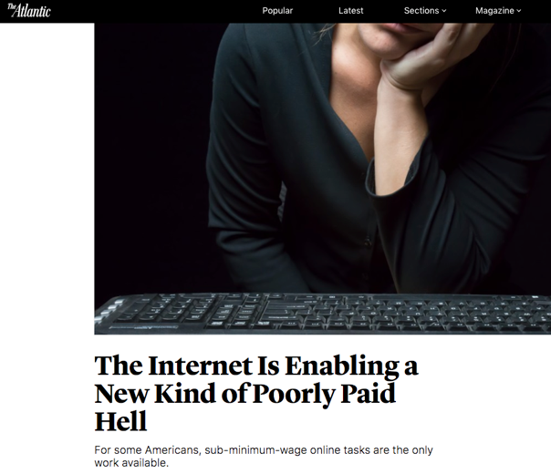

Slide 53
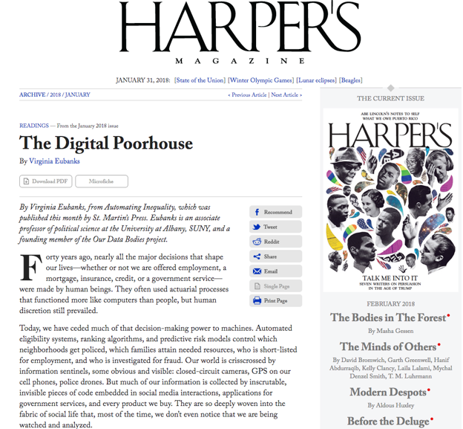

Slide 54


Slide 55

Coming soon?…

Slide 56
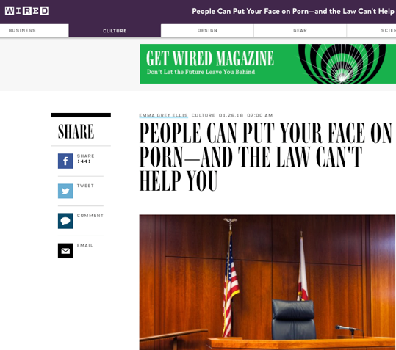

Slide 57
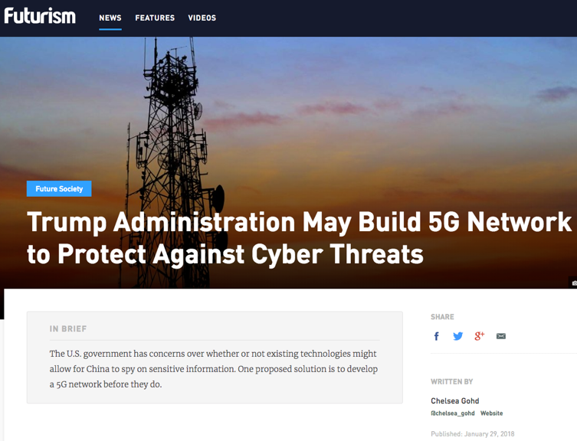

Slide 58
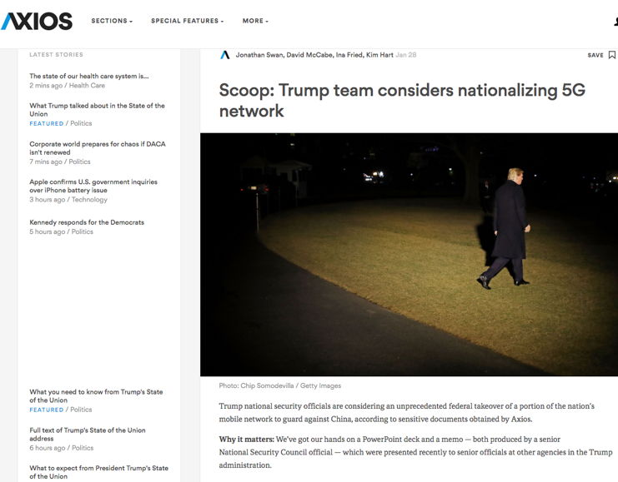

Slide 59
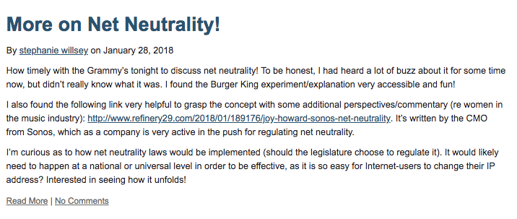
From the website…

Slide 60
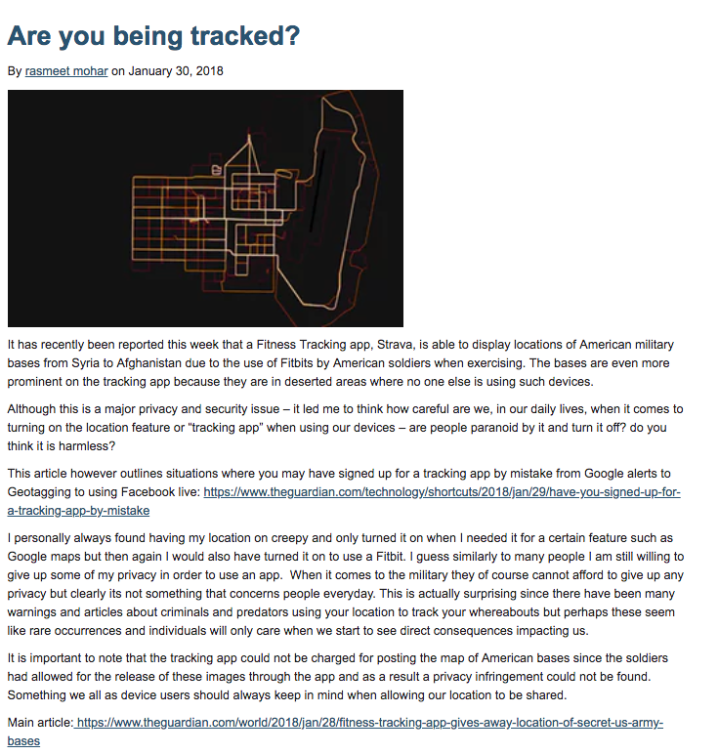

Slide 61
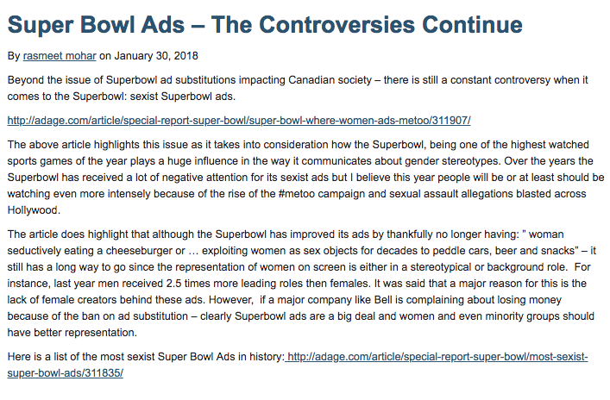

Slide 62
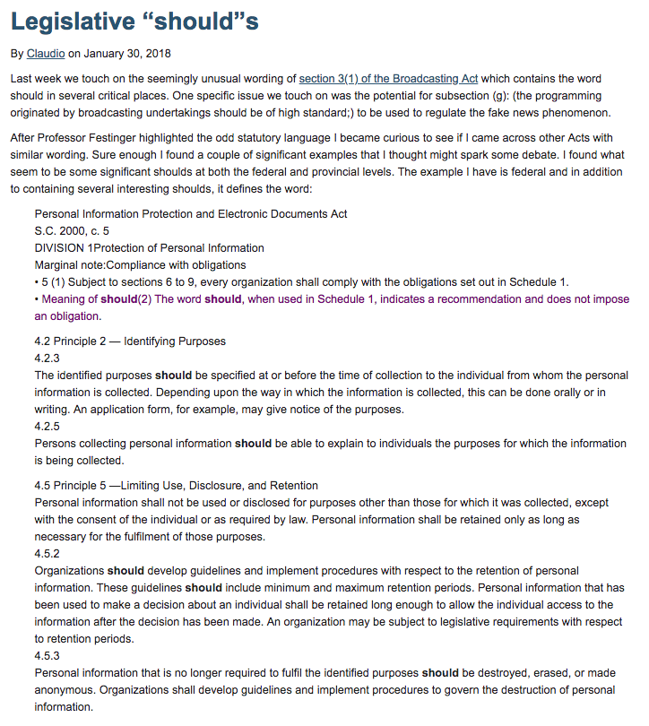

Slide 63
QUESTIONS?
THOUGHTS?
DISCUSSION?

Slide 64
Pause

Slide 65
QUESTION
OF THE
WEEK

Slide 66

Will the “Singularity” be achieved by the year 2065?

Slide 67


Slide 68
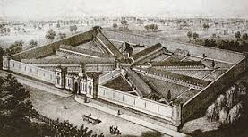
Reminds me of: FCC prisoner case

Slide 69


Slide 70
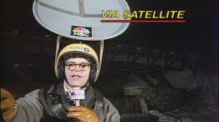
Are we all turning into 24/7 television transmitters?
Regulatory implications???

Slide 71
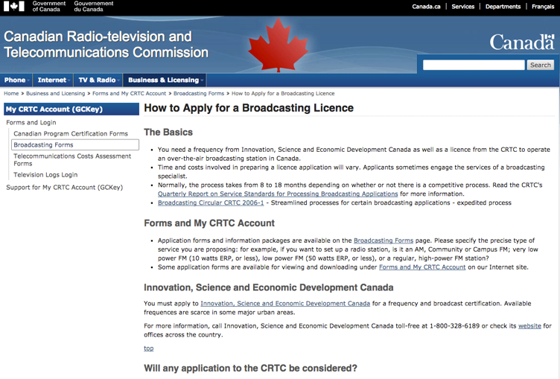
Should/could we be licensed?

Slide 72
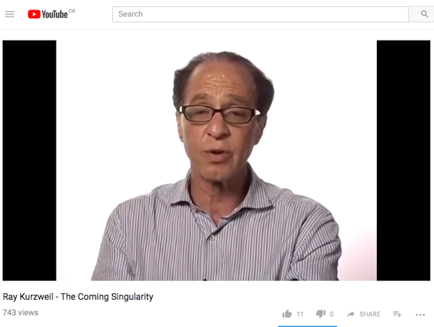
Deeper Issue?

Slide 73
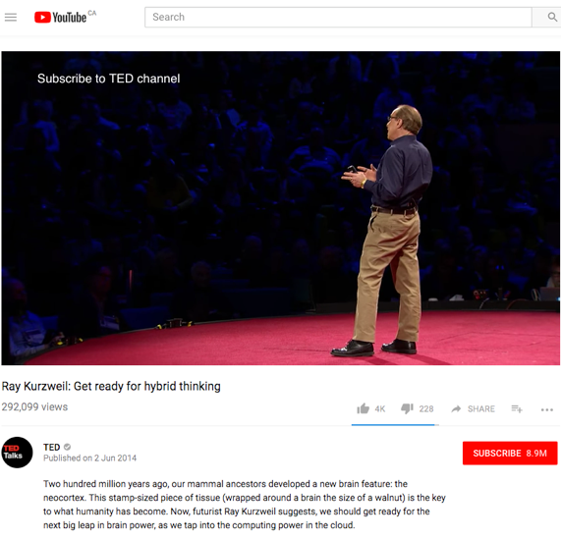

Slide 74
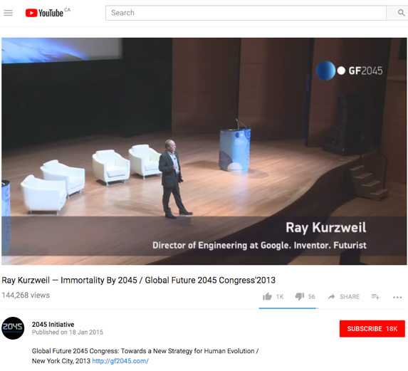

Slide 75
Whither Law?

Slide 76
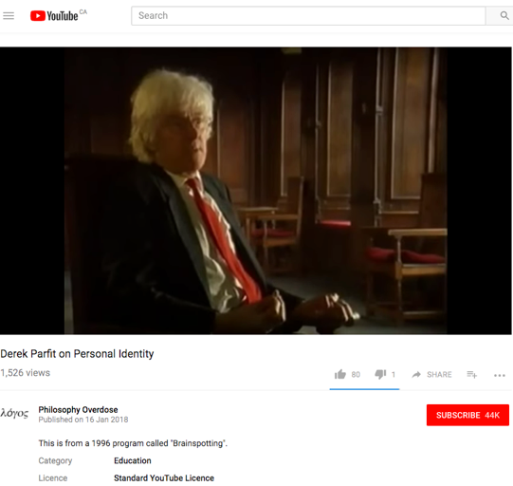
Whither Personhood?

Slide 77

BY 2065???

Slide 78
QUESTIONS?
THOUGHTS?
DISCUSSION?

Slide 79
Pause

Slide 80

RECAPPING

Slide 81
Core Binaries
Cultural
Content
Regulation
Privacy
Industrial
Carriage
Free Market
Surveillance

Slide 82

In Broadcasting the issue seems to be
CULTURE (OWNERSHIP)

Slide 83

In Telecom the issue seems to be
SOVERIGNTY/(OWNERSHIP)

Slide 84

Today → Telecommunications Policy

Slide 85
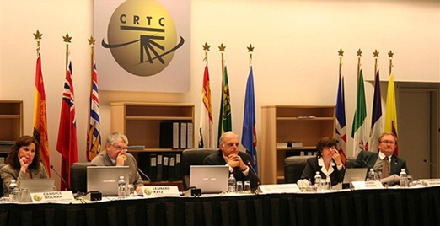
It’s own world ?
E.G. Telecom (not broadcasting) CRTC hearings under oath, with cross-examination (run by counsel)

Slide 86
The Canadian Telecom Industry
Telecom Service Providers (TSPs)
LECs - ILECs & CLECs
Resellers – Wireline & MVNOs
(Voice over Internet Protocol (VOIP) providers)
Wireless Service Providers (WSPs)
Internet Service Providers (ISPs)
New Media (OTT) (?)

Slide 87

Do you speak

Slide 88
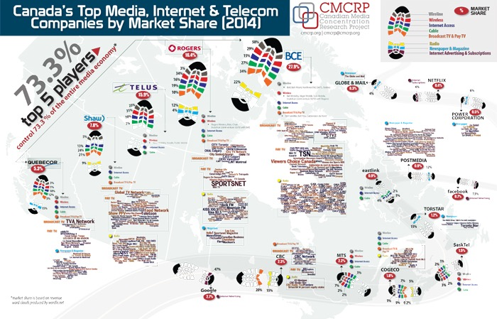

Slide 89
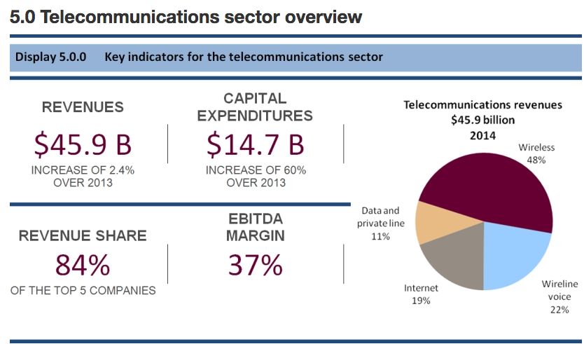
CRTC 2014 figures published in 2015

Slide 90
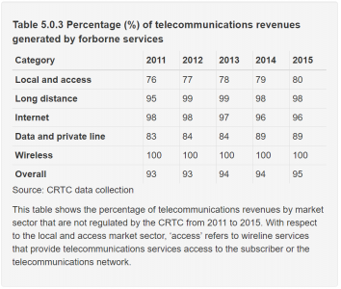
Is this good or bad?
Thanks to David Heinrich for finding the latest version of this chart

Slide 91
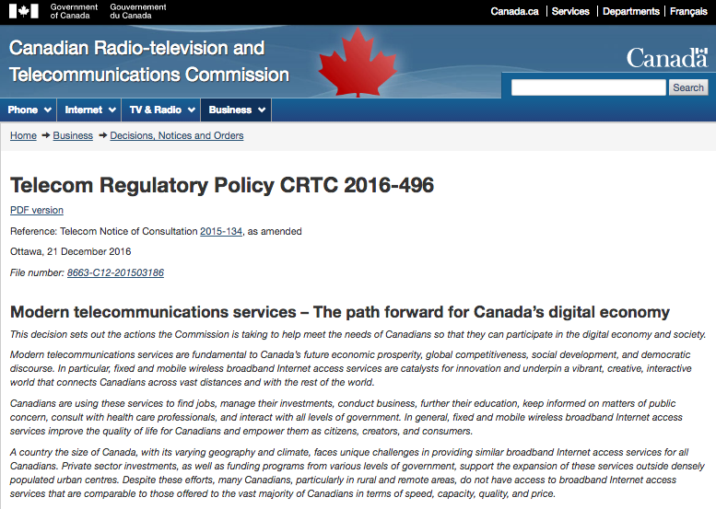

Slide 92
QUESTIONS?
THOUGHTS?
DISCUSSION?

Slide 93
Who’s Who ????????
  The CRTC: telecom & broadcasting regulator
  Industry Canada: telecom policy maker & spectrum regulator
  Canadian Heritage: broadcasting & cultural policy maker
  Other agencies: Courts, Competition Bureau; CCTS, various self-regulatory bodies

Slide 94
Telecom History
1852 First Telegraphs Act → construction powers & duty to dispatch messages in order received (1st telecom non-discrimination law)
1892 Federal Cabinet first regulates Bell Canada’s rates
1900’s (early) Federal Gov’t regulates spectrum

Slide 95
1905 Mullock Select Ctee. where Bell Telephone Co. of Canada was accused of neglecting unprofitable lines.
1906 Board of Railway Commissioners regulate telephone rate.
1908 Three prairie Bell franchises are nationalized (all but Sasktel re-privatized in the 1980’s)
1938 Board of Transport Commissioners as regulator

Slide 96
1950-56 Hush-A-Phone battle in U.S. courts. Hush-A-Phone v. United States, 238 F.2d 266 (D.C. Cir. 1956) held that a small, cup-like device which mounted on the speaking party's microphone, reducing the risk of conversations being overheard and increasing sound fidelity for the listening party could be attached to a phone despite the FCC’s finding in favour of ATT to the contrary.

Slide 97
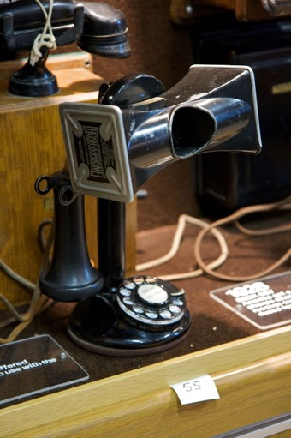
Hush-A-Phone v. Monopoly
1956

Slide 98
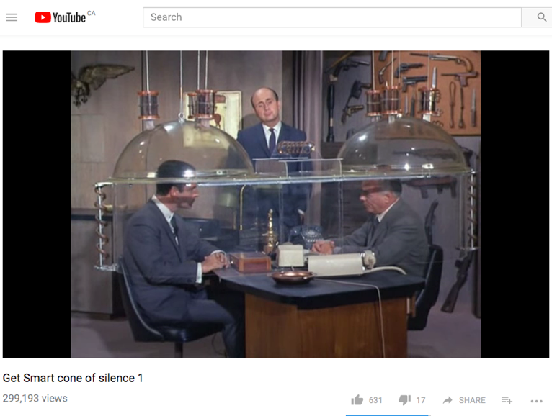
https://youtu.be/HWtPPWi6OMQ

Slide 99
1967 Canadian Transport Commission as regulator
1976 CRT(T)C as regulator & convergence of broadcasting & telecom regulation
1979 Private voice and data competition allowed in Canada. CRTC required telcos to interconnect with CNCP so CNCP could compete in that market.

Slide 100
1980 Terminal Attachment allowed in Canada by CRTC in CRTC 1980-82. Network harm “concerns” dealt with through Industry Canada equipment certification.
1982 Longstanding anti-trust concerns in the U.S. resulted in a consent decree breaking up of AT&T into regional RBOC’s. Monopoly regulation shifted to promotion of competition as the means to protect consumers.
1984 Wireless comes to Canada, Cantel/Rogers licensed by CRTC.

Slide 101
1985 CNCP denied entry into facilities-based long distance market due to concerns about the impact of competition on residential rates
1987 Long Distance Resale in Canada (resellers typically owned switches, but not long distance transmission lines.
1992 Long Distance Facilities Based competition allowed in Canada. Unitel (successor to CNCP) allowed to interconnect. Price wars follow. Long distance competition was never really successful. Today rates are low because the competitive pressures from new technologies.

Slide 102
1993 CRTC forbore from wireless regulation.
1994 Rate Base/Rate of Return Regulation replaced by a Price Cap Regime → Inflation-related formula sets upper limits of rates → Principles established to allow competitors to access incumbents “essential facilities” at cost-based rates.

Slide 103
1997 Local Competition (voice & data including internet) in Canada. Called for extensive unbundling of “essential facilities”. Followed by rapidly growing competition from cableco’s as they already had a 2nd wire to the home.
2006 Cabinet issues Telecom Policy Direction
“rely on market forces to maximum extent feasible”
CRTC measures to be efficient & proportionate
Generally streamline regulatory process services

Slide 104
2008 Traffic Throttling complaint
2009 CRTC Internet Traffic Management Practices (ITMP’s) Policy
Prior approval of discriminatory wholesale ITMP’s
Primary ISP’s must show valid reasons for discriminatory ITMP’s & limit harm
Preference for economic over technical ITMP’s
Disclosure to retail consumers

Slide 105
2014 CRTC Wireless Code
2016 Telecom Regulatory Policy CRTC 2016-496, Modern telecommunications services – The path forward for Canada’s digital economy → Broadband internet access as a basic telecommunications service

Slide 106
Telecommunications Policy
PRINCIPLES

Slide 107
Why were/are Telecommunications
Services Regulated?
“Natural monopoly” given economies of scale for network infrastructure ?
Shift from monopoly towards competition (1984 forward)
Myths and memes of the information economy → “The Information Highway”
Security & Sovereignty

Slide 108
Telecom Act
7. Telecom policy objectives
24. Services to be offered under CRTC-approved tariffs
27(1) Rates to be just & reasonable
27(2) No unjust discrimination against or undue preferences toward any person
34. CRTC forbearance power (to be used, e.g. where competition is sufficient to protect consumers)
36. Carriers not to control content or influence meaning of telecoms carried for public
40. Interconnection orders

Slide 109
Forbearance
CRTC may forbear where it finds that this will be consistent with telecom policy objectives and shall forbear where the service in question “is or will be subject to competition sufficient to protect the interests of users”
CRTC may forbear partially
Forbearance covers conditions of service, tariffs, carrier-access agreements etc.
CRTC developed principles governing the introduction of forbearance, including market share and market power analysis

Slide 110
CRTC Telecom Processes
2011 Rules of Procedure
Tariff filing process → now streamlined
Forbearance from most retail tariff regulation
Mostly “paper hearings”
Policy hearings are more common
Move towards ADR & expedited hearings or argument only hearing

Slide 111
Telecom Act: Policy Powers
S. 8, 10: Governor in Council (GiC) Policy Direction Power - proposed order to be discussed with CRTC, Gazetted & referred to Parliamentary Committee
S. 12: GiC Power to vary, rescind or refer back CRTC decisions - within 1 year
S. 14: May order CRTC to report on any matter under Telecom Act or Special Act

Slide 112
Policy parameters of telecom regulation
Canadian Ownership
Universal Service
Cross-subsidies were possible (urban/rural; business/residential; long distance/local)
Competition (since 1984 through both competition & privatization e.g. AGT & MTS)

Slide 113
CRTC has gradually forborne from economic regulation of telecommunications services as markets became more competitive. Price cap regulation remains in place for some local markets where there is less competition.
Requiring interconnection as non-interconnecting telecom networks are inefficient costing their customers more. AKA competitor access to “essential facilities”. E.G. a. CRTC 2015-177 (May 2015) CRTC regulates wholesale wireless roaming rates; b. CRTC 2015-236 (July 2015) CRTC mandates access to FTTP

Slide 114
Non-interference with content by telecom carriers (no responsibility either)
Net neutrality
Privacy (???)

Slide 115
QUESTIONS?
THOUGHTS?
DISCUSSION?

Slide 117
Leading to net neutrality (Canadian style)
Telecommunications Act S. 27
Just and reasonable rates
27 (1) Every rate charged by a Canadian carrier for a telecommunications service shall be just and reasonable.
Unjust discrimination
(2) No Canadian carrier shall, in relation to the provision of a telecommunications service or the charging of a rate for it, unjustly discriminate or give an undue or unreasonable preference toward any person, including itself, or subject any person to an undue or unreasonable disadvantage.

Slide 118
QUESTIONS?
THOUGHTS?
DISCUSSION?

Slide 119
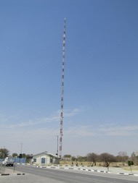
Coming Soon
“Broadcasting Policy: Origins, Regulation & Cases”

Slide 120
A MATTER OF PERSPECTIVE

Slide 121

Always include a cat picture

Slide 122
Our Academic Partners

