Slide 1


“Writing the Communications Act”
Talk 9
LAW 424 001
Communications Law 2.0
Allard School of Law, UBC
Spring, 2017
Jon Festinger Q.C.
Centre for Digital Media
Festinger Law & Strategy
http://commlaw.allard.ubc
@jonfestinger
jon_festinger@thecdm.ca

Slide 2
Logistics

Slide 3
Questions on..
Papers ?
Participation ?
Class Presentations ?

Slide 4

Additional resource?
http://berkmankleinassembly.org/includes/documents/Internet_Society_Syllabus_2017.pdf

Slide 5
News of the Week

Slide 6
Yours?

Slide 7

Mine

Slide 8

Explanation for last week ?

Slide 9


Slide 10
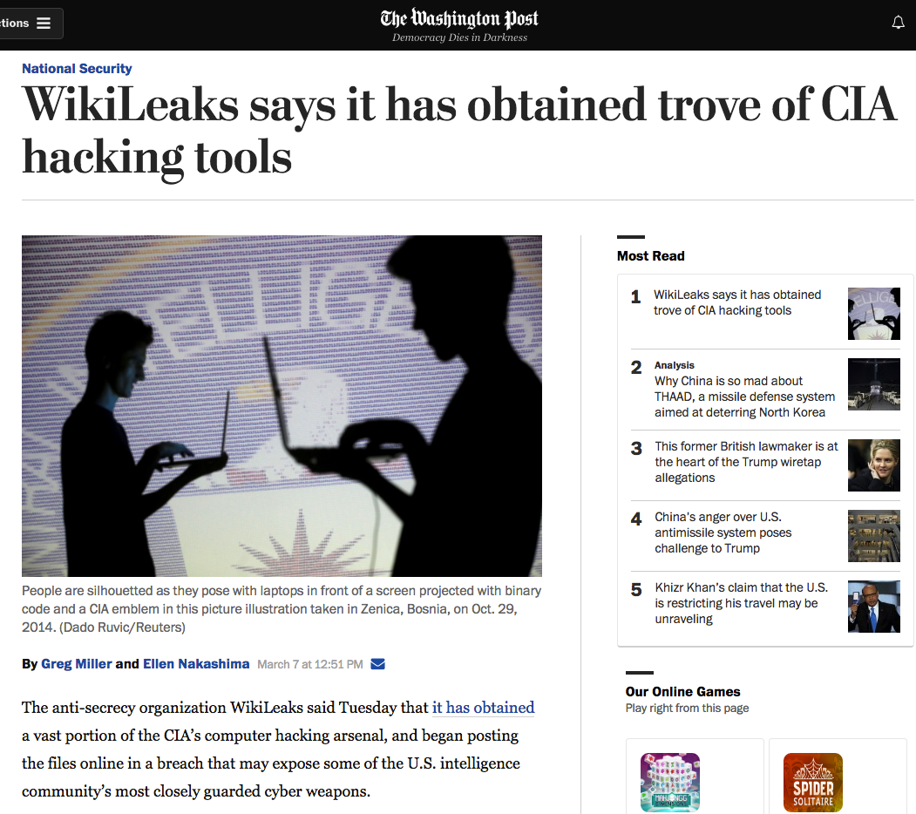

Slide 11

Today…

Slide 12

Collaborative Group Project

Slide 13
Designing a “Communications Act” for today

Slide 14
AKA
How would you (yes, YOU) replace
S. 3 of the Broadcasting Act, &
S. 7 of the Telecommunications Act
???????????????????????

Slide 15
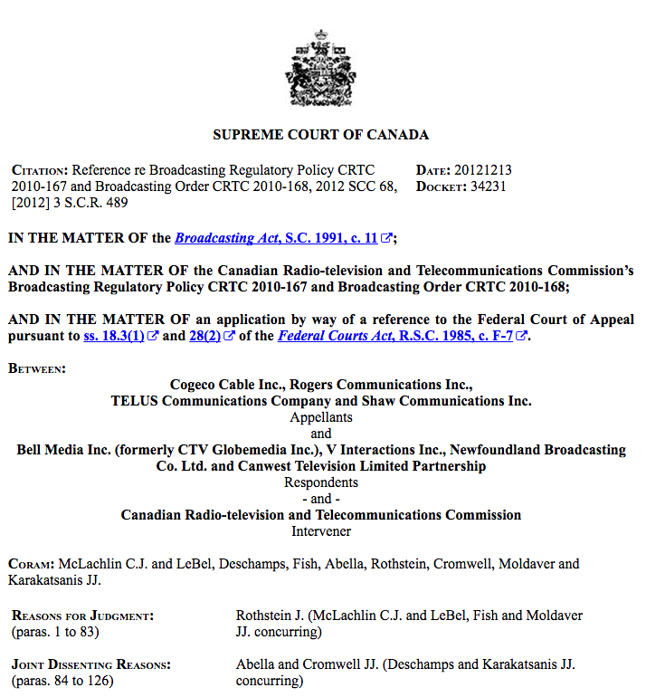

Slide 16
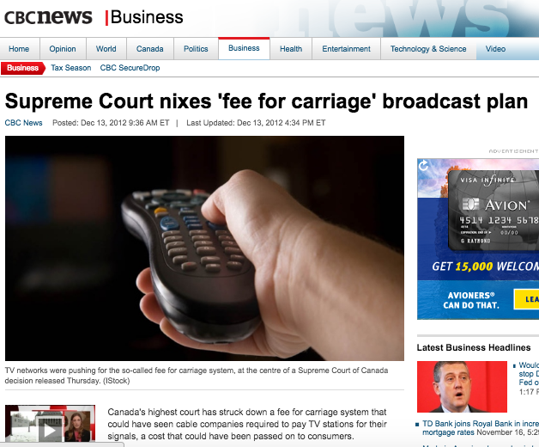

Slide 17
Majority
“…the CRTC seeks to implement what it terms a “value for signal regime”. This regime would permit broadcasters to negotiate with BDUs the terms upon which the BDUs may redistribute their signals…
In my respectful opinion, for two reasons, the provisions of the Broadcasting Act, considered in their entire context, may not be interpreted as authorizing the CRTC to implement the proposed value for signal regime. First, a contextual reading of the provisions of the Broadcasting Act themselves reveals that they were not meant to authorize the CRTC to create exclusive rights for broadcasters to control the exploitation of their signals or works by retransmission. Second, the proposed regime would conflict with specific provisions enacted by Parliament in the Copyright Act.”

Slide 18
“Policy statements, such as the declaration of Canadian broadcasting policy found in s. 3(1) of the Broadcasting Act, are not jurisdiction-conferring provisions. They describe the objectives of Parliament in enacting the legislation and, thus, they circumscribe the discretion granted to a subordinate legislative body... As such, declarations of policy cannot serve to extend the powers of the subordinate body to spheres not granted by Parliament in jurisdiction-conferring provisions.”

Slide 19
“The difference between general regulation making or licensing provisions and true jurisdiction-conferring provisions is evident when this case is compared with Bell Canada v. Bell Aliant Regional Communications, 2009 SCC 40, [2009] 2 S.C.R. 764. In Bell Aliant, this Court was asked to determine whether the creation and use of certain deferral accounts lay within the scope of the CRTC’s express power to determine whether rates set by telecommunication companies are just and reasonable. The CRTC’s jurisdiction over the setting of rates under s. 27 of the Telecommunications Act, S.C. 1993, c. 38, provides that rates must be just and reasonable. Under that section, the CRTC is specifically empowered to determine compliance with that requirement and is conferred the express authority to “adopt any method or technique that it considers appropriate” for that purpose (s. 27(5)).”

Slide 20
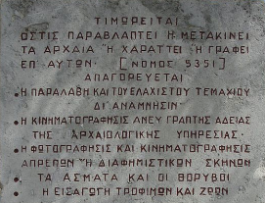
Suggested Rules

Slide 21
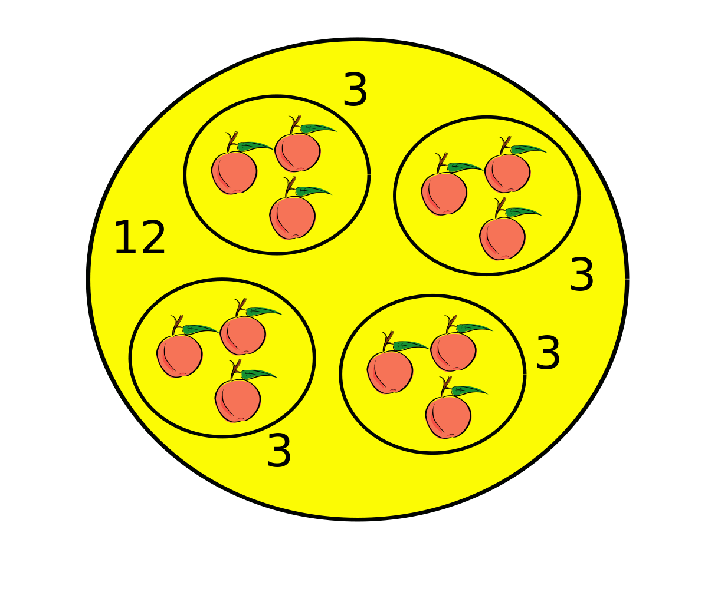
Step 1: Divide into Groups
Groups of 2 & Group of 3-4
Groups of 3 or 4 drafting provisions/principles
Rest of the groups (of 2) lobbying/influencing
Nyet Russian hacker group (sorry)

Slide 22
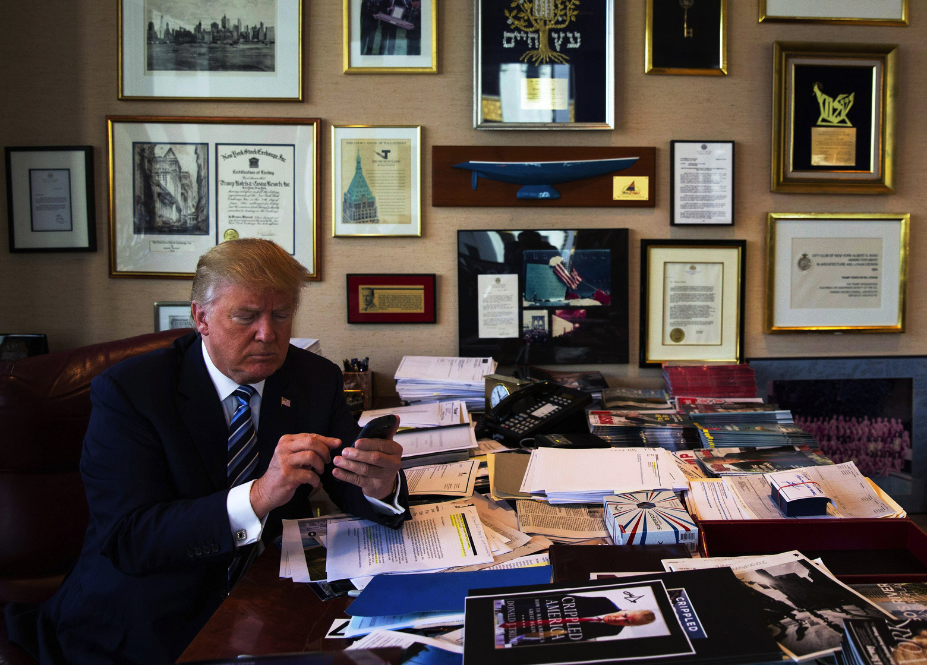
No Tweeting of proposed Policies

Slide 23

SREP 2: Form Issue Oriented Lobbying Groups
Some (non-binding) suggestions
Privacy
Net Neutrality/Open Internet
Cultural Policy
Industrial Policy
Creators
No players (broadcasters, telecoms, cableco’s, ISP’s) for this exercise

Slide 24
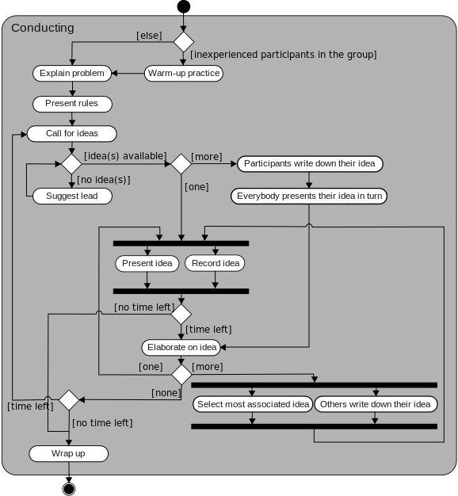
Step 3:
Brainstorm your policy priorities

Slide 25
One Act, or Two, or more?

Slide 26
Results of our one word poll on policy priorities
Access (x2); Competition; Content; Creativity; Economic Development; Efficiency; Expression; Freedom (x2); Net-neutrality (x2); Open; Privacy (x2); Security; Viewers

Slide 27
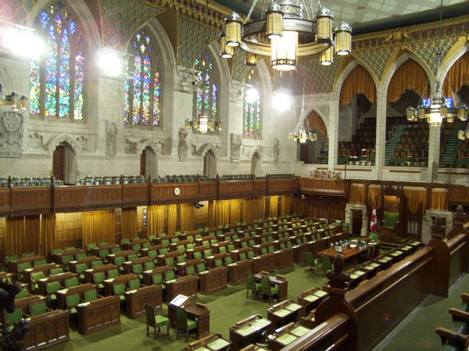
Step 4:
Drafters take a first cut
Lobbyists come up with your drafting suggestions

Slide 28

Step 5:
Present/Negotiate
(5 minutes) per group

Slide 29
Step 6:
Drafters draft
Lobbyists available to consult → At this stage (contrary to real life) lobbyists are not lobbying for their position just there to help drafters in any way

Slide 30
Thoughts
on Process?

Slide 31

Policy question reminders

Slide 32


Useful resources

Slide 33
Alignments
Cultural
Content
Regulation
Privacy
Industrial
Carriage
Free Market
Surveillance

Slide 34
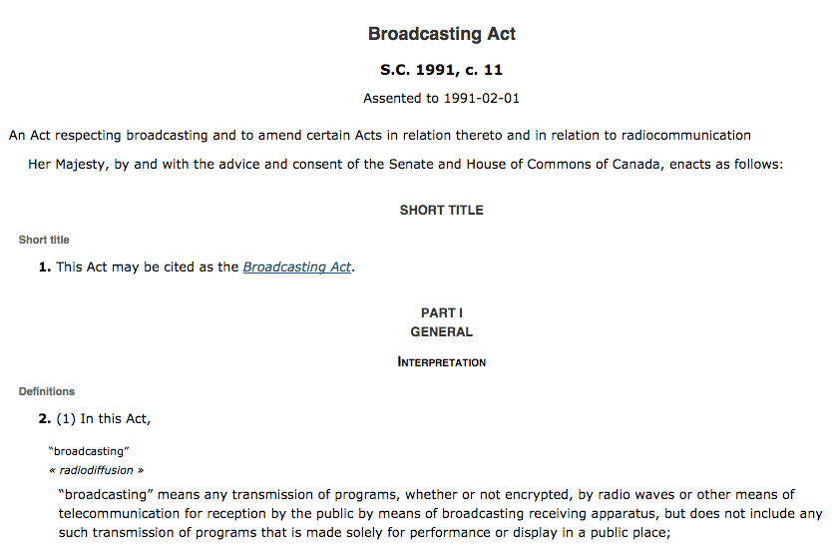

Slide 35
Broadcasting Policy for Canada
3 (1) It is hereby declared as the broadcasting policy for Canada that
  (a) the Canadian broadcasting system shall be effectively owned and controlled by Canadians;
  (b) the Canadian broadcasting system, operating primarily in the English and French languages and comprising public, private and community elements, makes use of radio frequencies that are public property and provides, through its programming, a public service essential to the maintenance and enhancement of national identity and cultural sovereignty;

Slide 36
(c) English and French language broadcasting, while sharing common aspects, operate under different conditions and may have different requirements;
(d) the Canadian broadcasting system should
  (i) serve to safeguard, enrich and strengthen the cultural, political, social and economic fabric of Canada,
  (ii) encourage the development of Canadian expression by providing a wide range of programming that reflects Canadian attitudes, opinions, ideas, values and artistic creativity, by displaying Canadian talent in entertainment programming and by offering information and analysis concerning Canada and other countries from a Canadian point of view,
  (iii) through its programming and the employment opportunities arising out of its operations, serve the needs and interests, and reflect the circumstances and aspirations, of Canadian men, women and children, including equal rights, the linguistic duality and multicultural and multiracial nature of Canadian society and the special place of aboriginal peoples within that society, and
  (iv) be readily adaptable to scientific and technological change;

Slide 37
(e) each element of the Canadian broadcasting system shall contribute in an appropriate manner to the creation and presentation of Canadian programming;
(f) each broadcasting undertaking shall make maximum use, and in no case less than predominant use, of Canadian creative and other resources in the creation and presentation of programming, unless the nature of the service provided by the undertaking, such as specialized content or format or the use of languages other than French and English, renders that use impracticable, in which case the undertaking shall make the greatest practicable use of those resources;

Slide 38
The News
(g) the programming originated by broadcasting undertakings should be of high standard;
(h) all persons who are licensed to carry on broadcasting undertakings have a responsibility for the programs they broadcast;

Slide 39
The CBC
(i) the programming provided by the Canadian broadcasting system should
  (i) be varied and comprehensive, providing a balance of information, enlightenment and entertainment for men, women and children of all ages, interests and tastes,
  (ii) be drawn from local, regional, national and international sources,
  (iii) include educational and community programs,
  (iv) provide a reasonable opportunity for the public to be exposed to the expression of differing views on matters of public concern, and
  (v) include a significant contribution from the Canadian independent production sector;

Slide 40
Tie-breakers
(n) where any conflict arises between the objectives of the Corporation set out in paragraphs (l) and (m) and the interests of any other broadcasting undertaking of the Canadian broadcasting system, it shall be resolved in the public interest, and where the public interest would be equally served by resolving the conflict in favour of either, it shall be resolved in favour of the objectives set out in paragraphs (l) and (m);
(2) It is further declared that the Canadian broadcasting system constitutes a single system and that the objectives of the broadcasting policy set out in subsection (1) can best be achieved by providing for the regulation and supervision of the Canadian broadcasting system by a single independent public authority.

Slide 41

Consider…
How should we look at Canadian Content Rules in light of the SCC’s 2012 decision in Re Broadcasting Act (especially their comments about S.3 of the Broadcasting Act)?

Slide 42
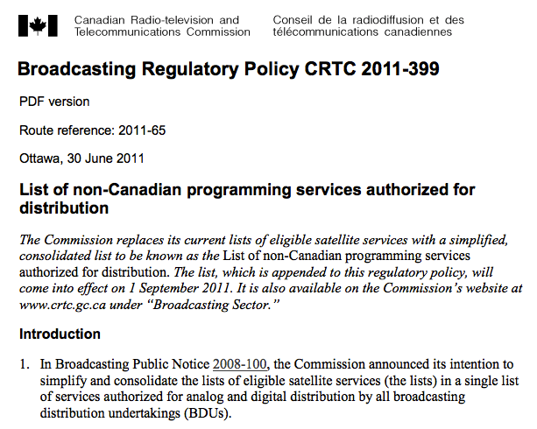

Slide 43
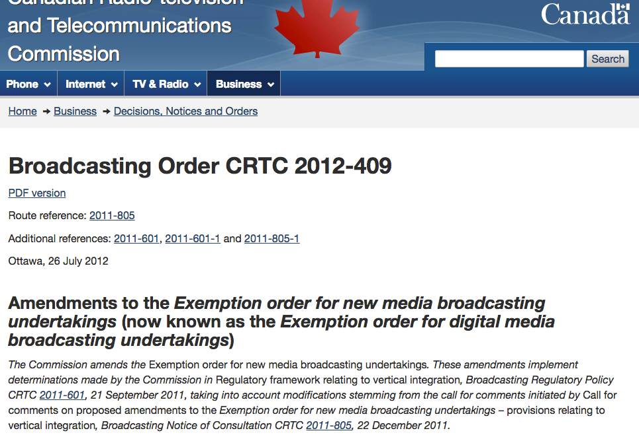

Slide 44


Slide 45
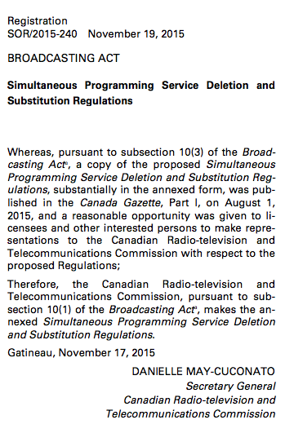
Simultaneous Programming Service Deletion and Substitution Regulations
P. 196 Red Book

Slide 46


Slide 47
Telecommunications Act S. 7
Canadian Telecommunications Policy Objectives
7. It is hereby affirmed that telecommunications performs an essential role in the maintenance of Canada’s identity and sovereignty and that the Canadian telecommunications policy has as its objectives
(a) to facilitate the orderly development throughout Canada of a telecommunications system that serves to safeguard, enrich and strengthen the social and economic fabric of Canada and its regions;
(b) to render reliable and affordable telecommunications services of high quality accessible to Canadians in both urban and rural areas in all regions of Canada;
(c) to enhance the efficiency and competitiveness, at the national and international levels, of Canadian telecommunications;

Slide 48
(d) to promote the ownership and control of Canadian carriers by Canadians;
(e) to promote the use of Canadian transmission facilities for telecommunications within Canada and between Canada and points outside Canada;
(f) to foster increased reliance on market forces for the provision of telecommunications services and to ensure that regulation, where required, is efficient and effective;
(g) to stimulate research and development in Canada in the field of telecommunications and to encourage innovation in the provision of telecommunications services;
(h) to respond to the economic and social requirements of users of telecommunications services; and
(i) to contribute to the protection of the privacy of persons.

Slide 49
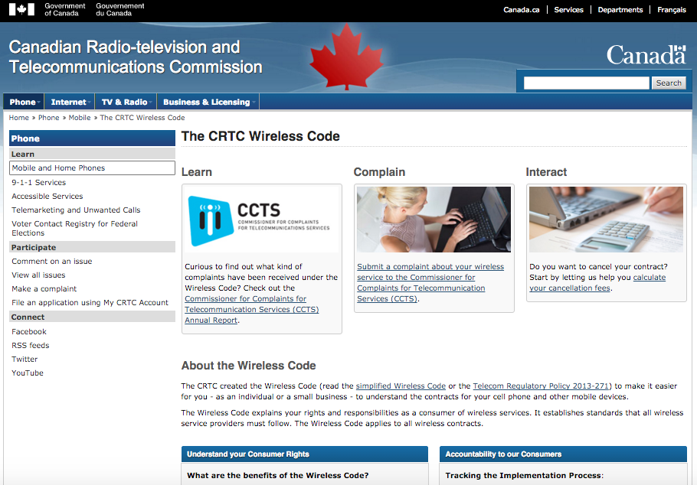

Slide 50
Possible Telecom Priorities
Net Neutrality
Interoperability
Consumer Protection

Slide 51
Telecom Act basis for net neutrality
7. Telecom policy objectives
24. Services to be offered under CRTC-approved tariffs
27(1) Rates to be just & reasonable
27(2) No unjust discrimination against or undue preferences toward any person
34. CRTC forbearance power (to be used, e.g. where competition is sufficient to protect consumers)
36. Carriers not to control content or influence meaning of telecoms carried for public
40. Interconnection orders

Slide 52
Telecommunications Act S. 27
Just and reasonable rates
27 (1) Every rate charged by a Canadian carrier for a telecommunications service shall be just and reasonable.
Unjust discrimination
(2) No Canadian carrier shall, in relation to the provision of a telecommunications service or the charging of a rate for it, unjustly discriminate or give an undue or unreasonable preference toward any person, including itself, or subject any person to an undue or unreasonable disadvantage.

Slide 53

Zero rating

Slide 54
Internet Rights?

Slide 55
RECOGNITION AND SAFEGUARDING OF RIGHTS
RIGHT TO INTERNET ACCESS
NET NEUTRALITY
PROTECTION OF PERSONAL DATA
THE RIGHT TO INFORMATIONAL SELF-DETERMINATION
INVIOLABILITY OF COMPUTER SYSTEMS AND COMPUTER DOMICILES
AUTOMATED PROCESSING
RIGHT TO ONE’S IDENTITY
ANONIMITY
RIGHT TO BE FORGOTTEN
RIGHTS AND SAFEGUARDS OF PEOPLE ON PLATFORMS
NETWORK SECURITY
RIGHT TO EDUCATION
CRITERIA FOR INTERNET GOVERNANCE

Slide 56

What about this?

Slide 57
Other Stuff

Slide 58


Slide 59
Everyone is a creator?
Should there be a
FREEDOM TO
CREAtE/REMIX?

Slide 60


Slide 61


Slide 62


Slide 63


Slide 64

And someday?…
http://motherboard.vice.com/read/we-need-a-legal-framework-for-biohacking-our-brains

Slide 65


Slide 66
QUESTIONS? DISCUSSION?

Slide 67

Pause

Slide 68

Start

Slide 69


A MATTER OF PERSPECTIVE

Slide 70

Always include a cat picture

Slide 71
Our Academic Partners

