Slide 1


“Logistics & News of the Week”
Talk 11
LAW 424 001
Communications Law 2.0
Allard School of Law, UBC
Spring, 2017
Jon Festinger Q.C.
Centre for Digital Media
Festinger Law & Strategy
http://commlaw.allard.ubc
@jonfestinger
jon_festinger@thecdm.ca

Slide 2
Logistics

Slide 3
April 6, 2017 → No class/no make-up
[CONFIRMED]

Slide 4
Questions on..
Papers ?
Participation ?
Class Presentations ?

Slide 5

Follow-up 1

Slide 6
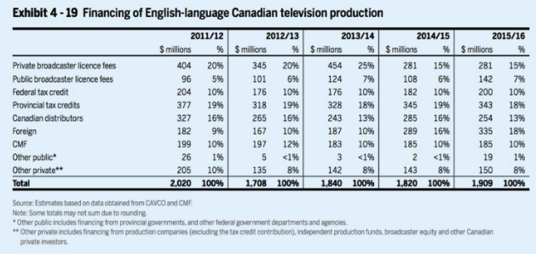

Slide 7
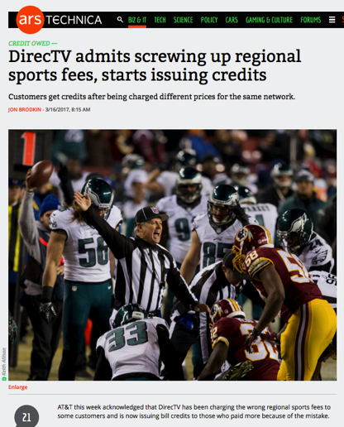
Follow-up 2

Slide 8
News of the Week

Slide 9
Yours?

Slide 10
Mine

Slide 11
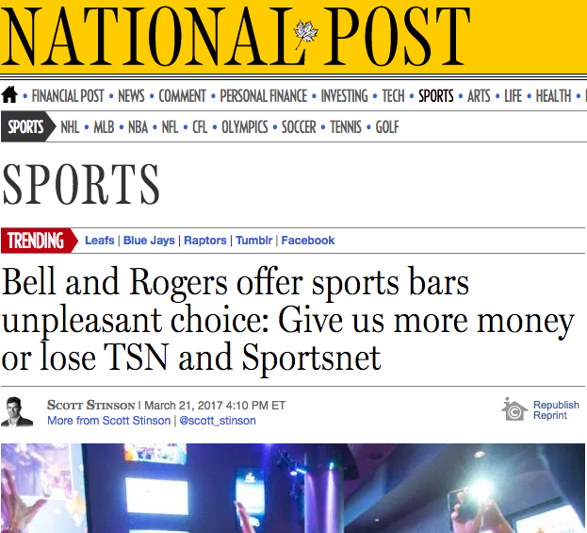

Slide 12


Slide 13
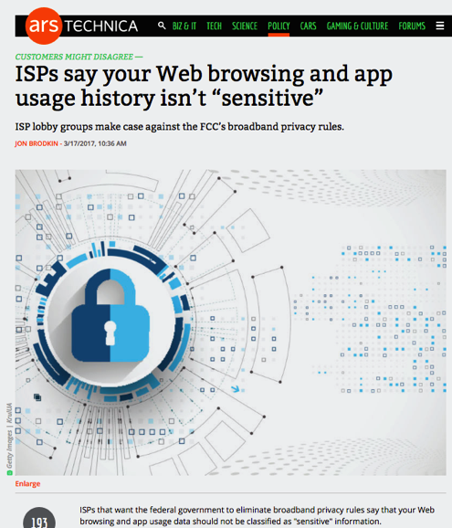

Slide 14
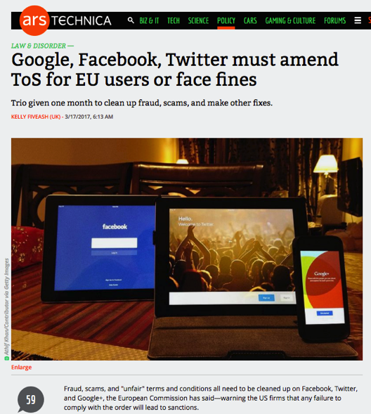

Slide 15
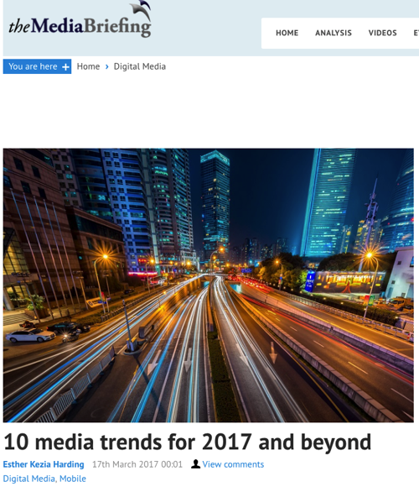

Slide 16
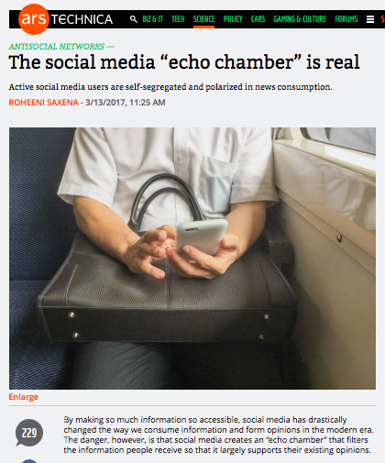

Slide 17
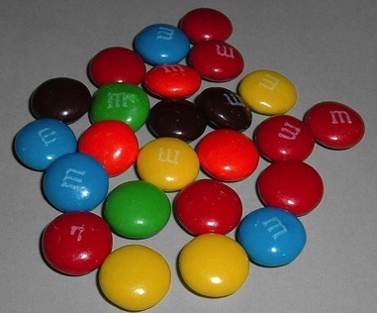

A MATTER OF PERSPECTIVE

Slide 18

Always include a cat picture

Slide 19
Our Academic Partners

