Slide 1
The Future of Journalism and Media Regulation

Slide 2
The History of Canadian Journalism
In the 18th Century, journalism was illegal in New France (and barely legal in the British Colony).
In Canada, journalists used to be united under the Canadian Press Association (and later several newspaper organizations) to shield themselves from Government intervention.
Since the dissolution of the organization, no self-governing body has been created to manage and regulate journalists.
Originally, newspapers and other news sources were almost focused exclusively on business and political partisanship as a source of survival.

Slide 3
The History of Canadian Journalism
However, today journalism has changed. The journalism industry operates as a body often referred to as, the ‘4th estate’ (ex. The Pentagon Papers, Watergate, etc.)
Most journalists see themselves as a check and balance against the actions of Government and an essential aspect of our democracy (The Washington Post’s mantra is, “Democracy Dies in Darkness”).
Journalists, thus, are skeptical about Government regulation and control of freedom of speech.

Slide 4
The History of Canadian Journalism
The 21st Century and the advancement of technology and the internet created the 24-hour news cycle.
Furthermore, the expansion of different modes of media have forced further competition in the industry and allowed all of us to become creators and journalists in our own right.
Vertical integration has reduced the amount of news sources publishing today as mergers have narrowed the market. As well, budget cuts have resulted in, arguably, poorer quality news.
Now, we are left in a place where, thanks to technology, journalism is less removed from the public than ever before.

Slide 5
History of Canadian Journalism (The Law)
Cases that have shaped our law:
R v. Keegstra
Saskatchewan v. Whatcott
New York Times v. Sullivan
Hill v. Church of Scientology
Grant v. Torstarr

Slide 6
Contemporary Law and Journalism
Privacy
BC Privacy Act creates tort
Copyright
Access to Information
Section 2(b) of the Charter
Obscenities - R v Butler

Slide 7
Harm and Offence
When is it appropriate to censor something when the material is potentially harmful or offensive?

Slide 8
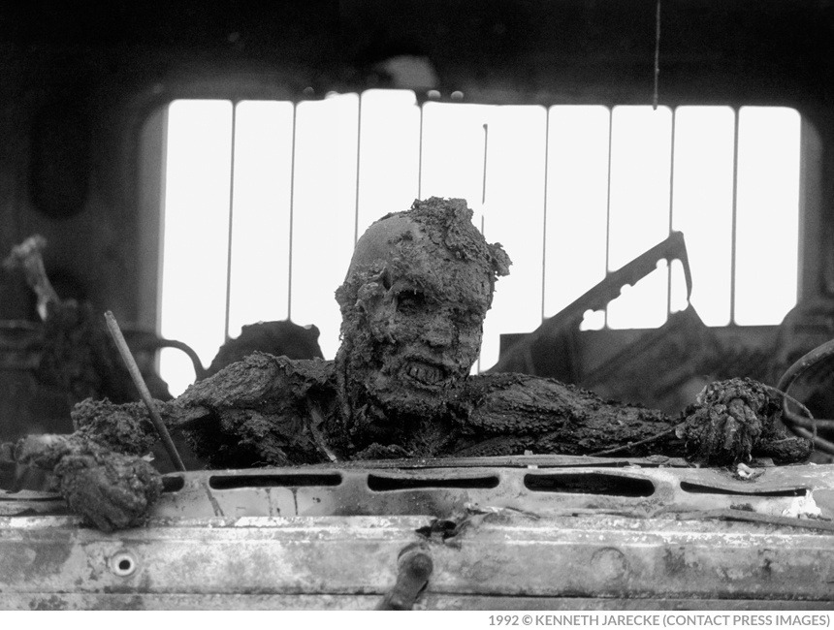

Slide 10
Harm and Offence
When is it appropriate to censor something when the material is potentially harmful or offensive?
What should journalists’ duties be regarding these matters?

Slide 11
Janet Cooke and the 8-year-old heroin addict

Slide 13
The Advent of Fake News
Starting Point: s.5(1)(d) of the Telecommunications Act
“Fake News”, as the phenomenon we know it, is a fairly recent problem.
Previous Fake News Sources: National Enquirer, and others.
Now: Stanford Study has a database of dozens of highly-visited sites.

Slide 14
The Evolved Problem of ‘Fake News’: The American Election
“Social Media and Fake news in the 2016 Election”, Allcott and Gentzkow
Social Media was an important but not dominant source of news in the run-up to the election, with 14% of Americans calling social media their ‘most important’ source of election news
Of the known false news stories that appeared in the three months before the election, those favoring Trump were shared a total of 30 million times on Facebook, while those favoring Clinton were shared eight million times
The average American saw and remembered 0.92 pro-Trump fake news stories and 0.23 pro-Clinton fake news stories, with just over half of those who recalled seeing fake news stories believing them
For fake news to have changed the outcome of the election, a single fake article would need to have had the same persuasive effect as 36 campaign ads

Slide 15
Questions for Discussion
Does the regulation of journalism need an overhaul?
If so, how should we be regulating the journalism industry?
Force a self-governing body?
Provide mandated funding?
Create a ‘ministry of truth’?

Slide 17
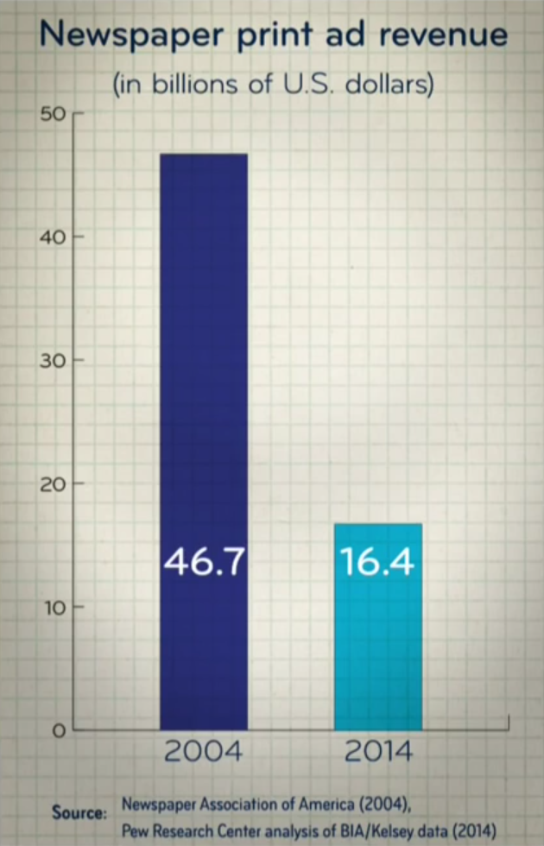
State of the Journalism Industry
Gain of 2 billion in digital ad revenues, but loss of 30 billion in print ad revenue

Slide 18
State of the Journalism Industry
Extra digital demands on today’s journalists
Facebook and Google estimated to have received 65% of all digital ad revenue in 2015
The current business of maximizing click-through rates might not be working. What else might?

Slide 19
Future of Journalism
Consumer changed from being a passive reader to one who can gather and post their own news
Artificial intelligence
Personalized news
Automation
Big data to aid investigative work and fact checking
Check out News Explorer by IBM Watson http://news-explorer.mybluemix.net/

