Slide 1
Cyber Safety in the legal world: Threats, regulations, and what you can do to protect yourself
Dave, Will & Mimi

Slide 2
Story Time…
“The problem with terms like “cyberlaw” and “cybersecurity” is that they imply a single discipline. The truth is that both are really a hodge-podge of many related but distinct disciplines. In order to fully understand liability for cybersecurity breaches and its potential ramifications for law firms, it is necessary to explore a mix of telecommunications laws, privacy and health statutes, corporate regulations, and court cases”
McNerney and Papadopoulos, “Hacker's Delight: Law Firm Risk and Liability in the Cyber Age”

Slide 3
A Legal Motley
International
Statutory
Privacy:
Personal Information Protection and Electronic Documents Act (PIPEDA)
Safeguards 4.7.3 “passwords and encryption”
Personal Information Protection Act (BC)
Federal Personal Information Protection and Electronic Documents Act
Freedom of Information and Protection of Privacy Act
Privacy in financial services and health care
Consumer protection
etc.
Common law negligence
Professional Codes of Conduct

Slide 4
Professional Codes of Conduct
Duty of Confidentiality 3.3-1
Duty of Competence 3.1-1
ABA Model Rule 1.1
“keep abreast of changes in the law... including the benefits and risks associated with relevant technology”
In Canada, it is not explicitly mentioned
But consider (1) data integrity (2) back-ups
Also see duty comply with Law Society and records

Slide 5
LSBC
LSBC
Cloud computing working group
Concerns about the ability to discharge professional obligations of confidentiality and security of record keeping
Cloud computing guidelines

Slide 6
Potential Issues
Regulation of lawyers rather than firms
Ethical decisions are often about individual accountability
IT tech and security are often a firm practice
Is this a problem?
Underdeveloped regulation
How to operate without clear guidance?

Slide 7
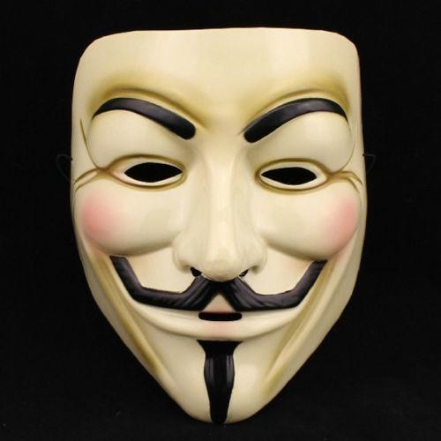
Threats

Slide 8
Why are law firms targets for cyber crime?
Have a large amount of sensitive and confidential info
Have large amounts of money in their bank accounts
Tend to have weaker security protection on their networks and systems (relative to their clients)

Slide 9
Malware
Malicious software! Fun fact!
One of the most common ways law firm computers and networks are infiltrated and compromised by cyber criminals
Often people done know their computer is infected, and its difficult to remove

Slide 10
What can malware do
Record keystrokes
Create a backdoor to access your computer/network
Disable security settings
Use your computer to hack into other computers on your firms network
Use your computer to send emails to others, whose computers will become infected if they click on links/open attachments
Steal, alter or delete your data and files
Allow someone to secretly watch you through your webcam

Slide 11
How malware attacks
Opening an infected email attachment
Just visiting a website (no need to click on link)
Downloading a program or app
Plugging in an infected USB stick or external hard drive to your computer

Slide 12
An inside job…
Statistics show that the majority of incidents involving the destruction or loss of data are perpetrated by current, soon-to-be dismissed or recently dismissed employees
IT staff are the greatest threats

Slide 13
Common types of malware
Viruses
Worms
Trojans
Spyware
Adware
Botnets
Rootkits
Scareware
Ransomware

Slide 14
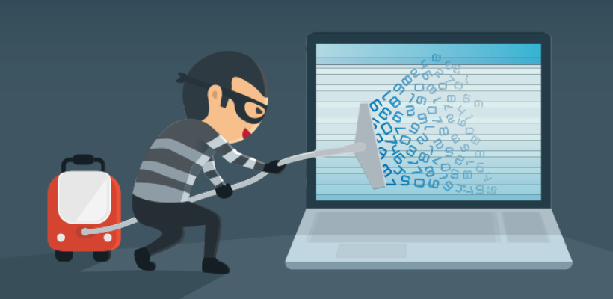
Protect yourself!
Basically, stuff Dave uses

Slide 15
Browser add-ons
For Firefox havers/users
Lightbeam (firefox)
Looks at your current browsing session, and visualizes all of the 3rd party sites that are connected to the sites you’ve visited

Slide 16
Browser add-ons: Adblock/AdAware
Blocks adds, but also block many 3rd party applications that try to load on many sites

Slide 17
Browser add-ons
Privacy Badger
Actively moniters what additional requests are made
Https Everywhere
Forces a more secure connection wherever possible

Slide 18
Websites
haveibeenpwned?
Compiles known leaked info, and allows you to check your accounts against them
10 Minute Mail
Temporary, functional email account for registrations, etc
Account Killer
Lets you know what steps to go through to close various online accounts

Slide 19
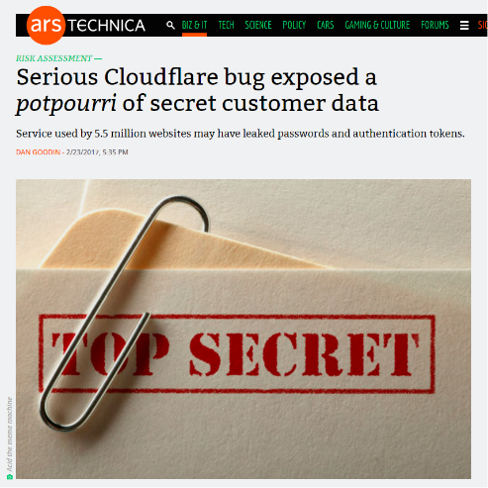
Software

Slide 20
Password managers
Allow for much stronger passwords
Simplify online transactions
Can be a safe means of retaining various wallet info w/o having cards on you

Slide 21
VPNs
Encrypt your communications
The connection you are on cannot monitor you
Change your ‘geographic location’
Prevents the site you access from knowing where you really are
Allows you to access services as if you were there
Typically no noticeable slowdown
(I use Private Internet Access)

Slide 22
VPNs - Be careful!
Do some research
Don’t use ‘free’ VPNs – they’re making money somehow
Hola VPN used to perform DDOS attacks & violate user privacy

Slide 23
Anti-virus/Anti-malware
Often have browser plug ins & will recognize known threats
(I use Avast)

Slide 24
Tor
Routs your traffic through different locations, masking your actual location
(Know your exit nodes, if possible)
(what a node, Dave?)
The FBI is known to make nodes so that they can monitor them

Slide 25
Further Tools
2-Factor ID
Often very easy to set up
Can just be email
Often apps
Dedicated
YubiKey from Yubico

Slide 26
Messagers
Signal
Encryped sms & video chat
Whats App
Owned now by Facebook so…

Slide 27
Cloud Storage
Don’t rely on Dropbox for *secure* storage
Recommended programs
ACLU’s IT recommended SpiderOak
LSBC (unofficially) recommends Sync

Slide 28
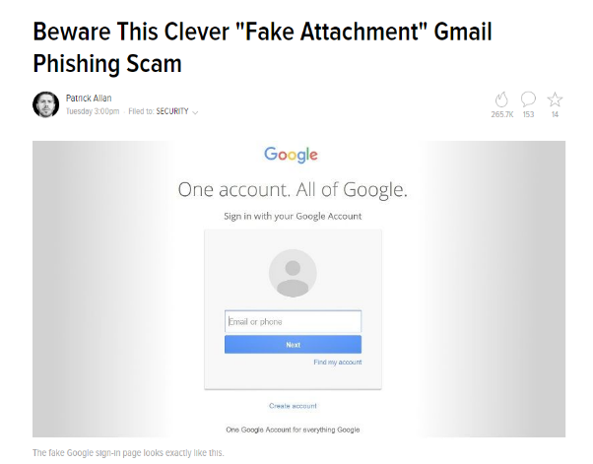
Pay Attention!
Beware this clever 'fake attachment' Gmail phishing scam

