Slide 1


“Broadcasting Policy: Origins, Regulation & Cases”
Talk 6
LAW 424 001
Communications Law 2.0
Allard School of Law, UBC
Spring, 2017
Jon Festinger Q.C.
Centre for Digital Media
Festinger Law & Strategy
http://commlaw.allard.ubc
@jonfestinger
jon_festinger@thecdm.ca

Slide 2
Logistics

Slide 3
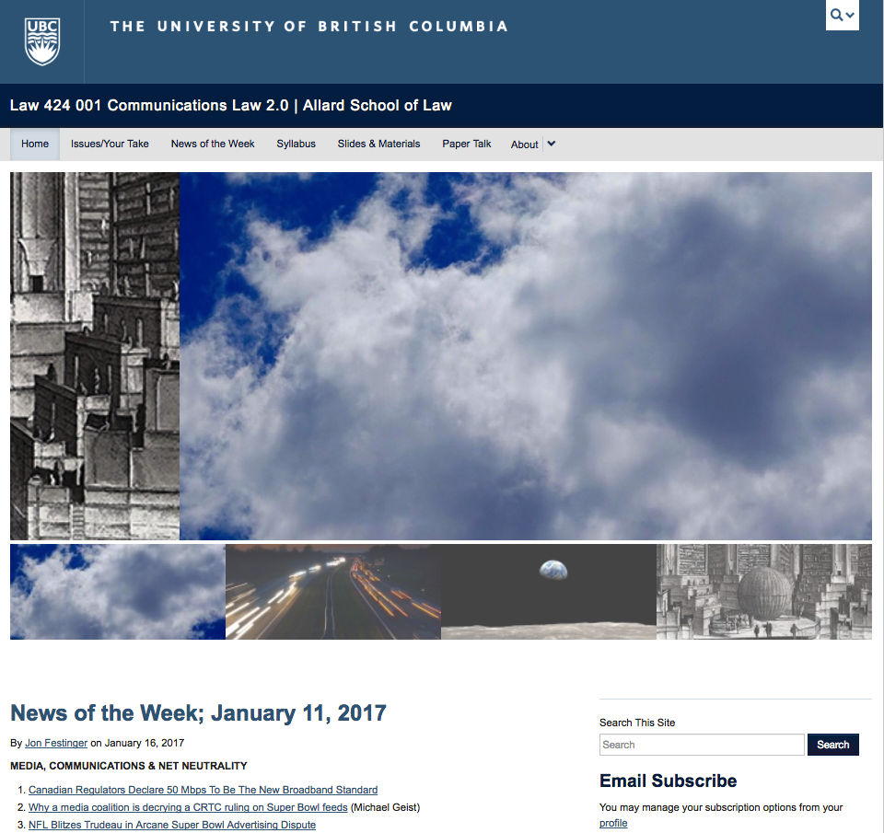
Course Website: Is everyone who wants to be on?
http://commlaw.allard.ubc.ca

Slide 4

Badges now working…

Slide 5
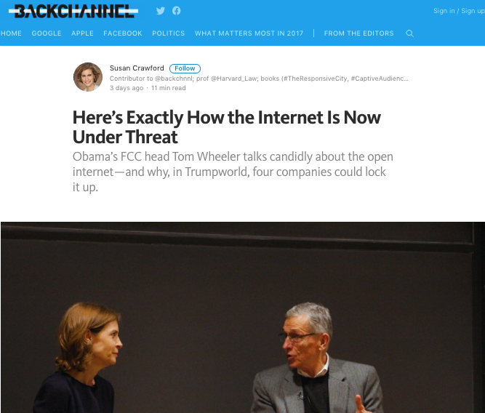
Follow-up 1

Slide 6

Follow-up 2

Slide 7


Slide 8
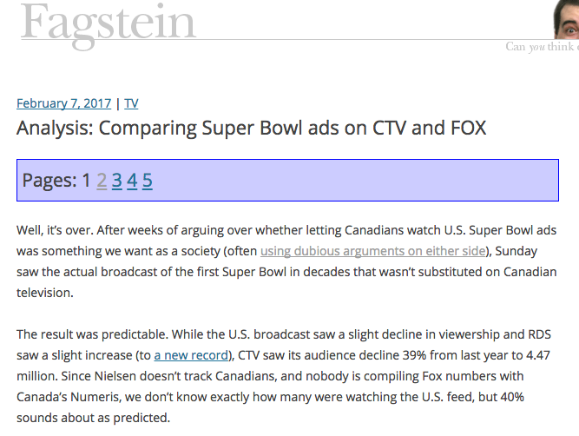
http://blog.fagstein.com/2017/02/07/super-bowl-ads-ctv-vs-fox/

Slide 9
News of the Week

Slide 10
Yours?

Slide 11

Mine

Slide 12


Slide 13
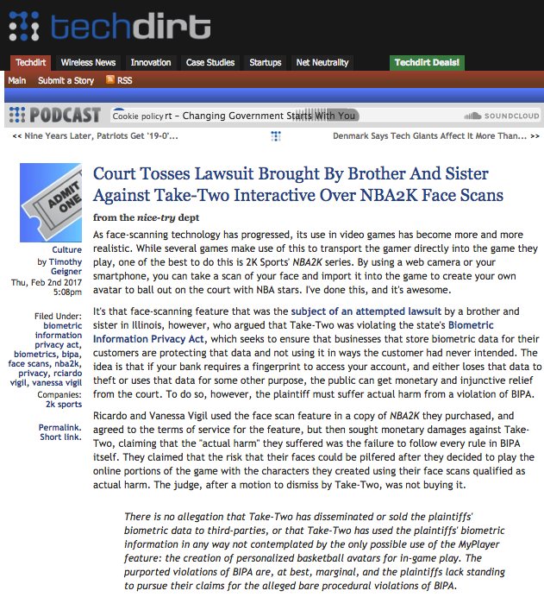

Slide 14


Slide 15

Other News of the Week …

Slide 16
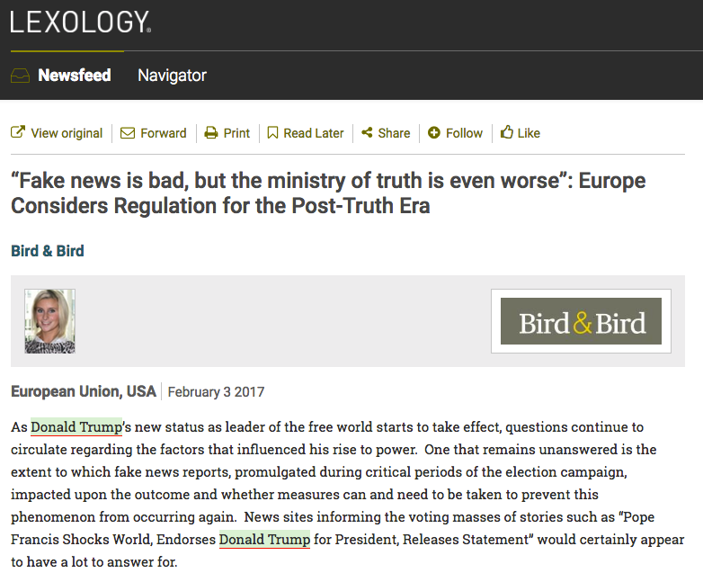

Slide 17

Oops…

Slide 18

The Green Bowling Ball Massacre

Slide 19
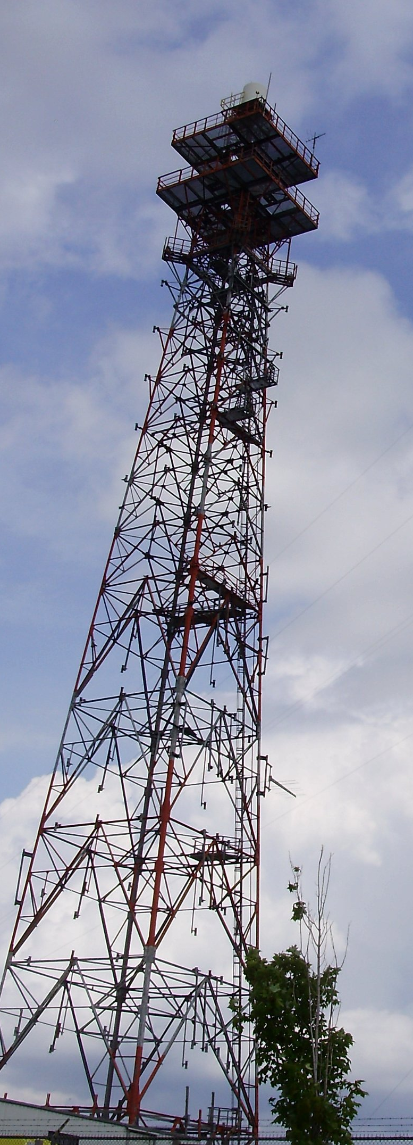
Today…
“Broadcasting Policy: Origins, Regulation & Cases”

Slide 20

Starting Point #1

Slide 21
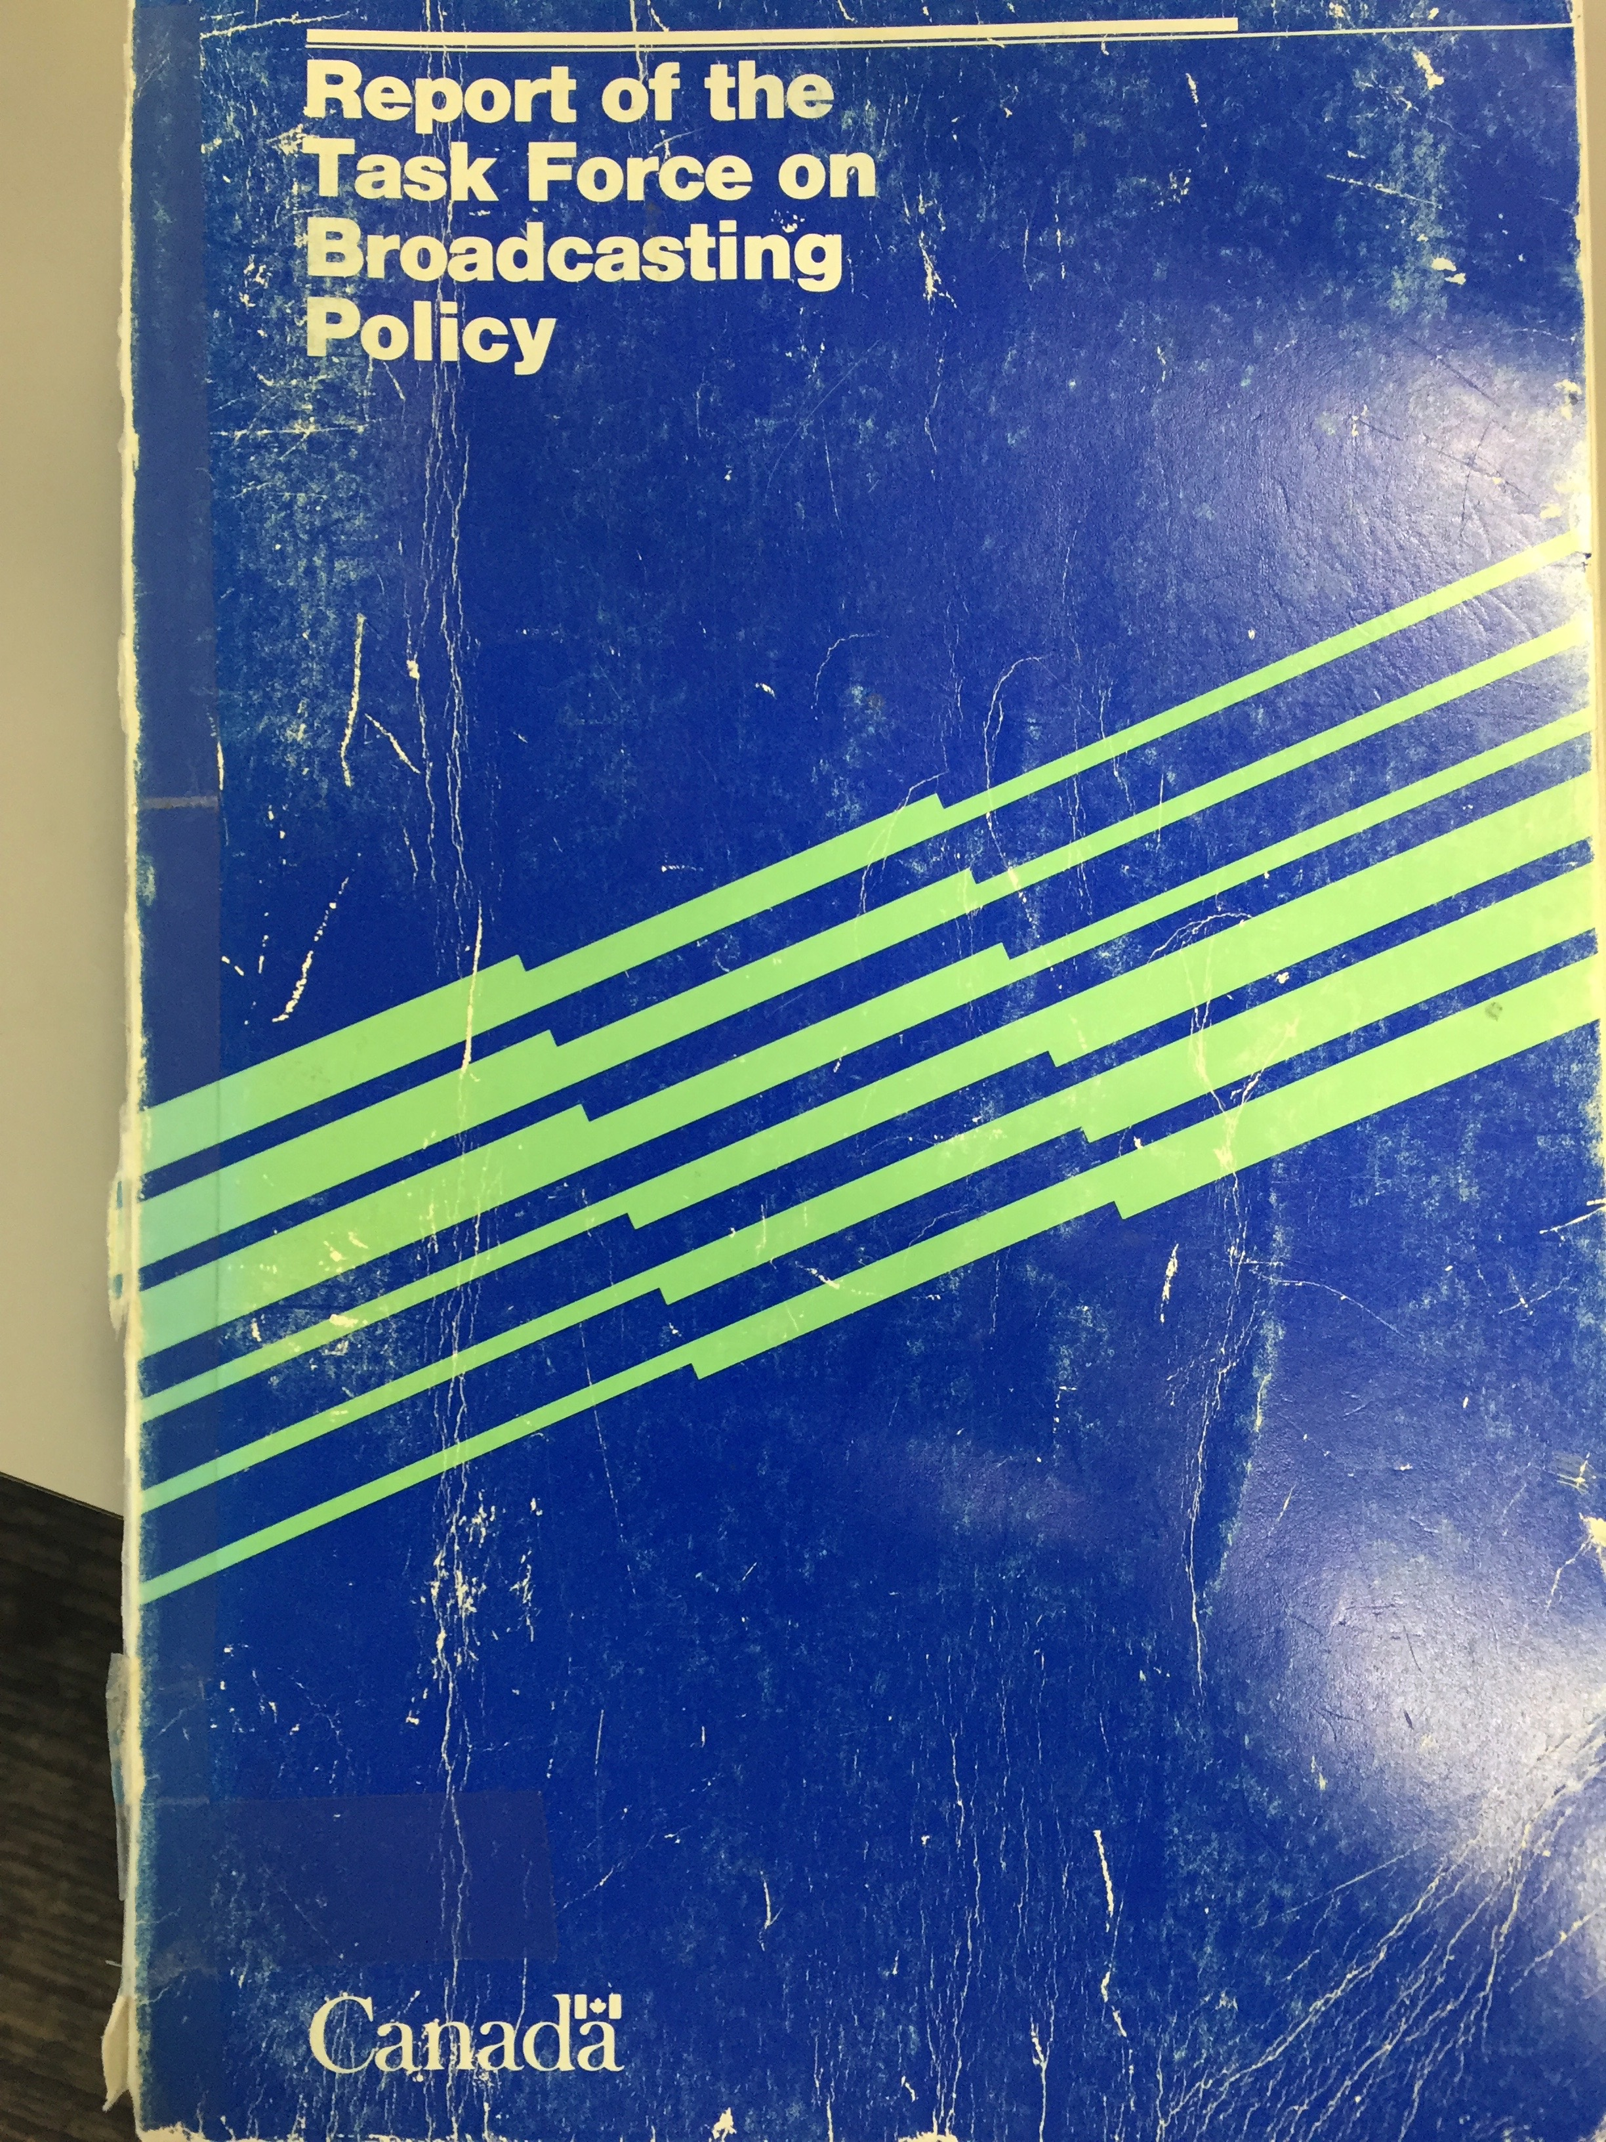
Q: Where did we lose our way?
Caplan/Sauvageau Report, 1986

Slide 22
A: Precisely here?...
“But whatever kind of Buck Rogers Future is in store for us, surely the Canadian tradition demands that we must continue to entrench the Canadian presence in our broadcasting system, and we must adopt policies to do so in a new world in which substantially greater choice may be available to Canadian viewers. More than ever, broadcasting must be seen as a fundamental part of cultural policy. It must be program-driven, not hardware-driven as in its first decades.”

Slide 23
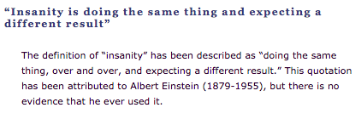
Entrench because tradition demands it
Broadcasting must be seen as cultural policy

Slide 24


Slide 25
D.L Shaw, “The Rise and Fall of American Mass
Media: Roles of Technology and Leadership”, April 1991 “Roy W. Howard Lecture” Indiana University.
“No medium, once it has lost it’s dominant position has ever returned to the top”
“Audience choice, made possible by modern technologies, has made the concept of “mass media” obsolete; and audiences are not necessarily loyal, exercising choices when available to obtain information and entertainment in the most efficient way possible.”
“Historically mass media seem to play the role of Trojan Horse to social change. That seems to be an effect of evolving communication technologies.”
Limitation – does not foresee audience as CREATOR

Slide 26
Starting Point #2: History
Most slides in this section are only slightly adapted from those prepared by
Hank Intven of McCarthy’s for his Communications Law materials.

Slide 27

Say again…
Prime Minister R.B. Bennett 1932; “…this country must be assured of complete Canadian control of broadcasting from Canadian sources. Without such control, broadcasting can never be the agency by which national consciousness may be fostered and sustained and national unity still further strengthened….”

Slide 28
Early Radio
1913 Radiotelegraph Act
Federal government Minister authorized licensed radio broadcasters. There was small license fee for each radio receiver [remnant in Radiocommunication Act - p. 65 “Black Book” - 4 (1) No person shall, except under and in accordance with a radio authorization, install, operate or possess radio apparatus, other than: (a) radio apparatus exempted by or under regulations made under paragraph 6(1)(m); or (b) radio apparatus that is capable only of the reception of broadcasting and that is not a distribution undertaking.]
1928 - 68 radio stations; 400,000 battery-operated radios
Mostly private stations
CNR radio department formed 1st national broadcasting network

Slide 29
1928-9: Aird Royal Commission
First major policy review of Canadian broadcasting. Key issues:
1. Lack of Canadian programming: “the majority of programs heard are from sources outside of Canada…[this] has a tendency to mold the minds of young people in the home to ideas and opinions that are not Canadian”
2. Universal service issues: Uneven availability of Canadian services and programming in different parts of the country.

Slide 30
Aird: Key Recommendations
The federal government should create a national broadcaster to promote Canadian unity and development – and to inform the public on questions of Canadian national interest
“…broadcasting will undoubtedly become a great force in fostering a national spirit and interpreting national citizenship…”

Slide 31
1932 Radio Reference intervenes
During the Aird Commission’s work, Québec passed legislation authorizing provincial licensing and regulation of radio broadcasting.
In Re Regulation and Control of Radio Communication, [1932] A.C. 304 Privy Council ruled jurisdiction over broadcasting was federal only.
Case did not address the “content question” directly. Question referred to the court was: “Has the Parliament of Canada jurisdiction to regulate and control radio communication, including the transmission and reception of signs, signals, pictures and sounds of all kinds by means of Hertzian waves, and including the right to determine the character, use, and location of the apparatus employed?”

Slide 32
Found the basis of federal jurisdiction in S. 92(10)(a) BNA Act: “Lines of Steam or other Ships, Railways, Roads, Telegraphs, and other Works and Undertakings connecting the Province with any other or others of the Provinces, or extending beyond the Limits of the Province.”
Viscount Dunedin: “Broadcasting as a system cannot exist without both a transmitter and a receiver. The receiver is indeed useless without a transmitter and can be reduced to a nonentity if the transmitter closes. The system cannot be divided into two parts, each independent of the other. "Undertaking" is not a physical thing but is an arrangement under which of course physical things are used.”

Slide 33
Canadian Radio Broadcasting Commission
After the Radio Reference, the Conservative R.B. Bennett government established the CRBC to:
Regulate, control and carry on broadcasting activities in Canada, in the national interest.
Take over operations of the CNR national radio network.
Regulate private broadcasters, and over time, assume control over all aspects of Canadian broadcasting.
The latter objective was frustrated by the great depression of the 1930s, which prevented the government from buying out private radio operators and entrenching Canada’s mixed public private system (unlike UK and European systems of the time).
CRBC’s joint operator/regulator role transferred to CBC in 1936 – funded by increased licence fees

Slide 34
Fowler Commission & Committee
(1957 & 1965)
Canadian television started in Montréal & Toronto in 1952
  Initially 1 private station licensed per market to carry the CBC’s national programming
  Public demand for more choice and content
Fowler recommended separation of public broadcaster/regulator roles
  inherent conflict of interest for CBC
  1958 Broadcasting Act created the Board of Broadcast Governors (BBG) as regulator

Slide 35
1968 Broadcasting Act
1. New Act followed
1964 Fowler Committee Report
1966 White Paper on Broadcasting
2. Distanced government and the regulator from administration, finance and broadcast programming decisions of CBC
3. Established & mandated CRTC to implement a new “broadcasting policy” for Canada:
to safeguard, enrich and strengthen Canadian sovereignty
to ensure Canadian ownership and control of system
to promote high quality programming with substantial Canadian content
to limit concentration of private station ownership
to bring cable TV under CRTC jurisdiction

Slide 36
CRTC Initiatives to Implement 1968 Act
1. Pierre Juneau appointed first chair
2. Order in Council 1968-1809 required all broadcasting undertakings (including cable TV) to be 80% Canadian-owned
3. Established and enforced Canadian programming content quotas for CBC and private broadcasters
Radio (leading to naming of “Juno” awards)
TV (leading to everlasting frustration of Canadian viewers)

Slide 37
1991 Broadcasting Act
Current legislation – still in force
Four parts
I –Definitions & New Broadcasting Policy
II –Objects & Powers of CRTC re Broadcasting
III –Powers & Functions of CBC
IV –Related & Consequential Amendments

Slide 38
Starting Point #3: Carriage Cases

Slide 39

Which brings us to…
Capital Cities Communications Inc. v. CRTC. [1978] 2 S.C.R. 141

Slide 40

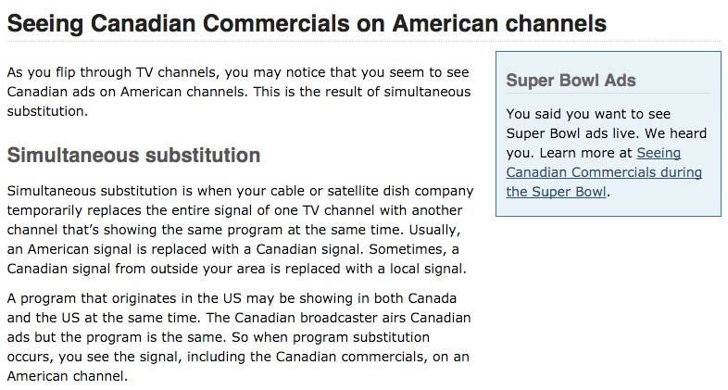
Simultaneous substitution

Slide 41
DISCUSSION:
Decided correctly?
Why or why not ?

Slide 42
Thoughts?

Slide 43
Where was “copyright”?
“Some of the legal consequences of the transmission of TV programs by coaxial cable were considered, in respect of copyright legislation, in two cases that came at the same time, one before this Court, the other before the Supreme Court of the United States. The case in this Court was Composers, Authors and Publishers Association of Canada Ltd. v. CTV Television Network Ltd. The question was whether CTV was infringing composers' copyright by transmitting programs to stations holding licences to broadcast the copyrighted works. After finding that such transmission to the stations was not "a communication of the works" within the literal meaning of the statute, this Court held that, on the basis of the intention disclosed by the language of the treaty annexed to the statute, it did not constitute an infringement, the treaty provision being aimed only at radio communications to the public i.e., broadcasts.”

Slide 44
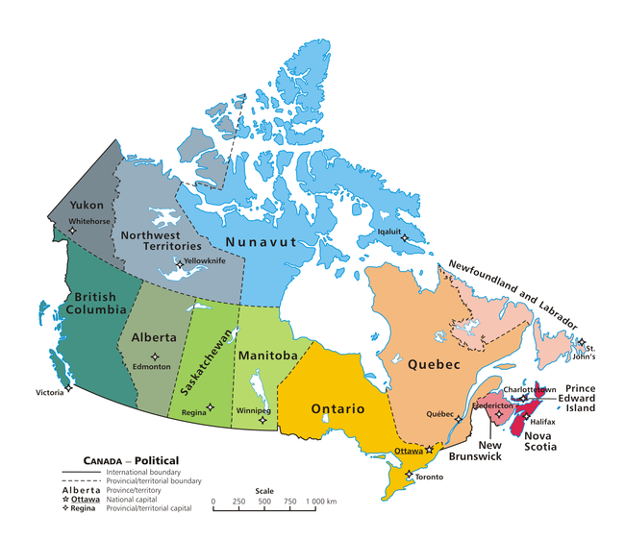
Held…
Cable television is part of a “single system” coming under Federal jurisdiction

Slide 45
Laskin, C.J.
“Rogers' licence, which is formally a licence to carry on a "broadcasting receiving undertaking", as defined in the Broadcasting Act, 1967-68 (Can.),…authorized it to serve certain areas of Metropolitan Toronto with an off-air broadcasting receiving antenna at a specified location. The licence specified eleven television broadcasting stations whose signals or programmes could be received by Rogers and distributed or retransmitted by it on the same or different channels,… Among the eleven television broadcasting stations included in the licence were three Buffalo stations, operated respectively by the three appellant com­panies and whose signals or programmes were carried over channels 2, 4 and 7.”

Slide 46
“The appellants were not and were not required to be licensed by the respondent CRTC. Their programmes reached Canadian viewers in areas adjacent to Buffalo, including Toronto, and were freely available to those whose television sets could directly receive those programmes. They could however receive them, and other programmes too which their sets could not attract, by becoming subscribers of Rogers through the latter's cable operation. I will consider the nature of that operation later on in these reasons. What precipitated the matters now before this Court was Rogers' decision, made and carried out some time prior to October, 1973, to delete commercial messages from the programmes received from the appellants' stations and to transmit those programmes to its subscribers without those messages but with substituted announcements of its own.”

Slide 47

“In dealing with the constitutional authority of Parliament to regulate cable distribution systems which receive and distribute television signals, I leave to one side, so far as the present case is concerned, the determination of regulatory authority over programmes carried by such systems which are of their own origination and which are transmitted to their subscribers in the Province of such origination, and hence not received by other owners of television sets in the Province.”

Slide 48
“The fallacy in the contention on behalf of the Attorney-General of' Ontario and of the Attorneys-General of Quebec and of British Columbia, and, indeed, of the appellants, is in their reliance on the technology of transmission as a ground for shifting constitutional competence when the entire undertaking relates to and is dependent on extra-provincial signals which the cable system receives and sends on to subscribers. It does not advance their contentions to urge that a cable distribution system is not engaged in broadcasting. The system depends upon a telecast for its operation, and is no more than a conduit for signals from the telecast, interposing itself through a different technology to bring the telecast to paying subscribers.”

Slide 49
“I am therefore in no doubt that federal legislative authority extends to the regulation of the reception of television signals emanating from a source outside of Canada and to the regulation of the transmission of such signals within Canada. Those signals carry the programmes which are ultimately viewed on home television sets; and it would be incongruous, indeed, to admit federal legislative jurisdiction to the extent conceded but to deny the continuation of regulatory authority because the signals are intercepted and sent on to ultimate viewers through a different technology. Programme content regulation is inseparable from regulating the undertaking through which programmes are received and sent on as part of the total enterprise.”

Slide 50
Starting Point #3

Slide 51
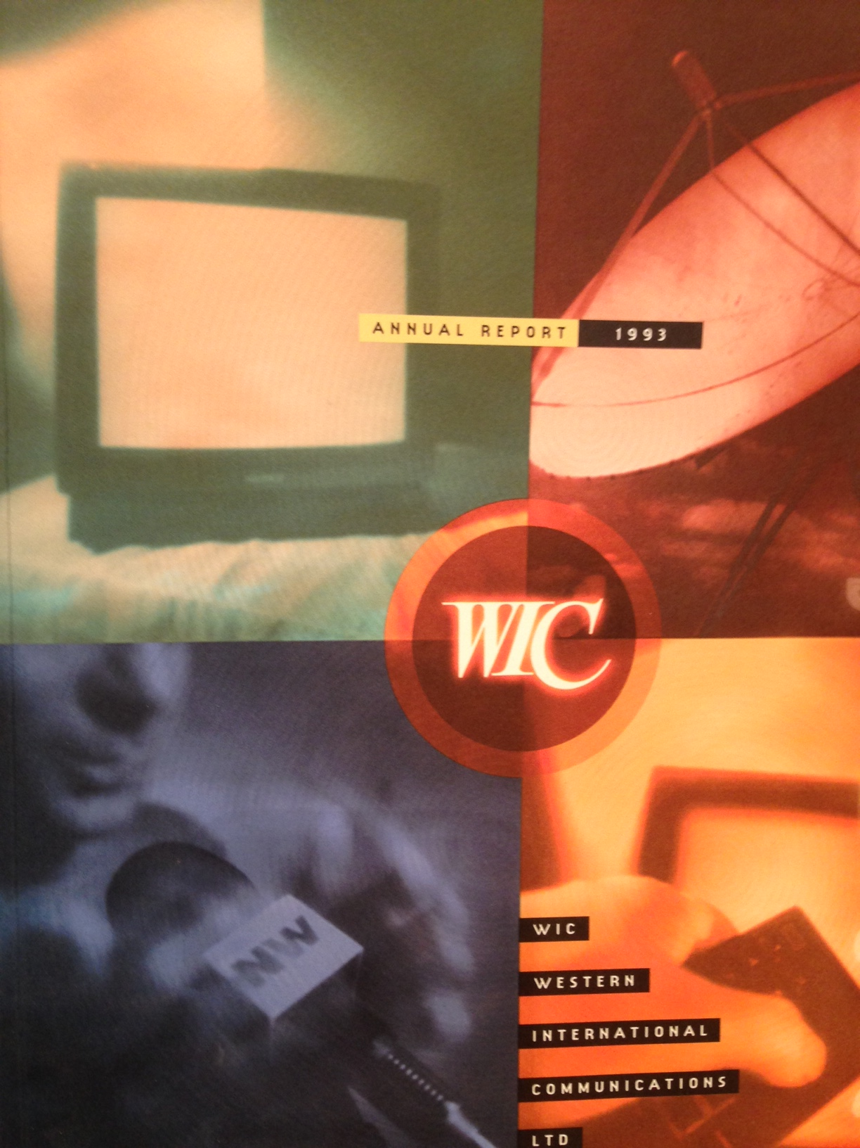
Case Study #2*
*Cancom was case
study #1

Slide 52
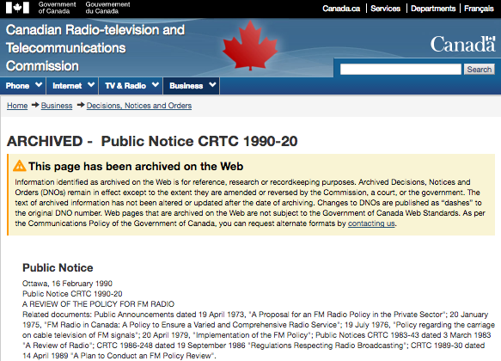
CRTC FM Regulations in the 1980’s

Slide 53

P.D.’s as accountants

Slide 54
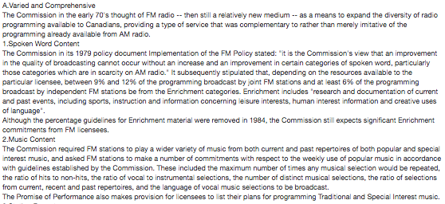
A. Varied and Comprehensive FM

Slide 55
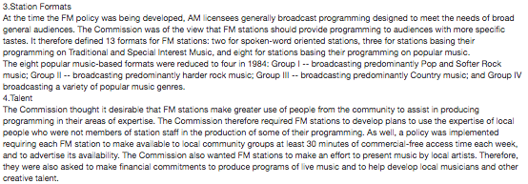

Slide 56
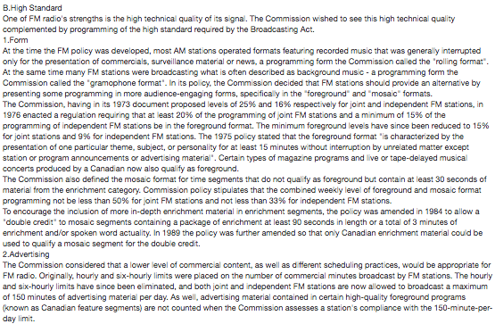
B. High Standard FM

Slide 57
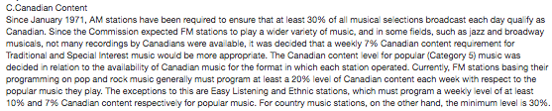
C. Canadian Content on FM

Slide 58
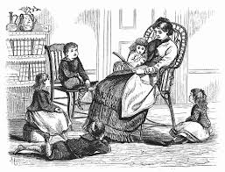
Story time…

Slide 59


Slide 60
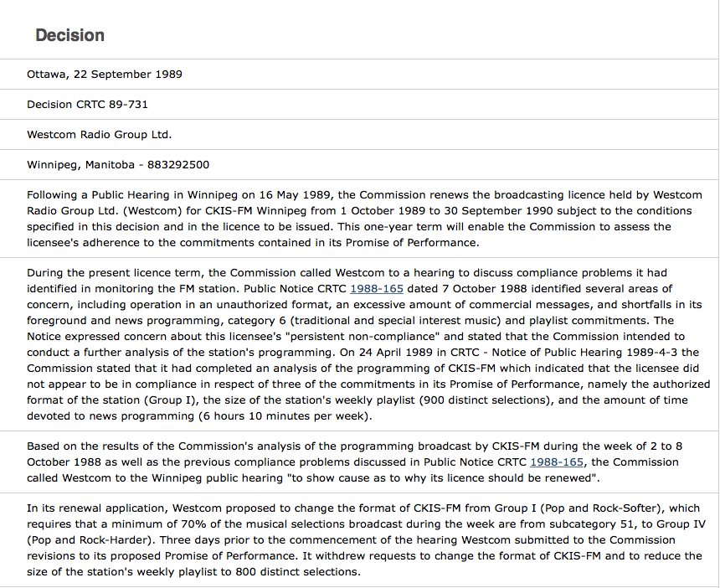

Slide 61
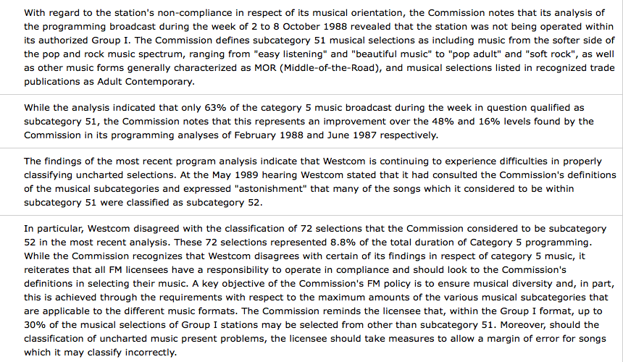

Slide 62

https://youtu.be/9Q7Vr3yQYWQ
@ 6:09 →

Slide 63
Starting Point #3: Content Cases

Slide 64
Re C.F.R.B. [1973] 3 O.R. 819 (Ont. CA)
Issue was Broadcasting Act prohibition of partisan comment on the day of and the day before a provincial election:
Kelly, J.A.: “Even if it be assumed that the decision in the Radio Reference case was intended to declare only the carrier system to be exclusively a subject for the legislative jurisdiction of Parliament, then the decision in that case at best is silent as to the right of Parliament to control and regulate the intellectual content of the material disseminated by the operation of the carrier system. Since there is no binding precedent holding that the control and regulation of the intellectual content is beyond the competence of Parliament, it would be flying in the face of all practical considerations and logic to charge Parliament with the responsibility for the regulation and control of the carrier system and to deny it the right to exercise legislative control over what is the only reason for the existence of the carrier system, i.e., the transmission and reception of intellectual material…”

Slide 65
Therefor…
“I am of the opinion that the exclusive legislative authority of Parliament with respect to radio communication extends to the control and regulation of the intellectual content of radio communication. If the Broadcasting Act comes within the classes of subjects assigned to Parliament, the scope of Parliament's powers is not affected by the fact that its enactments affect some of the classes of subjects reserved to the provincial Legislatures.”

Slide 66
R. v. CKOY Ltd. [1979] 1 SCR 2
CKOY broadcast a telephone interview without the interviewee’s consent contrary to a CRTC regulation prohibiting the broadcast of such interviews. Remember S. 3 of the Broadcasting Act states that “the programming provided by each broadcaster should be of high standard…”

Slide 67
Spence J.: “That “an undesirable broadcasting technique” may well affect the high standard of programming is, I think, self-evident. I am in agreement with counsel for the respondent that the word “programming” extends to more than the mere words which go out over the air but the total process of gathering, assembling and putting out the programmes generally which is covered by the requirement of a high standard of programming.”
* Note Laskin, C.J. dissenting

Slide 68
Canada (CRTC) v. CTV Television Network Ltd. [1982] 1 SCR 530
CTV applied to the CRTC for the renewal of its broadcasting licence. CRTC granted the licence on condition “that 26 hours of original new Canadian drama be presented during the 1980-81 broadcasting year, and 39 hours of original new Canadian drama be presented during the 1981-82 season”.
Fed. C.A. found the CRTC had jurisdiction to impose the condition but set aside the CRTC’s decision because of a breach of natural justice since CTV was not provided details at the hearing of the particular condition being considered.

Slide 69
Laskin, C.J.: “I do not see therefore how CTV can assert…a failure of natural justice in the specification of the particular condition that was in fact included as a term of licence renewal. This is not a case where CTV was being required to answer a criminal or penal charge or where some property right was in jeopardy…The line is too narrow between notice that increased Canadian drama offerings would be discussed (such notice having been amply given) and notice of what in particular would be required in that respect as a condition of licence renewal. Even if such a line could properly be drawn, I do not think that there is a duty on CRTC to give an advance indication of its probable decision in the particularity stated by the Federal Court of Appeal. An applicant seeking a statutory privilege has no right to know in advance of a probable decision unless the statute commands it or the administering tribunal wishes to disclose it. It cannot be said that CTV was being misled here or had not the slightest reason to apprehend the likelihood of a condition such as that attached here to the licence renewal. Conditions had been attached before, although not relating to content...”

Slide 70
Genex Communications Inc. v. Canada (AG) 2005 FCA 283
Appeal from a decision of the CRTC not to renew the broadcasting licence for a French-language commercial radio station CHOI-FM. In February 1997, CHOI was awarded a licence on FM frequency 98.1 expiring on August 31, 2002. That licence was subject to conditions, including compliance with guidelines on non-sexist representation of individuals. CHOI’s operations resulted in numerous public complaints that offensive, sexist, aggressive, discriminatory and degrading comments were made on air. In 2002 CHOI applied for a licence renewal. The CRTC held a public hearing and despite serious reservations regarding “high standard” programming, the licence was renewed for 2 years under “special conditions” including that such condition was that CHOI comply with a Code of Ethics it proposed. After the renewal, new complaints about the spoken-word content by the station's hosts were made and were considered at a further public hearing. The CRTC decided not to renew CHOI's licence.

Slide 71

Cliffhanger to next week…

Slide 72
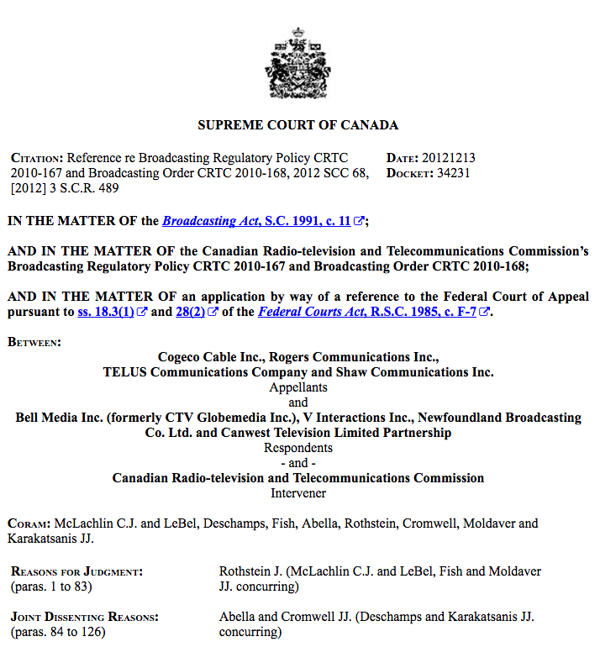

Slide 73
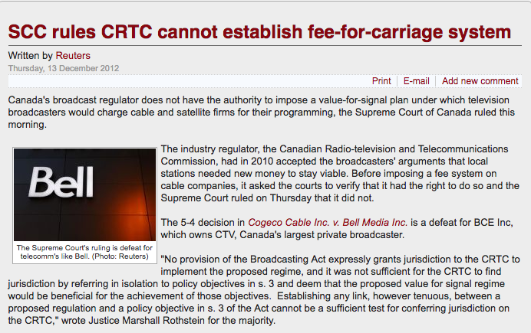
Impact of SCC fee for carriage decision

Slide 74
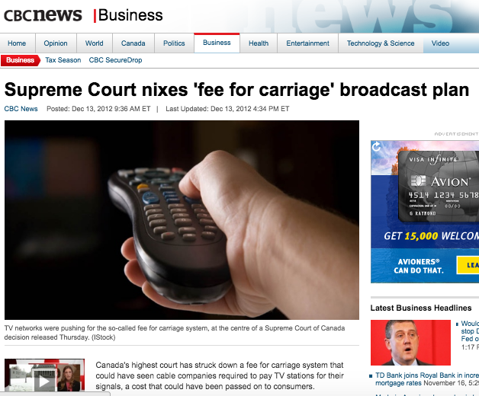

Slide 75
Coming Soon
“A History of Cultural Policy: Regulated, Unregulated & Self Regulated Industries”

Slide 76


A MATTER OF PERSPECTIVE

Slide 77

Always include a cat picture

Slide 78
Our Academic Partners

