Slide 1


Roles of Sovereignty & Culture in the Communications Landscape
Talk 3
LAW 424 001
Communications Law 2.0
Allard School of Law, UBC
Spring, 2017
Jon Festinger Q.C.
Centre for Digital Media
Festinger Law & Strategy
http://commlaw.allard.ubc
@jonfestinger
jon_festinger@thecdm.ca

Slide 2
Logistics

Slide 3
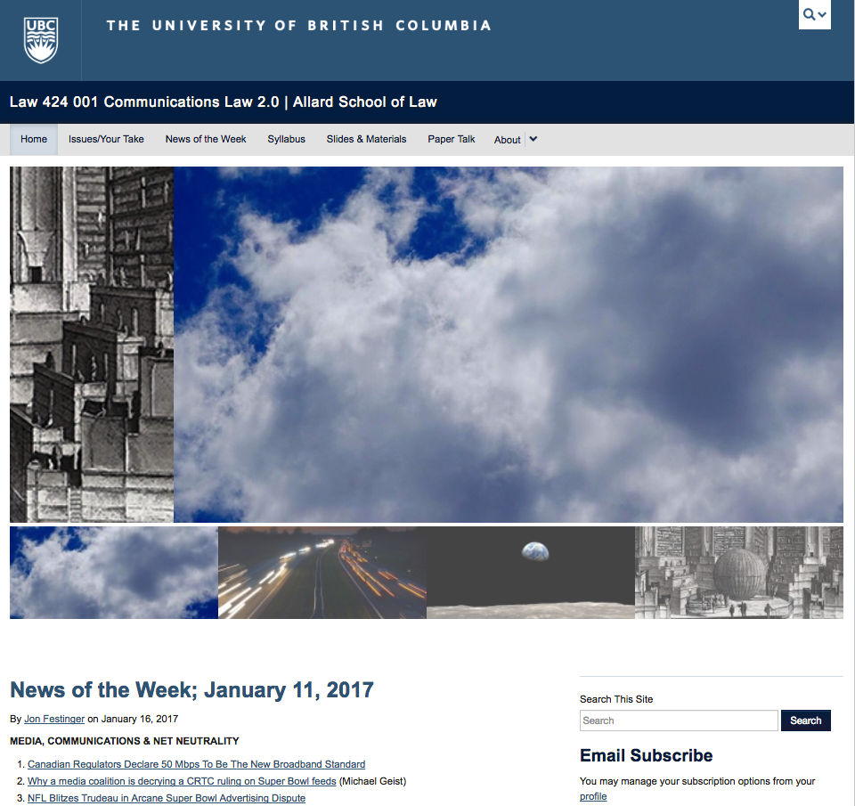
Course Website
http://commlaw.allard.ubc.ca

Slide 4
For full privileges on the website
1. Please create an account at http://cms.ubc.ca/ using your CWL.
2. Once you create an account and sign in at http://cms.ubc.ca/ you can click your name in the top right. Half way down the following page will be your WordPress email address.
3. Send me your WordPress email address at jfestinger@telus.net or at jon@fblawstrategy.com
4. Then, I will invite you to participate with authoring privileges via your WordPress email address.

Slide 5
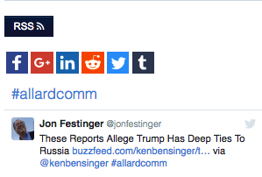
As of yesterday…#allardcomm

Slide 6

& Badges…

Slide 7
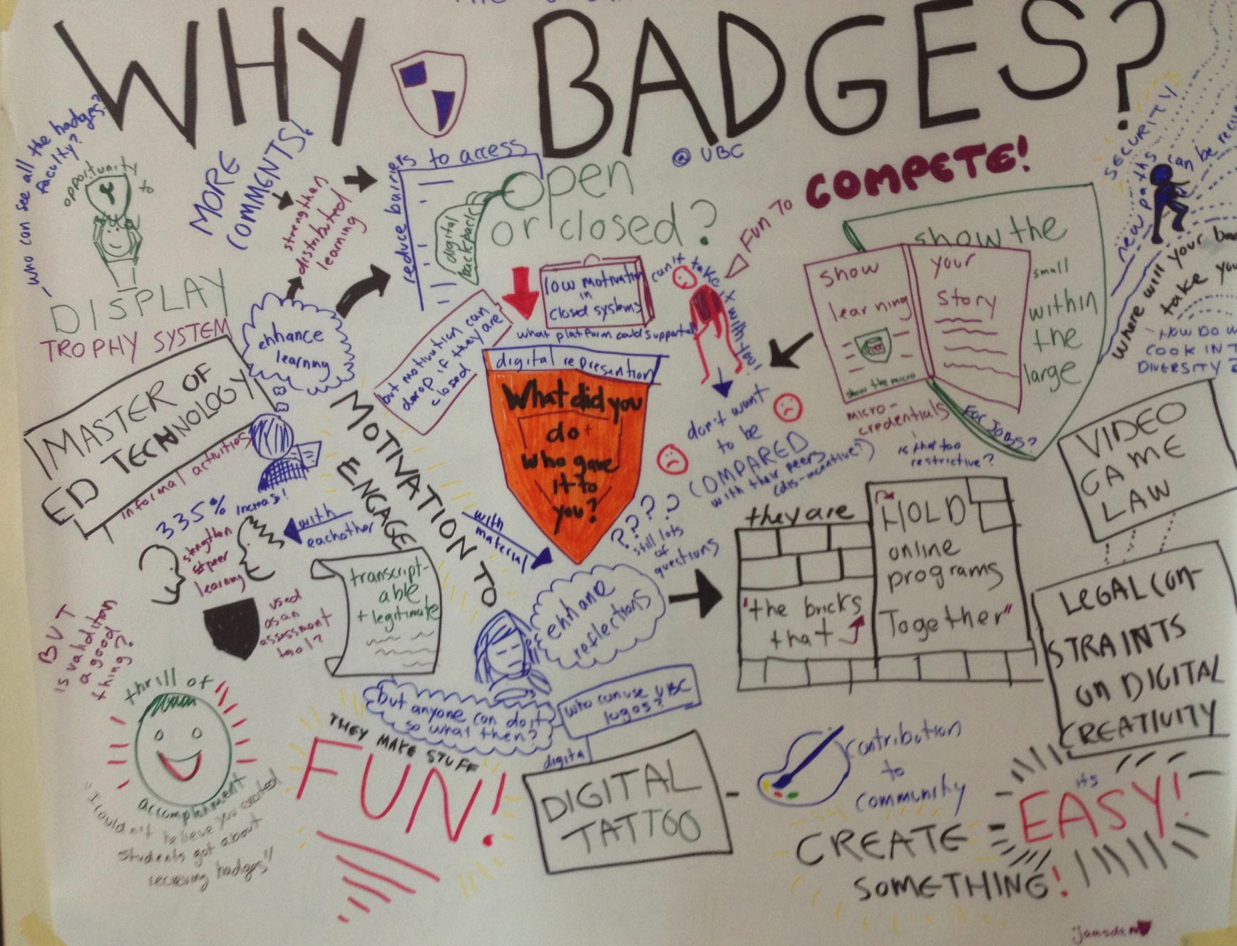

Slide 8

Why post?
Engaging and engaging others is the key.
Because you don’t love speaking up in class.
Because you just saw something and you’ll never remember it unless you post it now.
If you : #allardcomm

Slide 9

No problem if you are not comfortable posting on-line

Slide 10
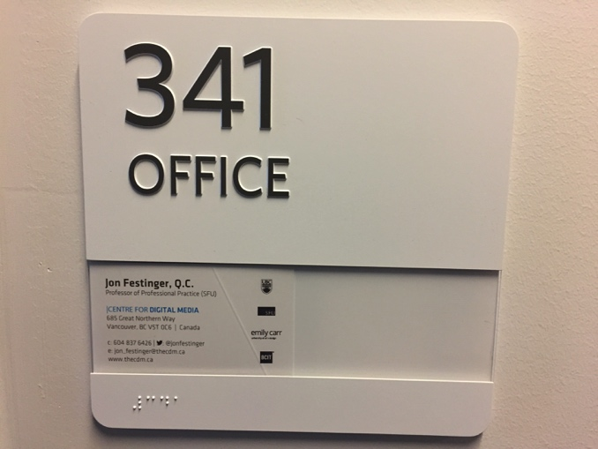
Office “Hours”: Ideally Wednesdays after class but…
Email me & am happy to come to Allard: jfestinger@telus.net
Skype: jon.festinger
Phone:
o. 604-568-9192
c. 604-837-6426

Slide 11
Group Presentations
2 per group
On website Syllabus & will circulate
Sign-up/negotiate at the break or email me
Any topic
Consult with me re topic
Post one thing you want us to read or watch

Slide 12

Because you have sooo much time ;)

Slide 13
News of the Week

Slide 14
Yours?

Slide 15


Slide 16
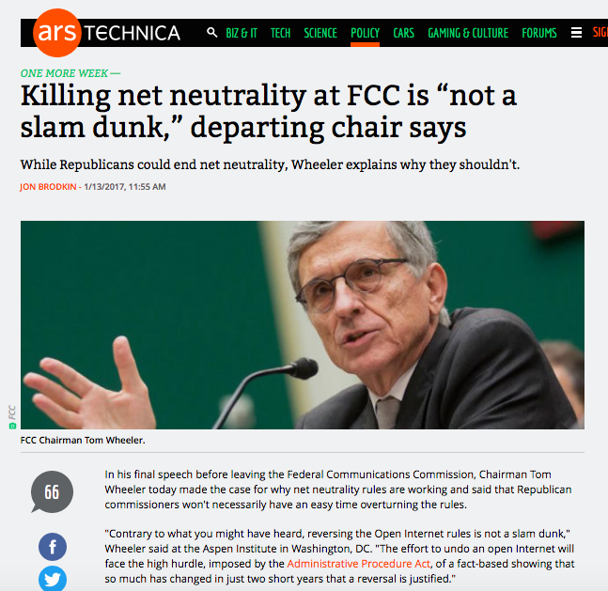

Slide 17
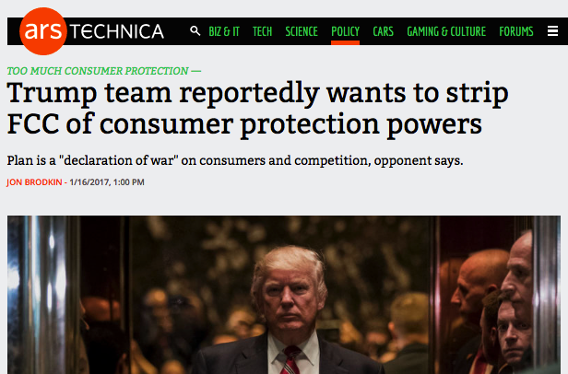

Slide 18
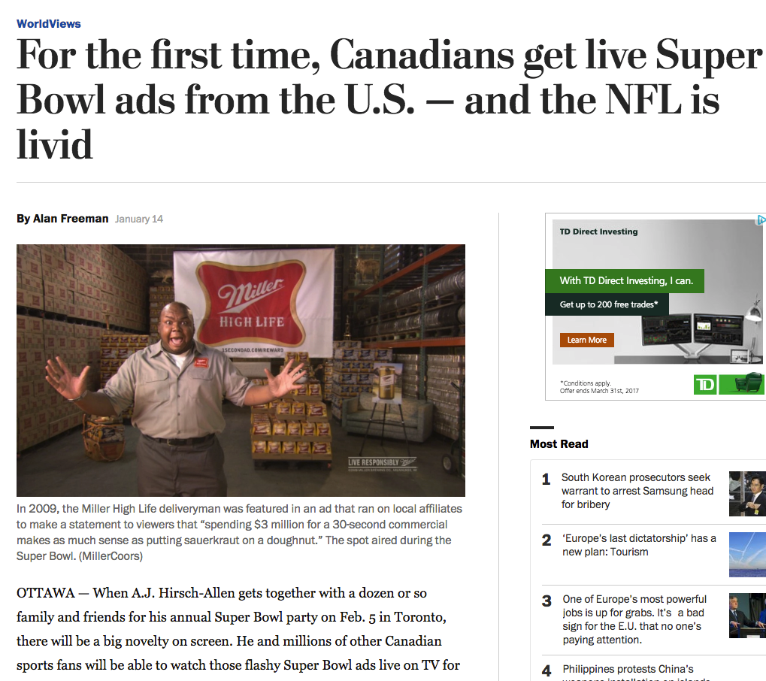

Slide 19

Pause

Slide 20
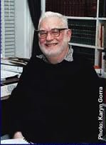
Only rule of of Admin Law
(H. Janisch)?

Slide 21
READ THE STATUTE !!!

Slide 22

Where are the sim-sub regulations?

Slide 23
?????????????????????
Not in the Broadcasting Act
Not in the CRTC Act
Not in the Television Broadcasting Regulations
Not in the Broadcasting Distribution Regulations

Slide 24
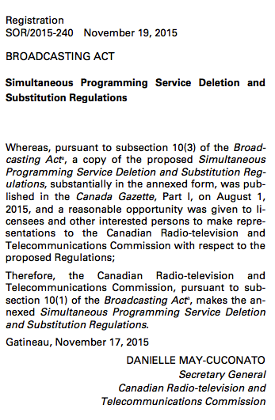
Simultaneous Programming Service Deletion and Substitution Regulations
P. 196 Red Book

Slide 25
4 (1) …a licensee that receives a request referred to in section 3 must carry out the requested deletion and substitution if the following conditions are met:
  (a) the request is in writing and is received by the licensee at least four days before the day on which the programming service to be substituted is to be broadcast;
  (b) the programming service to be deleted and the programming service to be substituted are comparable and are to be broadcast simultaneously;
  (c) the programming service to be substituted has the same format as, or a higher format…

Slide 26

Starting Point 1 For Today

Slide 27

Comm. Law 1.0: Different rules for different screens (& boxes)

Slide 28
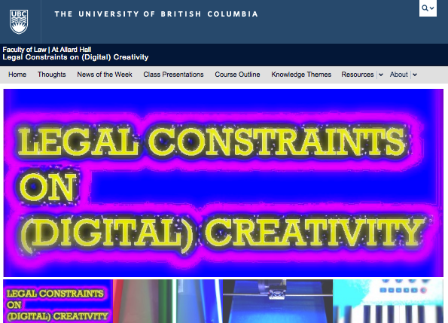
2015 @ Allard Hall: bottom up

Slide 29
Constraints Distort Creativity
10. Internet Governance & Surveillance (International Law)
9. Taxation/Currency/Gambling/Criminal/Obscenity
(Criminal & Quasi Criminal)
8. Misleading promises/advertising, physical or
psychological harm, unfair competition/anti-trust
(consumer protection)
7. Industry self regulation (delegated authority) & medium
specific regulation (constitutional)
Out of the Creation Norms (Censorship) ----------------------------------------------------------------------------------------------------------------
In the Creation Ethics (of Originality, Creativity & Expression)
6. EULA/ToS & Contracts (contractual, private)
5. Privacy, Defamation & Personality law (tort, IP)
4. Trademark, Patents & the IP Business
3. Copyright & Users Rights (statutory)
2. Technology (quasi extra-legal)
1. Community (extra-legal)

Slide 30
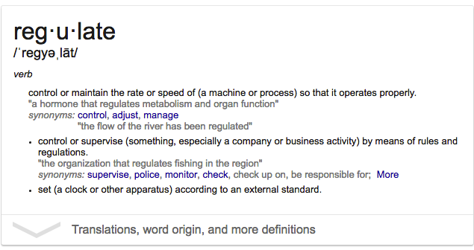
“Regulate” = make regular

Slide 31

An interesting/odd thing to do to human communications (whether creative or political)?

Slide 32
Core
Binaries

Slide 33

Cultural/Industrial
  a. Domestic Ownership
  b. CBC

Slide 34
Content/Carriage
→
Vertical Integration

Slide 35

Regulation/Free Market
    Cellular

Slide 36

Privacy/Surveillance
commercial/gov’t →

Slide 37
Alignments
Cultural
Content
Regulation
Privacy
Industrial
Carriage
Free Market
Surveillance

Slide 38

Where are we actually ?

Slide 39
Vertically integrated free market → oligopoly
Free market industrial surveillance through carriage.

Slide 40
Dystopia?

Slide 41
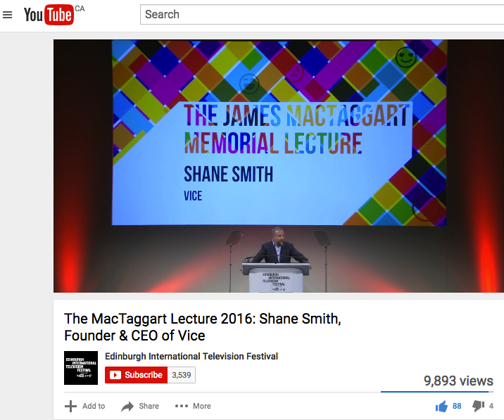
So what about?

Slide 42
THOUGHTS? DISCUSSION?

Slide 43
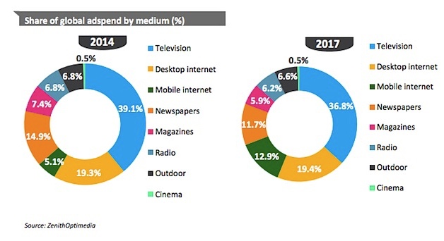

Slide 44
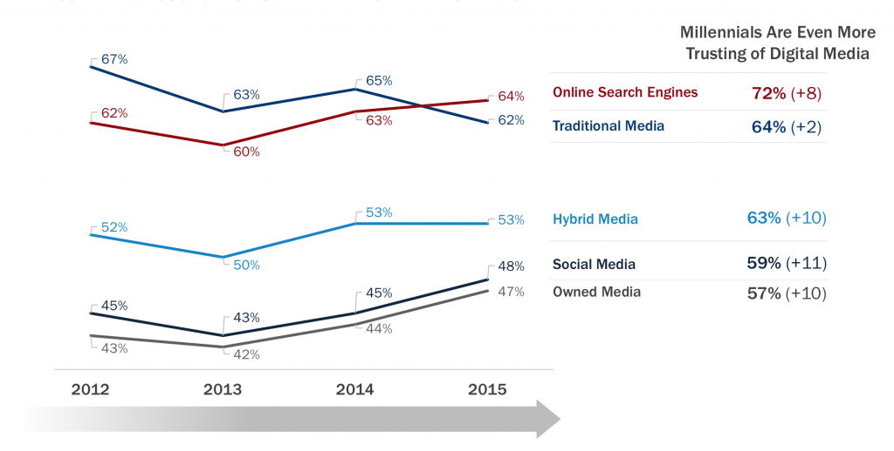

Slide 45

All mediums are the same medium?

Slide 46
THOUGHTS? DISCUSSION?

Slide 47
Starting Point 2 For Today

Slide 48
Roles of Sovereignty & Culture in the Communications Landscape

Slide 49
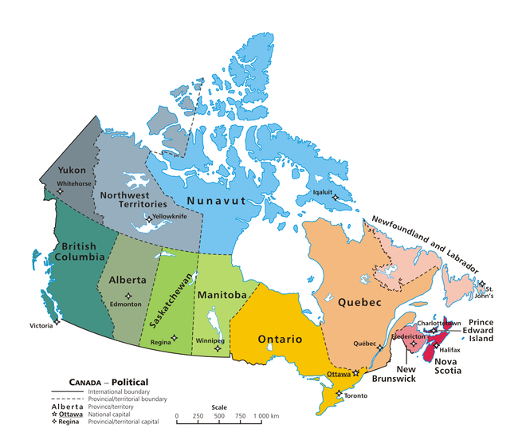

Slide 50


Slide 51
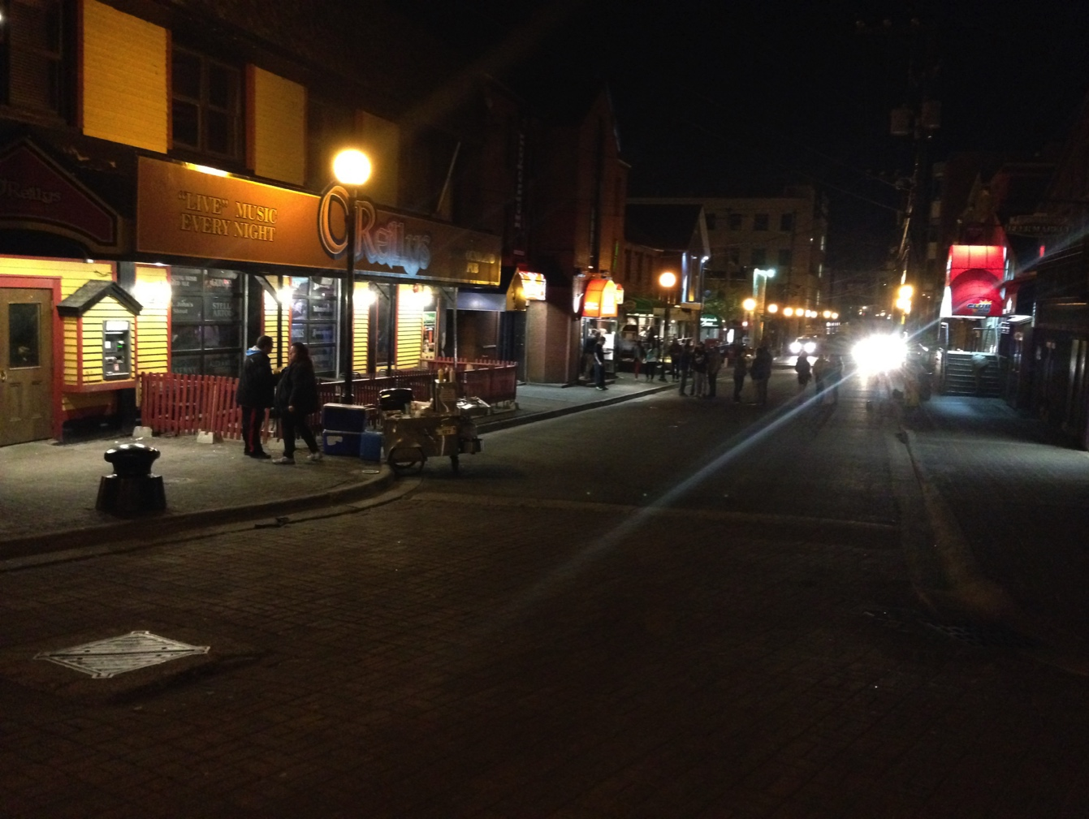
Does sovereignty makes sense? Does culture make sense?

Slide 52

Case Study #1

Slide 53
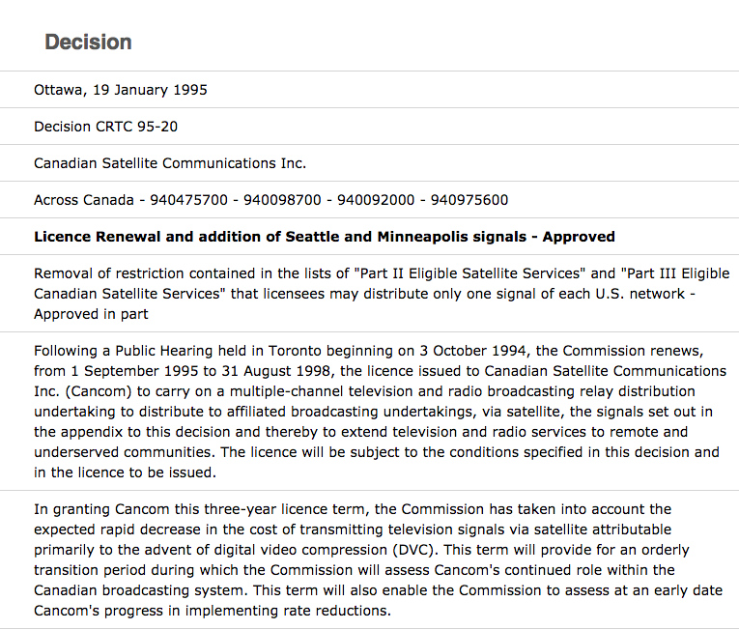

Slide 54
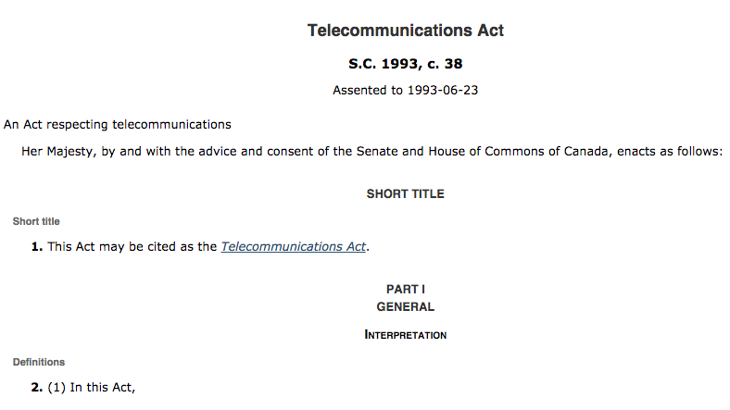

Slide 55
4. This Act does not apply in respect of broadcasting by a broadcasting undertaking.
36. Except where the Commission approves otherwise, a Canadian carrier shall not control the content or influence the meaning or purpose of telecommunications carried by it for the public.

Slide 56
Canadian Telecommunications Policy
Objectives
7 It is hereby affirmed that telecommunications performs an essential role in the maintenance of Canada’s identity and sovereignty and that the Canadian telecommunications policy has as its objectives
(a) to facilitate the orderly development throughout Canada of a telecommunications system that serves to safeguard, enrich and strengthen the social and economic fabric of Canada and its regions;

Slide 57
(b) to render reliable and affordable telecommunications services of high quality accessible to Canadians in both urban and rural areas in all regions of Canada;
(c) to enhance the efficiency and competitiveness, at the national and international levels, of Canadian telecommunications;
(d) to promote the ownership and control of Canadian carriers by Canadians;
(e) to promote the use of Canadian transmission facilities for telecommunications within Canada and between Canada and points outside Canada;

Slide 58
(f) to foster increased reliance on market forces for the provision of telecommunications services and to ensure that regulation, where required, is efficient and effective;
(g) to stimulate research and development in Canada in the field of telecommunications and to encourage innovation in the provision of telecommunications services;
(h) to respond to the economic and social requirements of users of telecommunications services; and
(i) to contribute to the protection of the privacy of persons.

Slide 59
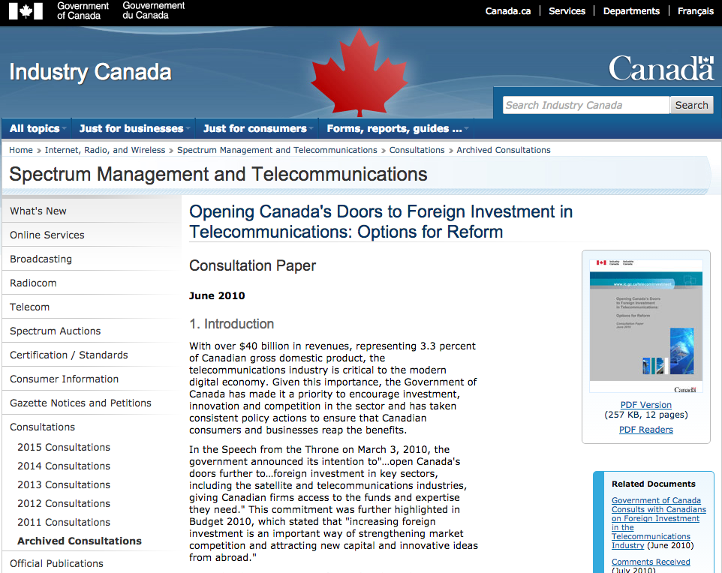
https://www.ic.gc.ca/eic/site/smt-gst.nsf/eng/sf09920.html

Slide 60
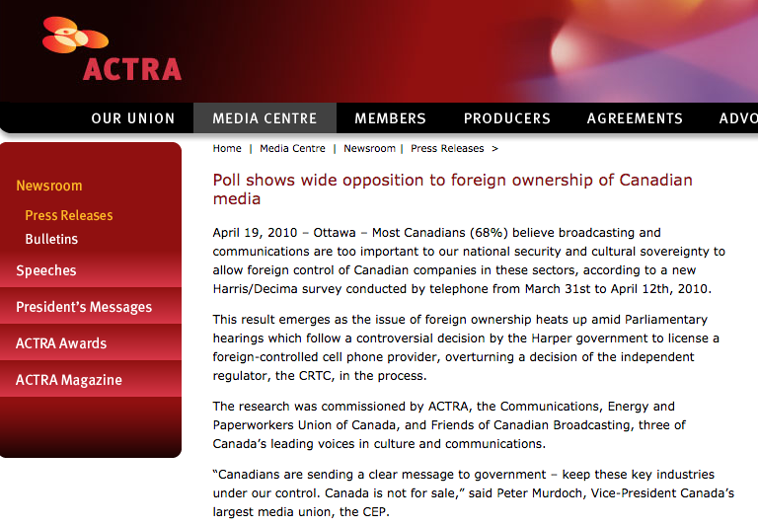

Slide 61

In Telecom the issue seems to be
SOVERIGNTY/(OWNERSHIP)

Slide 62
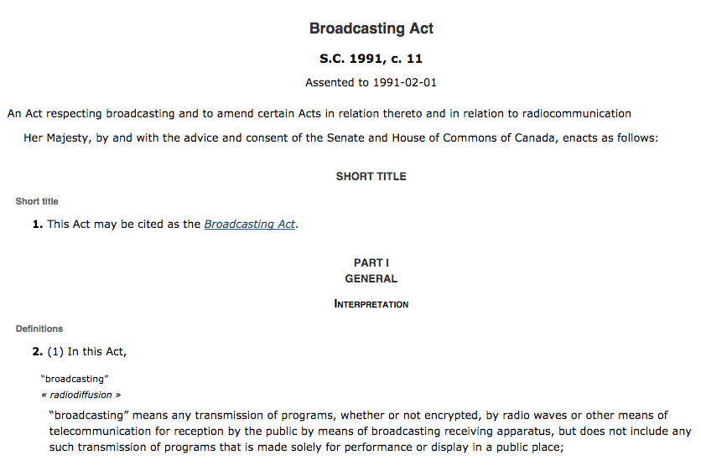

Slide 63
Huh?
Broadcasting Policy for Canada
3 (1) It is hereby declared as the broadcasting policy for Canada that
  (a) the Canadian broadcasting system shall be effectively owned and controlled by Canadians;
  (b) the Canadian broadcasting system, operating primarily in the English and French languages and comprising public, private and community elements, makes use of radio frequencies that are public property and provides, through its programming, a public service essential to the maintenance and enhancement of national identity and cultural sovereignty;

Slide 64
(c) English and French language broadcasting, while sharing common aspects, operate under different conditions and may have different requirements;
(d) the Canadian broadcasting system should
  (i) serve to safeguard, enrich and strengthen the cultural, political, social and economic fabric of Canada,
  (ii) encourage the development of Canadian expression by providing a wide range of programming that reflects Canadian attitudes, opinions, ideas, values and artistic creativity, by displaying Canadian talent in entertainment programming and by offering information and analysis concerning Canada and other countries from a Canadian point of view,
  (iii) through its programming and the employment opportunities arising out of its operations, serve the needs and interests, and reflect the circumstances and aspirations, of Canadian men, women and children, including equal rights, the linguistic duality and multicultural and multiracial nature of Canadian society and the special place of aboriginal peoples within that society, and
  (iv) be readily adaptable to scientific and technological change;

Slide 65
(e) each element of the Canadian broadcasting system shall contribute in an appropriate manner to the creation and presentation of Canadian programming;
(f) each broadcasting undertaking shall make maximum use, and in no case less than predominant use, of Canadian creative and other resources in the creation and presentation of programming, unless the nature of the service provided by the undertaking, such as specialized content or format or the use of languages other than French and English, renders that use impracticable, in which case the undertaking shall make the greatest practicable use of those resources;

Slide 66
The News?
(g) the programming originated by broadcasting undertakings should be of high standard;
(h) all persons who are licensed to carry on broadcasting undertakings have a responsibility for the programs they broadcast;

Slide 67
The CBC
(i) the programming provided by the Canadian broadcasting system should
  (i) be varied and comprehensive, providing a balance of information, enlightenment and entertainment for men, women and children of all ages, interests and tastes,
  (ii) be drawn from local, regional, national and international sources,
  (iii) include educational and community programs,
  (iv) provide a reasonable opportunity for the public to be exposed to the expression of differing views on matters of public concern, and
  (v) include a significant contribution from the Canadian independent production sector;

Slide 68
Tie-breakers???
(n) where any conflict arises between the objectives of the Corporation set out in paragraphs (l) and (m) and the interests of any other broadcasting undertaking of the Canadian broadcasting system, it shall be resolved in the public interest, and where the public interest would be equally served by resolving the conflict in favour of either, it shall be resolved in favour of the objectives set out in paragraphs (l) and (m);
(2) It is further declared that the Canadian broadcasting system constitutes a single system and that the objectives of the broadcasting policy set out in subsection (1) can best be achieved by providing for the regulation and supervision of the Canadian broadcasting system by a single independent public authority.

Slide 69

In Broadcasting the issue seems to be
CULTURE (OWNERSHIP)

Slide 70

Does this sound familiar?…
Prime Minister R.B. Bennett 1932: “…this country must be assured of complete Canadian control of broadcasting from Canadian sources. Without such control, broadcasting can never be the agency by which national consciousness may be fostered and sustained and national unity still further strengthened….”

Slide 71
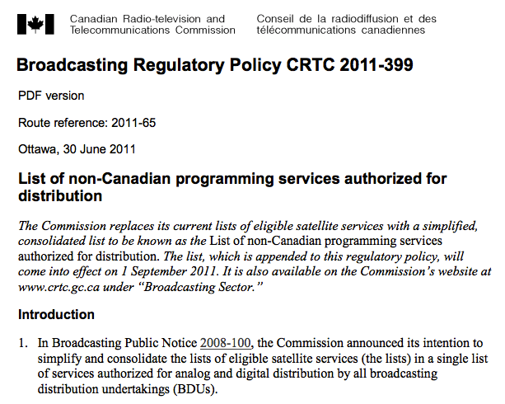

Slide 72


Slide 73
A strange digression…
One Act, or Two, or more?

Slide 74

Why the differences between technologies?

Slide 75
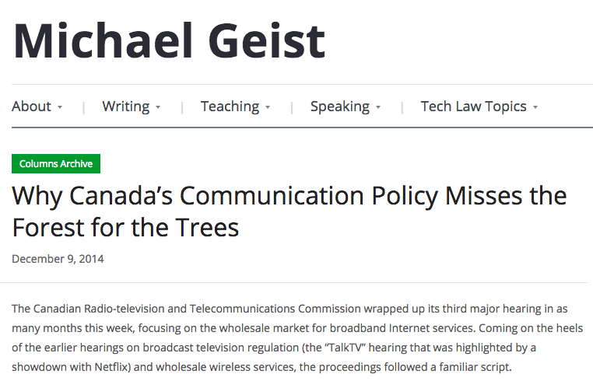

Slide 76
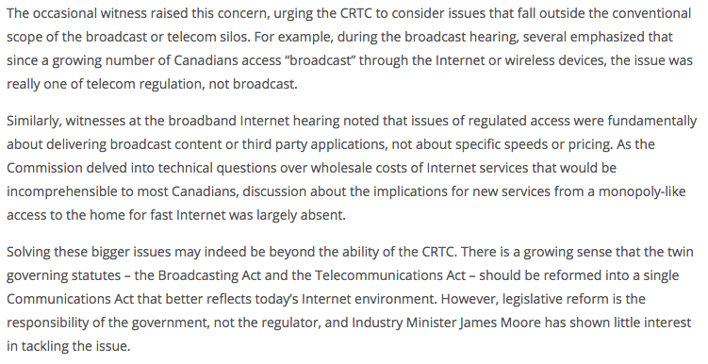

Slide 77
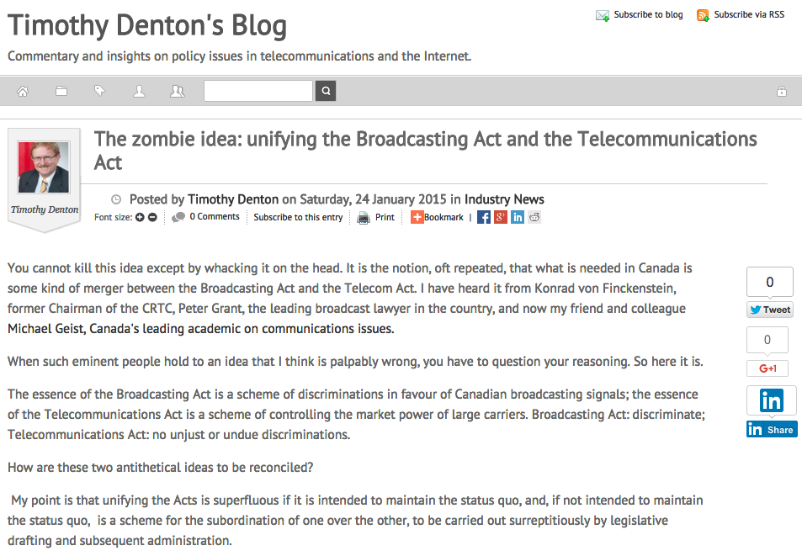
http://tmdenton.com/index.php/easyblog/entry/the-zombie-idea-unifying-the-broadcasting-act-and-the-telecommunications-act

Slide 78
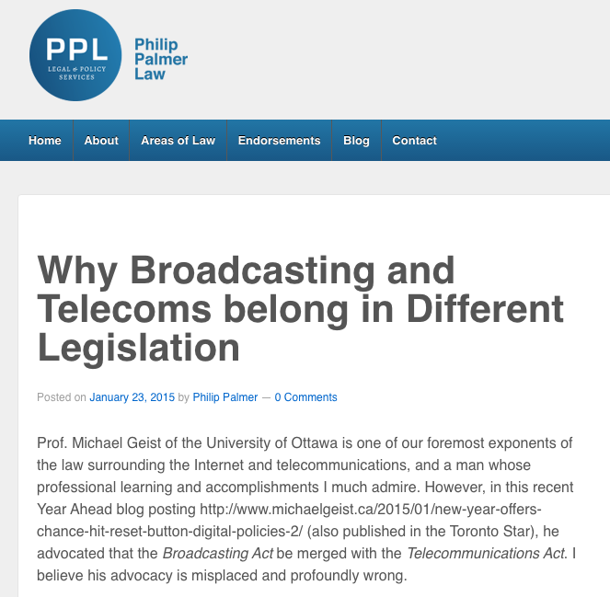
http://philippalmerlaw.ca/broadcasting-telecoms-belong-different-legislation/

Slide 79
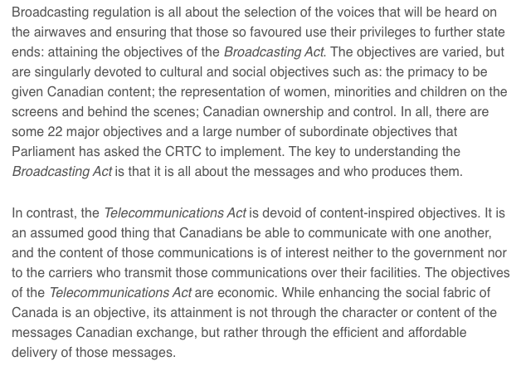

Slide 80
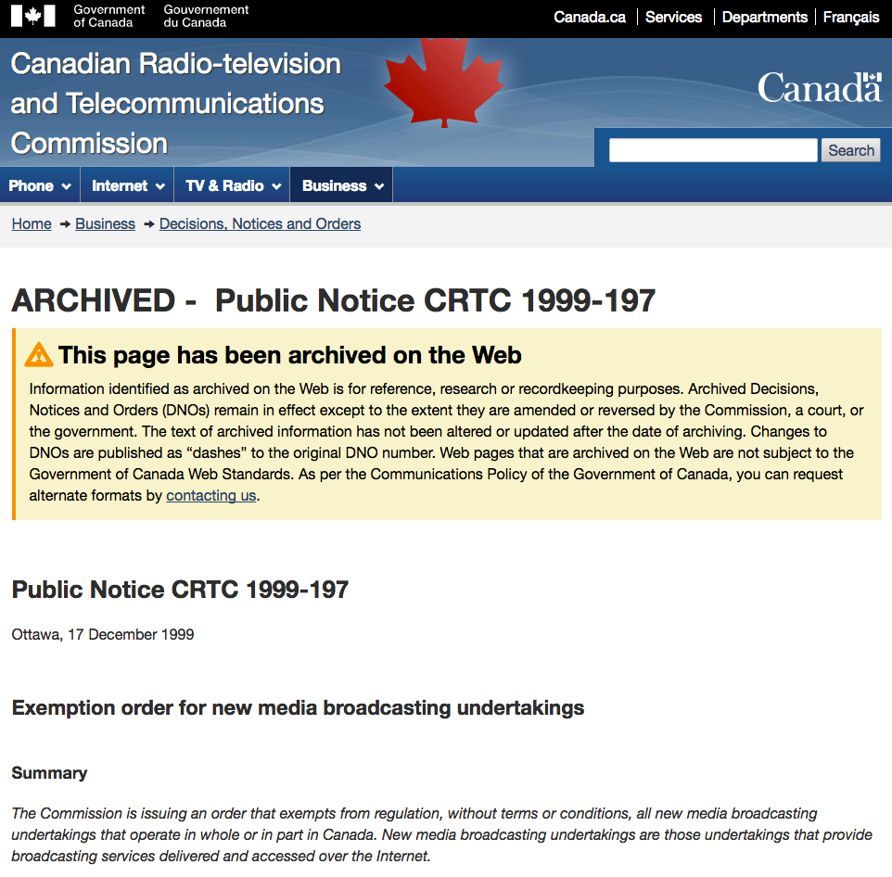
Does all this explain?…

Slide 81
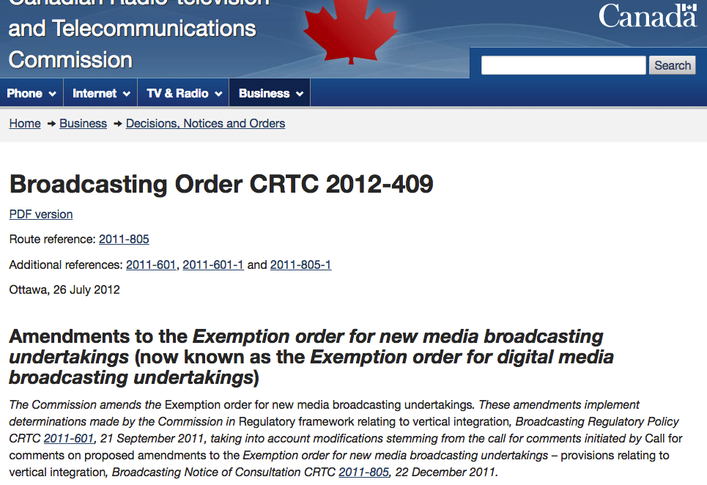

Slide 82

Digital net doesn’t fit…culture or sovereignty all that well???

Slide 83

What are “first principles” in the digital age?
More importantly, what should they be?

Slide 84
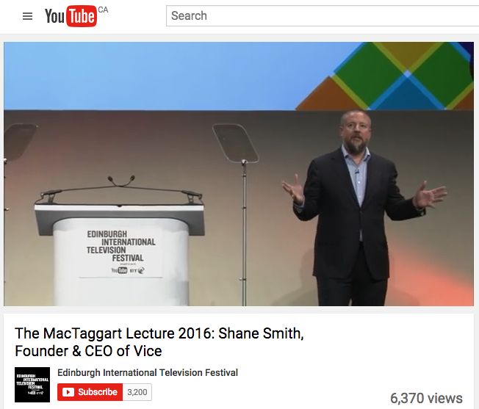
Second Thoughts?

Slide 85
How about as 1st principles?
“To encourage and facilitate the creativity and expression of all Canadians.”

Slide 86
Coming Soon
“Telecommunications Policy: Origins, Regulation & Cases”

Slide 87


A MATTER OF PERSPECTIVE

Slide 88

Always include a cat picture

Slide 89
Our Academic Partners

