Slide 1
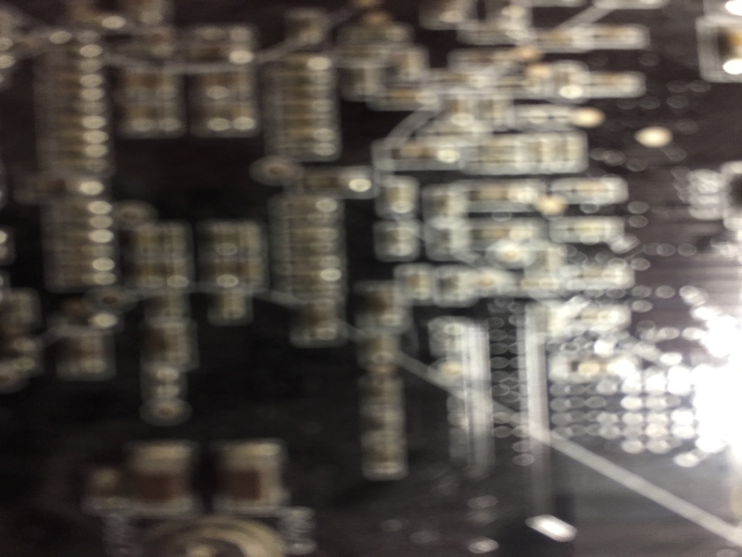

The Future of MEdia
Talk 11
LAW 424 001
Communications Law
Allard School of Law, UBC
Spring, 2018
Jon Festinger Q.C.
Centre for Digital Media
QMUL School of Law (CCLS)
Festinger Law & Strategy
http://commlaw.allard.ubc
@jonfestinger
jon_festinger@thecdm.ca

Slide 2
Virtual Reality 4.0
MEdia

Slide 3
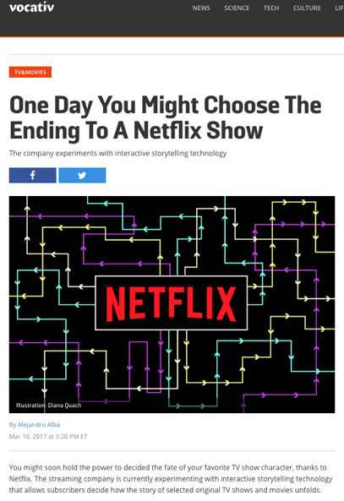

Slide 4
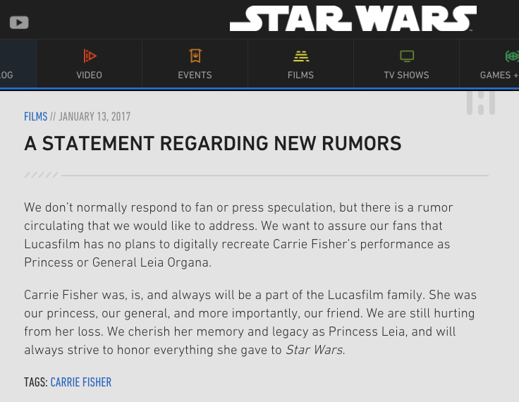

Slide 5
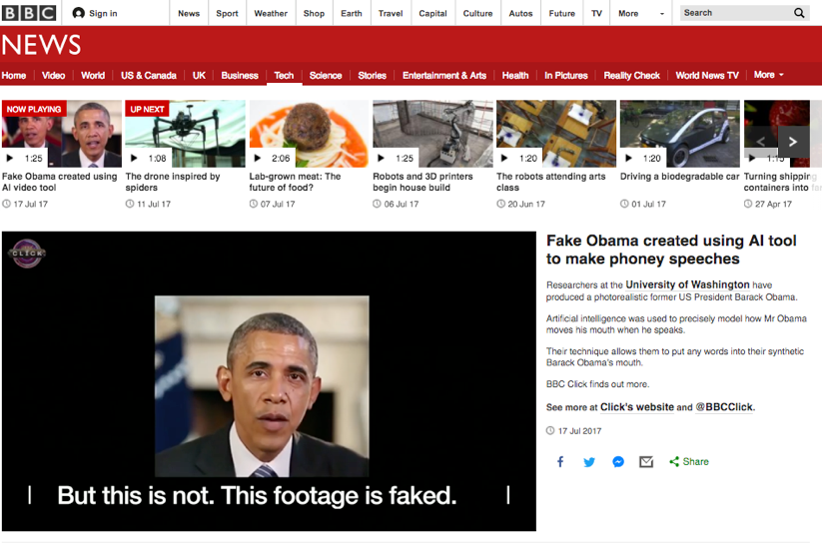

Slide 6
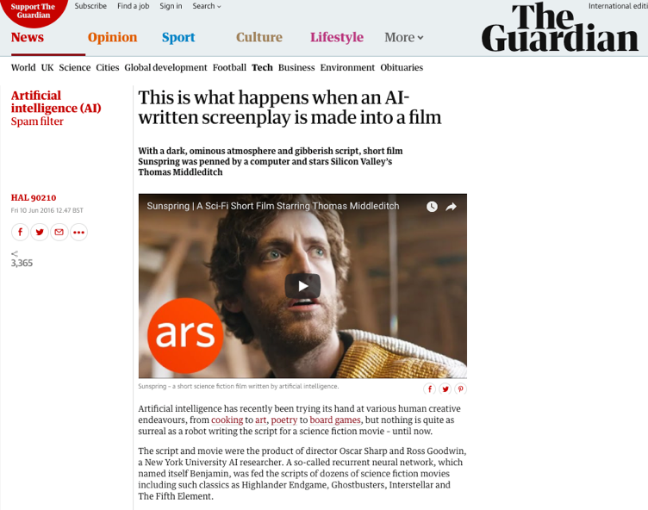

Slide 7
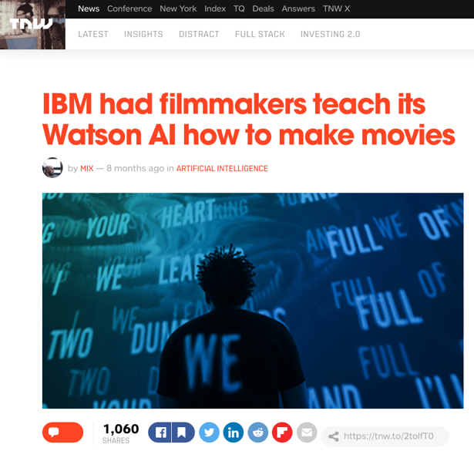

Slide 8
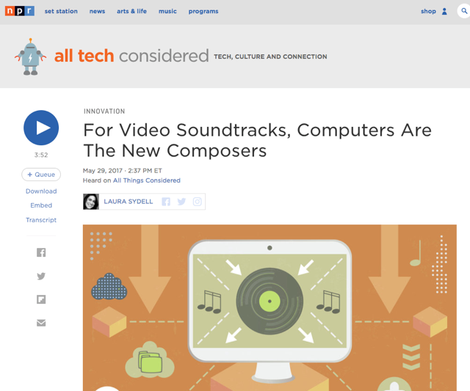

Slide 9
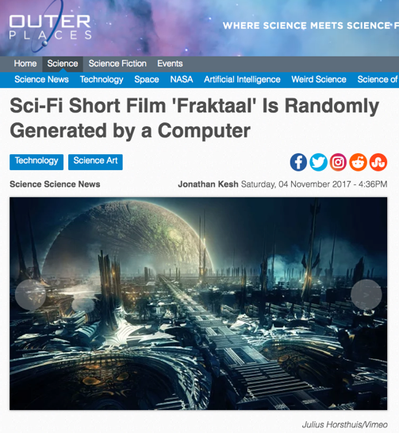

Slide 10
What if your algorithm knew…
My favorite type of movie (romantic comedy)
My favorite stars (Anna Kendrick + “young” John Cusack)
My favorite screen writer (Adam Sorkin)
My favorite plot trope (time travel that teaches life lessons)
Plot points & dialogue that I laugh at
Plot points & dialogue that I cry at
Favorite music (Springsteen, The Clash)
My personality profile (in detail)
My personal history & biographical details (Dad passed of cancer; mom of Alzheimer’s; Parents both Holocaust survivors from Poland)
& pretty well everything else about me.

Slide 11
Jung: People are complex; & unique (?)
The shoe that fits one person pinches another; there is no recipe for living that suits all cases.”
In all chaos there is a cosmos, in all disorder a secret order.
Who looks outside, dreams; who looks inside, awakes.
When an inner situation is not made conscious, it appears outside as fate.

Slide 12

Fictional Storytelling uniquely tailored to me: An algorithmically directed “The Truman Show”

Slide 13
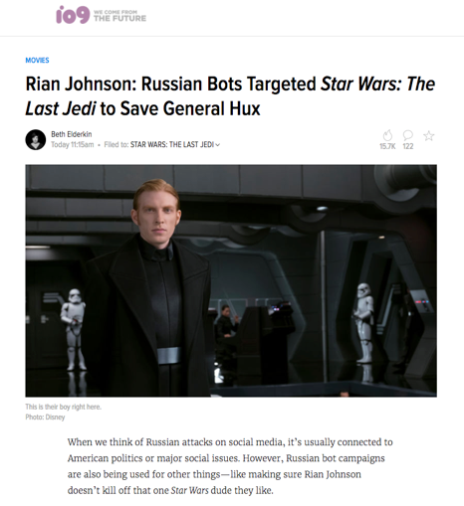
What if your algorithm wanted something…

Slide 14
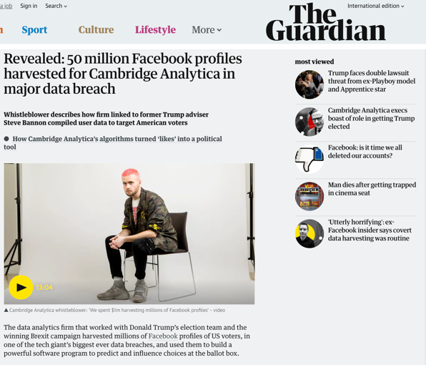
Not so very different from…

Slide 15
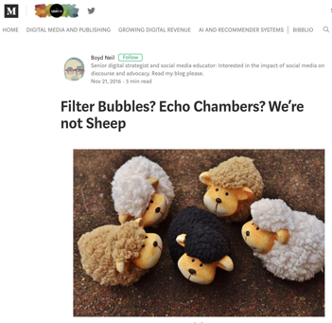
Note “paradox” of algorithmically filtered big data influencing each of us demonstrates our individuality and complexity rather than disproving it.

Slide 16
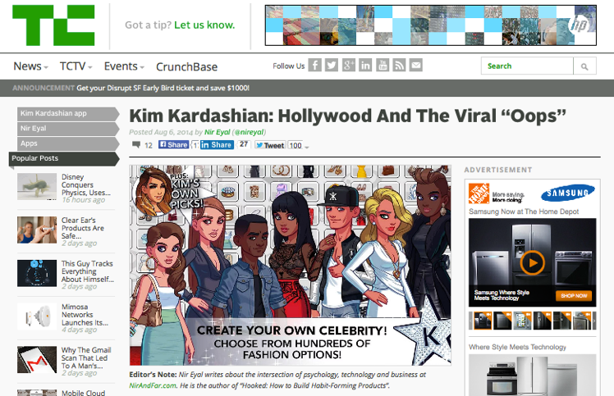
Antecedents
http://techcrunch.com/2014/08/06/kim-kardashian-hollywood-and-the-viral-oops/

Slide 17
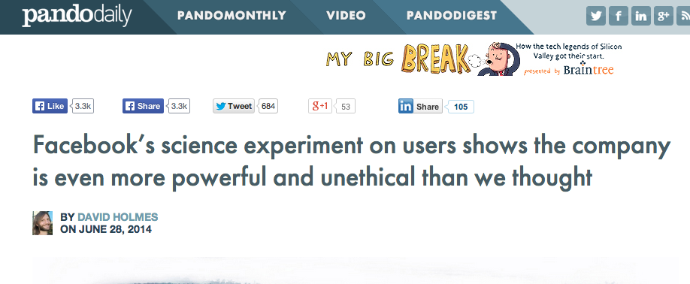
Previous very poor judgment
…care of Facebook
http://pando.com/2014/06/28/facebooks-science-experiment-on-users-shows-the-company-is-more-even-powerful-and-unethical-than-we-thought/

Slide 18
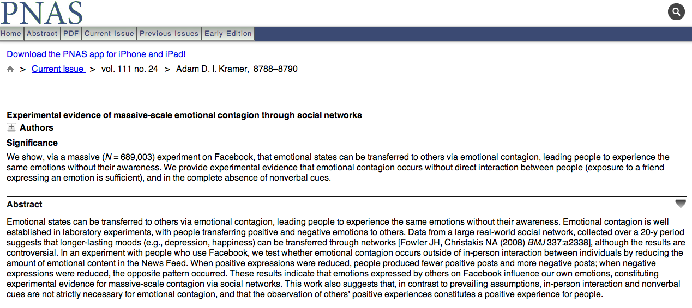
http://www.pnas.org/content/111/24/8788.full

Slide 19
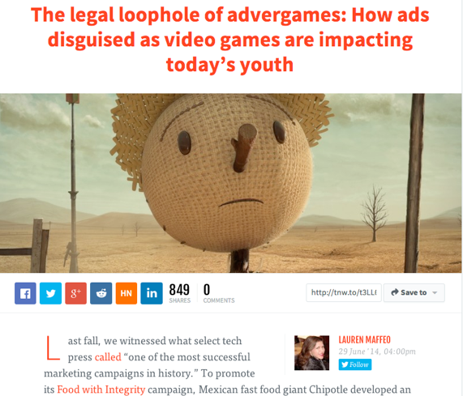
And other stuff too…
http://thenextweb.com/dd/2014/06/29/legal-loophole-advergames/

Slide 20
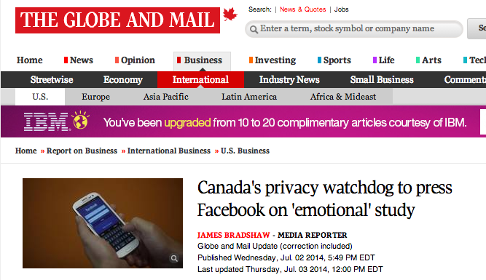
All of which ended up here…
http://www.theglobeandmail.com/report-on-business/international-business/us-business/facebook-in-hot-water-for-social-study/article19434632/

Slide 21
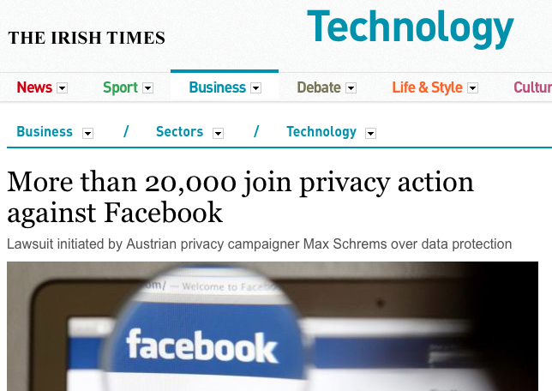
And here…
http://www.irishtimes.com/business/sectors/technology/more-than-20-000-join-privacy-action-against-facebook-1.1889192

Slide 22
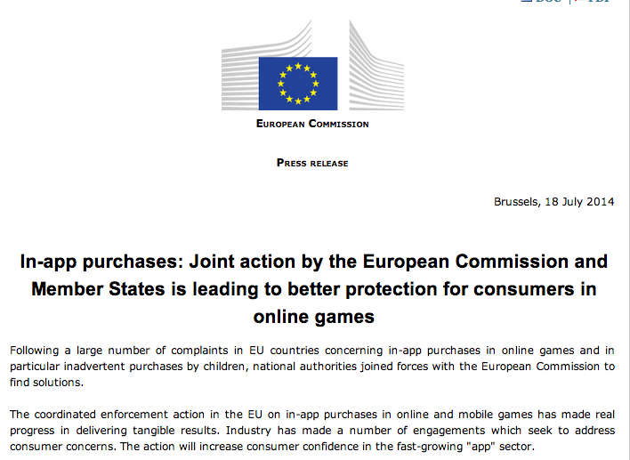
Here too…
http://europa.eu/rapid/press-release_IP-14-847_en.htm

Slide 23
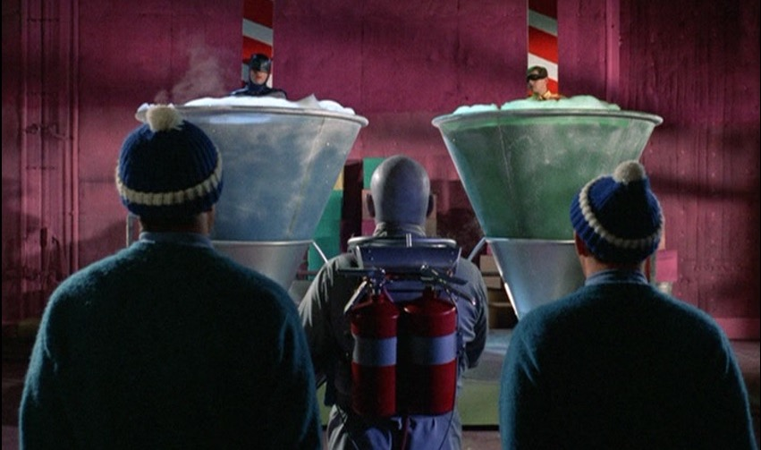
Cliffhanger…

Slide 24
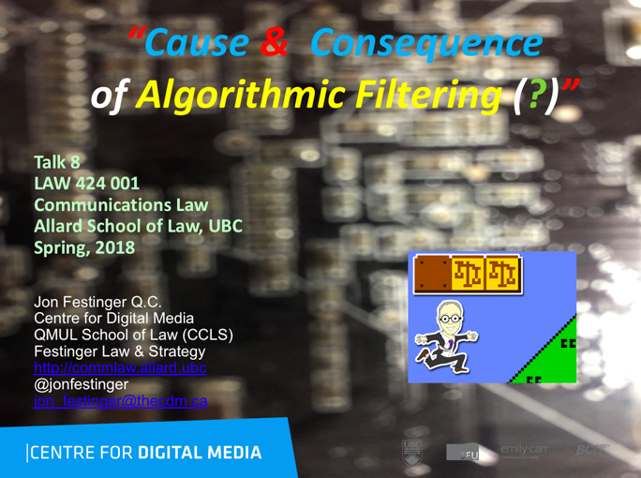
Remember…

Slide 25

1. Algorithmic Filtering

Slide 26
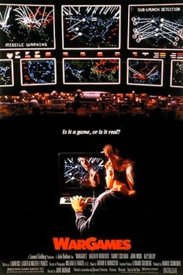

Slide 27
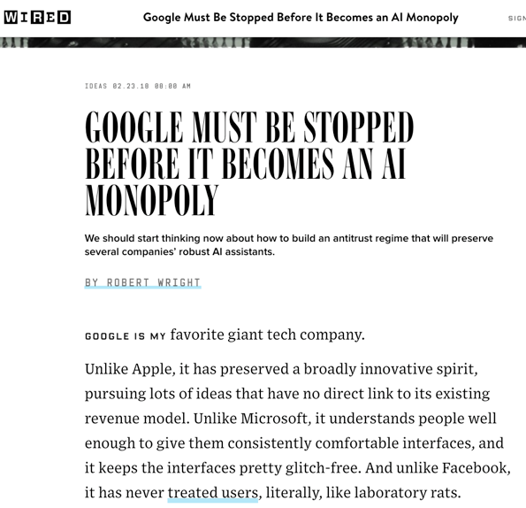

Slide 28
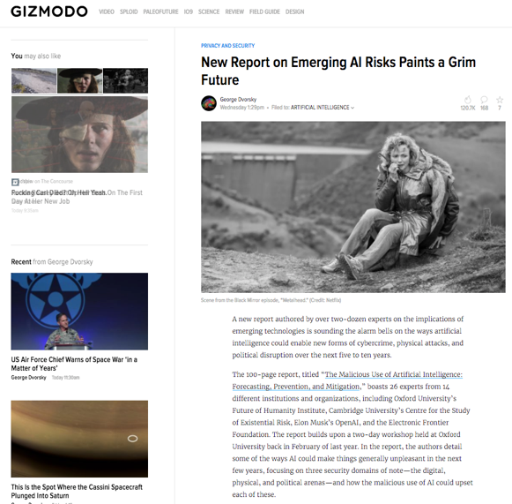

Slide 29
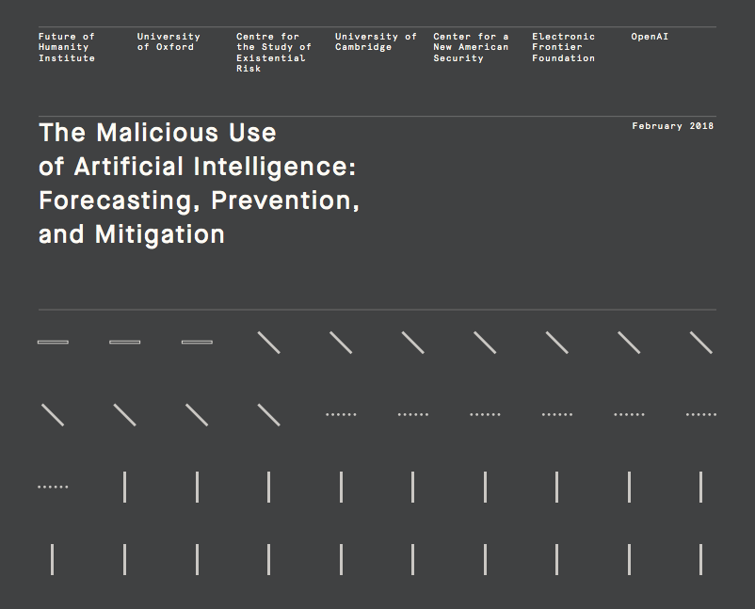

Slide 30
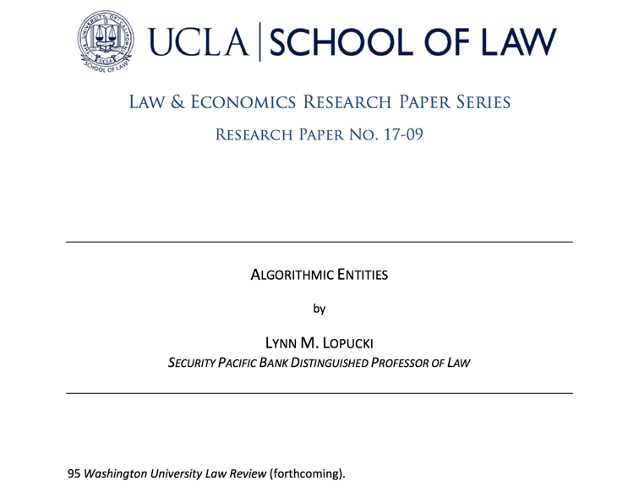

Slide 31
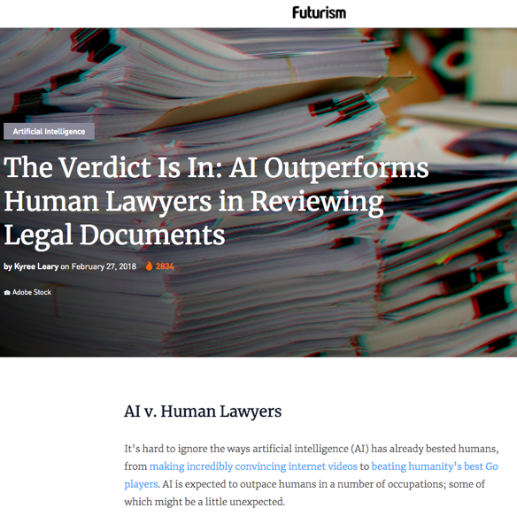

Slide 32
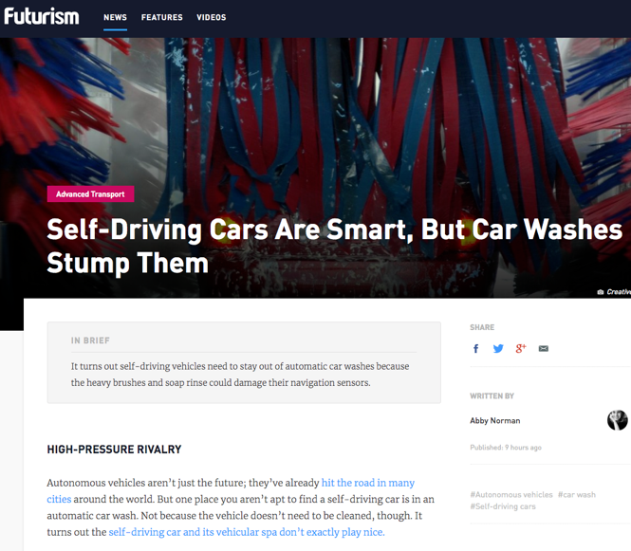

Slide 33
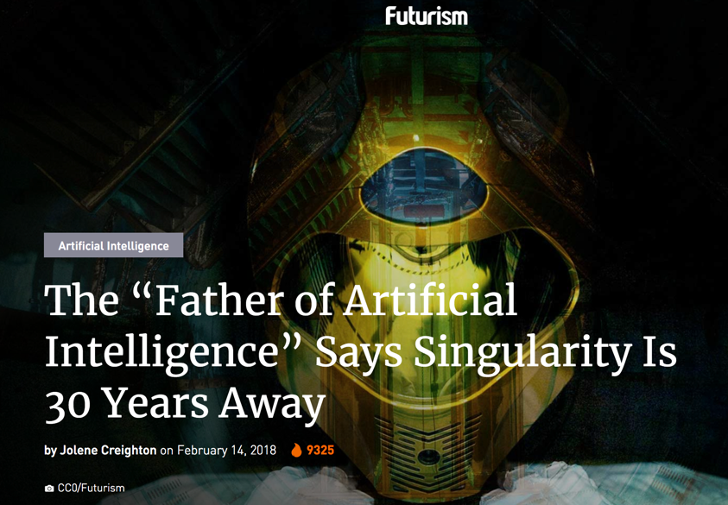

Slide 34
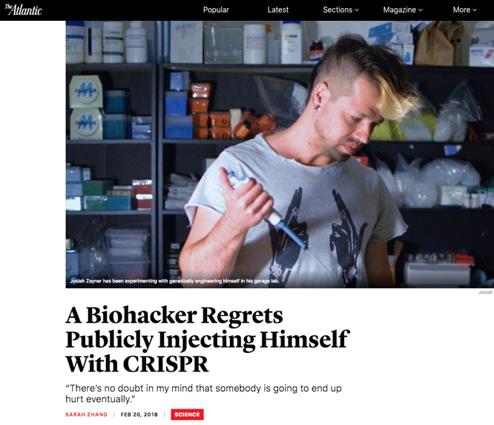

Slide 35
2. Cause?

Slide 36
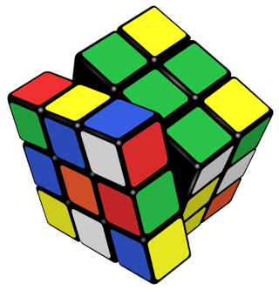
Start with :What works
(& what doesn’t work) on the internet?

Slide 37
Contrary to what we may believe…
DIRECT PERSONAL CONFRONTATION (as opposed to watching others confront each other) doesn’t seem to work! If you don’t believe it Google the word and it’s derivatives looking for websites and see what you find.

Slide 38
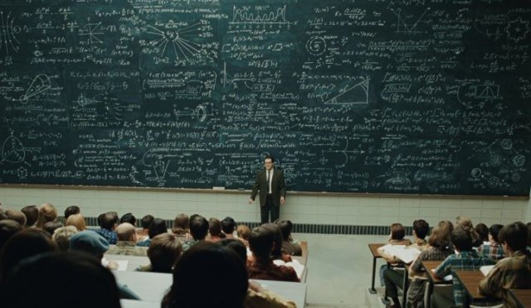
Theory please?…

Slide 39

Could it be that we want from the internet what we pretty well want from everything in life –
Personal Reinforcement?

Slide 40
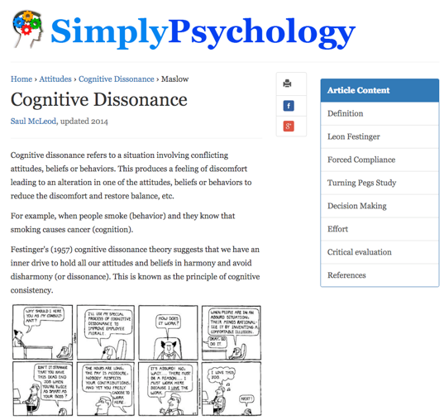
Theory of Cognitive Dissonance

Slide 41
3. Consequence of algorithms?

Slide 42

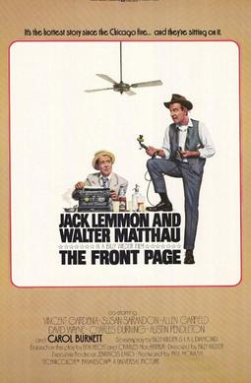
Are algorithms in fact an editorial choice?
How can they not be?

Slide 43
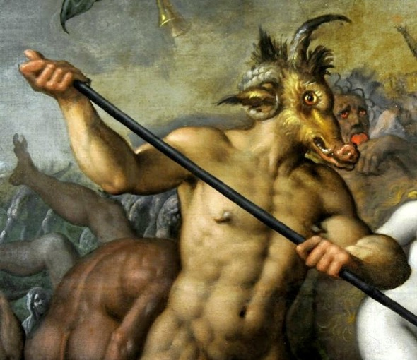
The Devils’ Choice?

Slide 44
For Google, Twitter, & Facebook
S. 230 DMCA v.
The 1st
Amendment

Slide 45
S. 230 Digital Millennium
Copyright Act (U.S.)
"No provider or user of an interactive computer service shall be treated as the publisher or speaker of any information provided by another information content provider."
47 U.S.C. § 230

Slide 46
The 1st Amendment to the
U.S. Constitution
“Congress shall make no law respecting an establishment of religion, or prohibiting the free exercise thereof; or abridging the freedom of speech, or of the press; or the right of the people peaceably to assemble, and to petition the government for a redress of grievances.”

Slide 47
Can the provisions be reconciled or are they mutually exclusive?
Either you are a speaker
( = 1st Amendment) or you are not
( = s. 230 of the DMCA)?

Slide 48
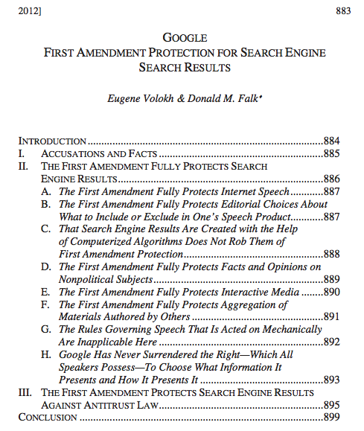

884 JOURNAL OF LAW, ECONOMICS & POLICY [VOL. 8:4]

Slide 49
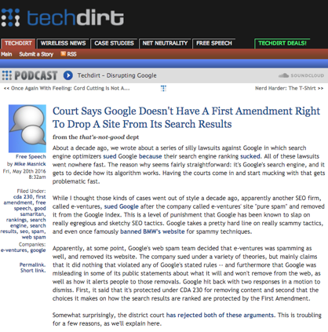
But? (probably incorrect)

Slide 50
Where are my
constitutional/
rule of law rights in
this equation ?

Slide 51
“To regulate, or not to regulate, that is the question.”

Slide 52
QUESTIONS?
THOUGHTS?
DISCUSSION?

Slide 53

Pause

Slide 54


Slide 55
Thoughts?

Slide 56
Coming Soon
“Net Neutrality & Regulation: Meanings, Myths, & Modes”

Slide 57
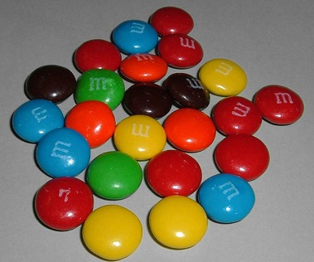

A MATTER OF PERSPECTIVE

Slide 58

Always include a cat picture

Slide 59
Our Academic Partners

