Slide 1


Roles of Sovereignty & Culture in the Communications Landscape
Talk 4
LAW 424 001
Communications Law 2.0
Allard School of Law, UBC
Spring, 2018
Jon Festinger Q.C.
Centre for Digital Media
QMUL School of Law (CCLS)
Festinger Law & Strategy
http://commlaw.allard.ubc
@jonfestinger
jon_festinger@thecdm.ca

Slide 2
Logistics

Slide 3
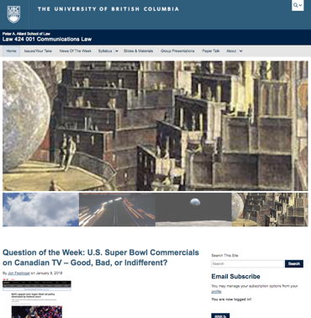
Course Website
http://commlaw.allard.ubc.ca

Slide 4
For full privileges on the website
1. Please create an account at http://cms.ubc.ca/ using your CWL.
2. Once you create an account and sign in at http://cms.ubc.ca/ you can click your name in the top right. Half way down the following page will be your WordPress email address.
3. Send me your WordPress email address at jfestinger@telus.net or at jon@fblawstrategy.com
4. Then, I will invite you to participate with authoring privileges via your WordPress email address.

Slide 5
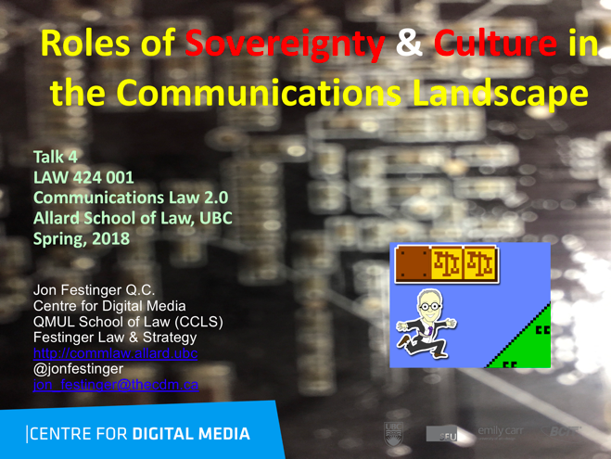
Starting This Week:
On the Website before class…

Slide 6
Group Presentations: All in?
2 (ideally) per group
Sign-up at the break or email me
Any topic – not constrained by what I’m talking about that week
Consult with me re the topic you want to take on
Post one thing you want us to read or watch

Slide 7

Office “Hours”: Ideally Wednesdays after class but…
Email me & am happy to come to Allard: jfestinger@telus.net
Skype: jon.festinger
Phone:
o. 604-568-9192
c. 604-837-6426

Slide 8
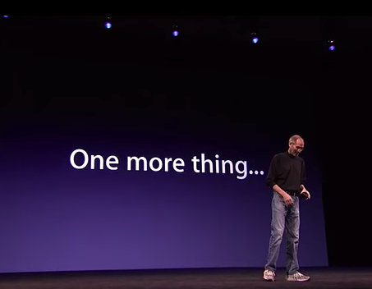

Slide 9


Slide 10
QUESTIONS?
THOUGHTS?
DISCUSSION?

Slide 11
News of the Week

Slide 12
Yours?

Slide 13
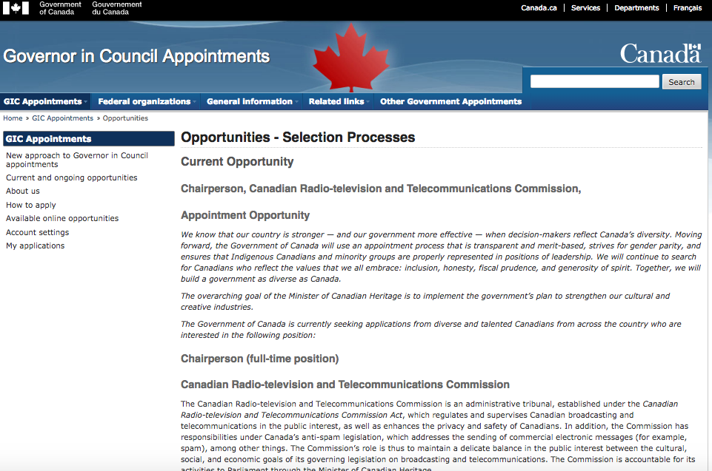
Last year this time…

Slide 14
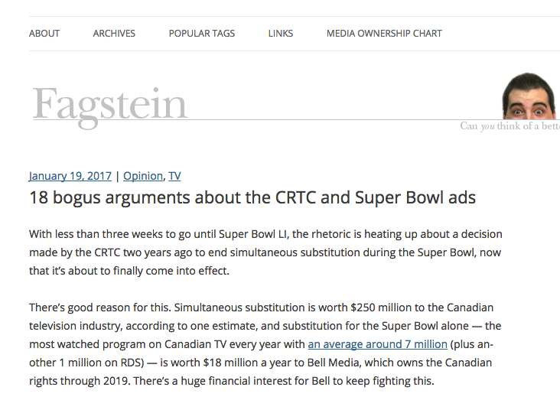

Slide 15
“1. Only 100 Canadians are against simultaneous substitution during the Super Bowl
2. The CRTC has ordered CTV to broadcast U.S. ads
3. Canadians have a right to see U.S. ads without censorship
4. This decision violates copyright law
5. Canadians shouldn’t have access to U.S. ads because they’re irrelevant and don’t have to comply with our laws

Slide 16
6. This decision is unnecessary because Canadians can watch the U.S. ads on YouTube (some even before the game)
7. The government should not be allowed to interfere in a private contract
8. If only CTV offered added value this wouldn’t be an issue
9. The CRTC made this decision without warning
10. This is a power trip by CRTC chairman Jean-Pierre Blais

Slide 17
11. Broadcasters are hypocrites for calling for more CRTC intervention while complaining about regulations
12. The CRTC made this decision because it doesn’t like boring Canadian Super Bowl ads
13. Simultaneous substitution is bad for Canada’s broadcasting system
14. If only Canada’s broadcast laws were more like American laws we wouldn’t be stuck in this mess

Slide 18
15. Everything worked fine with simultaneous substitution and the CRTC is ruining it
16. The CRTC should wait until after the federal government’s review of Canadian content before making these kinds of changes
17. We pay to subscribe to U.S. networks, so we should get them unfiltered
18. This is a slippery slope that will lead to the end of simultaneous substitution”

Slide 19

Activity on the Super Bowl issue…

Slide 20


Slide 21
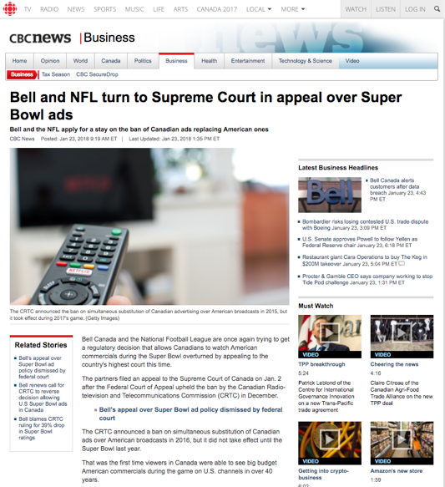

Slide 22
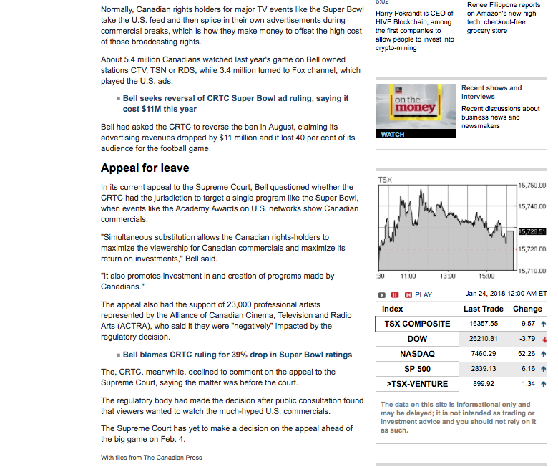

Slide 23

Hedging their Super Bowl bet…

Slide 24

Same $ as last year…

Slide 25
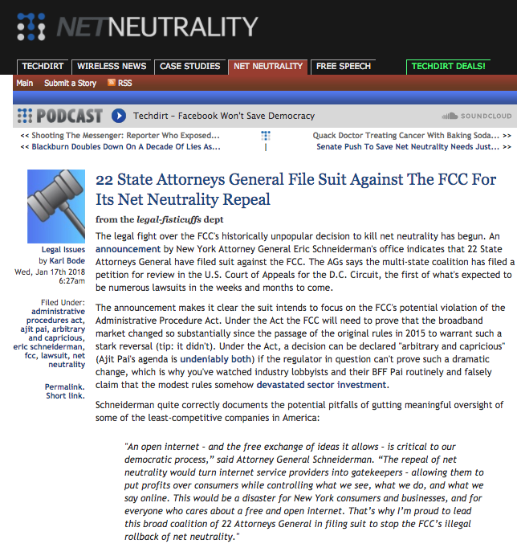
Back to the present (future) 4

Slide 26


Slide 27


Slide 28
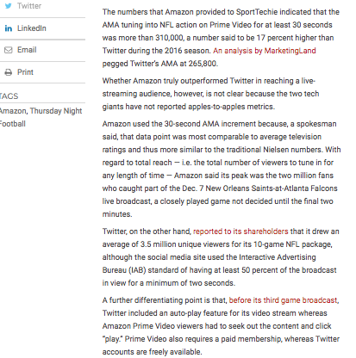

Slide 29


Slide 30


Slide 31


Slide 32
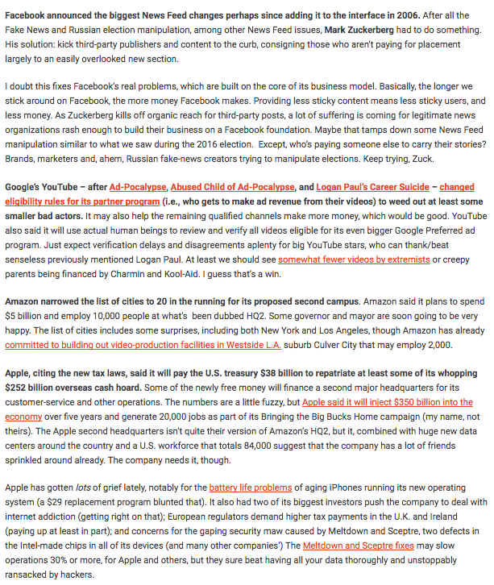

Slide 33


Slide 34


Slide 35


Slide 36
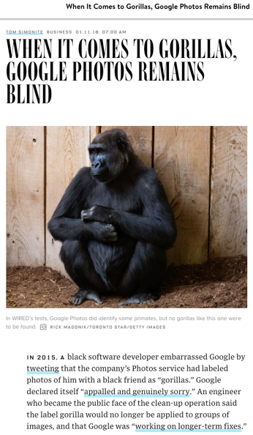

Slide 37


Slide 38

Uh-Oh

Slide 39

From the website…

Slide 40


Slide 41
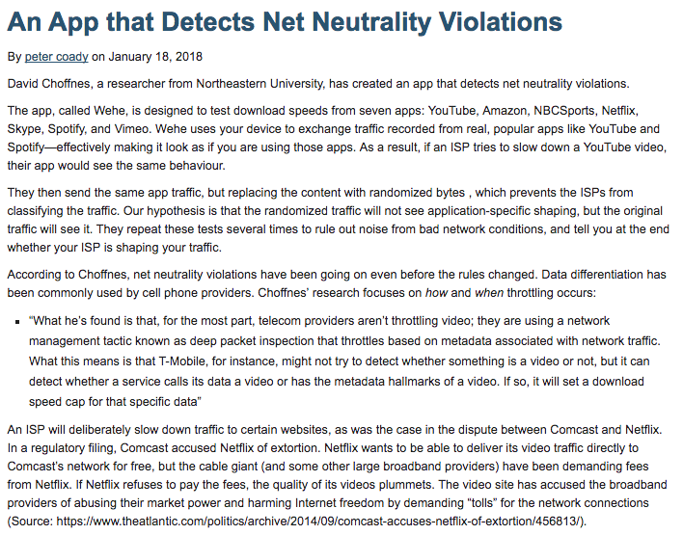

Slide 42


Slide 43
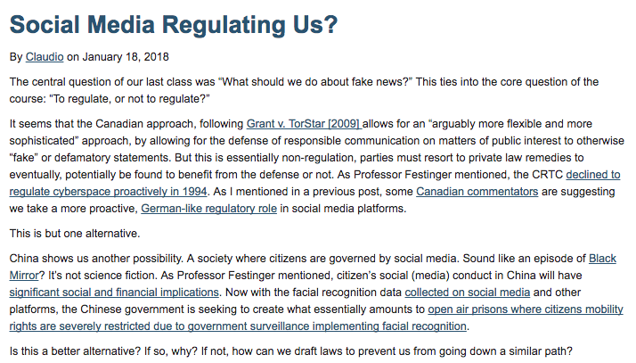

Slide 44
QUESTIONS?
THOUGHTS?
DISCUSSION?

Slide 45

Pause

Slide 46
QUESTION
OF THE
WEEK

Slide 47

Should there be “should’s” in
S. 3 of the Broadcasting Act?
“NO! TRY NOT!
DO OR DO NOT.
THERE IS NO TRY.”
Yoda

Slide 48
Broadcasting Act (S.C. 1991, c. 11)“Broadcasting Policy for Canada”
Declaration
3 (1) It is hereby declared as the broadcasting policy for Canada that
(a) the Canadian broadcasting system shall be effectively owned and controlled by Canadians;…
(d) the Canadian broadcasting system should
  (i) serve to safeguard, enrich and strengthen the cultural, political, social and economic fabric of Canada,
  (ii) encourage the development of Canadian expression by providing a wide range of programming that reflects Canadian attitudes, opinions, ideas, values and artistic creativity, by displaying Canadian talent in entertainment programming and by offering information and analysis concerning Canada and other countries from a Canadian point of view,
  (iii) through its programming and the employment opportunities arising out of its operations, serve the needs and interests, and reflect the circumstances and aspirations, of Canadian men, women and children, including equal rights, the linguistic duality and multicultural and multiracial nature of Canadian society and the special place of aboriginal peoples within that society, and
  (iv) be readily adaptable to scientific and technological change;
(e) each element of the Canadian broadcasting system shall contribute in an appropriate manner to the creation and presentation of Canadian programming;

Slide 49
(f) each broadcasting undertaking shall make maximum use, and in no case less than predominant use, of Canadian creative and other resources in the creation and presentation of programming, unless the nature of the service provided by the undertaking, such as specialized content or format or the use of languages other than French and English, renders that use impracticable, in which case the undertaking shall make the greatest practicable use of those resources;
(g) the programming originated by broadcasting undertakings should be of high standard;
(h) all persons who are licensed to carry on broadcasting undertakings have a responsibility for the programs they broadcast;
(i) the programming provided by the Canadian broadcasting system should
  (i) be varied and comprehensive, providing a balance of information, enlightenment and entertainment for men, women and children of all ages, interests and tastes,
  (ii) be drawn from local, regional, national and international sources,
  (iii) include educational and community programs,
  (iv) provide a reasonable opportunity for the public to be exposed to the expression of differing views on matters of public concern, and
  (v) include a significant contribution from the Canadian independent production sector;…
(k) a range of broadcasting services in English and in French shall be extended to all Canadians as resources become available;
(l) the Canadian Broadcasting Corporation, as the national public broadcaster, should provide radio and television services incorporating a wide range of programming that informs, enlightens and entertains;
(m) the programming provided by the Corporation should

Slide 50
  (i) be predominantly and distinctively Canadian,
  (ii) reflect Canada and its regions to national and regional audiences, while serving the special needs of those regions,
  (iii) actively contribute to the flow and exchange of cultural expression,
  (iv) be in English and in French, reflecting the different needs and circumstances of each official language community, including the particular needs and circumstances of English and French linguistic minorities,
  (v) strive to be of equivalent quality in English and in French,
  (vi) contribute to shared national consciousness and identity,
  (vii) be made available throughout Canada by the most appropriate and efficient means and as resources become available for the purpose, and
  (viii) reflect the multicultural and multiracial nature of Canada;
(n) where any conflict arises between the objectives of the Corporation set out in paragraphs (l) and (m) and the interests of any other broadcasting undertaking of the Canadian broadcasting system, it shall be resolved in the public interest, and where the public interest would be equally served by resolving the conflict in favour of either, it shall be resolved in favour of the objectives set out in paragraphs (l) and (m);
(o) programming that reflects the aboriginal cultures of Canada should be provided within the Canadian broadcasting system as resources become available for the purpose;
(p) programming accessible by disabled persons should be provided within the Canadian broadcasting system as resources become available for the purpose;
(q) without limiting any obligation of a broadcasting undertaking to provide the programming contemplated by paragraph (i), alternative television programming services in English and in French should be provided where necessary to ensure that the full range of programming contemplated by that paragraph is made available through the Canadian broadcasting system;

Slide 51
(r) the programming provided by alternative television programming services should
  (i) be innovative and be complementary to the programming provided for mass audiences,
  (ii) cater to tastes and interests not adequately provided for by the programming provided for mass audiences, and include programming devoted to culture and the arts,
  (iii) reflect Canada’s regions and multicultural nature,
  (iv) as far as possible, be acquired rather than produced by those services, and
  (v) be made available throughout Canada by the most cost-efficient means;
(s) private networks and programming undertakings should, to an extent consistent with the financial and other resources available to them,
  (i) contribute significantly to the creation and presentation of Canadian programming, and
  (ii) be responsive to the evolving demands of the public;…
(t) distribution undertakings
  (i) should give priority to the carriage of Canadian programming services and, in particular, to the carriage of local Canadian stations,
  (ii) should provide efficient delivery of programming at affordable rates, using the most effective technologies available at reasonable cost,
  (iii) should, where programming services are supplied to them by broadcasting undertakings pursuant to contractual arrangements, provide reasonable terms for the carriage, packaging and retailing of those programming services, and
  (iv) may, where the Commission considers it appropriate, originate programming, including local programming, on such terms as are conducive to the achievement of the objectives of the broadcasting policy set out in this subsection, and in particular provide access for underserved linguistic and cultural minority communities.”

Slide 52
Telecommunications Act (S.C. 1993, c. 38)…"Canadian Telecommunications Policy” Objectives
7 It is hereby affirmed that telecommunications performs an essential role in the maintenance of Canada’s identity and sovereignty and that the Canadian telecommunications policy has as its objectives
(a) to facilitate the orderly development throughout Canada of a telecommunications system that serves to safeguard, enrich and strengthen the social and economic fabric of Canada and its regions;
(b) to render reliable and affordable telecommunications services of high quality accessible to Canadians in both urban and rural areas in all regions of Canada;
(c) to enhance the efficiency and competitiveness, at the national and international levels, of Canadian telecommunications;

Slide 53
(d) to promote the ownership and control of Canadian carriers by Canadians;
(e) to promote the use of Canadian transmission facilities for telecommunications within Canada and between Canada and points outside Canada;
(f) to foster increased reliance on market forces for the provision of telecommunications services and to ensure that regulation, where required, is efficient and effective;
(g) to stimulate research and development in Canada in the field of telecommunications and to encourage innovation in the provision of telecommunications services;
(h) to respond to the economic and social requirements of users of telecommunications services; and
(i) to contribute to the protection of the privacy of persons."

Slide 54
InReference re Broadcasting Regulatory Policy 2012 SCC 68, [2012] 3 S.C.R. 489, Rothstein J.:
"Policy statements, such as the declaration of Canadian broadcasting policy found in s. 3(1) of the Broadcasting Act, are not jurisdiction-conferring provisions. They describe the objectives of Parliament in enacting the legislation and, thus, they circumscribe the discretion granted to a subordinate legislative body (Sullivan, at pp. 387-88 and 390-91). As such, declarations of policy cannot serve to extend the powers of the subordinate body to spheres not granted by Parliament in jurisdiction-conferring provisions.
The difference between general regulation making or licensing provisions and true jurisdiction-conferring provisions is evident when this case is compared with Bell Canada v. Bell Aliant Regional Communications, 2009 SCC 40, [2009] 2 S.C.R. 764. In Bell Aliant, this Court was asked to determine whether the creation and use of certain deferral accounts lay within the scope of the CRTC’s express power to determine whether rates set by telecommunication companies are just and reasonable...

Slide 55
Jurisdiction-granting provisions are not analogous to general regulation making or licensing authority because the former are express grants of specific authority from Parliament while the latter must be interpreted so as not to confer unfettered discretion not contemplated by the jurisdiction-granting provisions of the legislation.
That is the fundamental point. Were the only constraint on the CRTC’s powers under s. 10(1) to be found in whether the enacted regulation goes towards a policy objective in s. 3(1), the only limit to the CRTC’s regulatory power would be its own discretionary determination of the wisdom of its proposed regulation in light of any policy objective in s. 3(1). This would be akin to unfettered discretion. Rather, discretion is to be exercised within the confines of the statutory regime and principles generally applicable to regulatory matters, for which the legislature is assumed to have had regard in passing that legislation."

Slide 56
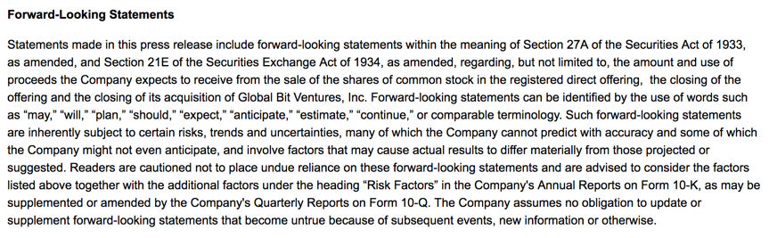
Weird, Helpful, or Irrelevant?

Slide 57
Should there be "should's" in S. 3 of the Broadcasting Act?

Slide 58
QUESTIONS?
THOUGHTS?
DISCUSSION?

Slide 59
Pause

Slide 60

RECAPPING

Slide 61
Core Binaries
Cultural
Content
Regulation
Privacy
Industrial
Carriage
Free Market
Surveillance

Slide 62
ONE WORD POLL
ON YOUR POLICY PRIORITY
Access (3); Competition (1); Content; Creativity; De-monopolization (1); Economic Development; Efficiency; Equality (1); Expression; Freedom; Human Dignity (1); Net-neutrality (2); Open (1); Privacy; Security (1); Viewers.

Slide 63
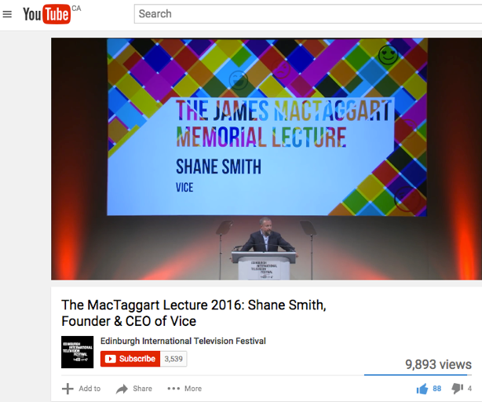
So what about?

Slide 64

BUT…

Slide 65
TODAY
Roles of Sovereignty & Culture in the Communications Landscape

Slide 66
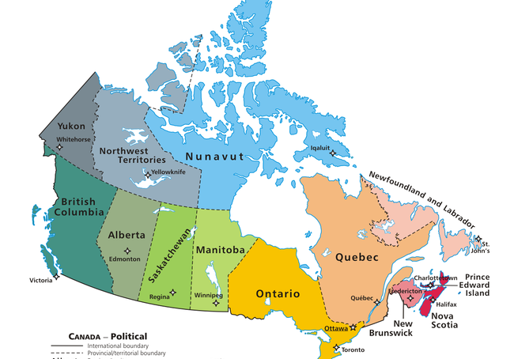

Slide 67


Slide 68

Does sovereignty makes sense? Does culture make sense?

Slide 69

Case Study #1

Slide 70
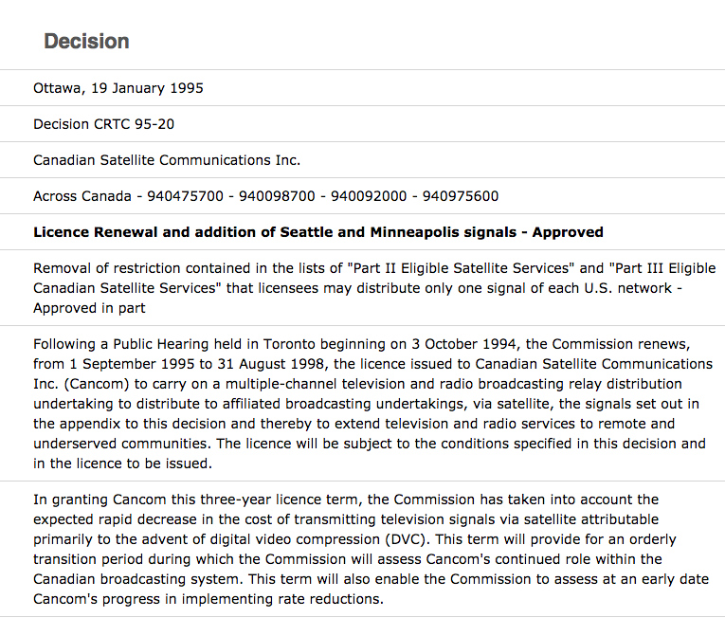

Slide 71
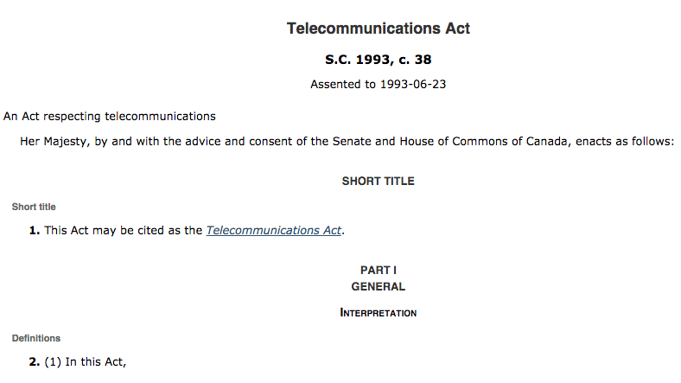

Slide 72
4. This Act does not apply in respect of broadcasting by a broadcasting undertaking.
36. Except where the Commission approves otherwise, a Canadian carrier shall not control the content or influence the meaning or purpose of telecommunications carried by it for the public.

Slide 73
Canadian Telecommunications Policy
Objectives
7 It is hereby affirmed that telecommunications performs an essential role in the maintenance of Canada’s identity and sovereignty and that the Canadian telecommunications policy has as its objectives
(a) to facilitate the orderly development throughout Canada of a telecommunications system that serves to safeguard, enrich and strengthen the social and economic fabric of Canada and its regions;

Slide 74
(b) to render reliable and affordable telecommunications services of high quality accessible to Canadians in both urban and rural areas in all regions of Canada;
(c) to enhance the efficiency and competitiveness, at the national and international levels, of Canadian telecommunications;
(d) to promote the ownership and control of Canadian carriers by Canadians;
(e) to promote the use of Canadian transmission facilities for telecommunications within Canada and between Canada and points outside Canada;

Slide 75
(f) to foster increased reliance on market forces for the provision of telecommunications services and to ensure that regulation, where required, is efficient and effective;
(g) to stimulate research and development in Canada in the field of telecommunications and to encourage innovation in the provision of telecommunications services;
(h) to respond to the economic and social requirements of users of telecommunications services; and
(i) to contribute to the protection of the privacy of persons.

Slide 76
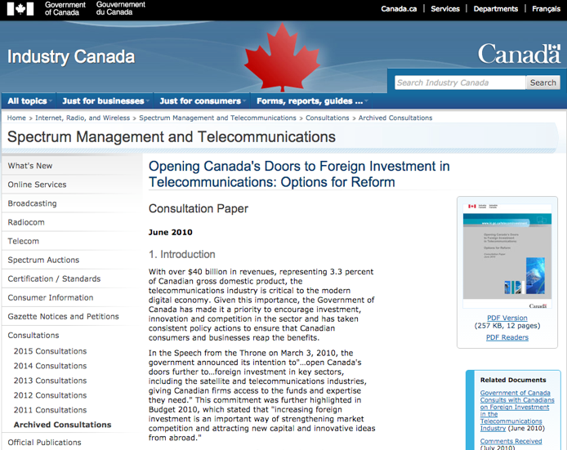
https://www.ic.gc.ca/eic/site/smt-gst.nsf/eng/sf09920.html

Slide 77
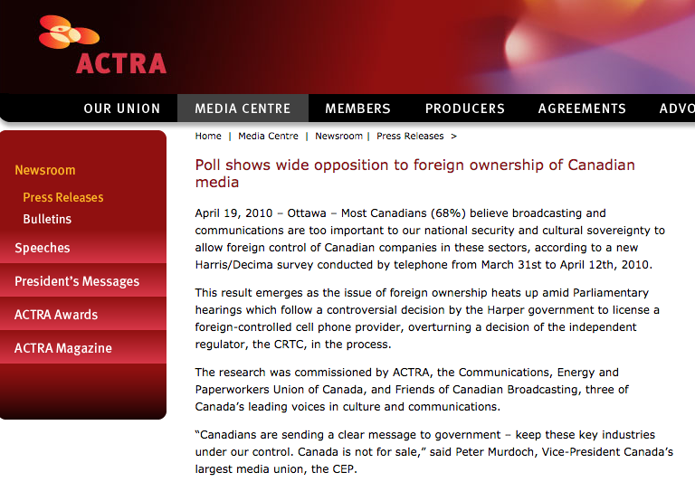

Slide 78

In Telecom the issue seems to be
SOVERIGNTY/(OWNERSHIP)

Slide 79
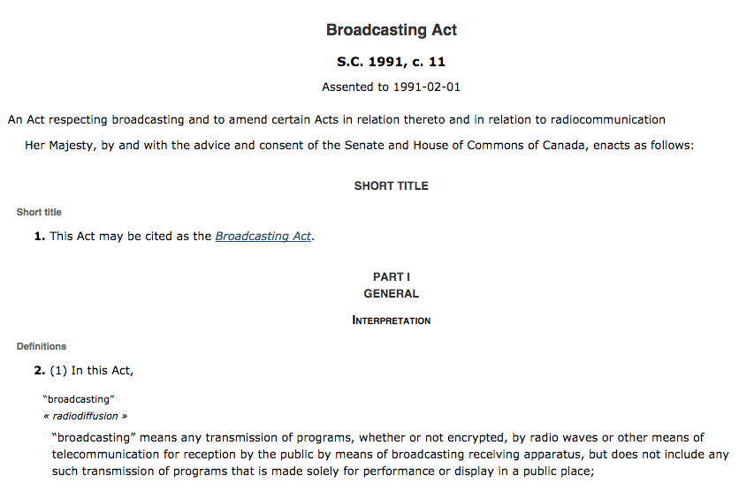

Slide 80
Huh?
Broadcasting Policy for Canada
3 (1) It is hereby declared as the broadcasting policy for Canada that
  (a) the Canadian broadcasting system shall be effectively owned and controlled by Canadians;
  (b) the Canadian broadcasting system, operating primarily in the English and French languages and comprising public, private and community elements, makes use of radio frequencies that are public property and provides, through its programming, a public service essential to the maintenance and enhancement of national identity and cultural sovereignty;

Slide 81
(c) English and French language broadcasting, while sharing common aspects, operate under different conditions and may have different requirements;
(d) the Canadian broadcasting system should
  (i) serve to safeguard, enrich and strengthen the cultural, political, social and economic fabric of Canada,
  (ii) encourage the development of Canadian expression by providing a wide range of programming that reflects Canadian attitudes, opinions, ideas, values and artistic creativity, by displaying Canadian talent in entertainment programming and by offering information and analysis concerning Canada and other countries from a Canadian point of view,
  (iii) through its programming and the employment opportunities arising out of its operations, serve the needs and interests, and reflect the circumstances and aspirations, of Canadian men, women and children, including equal rights, the linguistic duality and multicultural and multiracial nature of Canadian society and the special place of aboriginal peoples within that society, and
  (iv) be readily adaptable to scientific and technological change;

Slide 82
(e) each element of the Canadian broadcasting system shall contribute in an appropriate manner to the creation and presentation of Canadian programming;
(f) each broadcasting undertaking shall make maximum use, and in no case less than predominant use, of Canadian creative and other resources in the creation and presentation of programming, unless the nature of the service provided by the undertaking, such as specialized content or format or the use of languages other than French and English, renders that use impracticable, in which case the undertaking shall make the greatest practicable use of those resources;

Slide 83
The News?
(g) the programming originated by broadcasting undertakings should be of high standard;
(h) all persons who are licensed to carry on broadcasting undertakings have a responsibility for the programs they broadcast;

Slide 84
The CBC
(i) the programming provided by the Canadian broadcasting system should
  (i) be varied and comprehensive, providing a balance of information, enlightenment and entertainment for men, women and children of all ages, interests and tastes,
  (ii) be drawn from local, regional, national and international sources,
  (iii) include educational and community programs,
  (iv) provide a reasonable opportunity for the public to be exposed to the expression of differing views on matters of public concern, and
  (v) include a significant contribution from the Canadian independent production sector;

Slide 85
Tie-breakers???
(n) where any conflict arises between the objectives of the Corporation set out in paragraphs (l) and (m) and the interests of any other broadcasting undertaking of the Canadian broadcasting system, it shall be resolved in the public interest, and where the public interest would be equally served by resolving the conflict in favour of either, it shall be resolved in favour of the objectives set out in paragraphs (l) and (m);
(2) It is further declared that the Canadian broadcasting system constitutes a single system and that the objectives of the broadcasting policy set out in subsection (1) can best be achieved by providing for the regulation and supervision of the Canadian broadcasting system by a single independent public authority.

Slide 86

In Broadcasting the issue seems to be
CULTURE (OWNERSHIP)

Slide 87

Does this sound familiar?…
Prime Minister R.B. Bennett 1932: “…this country must be assured of complete Canadian control of broadcasting from Canadian sources. Without such control, broadcasting can never be the agency by which national consciousness may be fostered and sustained and national unity still further strengthened….”

Slide 88
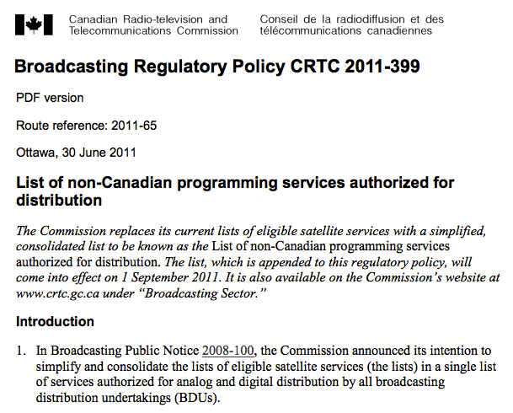

Slide 89
A strange digression…
One Act, or Two, or more?

Slide 90

Why the differences between technologies?

Slide 91
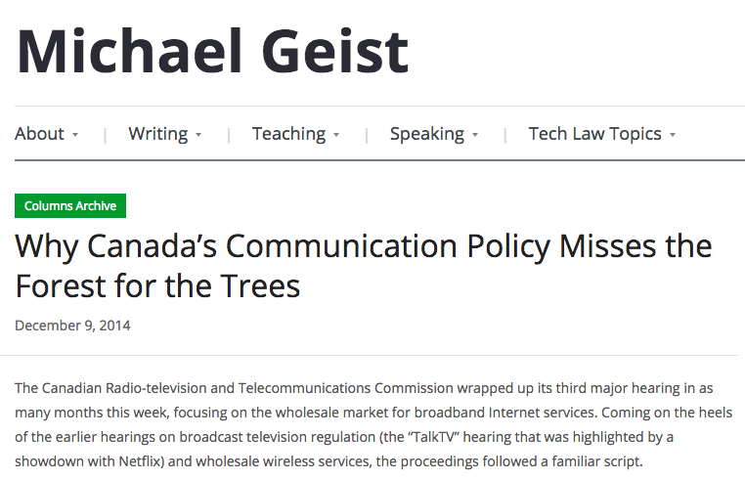

Slide 92
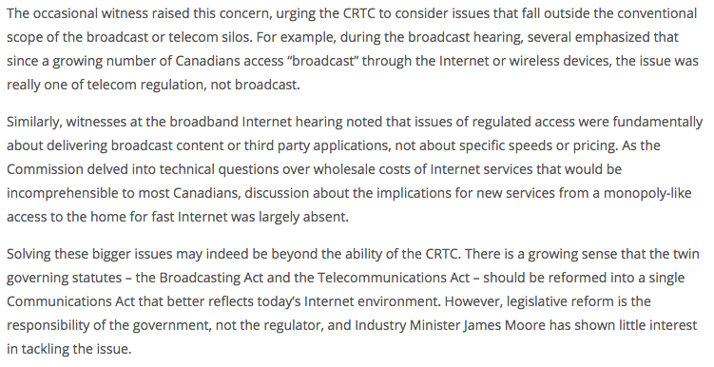

Slide 93
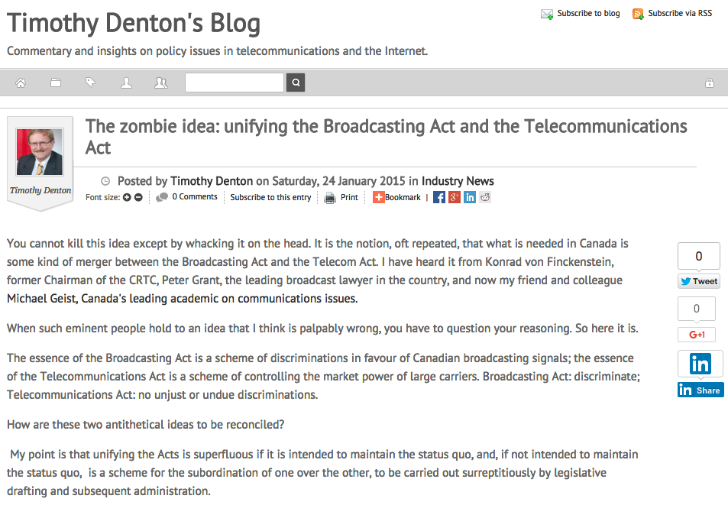
http://tmdenton.com/index.php/easyblog/entry/the-zombie-idea-unifying-the-broadcasting-act-and-the-telecommunications-act

Slide 94

http://philippalmerlaw.ca/broadcasting-telecoms-belong-different-legislation/

Slide 95
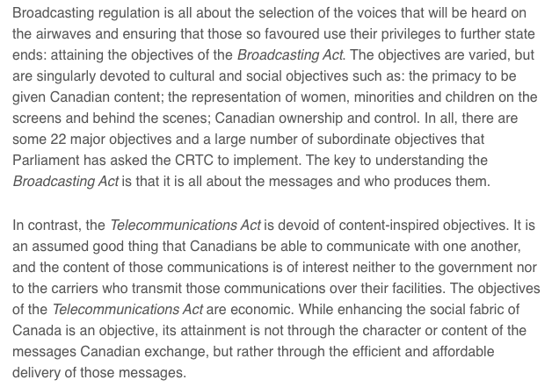

Slide 96

Digital net doesn’t fit…culture or sovereignty all that well???

Slide 97
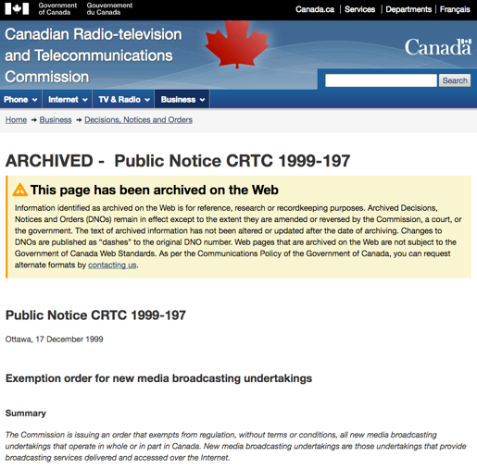
Does all this explain?…

Slide 98
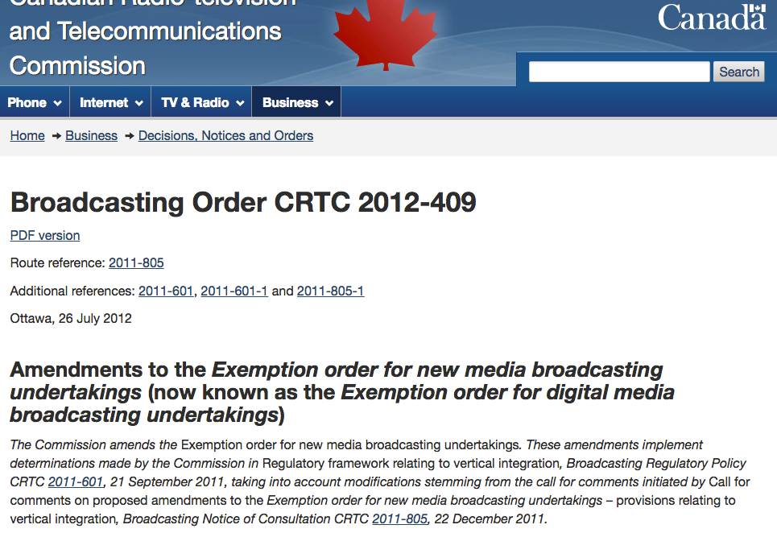

Slide 99
Another strange digression…
Relating freedom to creativity and production.

Slide 100


Slide 101


“It’s the restrictive covenant, stupid.”

Slide 102
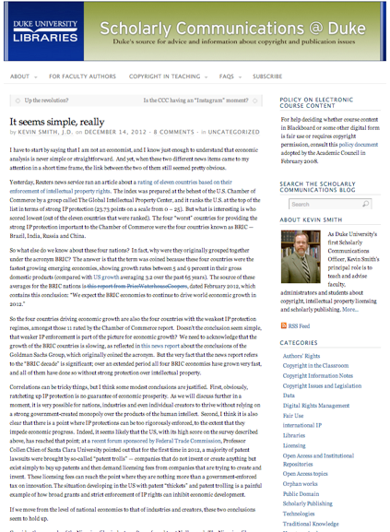

Slide 103
One more (wild & crazy) thing on freedoms
Economic growth & IP freedoms (freedom from IP) – Where would a data-crunch take us?
“It seems simple, really” (Kevin Smith @ Duke) CORRELATES STRONG ECONOMIES & WEAK IP LAWS (BRIC – Brazil, India, Russia, and China)

Slide 104
My Version: attempt to correlate
Economic Success & Facilitating Creativity but add respect for Fundamental Rights
CAUTION: (entirely unscientific – gut and Google…)
1.The World Justice Project | Rule of Law Index 2012-2013 (241 pages): Highest Rankings in “Fundamental Rights” are Sweden, Denmark & Norway. Highest Rankings in “Open Government” are Sweden, Netherlands & Norway.
2. Worlds best economies in 2012 (World Economic Forum – Global Competitiveness Report): Finland (3rd), Sweden (4th) & the Netherlands (5th)
3. Global Creativity Index (Martin Prosperity Institute): Sweden (1st), Finland (3rd) & Denmark (4th)
WHAT LEVELS OF CREATIVE FREEDOMS ARE IN
THOSE COUNTRIES IP/COPYRIGHT REGIMES?

Slide 105

Connection
Between
Creativity &
Weak IP Laws?

Slide 106

https://www.ted.com/talks/johanna_blakley_lessons_from_fashion_s_free_culture?language=en

Slide 107

What are “first principles” in the digital age?
More importantly, what should they be?

Slide 108

How about as 1st principles?
“To encourage and facilitate the creativity and expression of all Canadians.”

Slide 109
QUESTIONS?
THOUGHTS?
DISCUSSION?

Slide 110

Coming Soon
“Telecommunications Policy: Origins, Regulation & Cases”

Slide 111


A MATTER OF PERSPECTIVE

Slide 112

Always include a cat picture

Slide 113
Our Academic Partners

