Slide 1


“A History of Cultural Policy: Regulated, Unregulated & Self Regulated Industries”
Talks 7 & 8
LAW 424 001
Communications Law 2.0
Allard School of Law, UBC
Spring, 2017
Jon Festinger Q.C.
Centre for Digital Media
Festinger Law & Strategy
http://commlaw.allard.ubc
@jonfestinger
jon_festinger@thecdm.ca

Slide 2
Logistics

Slide 3
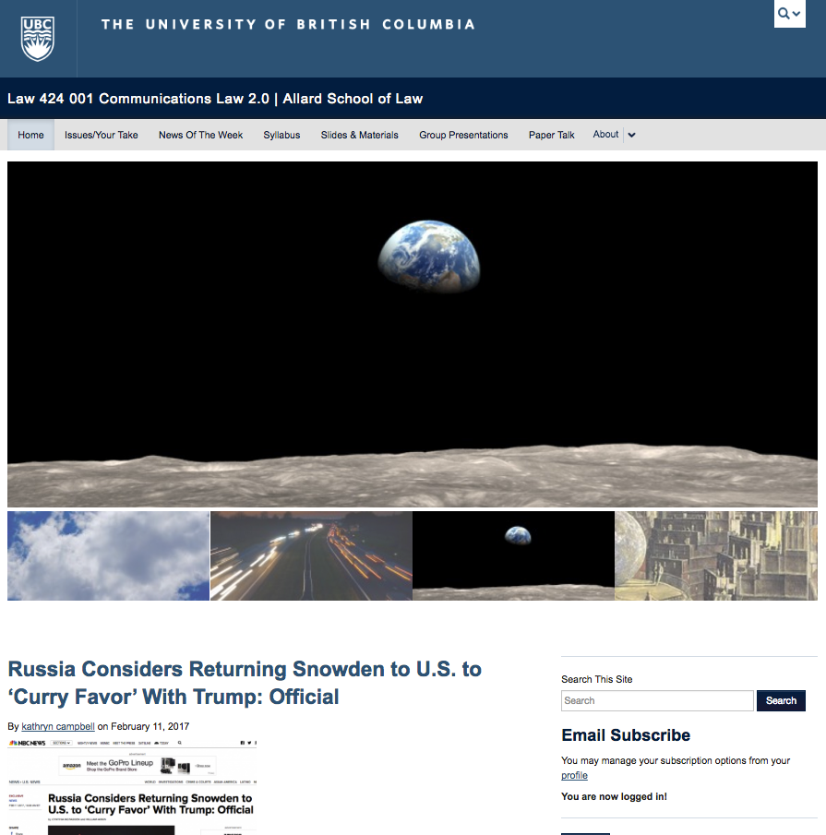
Course Website: Redecorated
http://commlaw.allard.ubc.ca

Slide 4

Badges now working…

Slide 5
Marking generally
Average is Allard Law way – know the ramifications
Useful to ask re paper topics (but not mandatory)
Will help you sort through topics
Will read and review all or part of a paper
Inclusive definition of “participation”

Slide 6
Papers: My marking criteria
Topic originality/angle
Set out your purpose, vision and goal for the paper
Organize into named sections & sub-sections
Am a sucker for clever creative arguments, but only if they are fully supported
Citations/research is looked at seriously (for substance more than form)
Don’t simply describe a problem and apply the “fairness doctrine”
This is graduate school – move things forward

Slide 7
Questions on..
Papers ?
Participation ?
Class Presentations ?

Slide 8

Additional resource?
http://berkmankleinassembly.org/includes/documents/Internet_Society_Syllabus_2017.pdf

Slide 9
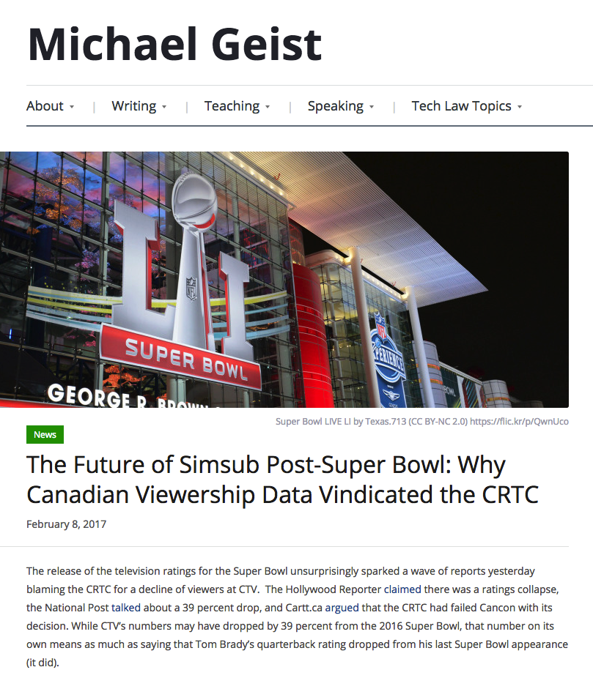
Follow-up 1

Slide 10


Slide 11

Thematic Follow-up 2

Slide 12


Slide 13


Slide 14


Slide 15


Slide 16
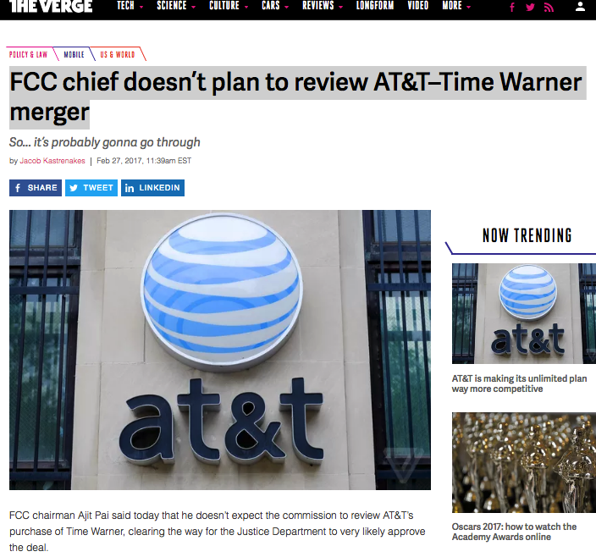
Thematic Follow-Up 3

Slide 17


Slide 18
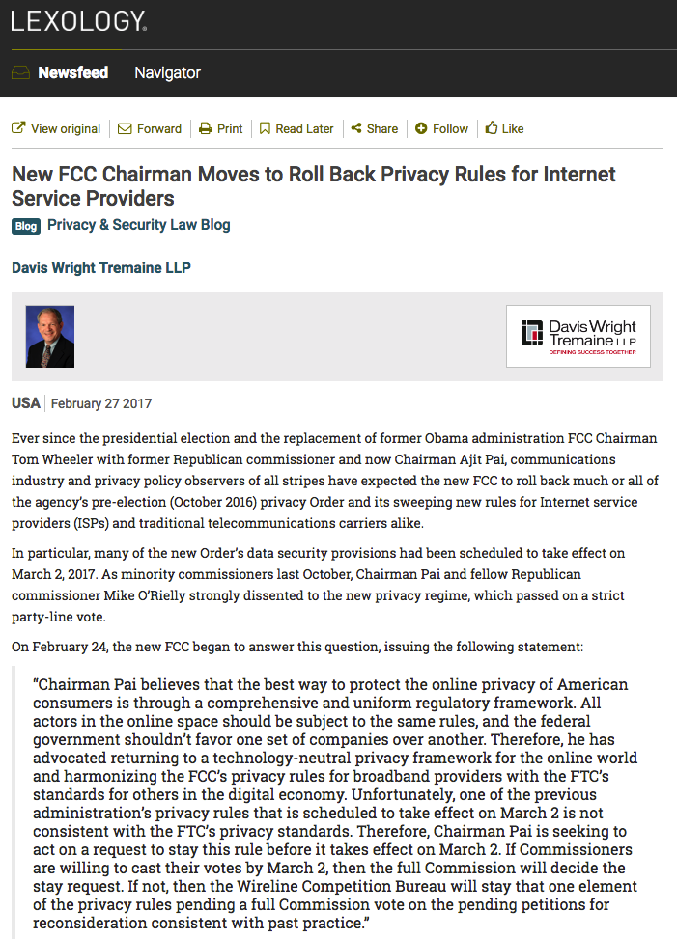

Slide 19
New FCC formula?
Net neutrality → for corporate providers
=
ISP’s are equal to Google/Facebook
=
No greater consumer privacy protections from ISP carriers than exists for Google, Facebook and other content providers
=
Even less content/carriage separation

Slide 20
Implicates 3 of the 4 Binaries
Cultural
Content
Regulation
Privacy
Industrial
Carriage
Free Market
Surveillance

Slide 21


Slide 22
Thoughts?

Slide 23
News of the Week

Slide 24
Yours?

Slide 25

Mine

Slide 26
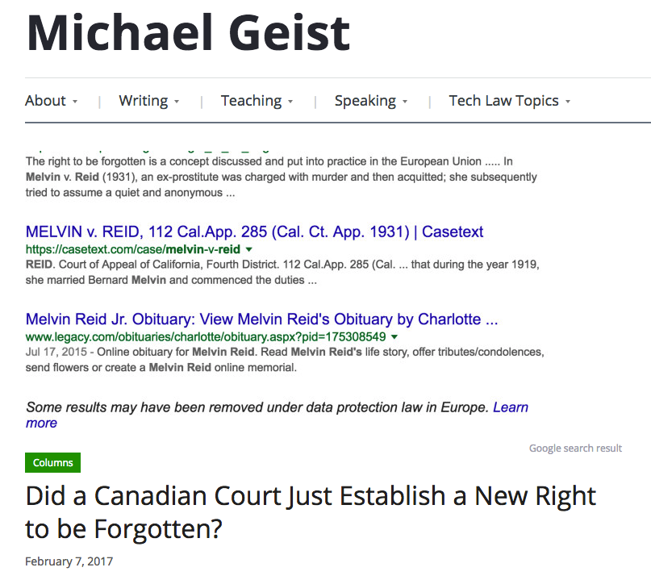

Slide 27


Slide 28
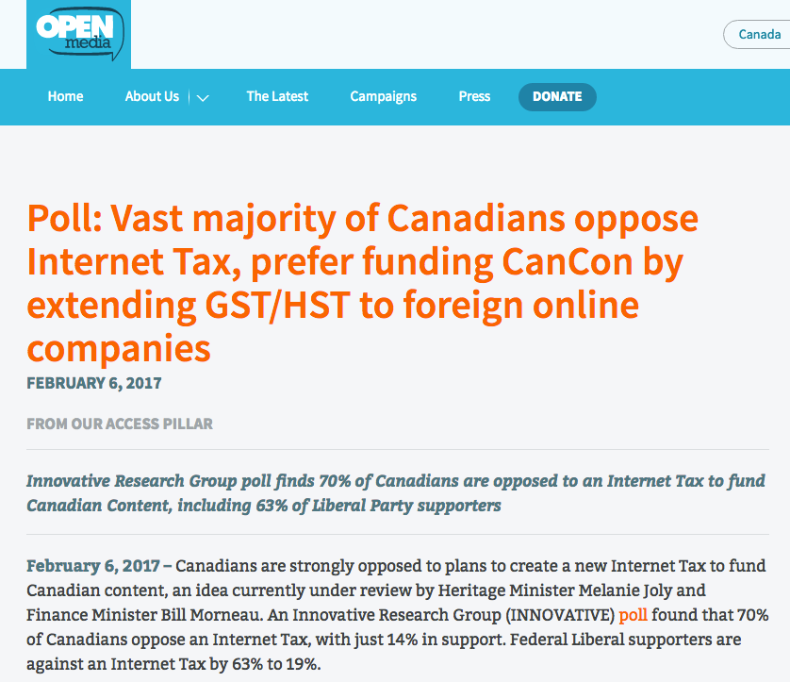

Slide 29

Huge?

Slide 30


Personal News of the Week

Slide 31
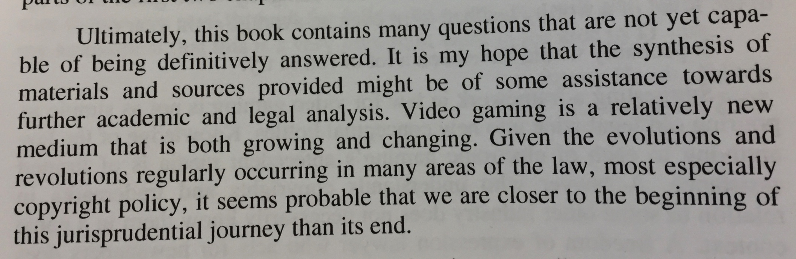
“Video Game Law “ 2005

Slide 32
Thoughts?

Slide 33
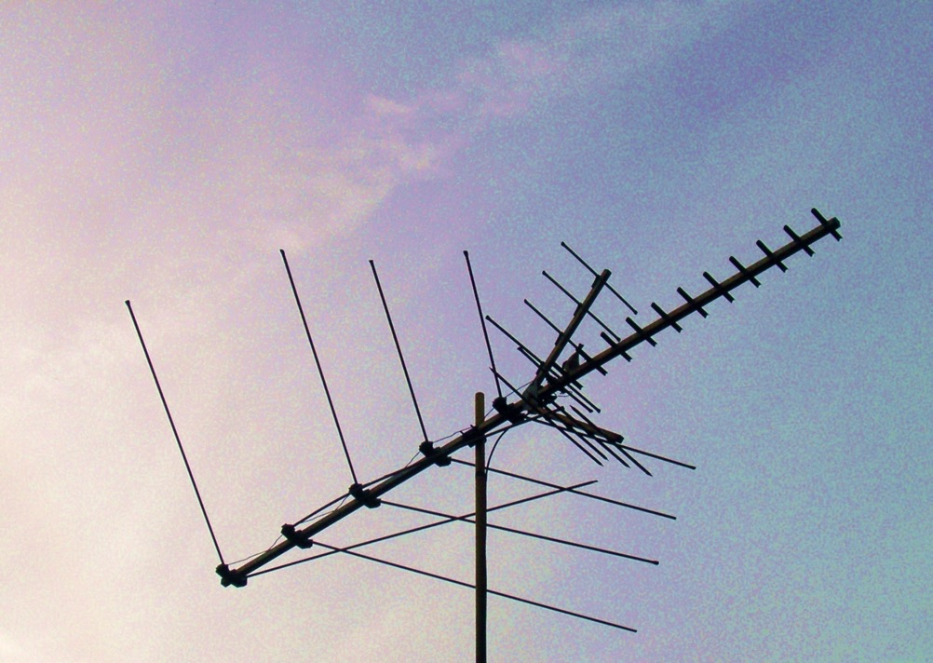
Now Back to Our Regularly Scheduled Programming…

Slide 34
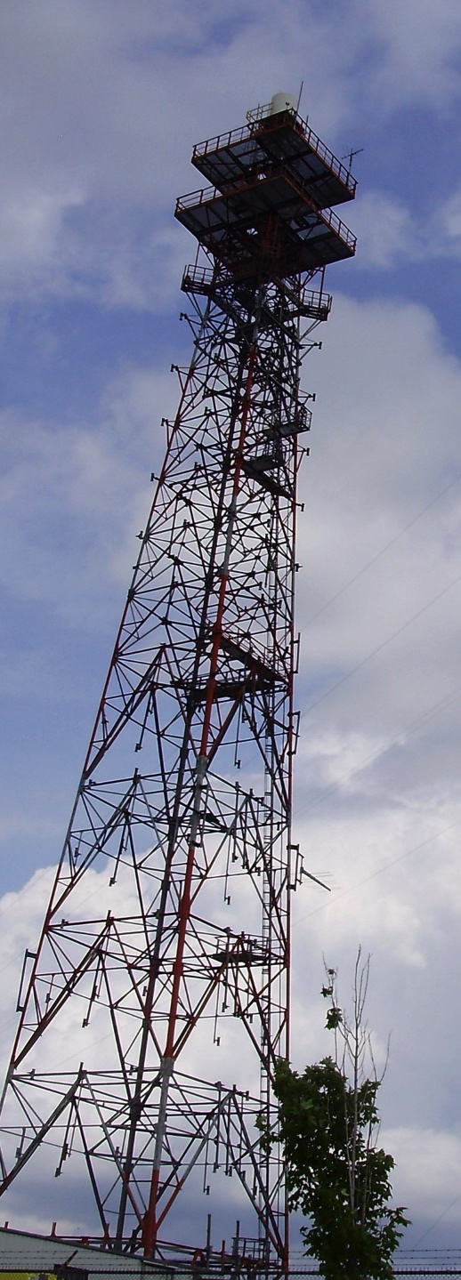
Today…
“A (not so brief) History of Cultural Policy: Regulated, Unregulated & Self Regulated Industries”

Slide 35

AKA: Mid-Term Review of the maze

Slide 36

A Theory…
Persistent regulatory vagueness leads to judicial push-back
Or
Loose = Noose

Slide 37

Starting Point #1

Slide 38
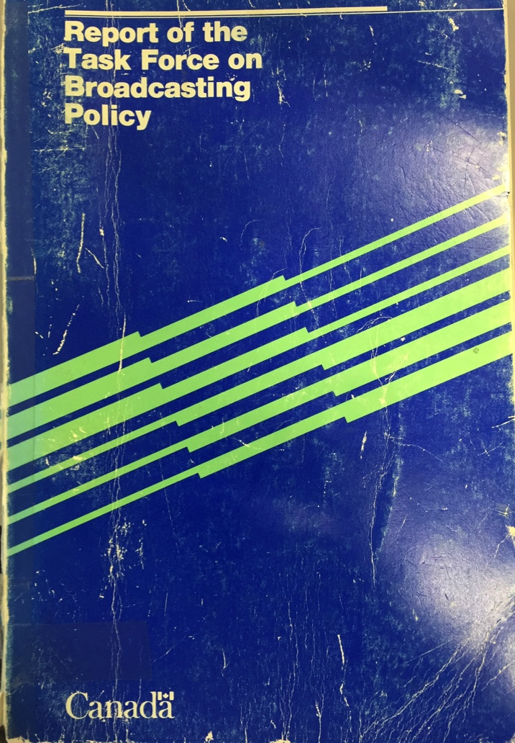
Q: Where did we lose our way?
Caplan/Sauvageau Report, 1986

Slide 39
A: Precisely here?...
“But whatever kind of Buck Rogers Future is in store for us, surely the Canadian tradition demands that we must continue to entrench the Canadian presence in our broadcasting system, and we must adopt policies to do so in a new world in which substantially greater choice may be available to Canadian viewers. More than ever, broadcasting must be seen as a fundamental part of cultural policy. It must be program-driven, not hardware-driven as in its first decades.”

Slide 40
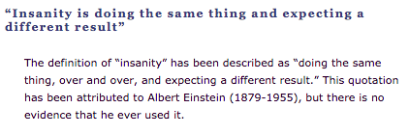
Entrench because tradition demands it
Broadcasting must be seen as cultural policy

Slide 41
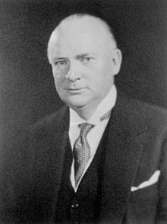
The evolution of…
Prime Minister R.B. Bennett 1932; “…this country must be assured of complete Canadian control of broadcasting from Canadian sources. Without such control, broadcasting can never be the agency by which national consciousness may be fostered and sustained and national unity still further strengthened….”

Slide 42

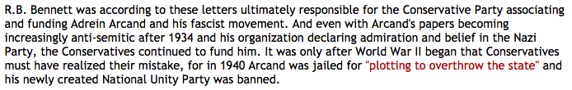
Fruit of the poisonous tree ?

Slide 43
Now add more vagueness…
Broadcasting Policy for Canada
3 (1) It is hereby declared as the broadcasting policy for Canada that
  (a) the Canadian broadcasting system shall be effectively owned and controlled by Canadians;
  (b) the Canadian broadcasting system, operating primarily in the English and French languages and comprising public, private and community elements, makes use of radio frequencies that are public property and provides, through its programming, a public service essential to the maintenance and enhancement of national identity and cultural sovereignty;

Slide 44
(c) English and French language broadcasting, while sharing common aspects, operate under different conditions and may have different requirements;
(d) the Canadian broadcasting system should
  (i) serve to safeguard, enrich and strengthen the cultural, political, social and economic fabric of Canada,
  (ii) encourage the development of Canadian expression by providing a wide range of programming that reflects Canadian attitudes, opinions, ideas, values and artistic creativity, by displaying Canadian talent in entertainment programming and by offering information and analysis concerning Canada and other countries from a Canadian point of view,
  (iii) through its programming and the employment opportunities arising out of its operations, serve the needs and interests, and reflect the circumstances and aspirations, of Canadian men, women and children, including equal rights, the linguistic duality and multicultural and multiracial nature of Canadian society and the special place of aboriginal peoples within that society, and
  (iv) be readily adaptable to scientific and technological change;

Slide 45
(e) each element of the Canadian broadcasting system shall contribute in an appropriate manner to the creation and presentation of Canadian programming;
(f) each broadcasting undertaking shall make maximum use, and in no case less than predominant use, of Canadian creative and other resources in the creation and presentation of programming, unless the nature of the service provided by the undertaking, such as specialized content or format or the use of languages other than French and English, renders that use impracticable, in which case the undertaking shall make the greatest practicable use of those resources;

Slide 46
The News…
(g) the programming originated by broadcasting undertakings should be of high standard;
(h) all persons who are licensed to carry on broadcasting undertakings have a responsibility for the programs they broadcast;

Slide 47
The CBC
(i) the programming provided by the Canadian broadcasting system should
  (i) be varied and comprehensive, providing a balance of information, enlightenment and entertainment for men, women and children of all ages, interests and tastes,
  (ii) be drawn from local, regional, national and international sources,
  (iii) include educational and community programs,
  (iv) provide a reasonable opportunity for the public to be exposed to the expression of differing views on matters of public concern, and
  (v) include a significant contribution from the Canadian independent production sector;

Slide 48
Starting Point #2:
Jurisdiction over Cable TV

Slide 49

Which brings us to…
Capital Cities Communications Inc. v. CRTC. [1978] 2 S.C.R. 141

Slide 50
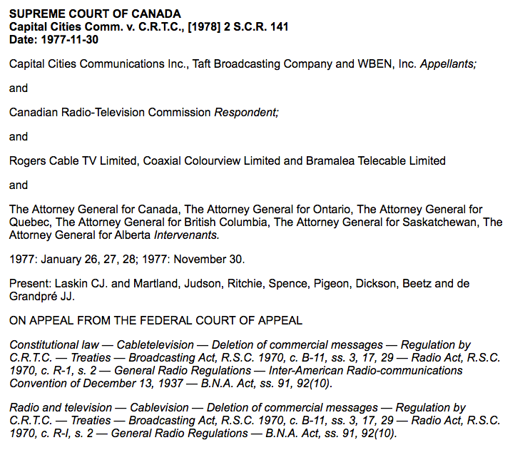

Slide 51
“I am therefore in no doubt that federal legislative authority extends to the regulation of the reception of television signals emanating from a source outside of Canada and to the regulation of the transmission of such signals within Canada. Those signals carry the programmes which are ultimately viewed on home television sets; and it would be incongruous, indeed, to admit federal legislative jurisdiction to the extent conceded but to deny the continuation of regulatory authority because the signals are intercepted and sent on to ultimate viewers through a different technology. Programme content regulation is inseparable from regulating the undertaking through which programmes are received and sent on as part of the total enterprise.”

Slide 52

Note Copyright barely mentioned

Slide 53
Starting Point #3:

Slide 54
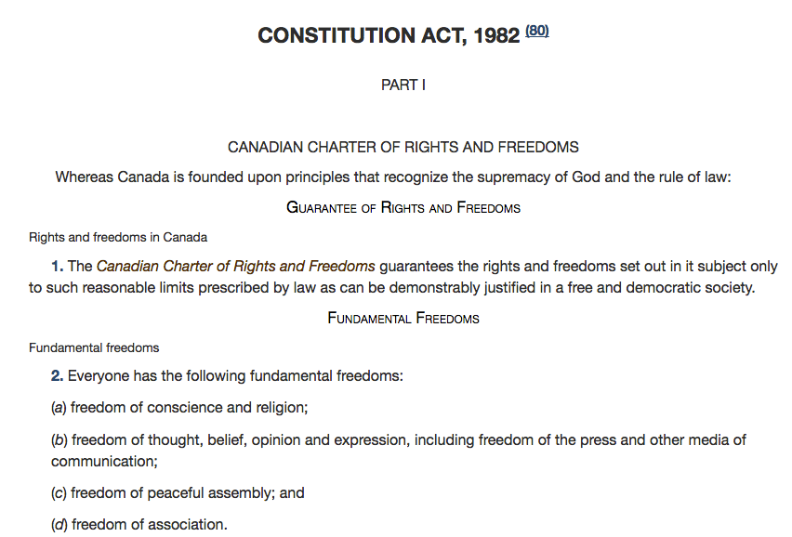
An “interesting” thing happened…

Slide 55
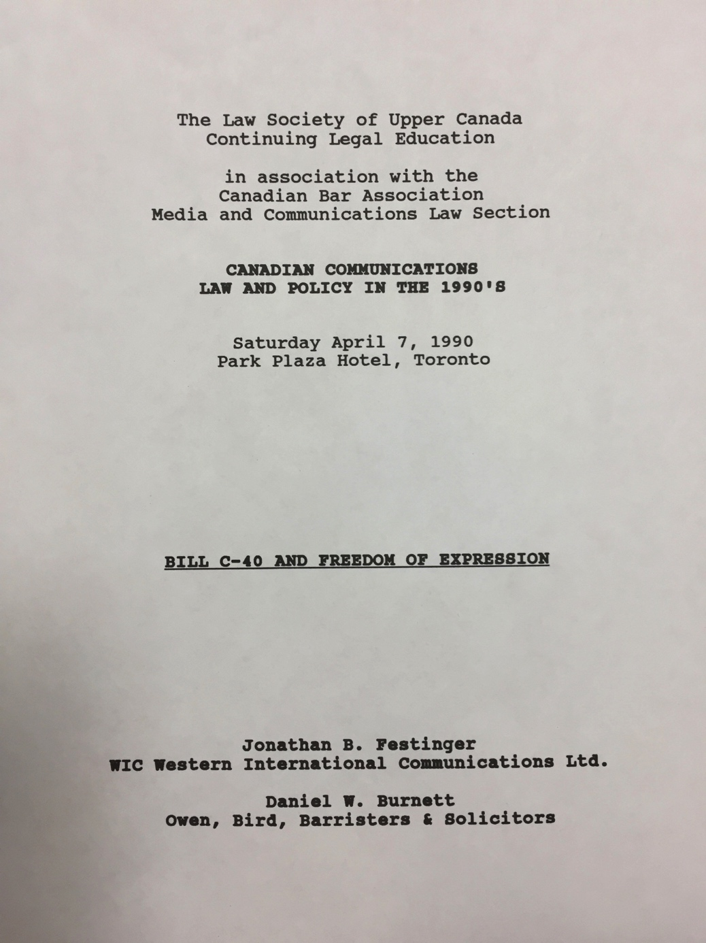

Slide 56
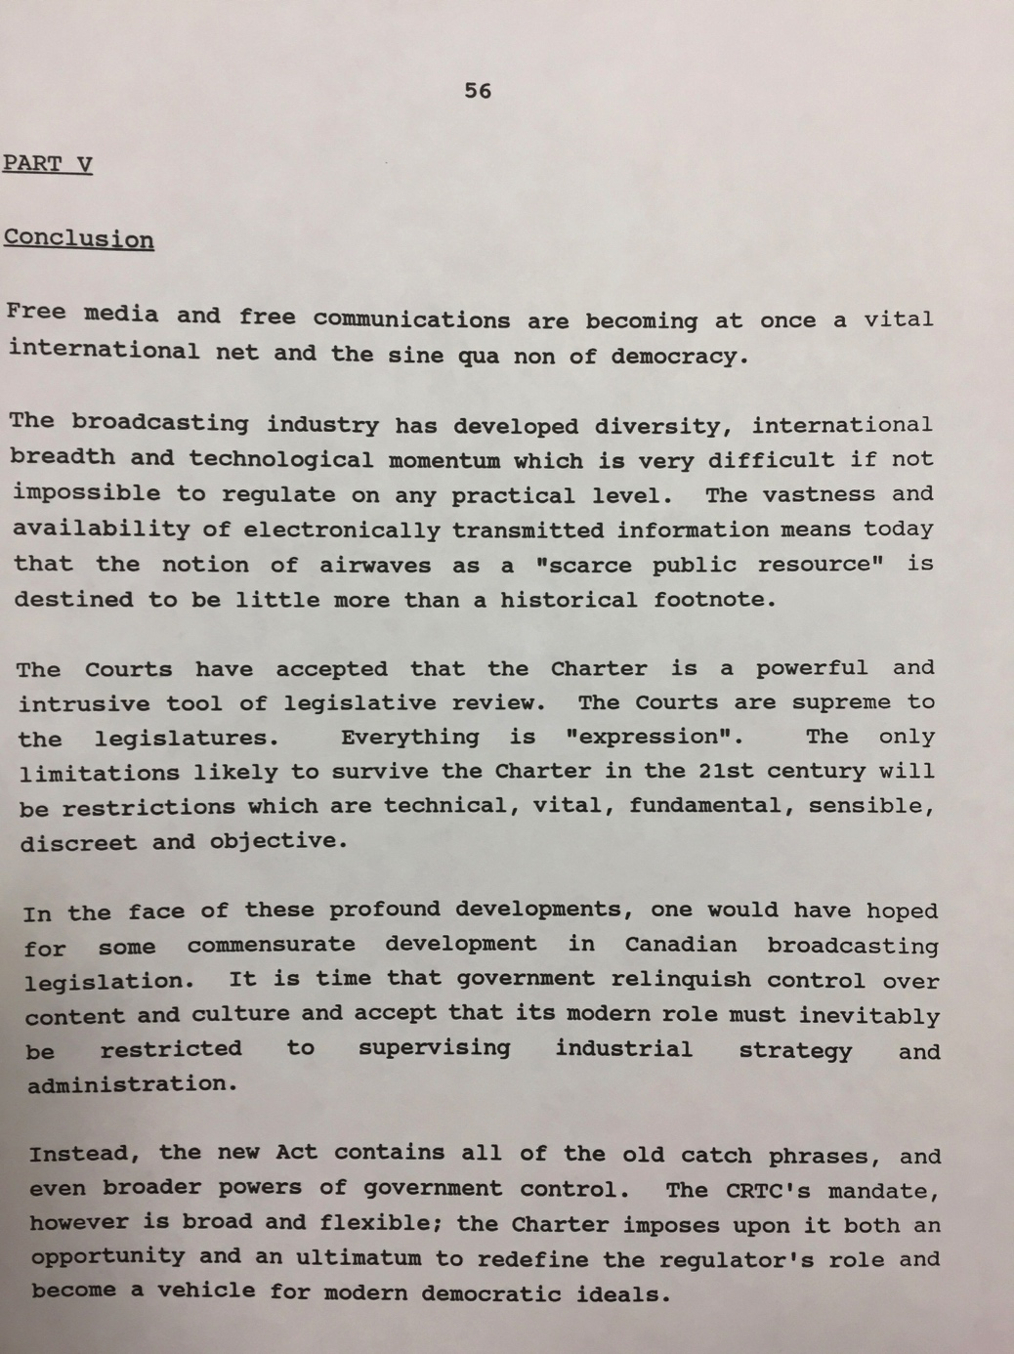

Slide 57
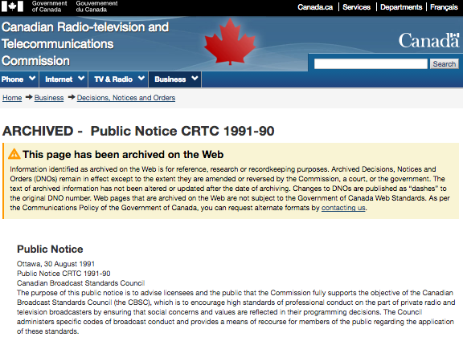

Slide 58
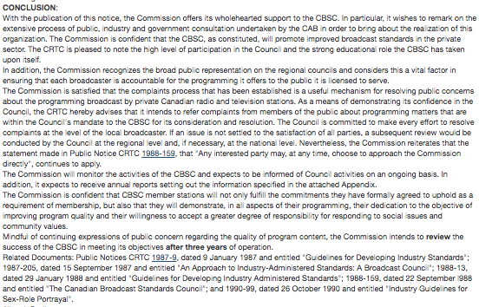

Slide 59
CAB Code (E.G.) covers:
Sex role stereotyping
Balance & fairness on controversial subjects
Full & fair presentation of news & opinion
No subliminal messaging
provide viewer advisories (e.g. re: explicit sex, violence, coarse language, nudity)
Codes administered by Canadian Broadcast Standards Council -CBSC

Slide 60


Slide 61
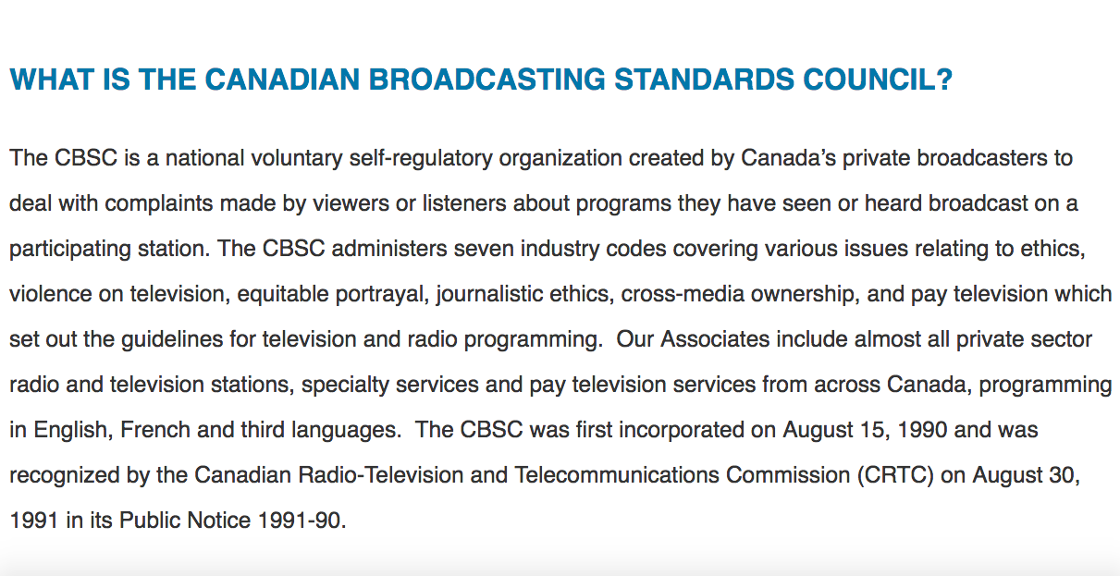

Slide 62
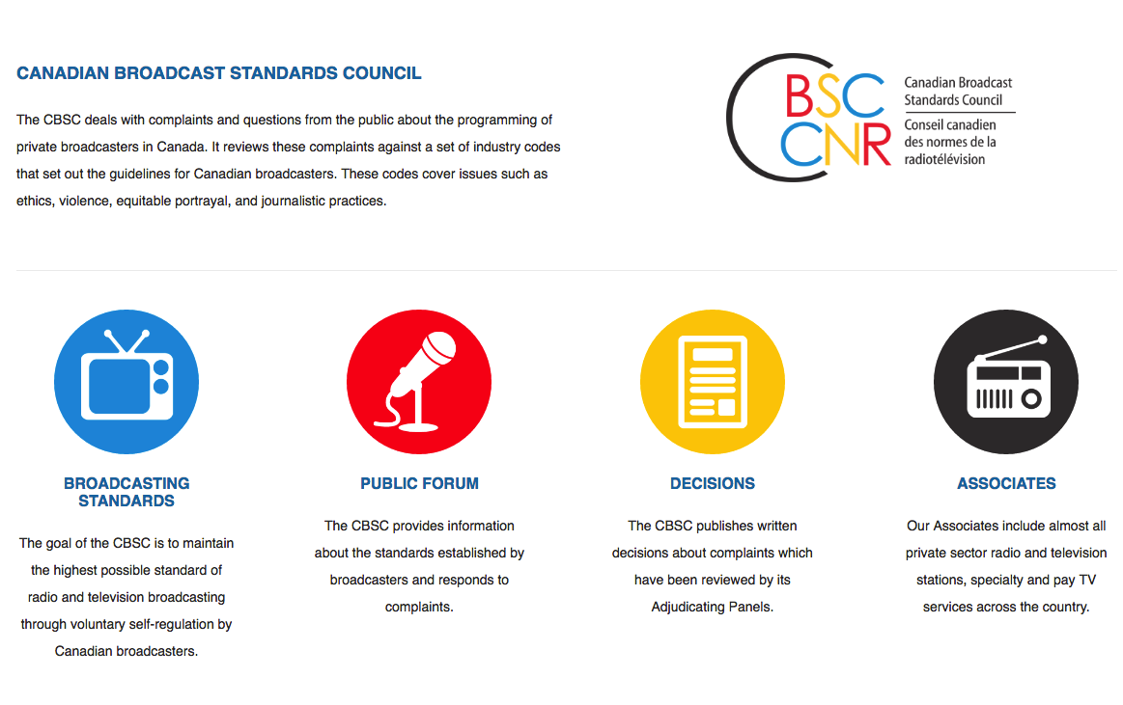

Slide 63
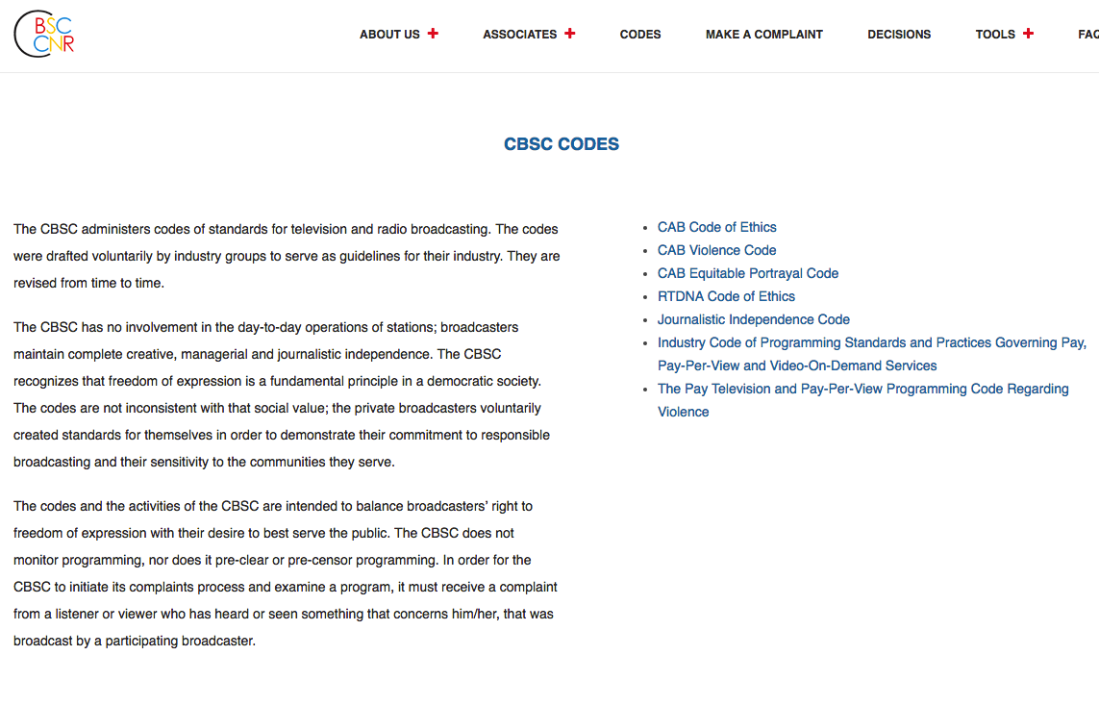

Slide 64
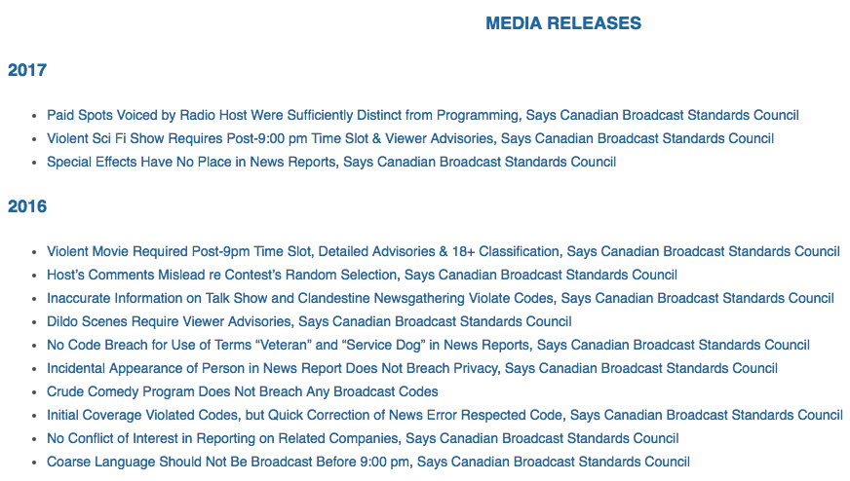

Slide 65
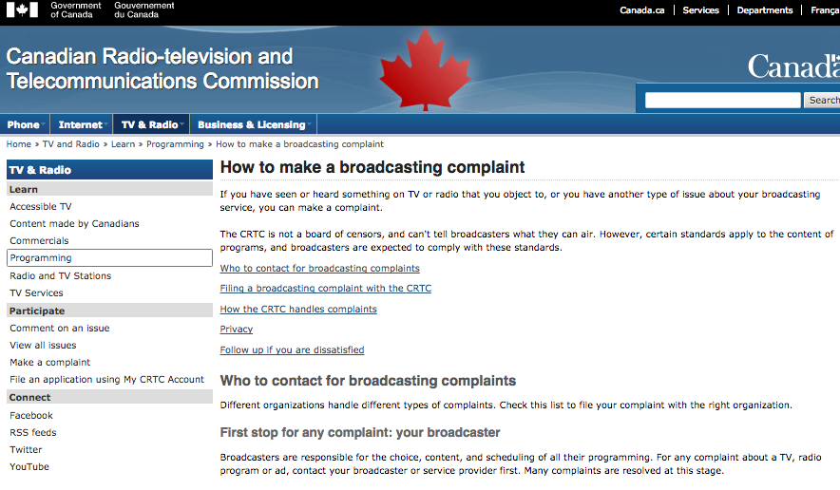

Slide 66
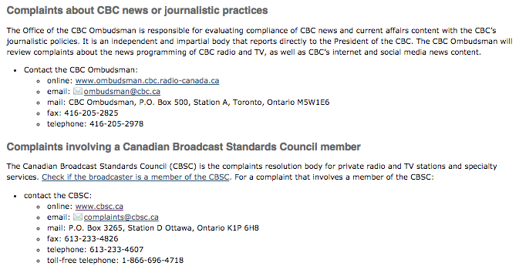

Slide 67


Slide 68
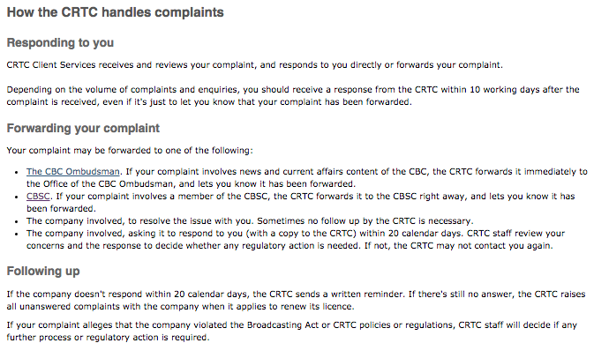

Slide 69
Some CSBC cases
Dire Straits case
CRTC asked CBSC to review its ruling that the use of the word “faggot” breached the Code
CRTC concerned that public thought it had made the decision
CBSC reiterated that slur was inappropriate, but left it to stations to decide whether to play the song
“The Thomas Crown Affair”
Appeal to CRTC from CBSC decision
Such appeals are considered as complaints de novo by CRTC
CRTC usually does not permit broadcasters to appeal
Complaint of nudity and sex not rated properly rating (contrary to Code)
CRTC upheld CBSC’s ruling that TQS had violated the code

Slide 70
So add to the equation
Uncertainty
+
Bureaucracy

Slide 71
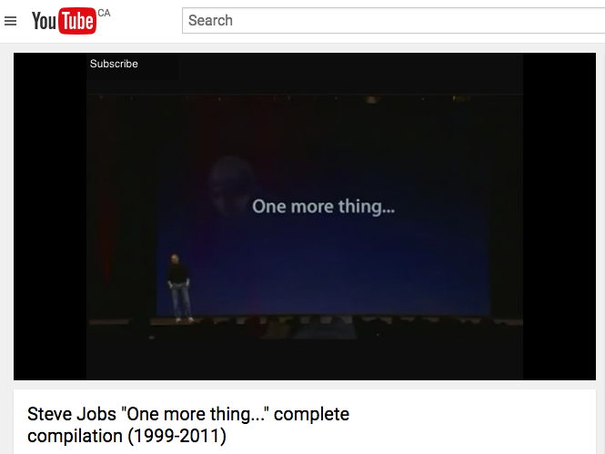
& One more thing…

Slide 72
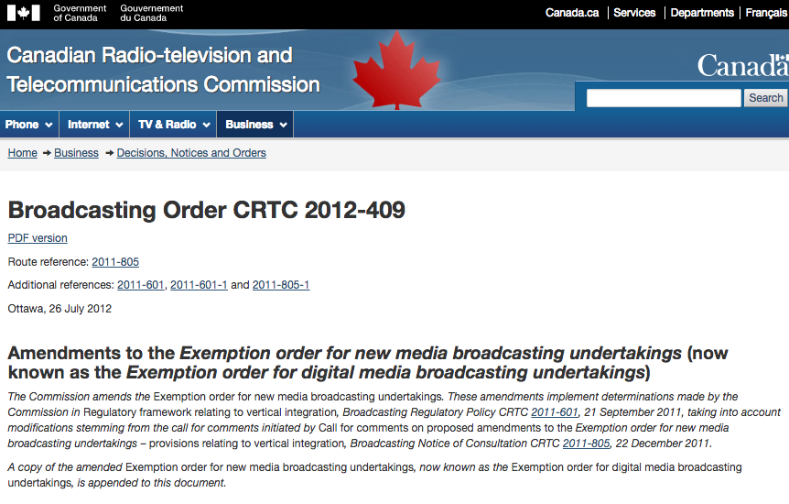

Slide 73
Starting Point #4:

Slide 74

Last Lecture Cliffhanger…

Slide 75
Newton C.J. (of “natural law”)
“For every action, there is an equal and opposite reaction.”

Slide 76
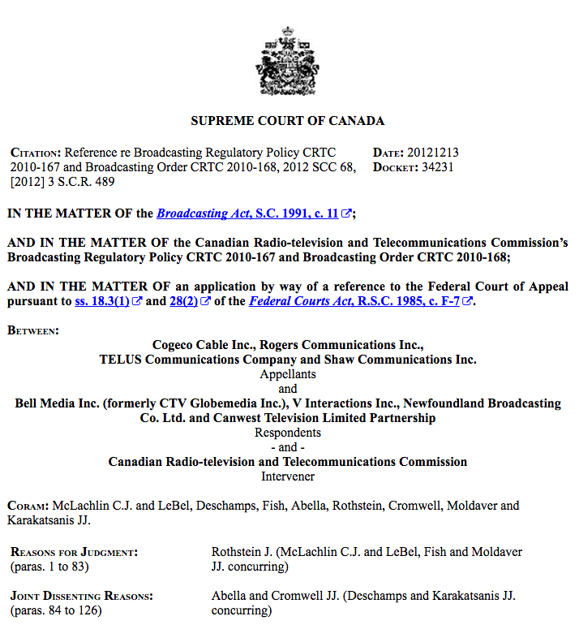

Slide 77
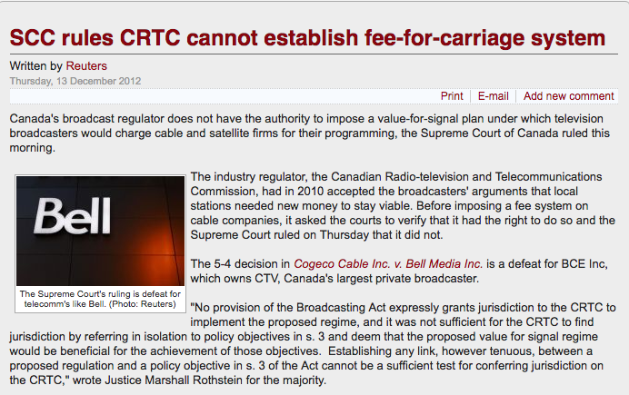
Impact of SCC fee for carriage decision

Slide 78
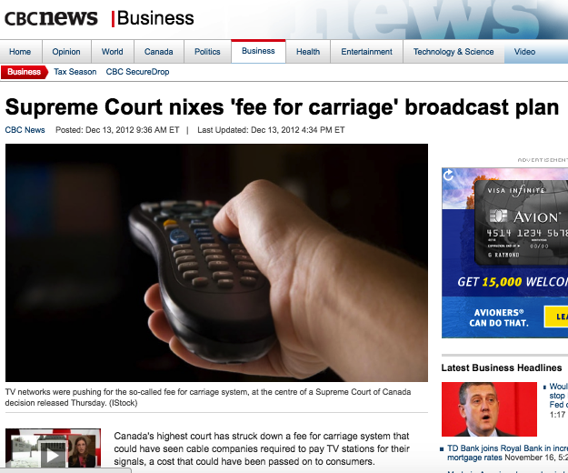

Slide 79
Some interesting things…
No one appeared for the intervener (CRTC).
5-4 decision
Majority of McLachlin C.J. and LeBel, Fish, Rothstein and Moldaver JJ. (Reasons of Rothstein J.)
Deschamps, Abella, Cromwell and Karakatsanis dissenting. (Joint Reasons of Abella & Cromwell JJ.)

Slide 80
Majority
“…the CRTC seeks to implement what it terms a “value for signal regime”. This regime would permit broadcasters to negotiate with BDUs the terms upon which the BDUs may redistribute their signals…
In my respectful opinion, for two reasons, the provisions of the Broadcasting Act, considered in their entire context, may not be interpreted as authorizing the CRTC to implement the proposed value for signal regime. First, a contextual reading of the provisions of the Broadcasting Act themselves reveals that they were not meant to authorize the CRTC to create exclusive rights for broadcasters to control the exploitation of their signals or works by retransmission. Second, the proposed regime would conflict with specific provisions enacted by Parliament in the Copyright Act.”

Slide 81
“Policy statements, such as the declaration of Canadian broadcasting policy found in s. 3(1) of the Broadcasting Act, are not jurisdiction-conferring provisions. They describe the objectives of Parliament in enacting the legislation and, thus, they circumscribe the discretion granted to a subordinate legislative body... As such, declarations of policy cannot serve to extend the powers of the subordinate body to spheres not granted by Parliament in jurisdiction-conferring provisions.”

Slide 82
“The difference between general regulation making or licensing provisions and true jurisdiction-conferring provisions is evident when this case is compared with Bell Canada v. Bell Aliant Regional Communications, 2009 SCC 40, [2009] 2 S.C.R. 764. In Bell Aliant, this Court was asked to determine whether the creation and use of certain deferral accounts lay within the scope of the CRTC’s express power to determine whether rates set by telecommunication companies are just and reasonable. The CRTC’s jurisdiction over the setting of rates under s. 27 of the Telecommunications Act, S.C. 1993, c. 38, provides that rates must be just and reasonable. Under that section, the CRTC is specifically empowered to determine compliance with that requirement and is conferred the express authority to “adopt any method or technique that it considers appropriate” for that purpose (s. 27(5)).”

Slide 83
Then…
“B. The Larger Statutory Scheme — Conflict with the Copyright Act
(1) Connection Between the Broadcasting Act and the Copyright Act
Even if jurisdiction for the proposed value for signal regime could be found within the text of the Broadcasting Act, that would not resolve the question in this reference as the Broadcasting Act is part of a larger statutory scheme that includes the Copyright Act and the Telecommunications Act…”

Slide 84
“The CRTC’s proposed value for signal regime would enable broadcasters to negotiate compensation for the retransmission by BDUs of their signals or programming services, regardless of whether or not they carry copyright protected “work[s]”, and regardless of the fact that any such works are carried in local signals for which the Copyright Act provides no compensation. Importantly, contrary to the retransmission regimes of the Copyright Act, the value for signal regime proposed by the CRTC would grant individual broadcasters, should they elect to be governed by this regime, the right to prohibit the simultaneous retransmission of their programs.”

Slide 85
Dissent
“The proposed regime is consistent with the market-based negotiations that increasingly prevail on other platforms, including discretionary pay and specialty services, video-on-demand and online and mobile streaming platforms. According to the CRTC, it is also consistent with its own approach of using market-based solutions when appropriate. Significantly, the CRTC has determined that the new regime is necessary to preserve local stations and ensure the fulfillment of the broadcasting policy objectives set out in s. 3(1) of the Broadcasting Act…”

Slide 86
“The narrow reference question requires us to determine whether the CRTC has jurisdiction under the Broadcasting Act to implement the new regime. Read on its own, the Broadcasting Act appears to grant this jurisdiction, which raises the question of whether something in the Copyright Act demonstrates Parliament’s intent to derogate from or attenuate this jurisdiction in order to satisfy another public interest. In other words, we must determine whether there would be an unavoidable conflict if the Broadcasting Act were read to confer on the CRTC the jurisdiction to implement the regime…”

Slide 87
“More importantly, however, the new regime’s potential success in achieving the broadcasting policy objectives is completely irrelevant to determining whether the CRTC has jurisdiction to implement it. Any question as to the wisdom of the regime is a question solely for the CRTC as the single broadcasting authority in s. 3(2) of the Broadcasting Act. As an expert body, the CRTC, not the courts, is in the best position to decide what measures are necessary to save local stations from going bankrupt. In any event, if for any reason the proposed regime proves unworkable in the future, the CRTC has both the authority and the necessary expertise to make the appropriate changes.”

Slide 88
Some thoughts
Case is a radical departure from previous cases regarding the CRTC.
Plays out as a statutory interpretation case.
Majority sees Broadcasting Act as part of a larger contextual scheme in the modern world. Minority sees the Broadcasting Act as a stand-alone.
Implication (perhaps even reasonably directly said) is that the Copyright Act takes precedence over the Broadcasting Act.

Slide 89
Single system wins (only way this is connected and not a contradiction of Capital Cities Communications Inc. v. Canadian Radio-Television Commission, [1978] 2 S.C.R. 141)
Reading between the lines majority did not like the CRTC interfering with the market and doing economic management of an industry based on a “cultural mandate”. Minority was fine with things continuing as they were.

Slide 90
Thoughts?

Slide 91

Point(s) of Convergence:

Slide 92

Consider…
How should we look at Canadian Content Rules in light of the SCC’s 2012 decision in Re Broadcasting Act (especially their comments about S.3 of the Broadcasting Act)?

Slide 93
CRTC Canadian Content Regulation
Tools used by the CRTC to promote s.3 objectives re Canadian content
Licensing/supervising the public broadcaster - the CBC
Cancon scheduling quotas
Cancon spending rules
Cancon production subsidies
Canadian ownership & control regs

Slide 94
Role of the CBC as Public Broadcaster
Canada: mixed public-private broadcasting sector from the start
In most countries, except the US, broadcasting began as a public enterprise (e.g. the BBC)
Mandate of most public broadcasters similar to the CBC’s – i.e. comprehensive programming, diversity, national & community identity, no-commercialism
Funding for public broadcasters varies significantly
BBC strong funding & presence:
CBC’s budget has shrunk significantly in real terms since the 1980s and has faced repeated cuts under the last gov’t
PBS – ‘public support’ approach to public broadcasting

Slide 95
Canadian Content:
Scheduling Quotas (Radio)
Radio-In 1971, CRTC first required radio stations (AM) to play at least 30% Canadian music
Radio rules use MAPL system: To qualify as “Canadian” music must generally meet 2 of the following 4 conditions:
M - Music composed by a Canadian
A - Artists performing it are principally Canadian
P - Production recorded or performed in Canada
L - Lyrics written by a Canadian
Quota system varies for types of radio stations, music, etc.

Slide 96
Canadian Content: Scheduling Quotas (TV)
TV Cancon scheduling quotas initially fought by private broadcasters
In 1970, CRTC first required 60% Cancon from 6 am to midnight; and 50% from 6 pm to midnight
CTV v. CRTC (SCC 1982) unanimously concluded that CRTC could impose quotas and that such quotas were not an infringement of freedom of expression (early Charter case → not particularly sophisticated rationale)

Slide 97
Canadian content: Scheduling Quotas (TV)
Scheduling quotas for Cancon in s.4 of TV Broadcasting Regulations (Red Book) and in CRTC license conditions
s. 4 (6) Subject to license conditions, a licensee shall devote not less than 60% of broadcast year and of any 6 month period to broadcasting Canadian programs
Emphasis on scheduling “priority programming”: drama, music, dance & variety, long-form documentaries, regional (except news), entertainment (magazine programs)
Specialty and Pay TV licenses contain Cancon scheduling conditions tailored to the type of service
BDUs are required to carry a preponderance of Canadian channels (S.6 BDU Regulations)

Slide 98
Canadian content: Spending Rules
Quotas obviously don’t address quality or diversity
CRTC has required a broad range and variety of Cancon spending requirements on conventional, specialty and Pay TV broadcasters over the years
Canadian Program Expenditures - Rules changed in Let’s Talk TV Decisions
Programs of National Interest: Drama, long-form documentary, music/variety & award shows
Broadcasting Distribution Undertakings required to contribute funding to Canadian program production (generally 5% of gross revenues to Canadian production, of which 80% to the Canadian Media Fund)
Remainder to one or more independent production funds

Slide 99
Canadian content:
Program production subsidies
The Canadian Media Fund and other program production subsidies & incentives
Some economists consistently recommend that government subsidies should replace regulatory mechanisms (license conditions, quotas, spending requirements, etc.) to promote domestic production
Are Cancon requirements for TV & BDUs sustainable when OTT competition is unregulated?

Slide 100
WHAT’S “CANCON”?
1. Producer
2. Expenditures
3. Points System

Slide 101
1. PRODUCER
Must be Canadian
Includes “any person fulfilling a producer-related function”
Must control and be the central decision-maker of a production from beginning to end
Includes financial and creative control

Slide 102
2. EXPENDITURES
At least 75% of Services Costs must be paid to Canadians
  Services Costs = the total cost of a production minus
    Remuneration for producers(s) and “key creative personnel”
    Post-production/lab costs, accounting and legal fees, insurance and financing costs
At least 75% of Post-Production/Lab expenses must be paid for services provided on Canada by Canadians or Canadian companies

Slide 103
3. Points System
A live action production or continuous-action animated production must earn a minimum of six points based on the following functions being performed by Canadians:
• Director - 2 points
• Screenwriter - 2 points
• Lead Performer (or first voice) - 1 point
• Second Lead Performer (or second voice) - 1 point
• Production Designer - 1 point
• Director of Photography - 1 point
• Music Composer - 1 point
• Picture Editor - 1 point
Notwithstanding the above, at least one of the director or screenwriter positions and at least one of the two lead performers must be Canadian.

Slide 104
Current Exhibition Rules
Private OTA’s: 55% over whole day (6am- midnight), 50% “evening” (6pm-midnight)
Specialty and Pay TV Services:
  “Category A’s”: individually- established, separate “daytime” and “evening” requirements ranging from 50% - 80%
  “Category B’s”: 35% “daytime”
  “Category C’s”: 60% “daytime”, 50% “evening”
“Over The Top’s”: nothing

Slide 105
Current Expenditure Rules
Large English-Language “Groups” (Bell, Corus, Shaw, Rogers) account for 90% of spending on English–language Cancon:
  OTAs/Cat As/Cat Bs > 1M subs: each has own individual Canadian Programming Expenditure/CPE obligation as % of revenue
  Overall, each Group must meet minimum 30% Canadian Programming Expenditure (“CPE”)
  5% of revenues for Programs of National Interest (“PNI”) → drama, comedy, kids, films, docs, certain awards shows
  75% of PNI to independently-produced programs
  CPE/PNI “spending flex” within the Group
  Must adhere to a “Terms of Trade Agreement” with independent producers
Independents: individually-based CPE for Cat A specialties, no CPE for OTAs
OTTs: nothing

Slide 106
Current BDU Rules
“Must-carry” for local OTAs and s. 9(1)(h) on basic; Cat A specialties (basic or discretionary tiers)
Must ensure each subscriber receives more Canadian programming services than non-Canadian (“predominance rule”)
Must allocate 5% of revenues to Canadian programming:
  Min. 3.5% to Canada Media Fund/CMF (may allocate up to 20% of this to a Canadian independent programming fund/CIPF)
  Max. 1.5% to community channel
Note NO rate regulation

Slide 107
Other Cancon Support:
Tangible Benefits
Applies to transfers of ownership of programming services
10% of the transaction value
80% to CMF/CIPFs (with min. 60% to CMF)
20% to purchaser’s “discretionary initiatives” (must not be self-serving)
Payable over 7 years

Slide 108
Thoughts?

Slide 109

Concluding Query

Slide 110
So What’s It All About?
Copyright
Creativity
Control
Incumbencies
$$$
Which is in service to which?

Slide 111
Thoughts?

Slide 112
Coming Soon
“Consumer/User/Creator Challenges: Cost, Copyright & Mass Contracts in the Digital World”

Slide 113


A MATTER OF PERSPECTIVE

Slide 114

Always include a cat picture

Slide 115
Our Academic Partners

